Slide 1
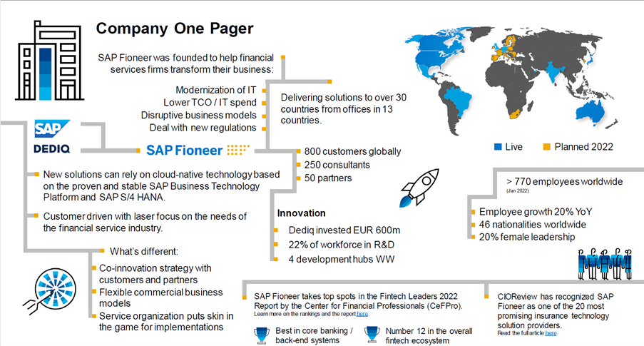
About the company

Slide 2
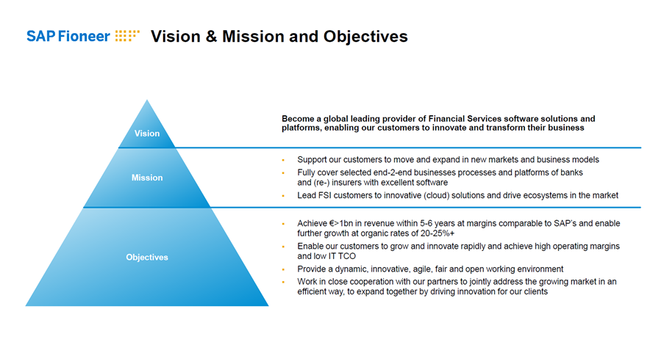
Vision and Mission

Slide 3
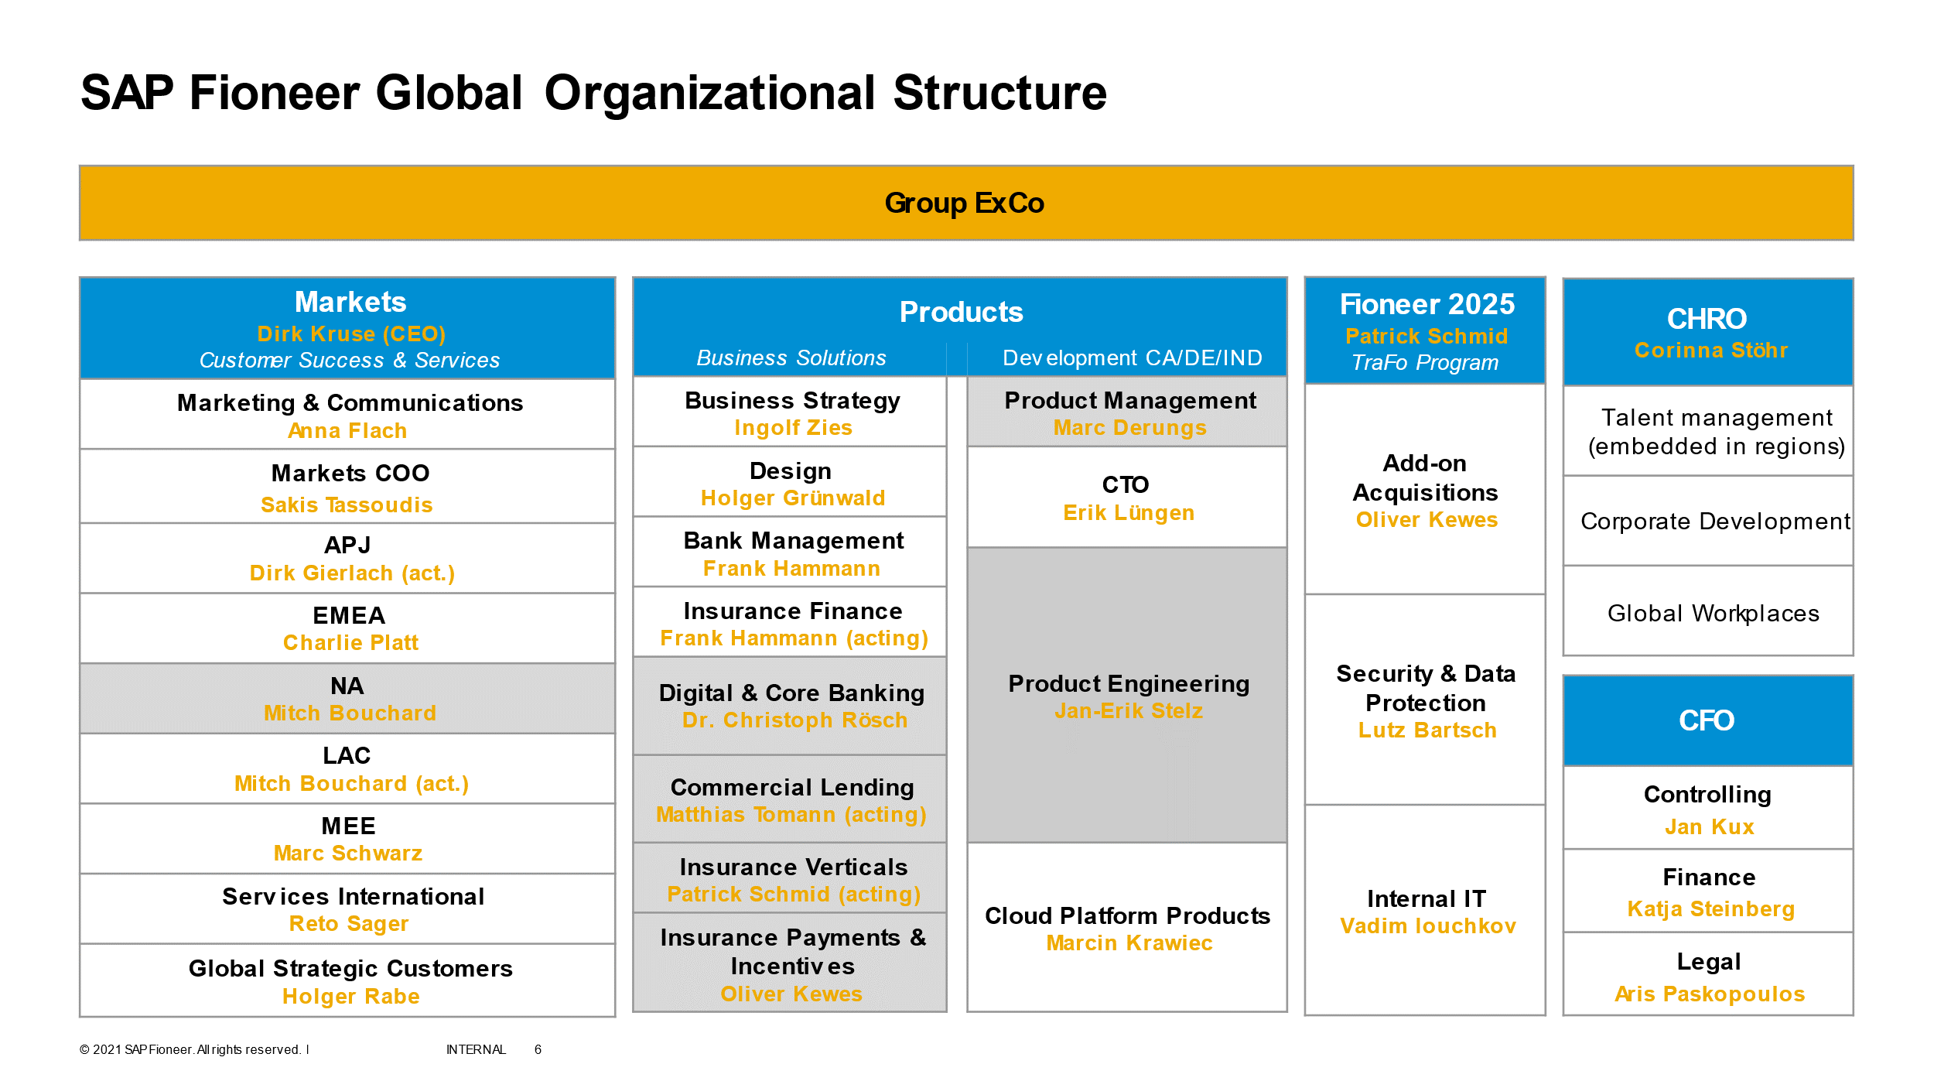
Organization Structure

Slide 4

Where Am I?

Slide 5

This handbook shall apply to all employees of the Company working in India. It is intended to provide employees with important information regarding the Company, its internal policies, procedures, and benefit programs. It also aims to clarify expectations regarding employee conduct and performance.
Purpose of the handbook

Slide 6

The Company reserves the right to add, delete or modify any aspect of this handbook at any time.
Revision

Slide 7

Recruitment

Slide 8

Provide an opportunity to current regular employees for referring external candidates for full-time positions who become employed at Fioneer India
Referral

Slide 9

All new hires in Fioneer India are eligible to avail of the relocation basis of the policy
Relocation

Slide 10

All new hires in Fioneer India are eligible
to avail of the relocation basis of the policy
Internal Job Postings

Slide 11

All new hires in Fioneer India are eligible to avail of the relocation basis of the policy
Relatives working in the same team

Slide 12
Background Verification (BGV)
Your employment with the Company is subject to your providing documentary proof of your educational qualifications and work testimonials if any. For more details, please refer to the offer letter signed by you.
The employee’s manager/supervisor will explain the Goals, job responsibilities, and the performance standards expected of each employee. It is important to note that the said job responsibilities may change at any time during the employment as per the business requirements. Further, from time to time, the employee may be asked to work on special projects or to assist with other work necessary or important to the operation of her/his department or the Company. Employee’s cooperation and assistance in performing such additional work are expected
Job duties
Office hours
Your normal working hours are 8:00 a.m. to 5:00 p.m. from Monday to Friday with an hour lunch break per day. Upon any change in the Company's working hours, your work will be rescheduled accordingly. You shall be expected to devote as much time as required for the proper discharge of your duties to the Company, and to the best of your ability, to seek, to safeguard the interests of the Company at all times.
Further, you may require to work in shifts as determined by business needs. Reasonable effort will be made to give you advance notice of such shift changes to minimize any inconvenience to you. Your work timings may vary according to the shift assigned to you. Shift work will be in accordance with the applicable "Shift Work Policy" if any

Slide 13


Each employee is given a unique employee number and a smart card. Every employee must wear her/his smart card diligently on always entering and leaving the facility and while on the Company premises. Employees are expected to swipe their smart card on entering and leaving the premises. It is also important that employees carry their smart card with them at times of travel to and from the various Company offices as well as at client sites. In case of loss of smart card, the employee should inform the Administration and Facilities Department immediately with a CC to HR/Supervisor. In the event of the employee leaving the company, the smart card must be returned to the Administration and Facilities Department not later than the last working day.
SAP Fioneer follows a business casual dress code approach. Employees are expected to take pride in their appearance and dress in a neat, clean, and well-groomed manner (Shorts, flip flops, and floaters are not allowed). When scheduled activities such as Customer/Client visits, summits, etc., employees are requested to dress appropriately as per the dress code mentioned above.

Slide 14

Time recording should happen weekly
Timesheet Fieldglass

Slide 15

Employees are expected to receive their monthly salary on the last working day of the month and can view their salary details on the ESS portal.
Salary

Slide 16

Where Am I? – Product Development

Slide 17

Where Am I - Services

Slide 18

Every Employee shall serve a probationary period of six months from the date of joining. Upon satisfactory completion of a formal performance appraisal, you shall be confirmed in the permanent establishment of the Company.
Probation period

Slide 19

The process is ongoing through regular progress updates and continuous feedback conversations are part of the performance review and employee development process.
The performance assessment cycle is annual from January to December
Appraisal cycle

Slide 20

The purpose of the Performance Improvement Plan is to support employees experiencing difficulty in achieving planned results against objectives because they are not meeting performance expectations
Performance Improvement Plan (PIP)

Slide 21



Wait for the content
IT Equipment

Slide 22


Employees may park their vehicles in designated areas if space permits. The Company is not responsible for any loss or damage to employee vehicles or contents while parked on Company property
Process for claiming internet reimbursement
Internet Reimbursement || Parking

Slide 23
Please view our policy on the various leave categories and process to avail the same
Out of Office
Benefits - Leave

Slide 24

Comprehensive medical coverage National Insurance Company Ltd
Medical Wellness Cover

Slide 25

3 Times of TTC with a minimum of INR 20 Lacs Aditya Birla Sun Life Insurance Co. Ltd
Life Insurance

Slide 26

Sum Insured –3 Times of TTC with minimum INR 20 Lacs and maximum 50 Lacs
Accident Insurance

Slide 27

Leasing enables you to obtain the use of a car for which you pay a series of contractual, periodic, and deductible payments
Company Car Fuel Allowance and Driver Salary reimbursement

Slide 28

Meal …..
Meal Program

Slide 29

Employees are encouraged to develop in their current roles and fulfill responsibilities at SAP Fioneer better. Reimbursement of 75% of the fees up to the maximum of INR 5L is possible
Higher Education

Slide 30

Fleet….
Fleet Management

Slide 31

Wedding: 5,000 INR Childbirth: 2,000 INR
Celebration Rewards

Slide 32

Employee Assistance Program…..
EAP

Slide 33

On-premise
DayCare

Slide 34



Full-Time Employees with completion of 5 years of service
12% of the Basic Salary by each, employer & employee
Voluntary - Up to 10% of Basic Salary (salary sacrifice) under section 80CCD (2) HDFC Securities
Retirals

Slide 35


LSA to recognize and demonstrate the appreciation of loyalty and commitment of long-serving employees
Appreciate…..
Rewards and Recognitions

Slide 36

For all questions or inquiries on the topic of learning, you can contact internal.training@sapfioneer.com
Learning

Slide 37

Business trips are journeys to locations other than your regular place of work and home that fulfill a business purpose. If you set out on a business trip from home, the trip begins as soon as you leave the house. If you set out on a business trip from work, the trip begins as soon as you leave the company’s premises.
travel

Slide 38

The employee must settle all travel expenses in accordance with the local amendment and the Code of Business Conduct, not later than 30 calendar days after the end of the trip.
Travel expenses

Slide 39

To-Do Before Travel
Carry your Passport, Visa, Insurance copy, Vaccination certificate (if any)
Portable/Universal laptop chargers, adapters
To-Do After Travel
Make sure to submit valid hard copies of the bills, boarding pass, etc.,
Travel Checklist

Slide 40

The Code of Business Conduct for Employees defines standards for conducting all business, legal, and ethical matters carried out in daily business and are meant as a tool and a guide for dealings with customers, vendors, and partners, interaction with competitors, as well as in financial areas.
Privacy, Security, Data, and other Policies –
SAP Fioneer Global Code of Conduct Policy

Slide 41

The Policy defines the rules for compliance with data protection and privacy laws that are applicable to SAP Fioneer. The Policy defines the basic principles for processing Personal Data, assigns responsibilities and competencies within the organization
Privacy, Security, Data, and other Policies –
SAP Fioneer Privacy Policy

Slide 42

The objectives of the Policy are to define the high-level requirements for:
Preserving the confidentiality, integrity, and availability of information and assets.
Protecting all assets from threats, whether internal or external, deliberate, or accidental, based on an assessment of risks to the organization.
Ensuring that legal, regulatory, operational, and contractual requirements are fulfilled.
Privacy, Security, Data, and other Policies –
SAP Fioneer Security Policy

Slide 43

A diverse and inclusive culture sparks innovation through diverse ideas, leverages individual potential and creativity, and is critical to building an innovative organization. When employees feel free to bring their authentic selves to work, the result is greater engagement and commitment. We believe that an inclusive culture is what can be a true differentiator and can help position the Company as a great place to work. Diversity & Inclusion are not nice to have, but they are strategic components of the Company’s corporate culture. Our Diversity & Inclusion strategy brings a host of benefits, including understanding the needs of a diverse customer base thereby driving business results.
Privacy, Security, Data, and other Policies –
SAP Fioneer Diversity and Inclusion Policy

Slide 44

Fioneer India Pvt. Ltd.(the “Company”)is an equal opportunity employer and is committed to providing its employees with a productive work environment, which is free of intimidation and harassment. As such, it is the Organization’s policy to maintain a work environment free of sexual harassment, intimidation, threats, coercion, or discrimination (which includes harassment based on gender, pregnancy, childbirth, or related medical conditions), as well as harassment, intimidation, threats, coercion or discrimination based on a person’s race, color, gender, disability, age, religion, national origin, sexual orientation or any other characteristic protected by law with respect to recruitment, hiring, training, promotion, and other terms and conditions of employment. The Organization strongly disapproves of and will not tolerate harassment of employees by managers, supervisors or co-workers, customers, agents, partners, or vendors. Similarly, the Company will not tolerate harassment by its employees of non-employees (retainers, freelancers, vendor employees, consultants, contract employees) with whom the Organization has a business, service, or professional relationship.
Privacy, Security, Data, and other Policies –
Prevention of Sexual Harassment

Slide 45

SAP FIONEER is committed to providing a work environment free of discrimination. Discrimination, including harassment, sexual harassment, and retaliation, as well as other forms of inappropriate workplace conduct, such as bullying (including mobbing and psychological harassment), is prohibited
Privacy, Security, Data, and other Policies –
SAP Fioneer Global Anti-Discrimination Policy

Slide 46

Either the Company or you may at any time terminate the agreement by giving in writing to the other party a prior 3 months notice or in lieu thereof a sum equal to the amount or pro-rated amount of base salary which would have been accrued to you during the period or remaining period of notice
Separation

Slide 47

Employees will retire from the job on the last working day of the month during which they would attain 60 years of age. For this purpose, the official record of the date of birth with the company will be the same as specified by you in the company application form at the time of joining.
Retirement

Slide 48
# | Topic | Link
1 | Intranet | https://fioneer.sharepoint.com/
2 | Policies | https://fioneer.sharepoint.com/SitePages/EC_Compensation-and-Benefits.aspx?OR=Teams-HL&CT=1647322191613&params=eyJBcHBOYW1lIjoiVGVhbXMtRGVza3RvcCIsIkFwcFZlcnNpb24iOiIyNy8yMjAyMDcwMTgxMiJ9
3 | IT Ticket | https://fioneer.atlassian.net/servicedesk/customer/portals
4 | Medi Assist ID | sapfioneer@mediassist.in
5 | Medi Assist Portal | Medi Assist Your e-gateway to Medi Assist services (medibuddy.in)
6 | SAP Concur | https://eu1.concursolutions.com/home.asp
7 | ESS Portal | https://fioneer.greythr.com/v3/portal/ess/home
8 | HR Ops | hr.apac@fioneer.com
9 | HR Support | hr.support-india@sapfioneer.com

