Slide 1
What Predicts Player Value & How to create it
David Clements

Slide 2
Three Core Insights
These three findings structure the rest of the analysis, each following section provides evidence and detail
Insight 1 – FIFA’s Overall & Potential ratings + age are the strongest predictors of value
      These three variables alone can explain ~98% of valuation, but this isn’t impressive or useful.
      Insight 2 – An Offensive Premium exists
      Dribbling, passing and shooting are what the market pays for Goal Threat > Goal Prevention
      Insight 3 – Offensive Demands vary by position
      Whilst the market values offensive skills, it doesn’t value an identical skill-set across positions. Each position has a unique way of unlocking this “offensive premium”

Slide 3
Black box predictions
The “best” predictors of player value on paper, don’t tell us anything useful
Overall, Potential & age are the 1# predictors of value
Overall and Potential are aggregated factors from professional FIFA scouts age adjusts the value. They are predictive but not transparent or actionable.
But they are not actionable
      “ Buy the best overall player!”
      “ Buy the player with highest potential!”
      “ We have to increase the teams overall stat!”
      these are circular requests
What really drives valuation?

Slide 4
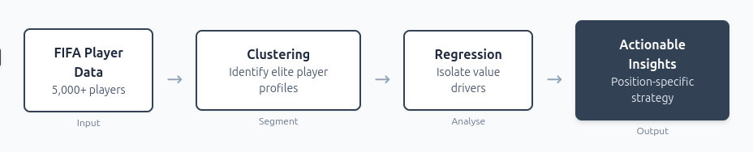
Why are some players so valuable?
By figuring out this puzzle, we get better descriptive, predictive and prescriptive analytics
Player valuations range from €35K to €143M — a 4,000x difference
Reverse Engineering the observable skill profiles of top earners tells us:

Slide 5
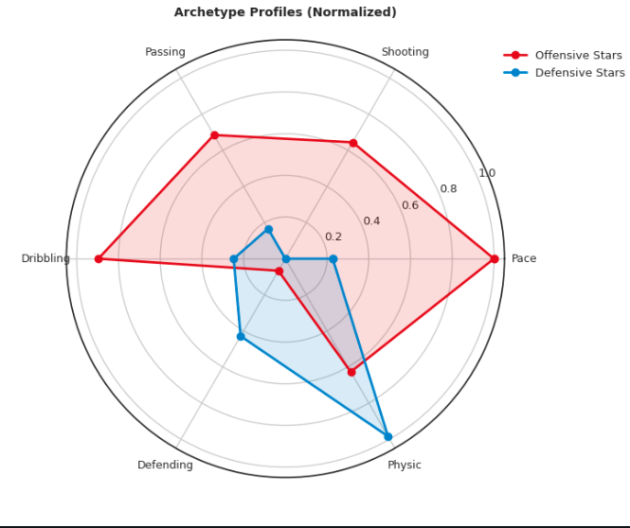
Two kinds of Star Player emerge
Clustering reveals two distinct elite profiles
Differences in Star players?
1. Offensive stars excel in pace, dribbling, passing, and shooting. Defensive stars concentrate skills in physic and defending.
2. Offensive profiles are broad; defensive profiles are specialized Attackers maintain strength across multiple attacking skills, while defenders peak in a narrow set.
3. The two archetypes occupy distinct skill profiles. Differences reflect structural variation in skill composition, not small ability gaps.
- Both these profiles serve as a useful benchmark for comparison.

Slide 6
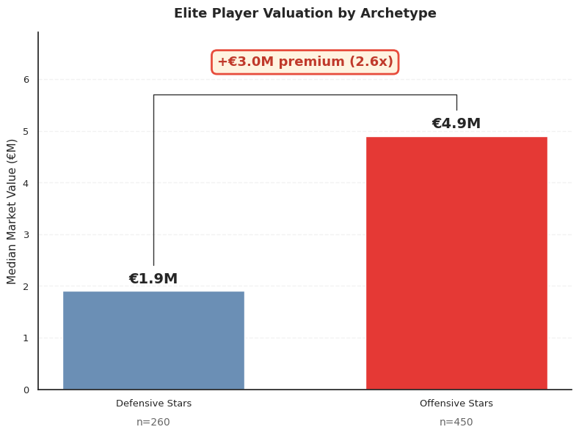
There are valuation differences even among the top players
The Offensive Premium
1. Elite Offensive players are worth 2.6x their Defensive counterparts.
2. Within the same leagues, within the same clubs, even within the same positions, offensive play-styles are rewarded more.
3. The market values offensive skills, dribbling, passing, shooting — significantly more than defensive ability.

Slide 7
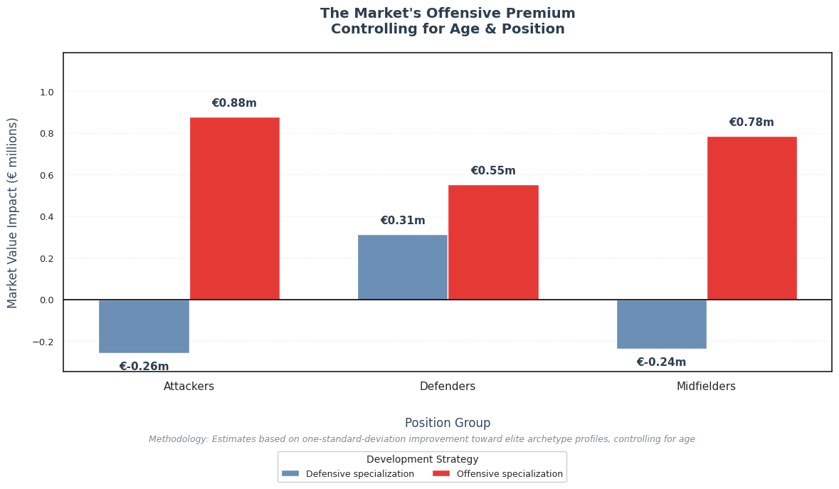
Only one kind of improvement is rewarded
What development pays off?
1. Offensive development adds €550K–€880K in value across all positions.
2. Even defenders gain ~1.9x more from developing offensive skills (€550K) than defensive ones (€310K).
3. For attackers and midfielders, defensive specialization is actively penalized.
The market prices proximity to an ideal player archetype — and value growth comes from closing that gap

Slide 8
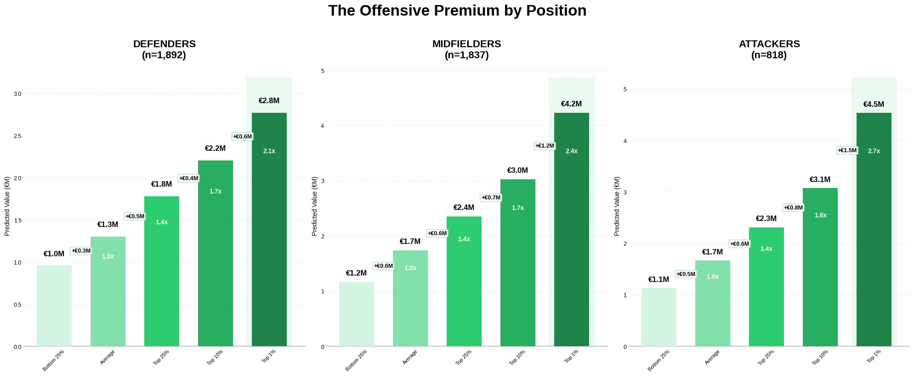
Marginal Returns of Offensive Development
Valuation gains from bad → avg → good → great → world class

Slide 9
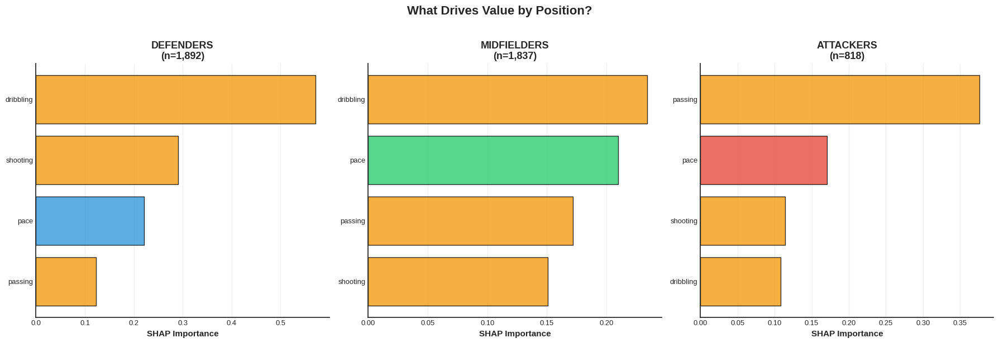
Offensive Premium is captured differently based on position
Which specific skills move players closer to the offensive ideal – broken down by position

Slide 10
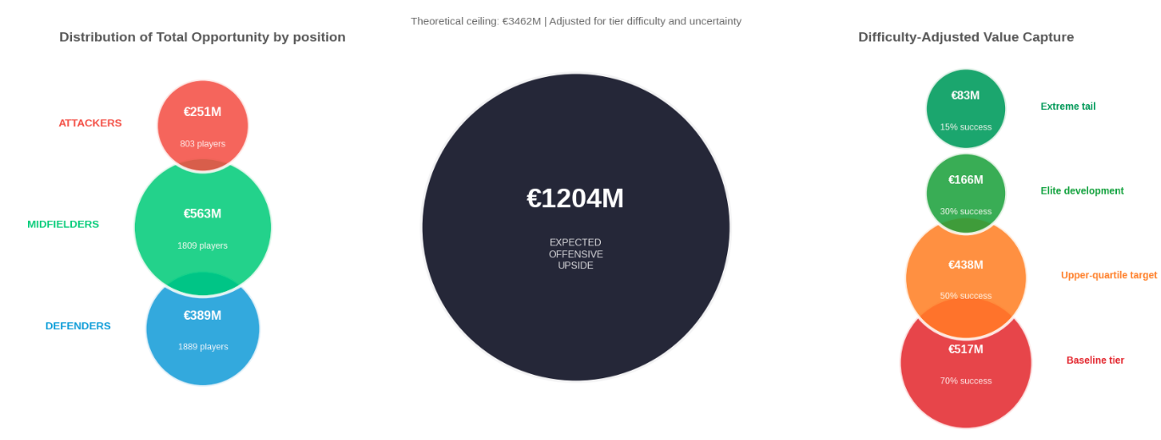
Offensive Premiums on the table
Estimates on realistically capture-able Offensive Premiums.

Slide 11
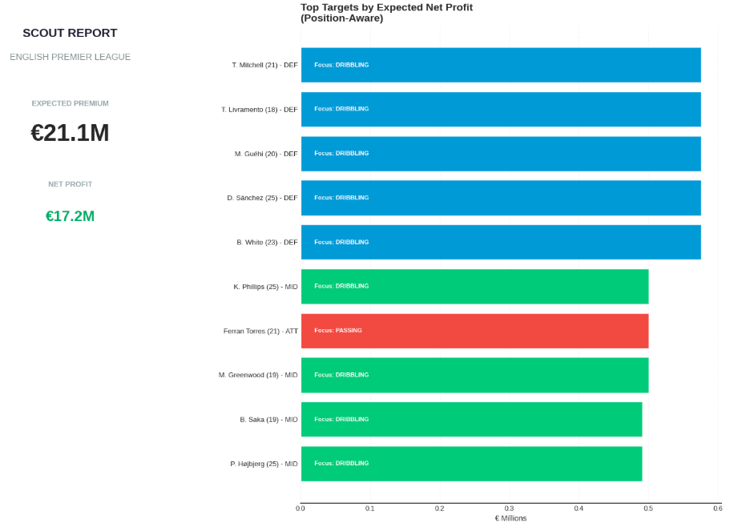
Model Validation : Who should we actually buy?
Market model predictions versus Reality
How we scan for ideal candidates:
1.Finds players closest to the next elite skill tier. Targets those needing the smallest improvements to progress.
2.Applies position-specific skill priorities. Evaluates defenders, midfielders, and attackers using different skill weights.
3.Ranks players by development feasibility. Combines age & effort required, to determine success likelihood.

Slide 12
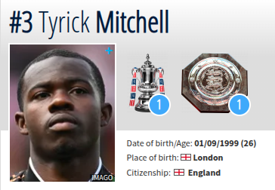
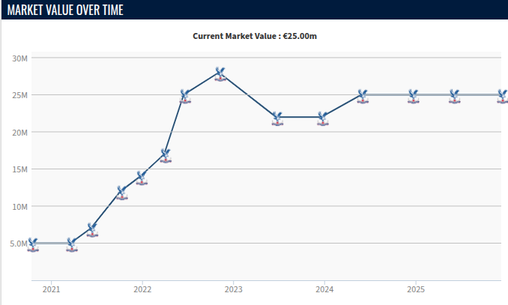
Model Case study : Who should we actually buy?
The framework identified Mitchell as a development candidate based on 2021-2022 data. Since then his value multiplied 2x (source: transfer-market)

Slide 13
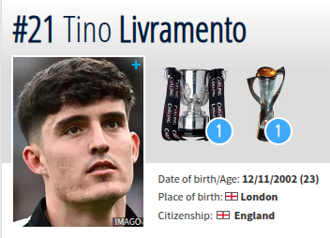
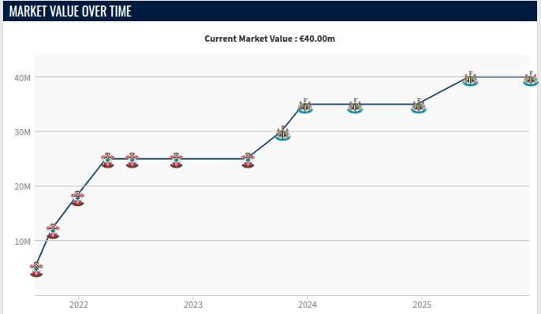
Model Case study : Who should we actually buy?
The framework identified Livramento as a development candidate based on 2021-2022 data. Since then his value multiplied 2x (source: transfer-market)

Slide 14
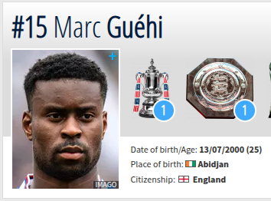
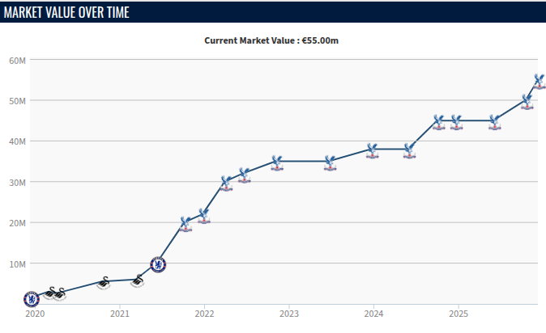
Model case study : Who should we actually buy?
The framework identified Guehi as a development candidate based on 2021-2022 data. Since then his value multiplied 2.5x (source: transfer-market)

Slide 15
Strategic Recommendations
How to value players and where to invest in development
1. Scouting: Purchase players near a break-point
Instead of looking for finished stars, target "average" players who are just one skill improvement away from a higher price tag . Buy them at the average price before they make that jump and their value spikes .
2. Development: Focus on the high leverage skill deficits
Stop generic coaching. Identify the single specific skill (like dribbling or passing) that most efficiently nudges players towards the next threshold, to maximize ROI from training.
3. Portfolio: Weight investment by position
Attackers are already expensive, and their offensive skills are already highly developed, further development is more challenging. The most consistent financial opportunity is in buying Midfielders and Defenders, where offensive talent is currently under-trained.

Slide 16
Thank you!
Q&A

