Slide 1
ENGR 489 Preliminary Presentation
Bayesian estimation of bound fluid fraction from NMR relaxation
Presented by: David Dobbie
Supervisor: Paul Teal
Co-supervisor: Robin Dykstra

Slide 2
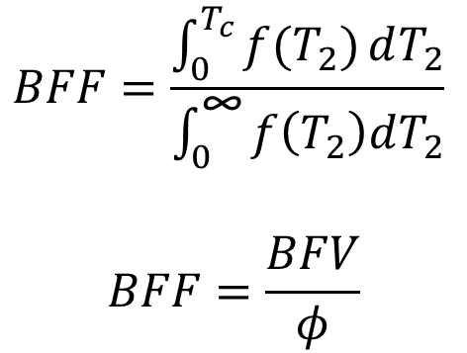
Introduction
Low Quality Nuclear Magnetic Resonance (NMR) measurements
Distribution of fluid’s NMR (T2) relaxation
How much fluid is bound in a porous media [1]
$$BFF=\frac{\int_{0}^{T_{c}}{f(T_{2})}dT_{2}}{\int_{0}^{\text{∞}}{f\left(T_{2}\right)dT_{2}}}$$
$$BFF=\frac{BFV}{φ}$$
Start
Estimator, the deliverable
Goal

Slide 3
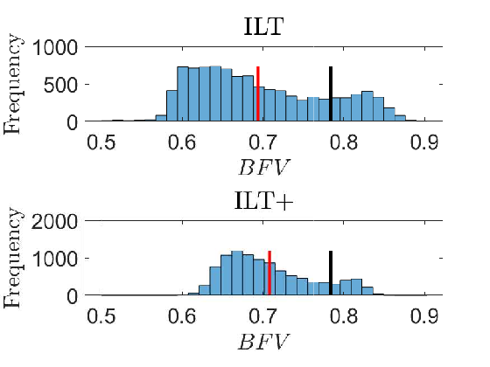
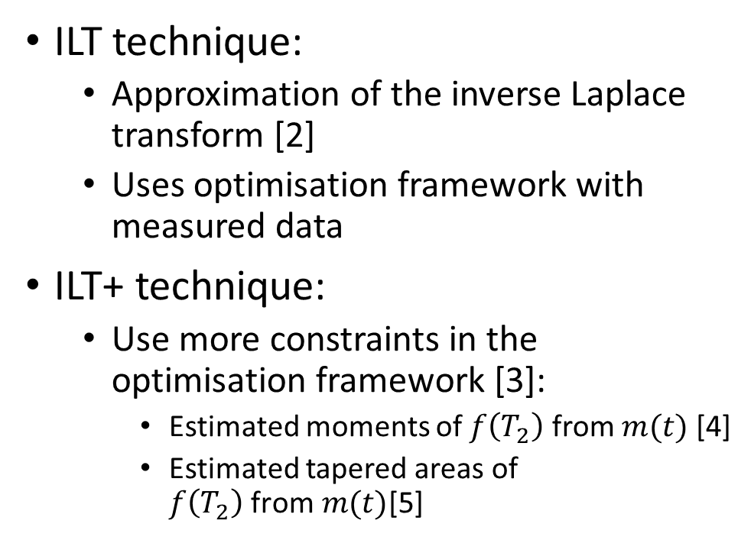
Past Techniques
ILT technique:
Approximation of the inverse Laplace transform [2]
Uses optimisation framework with measured data
ILT+ technique:
Use more constraints in the optimisation framework [3]:
Estimated moments of $f\left(T_{2}\right)$ from $m(t)$ [4]
Estimated tapered areas of $f\left(T_{2}\right) \text{from} m(t)$[5]
Black is true, red is mean estimate

Slide 4
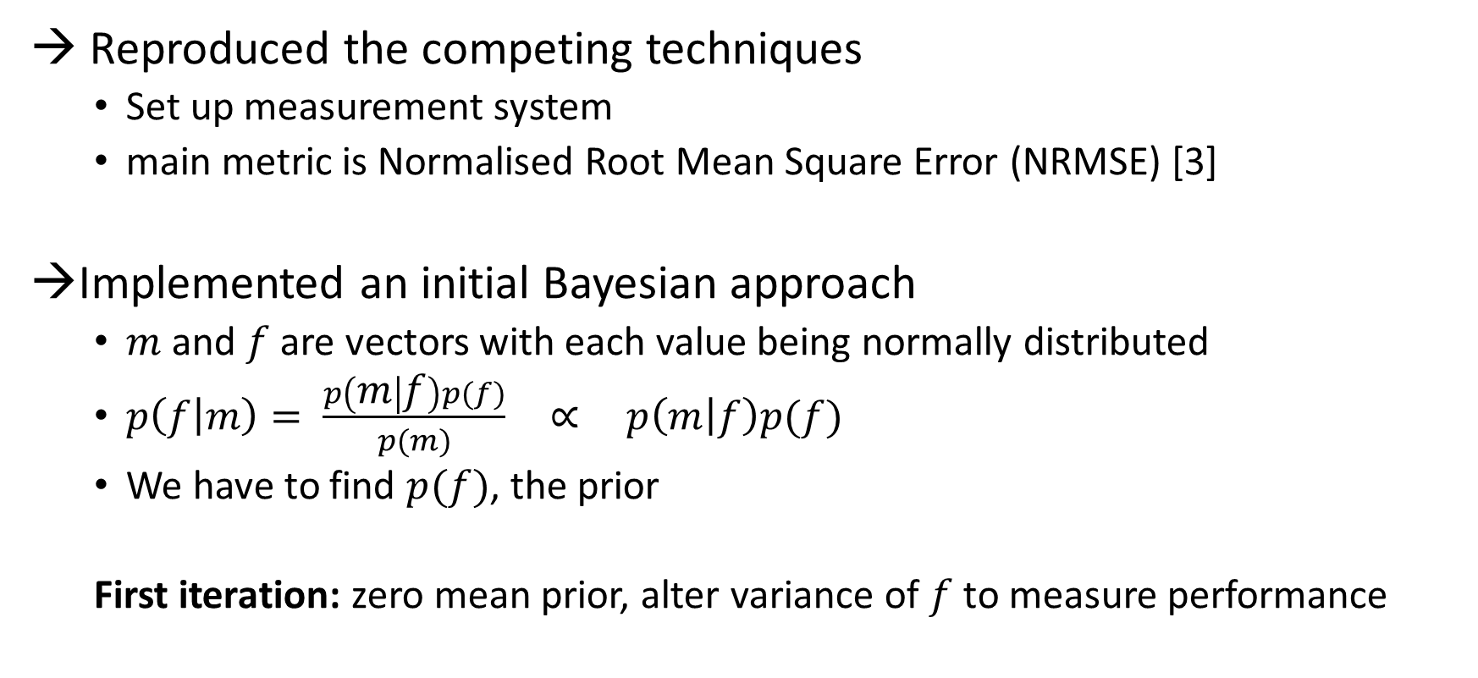
Work Done
→ Reproduced the competing techniques
Set up measurement system
main metric is Normalised Root Mean Square Error (NRMSE) [3]
Implemented an initial Bayesian approach
$m$and $f$are vectors with each value being normally distributed
$p\left(f | m\right)= \frac{p\left(m | f\right)p(f)}{p(m)} \text{∝} p\left(m | f\right)p(f)$
We have to find $p(f)$, the prior
First iteration: zero mean prior, alter variance of $f$ to measure performance

Slide 5
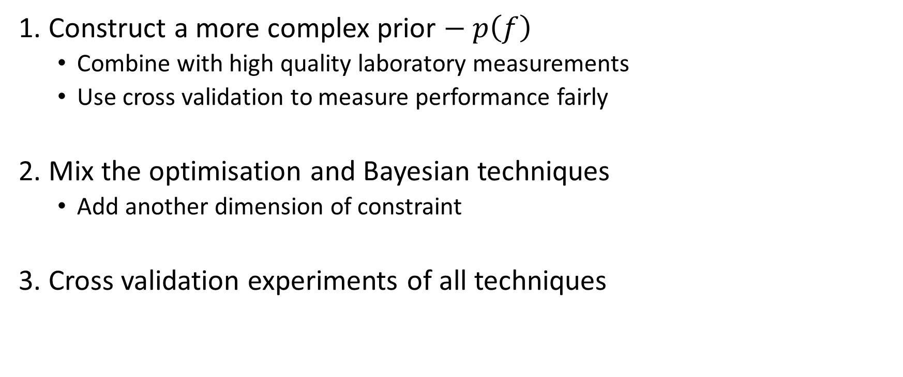
Future Plan
1. Construct a more complex prior $− p\left(f\right)$
Combine with high quality laboratory measurements
Use cross validation to measure performance fairly
2. Mix the optimisation and Bayesian techniques
Add another dimension of constraint
3. Cross validation experiments of all techniques

Slide 6
Conclusions
We want to find how much fluid is bound to a porous media in noisy environments
2. Current techniques utilise optimisation based on the ILT
3. The proposed technique is to use Bayesian statistics to combine with high quality laboratory data

Slide 7
References
[1] M. D. Hürlimann and N. J. Heaton, “NMR Well Logging,” in Mobile NMR and MRI: Developments and Applications (S. J. V. Edited by Michael L. Johns, Einar O. Fridjonsson and A. Haber, eds.), ch. 2, pp. 11–79, The Royal Society of Chemistry, 2016.
[2] L. Venkataramanan, Y.-Q. Song, and M. D. Hürlimann, “Solving Fredholm integrals of the first kind with tensor product structure in 2 and 2.5 dimensions,” IEEE Transactions on Signal Processing, vol. 50, pp. 1017–1026, May 2002
[3] F. K. Gruber, L. Venkataramanan, T. M. Habashy, P. M. Singer, and D. E. Freed, “A more accurate estimate of T2 distribution from direct analysis of NMR measurements,” Journal of Magnetic Resonance, vol. 228, pp. 95 – 103, 2013.
[4] L. Venkataramanan, F. K. Gruber, T. M. Habashy, and D. E. Freed, “Mellin transform of CPMG data,” Journal of Magnetic Resonance, vol. 206, no. 1, pp. 20 – 31, 2010.
[5] F. K. Gruber, L. Venkataramanan, T. M. Habashy, and D. E. Freed, “Estimation of petrophysical and fluid properties using integral transforms in nuclear magnetic resonance,” Journal of Magnetic Resonance , vol. 228, pp. 104 – 115, 2013.

