Slide 1
ENGR 489 Preliminary Presentation
Bayesian estimation of bound fluid fraction from NMR relaxation
Presented by: David Dobbie
Supervisor: Paul Teal
Co-supervisor: Robin Dykstra

Slide 2
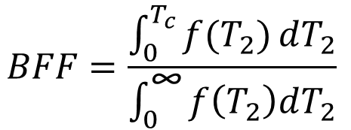
Introduction
Nuclear Magnetic Resonance (NMR) measurements
Distribution of fluid’s NMR relaxation
How much fluid is bound in a porous media [1]
$$BFF=\frac{\int_{0}^{T_{c}}{f(T_{2})}dT_{2}}{\int_{0}^{\text{∞}}{f\left(T_{2}\right)dT_{2}}}$$

Slide 3
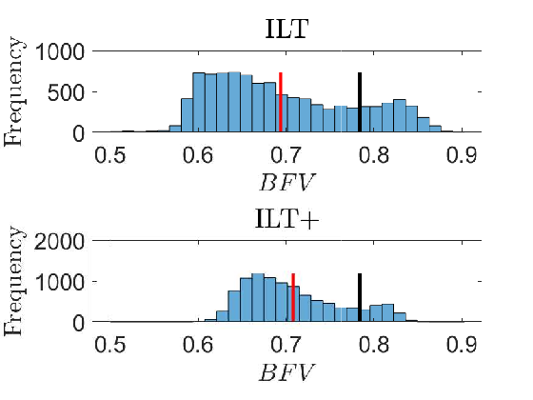
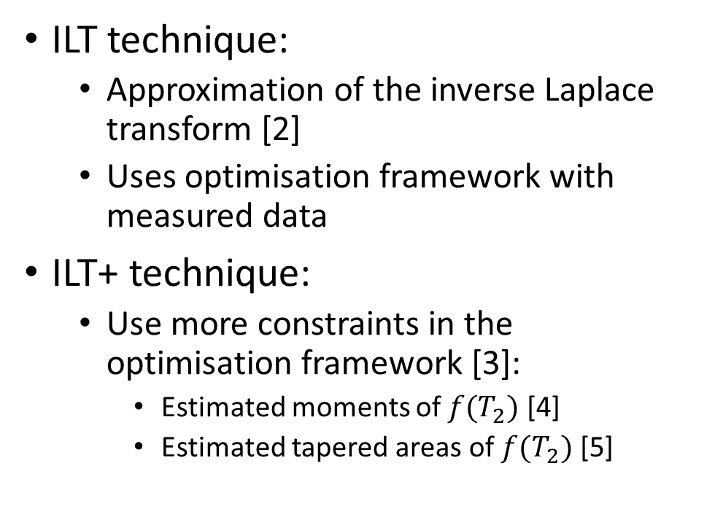
Background
ILT technique:
Approximation of the inverse Laplace transform [2]
Uses optimisation framework with measured data
ILT+ technique:
Use more constraints in the optimisation framework [3]:
Estimated moments of $f(T_{2})$ [4]
Estimated tapered areas of $f(T_{2})$ [5]
Black is true, red is mean estimate

Slide 4
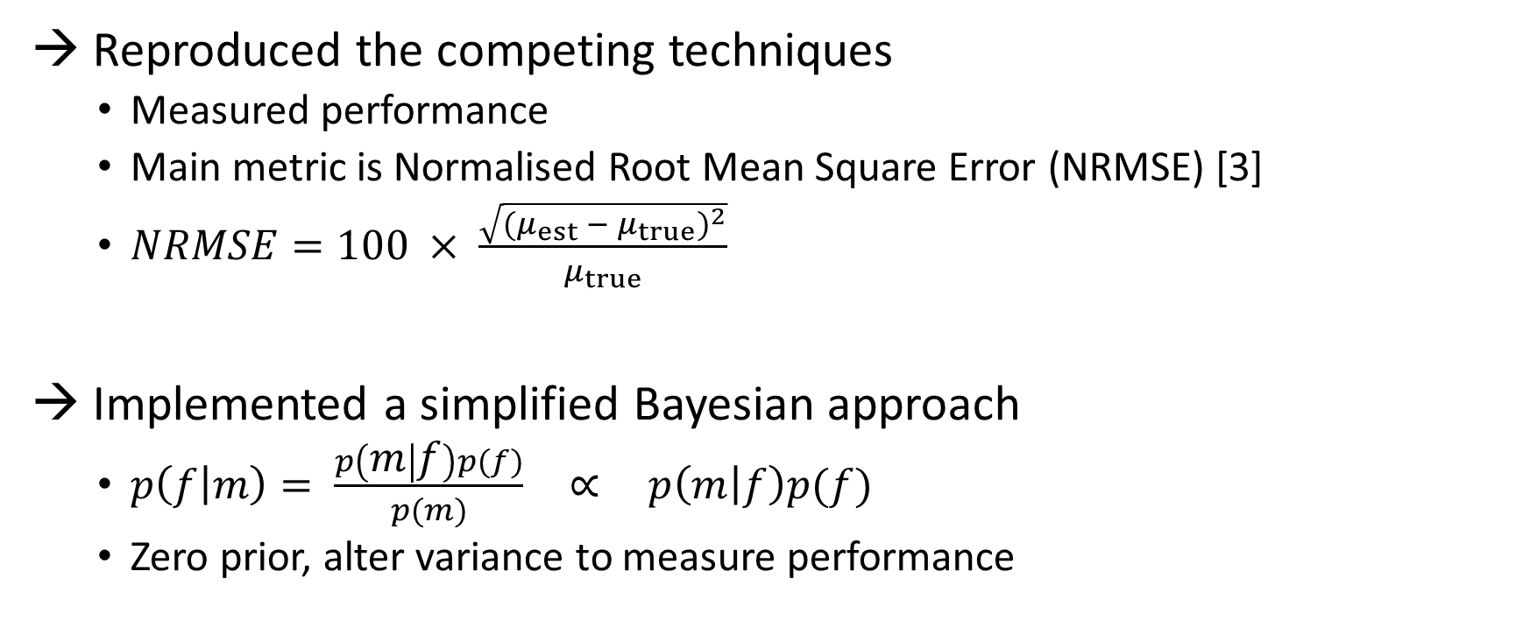
Work Done
→ Reproduced the competing techniques
Measured performance
Main metric is Normalised Root Mean Square Error (NRMSE) [3]
$NRMSE=100 × \frac{\sqrt{{(μ_{est} − μ_{true})}^{2}}}{μ_{true}}$
→ Implemented a simplified Bayesian approach
$p\left(f | m\right)= \frac{p\left(m | f\right)p(f)}{p(m)} \text{∝} p\left(m | f\right)p(f)$
Zero prior, alter variance to measure performance

Slide 5
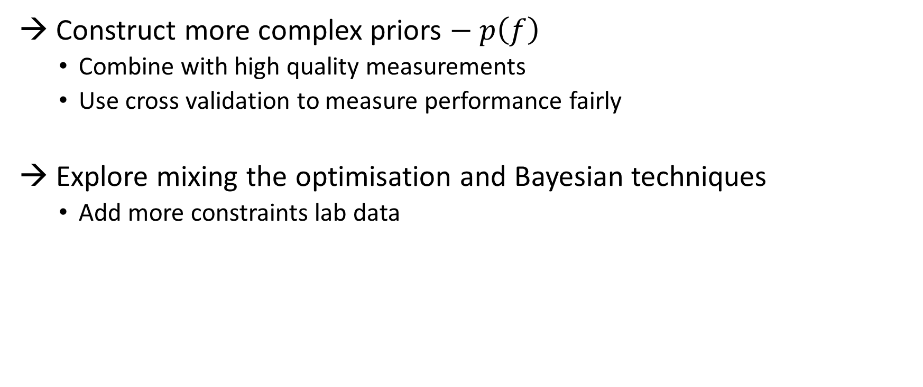
Future Plan
→ Construct more complex priors $− p\left(f\right)$
Combine with high quality measurements
Use cross validation to measure performance fairly
→ Explore mixing the optimisation and Bayesian techniques
Add more constraints lab data

Slide 6
References
[1] M. D. Hürlimann and N. J. Heaton, “NMR Well Logging,” in Mobile NMR and MRI: Developments and Applications (S. J. V. Edited by Michael L. Johns, Einar O. Fridjonsson and A. Haber, eds.), ch. 2, pp. 11–79, The Royal Society of Chemistry, 2016.
[2] L. Venkataramanan, Y.-Q. Song, and M. D. Hürlimann, “Solving Fredholm integrals of the first kind with tensor product structure in 2 and 2.5 dimensions,” IEEE Transactions on Signal Processing, vol. 50, pp. 1017–1026, May 2002
[3] F. K. Gruber, L. Venkataramanan, T. M. Habashy, P. M. Singer, and D. E. Freed, “A more accurate estimate of T2 distribution from direct analysis of NMR measurements,” Journal of Magnetic Resonance, vol. 228, pp. 95 – 103, 2013.
[4] L. Venkataramanan, F. K. Gruber, T. M. Habashy, and D. E. Freed, “Mellin transform of CPMG data,” Journal of Magnetic Resonance, vol. 206, no. 1, pp. 20 – 31, 2010.
[5] F. K. Gruber, L. Venkataramanan, T. M. Habashy, and D. E. Freed, “Estimation of petrophysical and fluid properties using integral transforms in nuclear magnetic resonance,” Journal of Magnetic Resonance , vol. 228, pp. 104 – 115, 2013.

