Slide 1

Online Sushi
Dongguo Wu
Olga Ersov
Xiaowei Chen

Slide 2
Main Technology
User requirements research
Mobile-first & responsive layout
Dynamic generate elements
Search and Sort
Git GitHub
Upload and download image

Slide 3
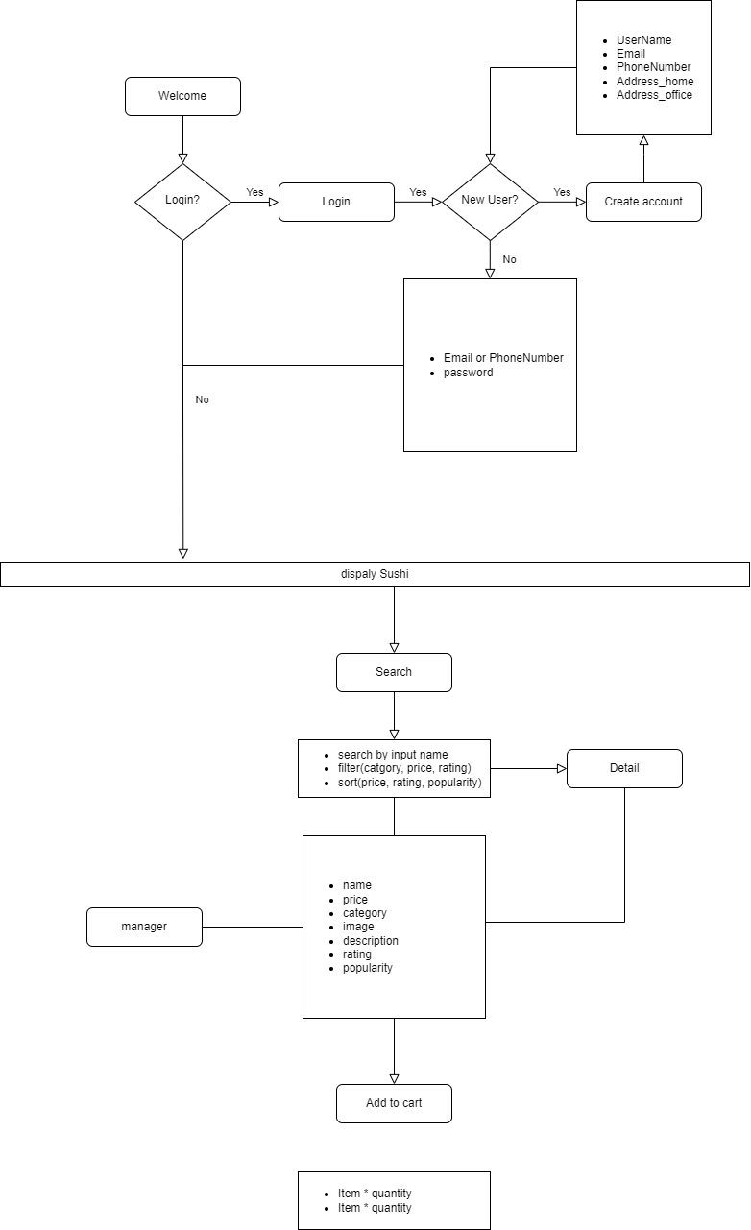
User requirements research

Slide 4
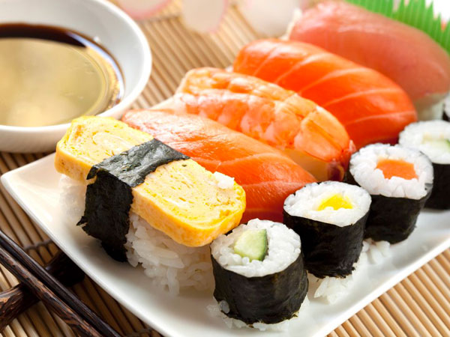

Mobile-first & responsive layout

Slide 5
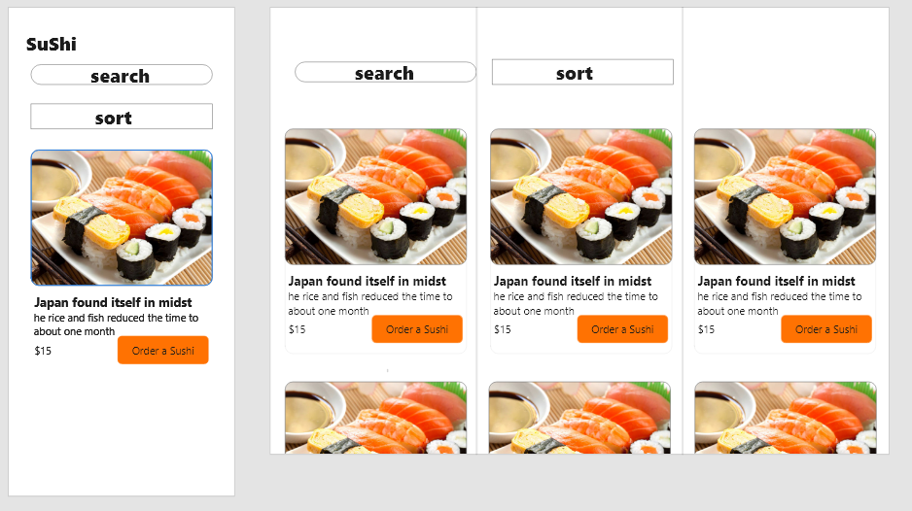
Mobile-first & responsive layout

Slide 6
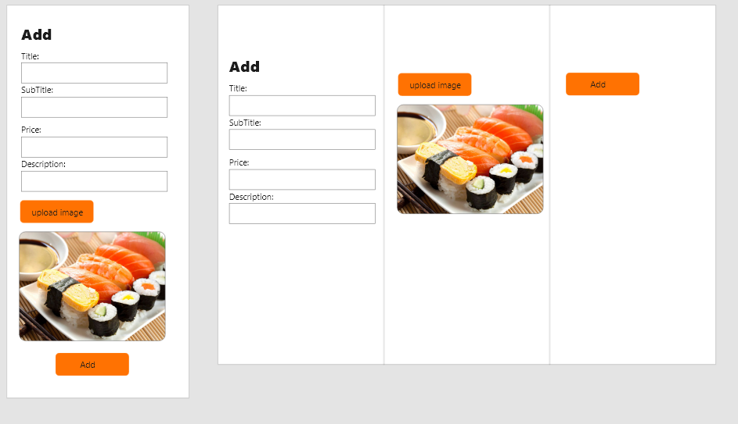
Mobile-first & responsive layout

Slide 7
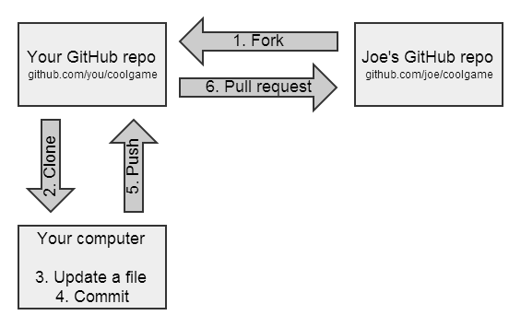
GitHub

