Slide 1
project Data Ptr
Project Data
State Machine
sub-state[0]
sub-state[1]
sub-state[N]
State Properties
name
transition[0]
transition[1]
transition[2]
State Properties
name
transition[0]
transition[1]
transition[2]
Transition Properties
target
event
condition
State Properties
name
transition[0]
transition[1]
transition[2]
Transition Properties
target
event
condition

Slide 2
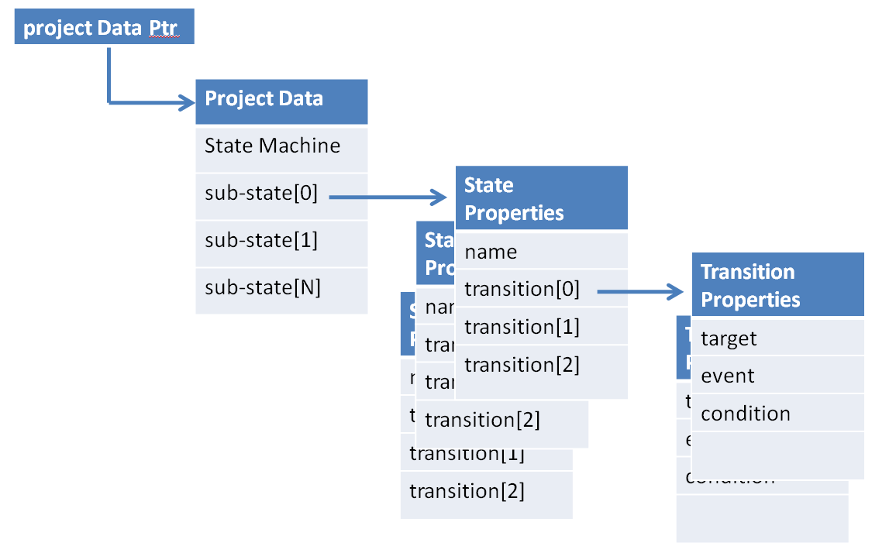
Property Editor View
Graphics Drawing Surface View
Transition Editor
target
event
condition
Edit Controller
add()
delete()
modify()
open()
save()
close()
Data Model
emit changed()
on any state that changed
emit changed()
on any property that changed
each individual property can emit a changed()
signal, as well as the container of the changed
property.
If a new state is added, the editor could receive
the changed signal.
If a new transition is added, the editor could receive
the changed signal.
emit changed()
on any property that changed
emit changed()

Slide 3
+
+

