Slide 1
CYBER GAMING HOUSE MANAGEMENT
Group (SE1401):
Dương Trí Tín – CE140401©
Trần Ngọc Mẫn Huy – CE140289
Hà Thúc Huỳnh Duy – CE140033
Tất Huỳnh Anh Khôi_ CE140273

Slide 2
Work Assignment
1.Customer login / management: Khoi
2.Admin’s management: All
3.Room management : Huy
4.Staff management: Tin
5. Device management: Minh
6. Food & Drink menu + Orders: Duy
7. Word: Tin, Khoi
8. Draw the map / diagram: Tin, Duy
9. Database: Huy, Minh
10. PPT+Presentation: All

Slide 3
I. Problem definition
Cyber Game is completely different from regular net shops. If the typical can own a steady profit, then when investing in Cyber Game that number will increase a lot of times.
Currently the cyber game business model is very popular. Sometimes we find it annoying to play games with so many annoying people !!! That's why the cyber gaming house was born. This model allows one or a group of people to enter a room with many devices to play games to create a quiet space for yourself and others.
Net shops will usually rely on the money earned from playing by the hour, eating, and loading cards. Meanwhile Cyber Game owns a series of catering services with a large turnover. For example: Catering, coffee, milk tea at the shop. Service of leasing places to organize tournaments, offline, fan meeting, soft drinks service for those who do not want to play games but love technology.

Slide 4
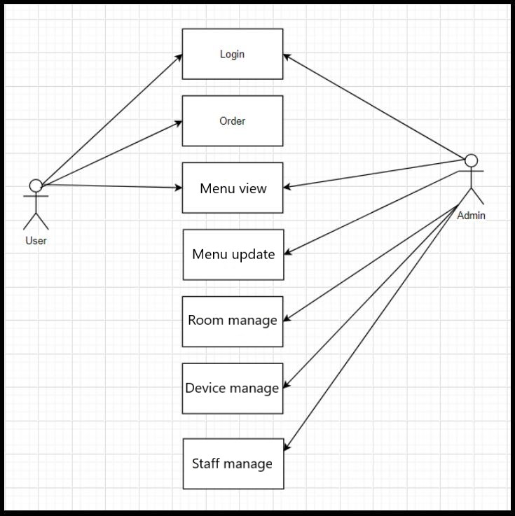
Use-case diagram

Slide 5
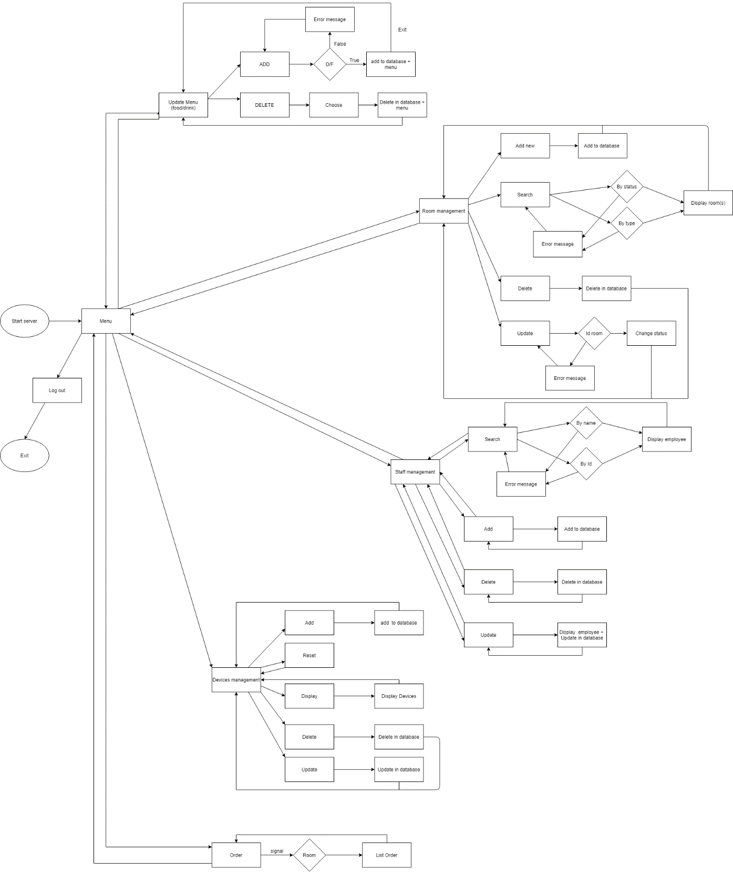
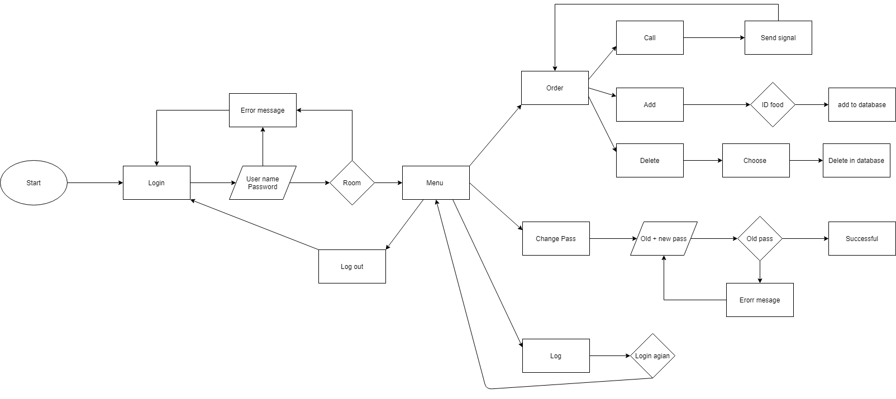
UML diagram

Slide 6
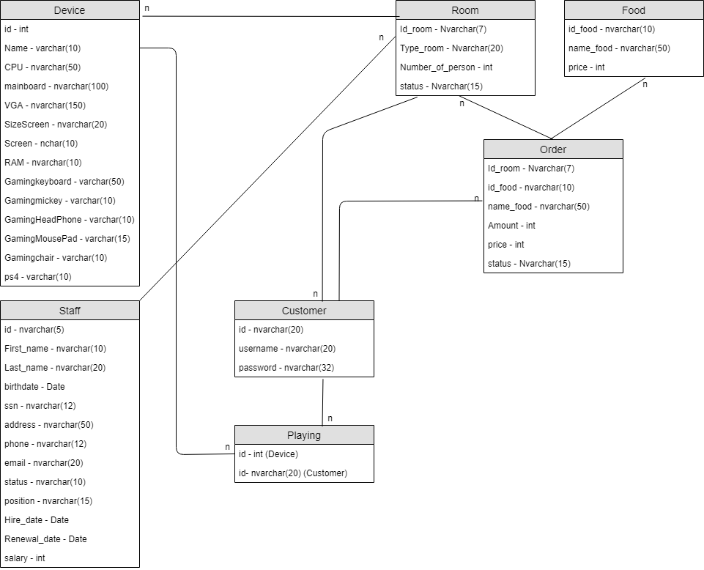
Entity Relative diagram

Slide 7
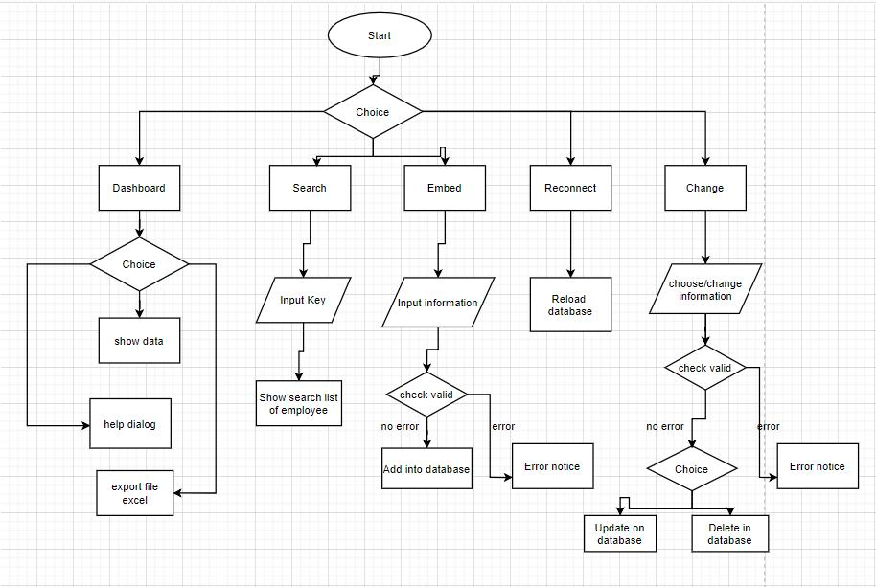
Employee managament

Slide 8
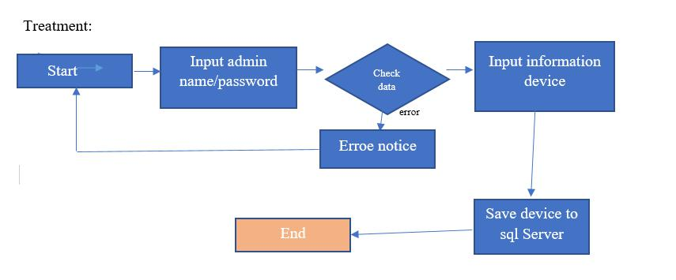
1.Device management

Slide 9
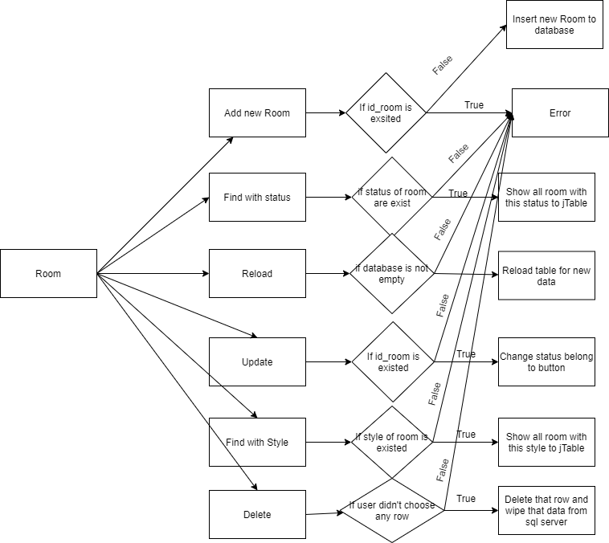
Room

Slide 10
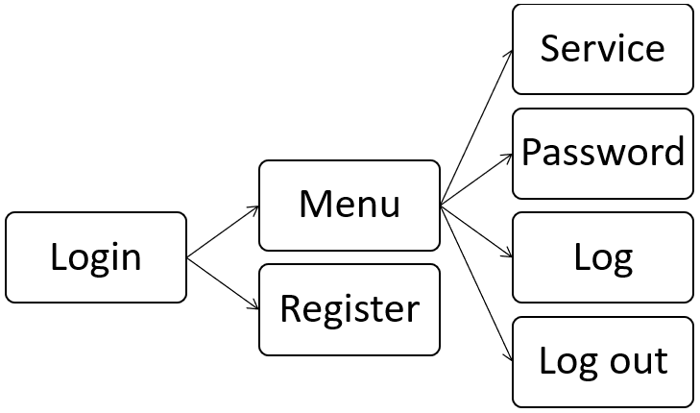
Customer

Slide 11
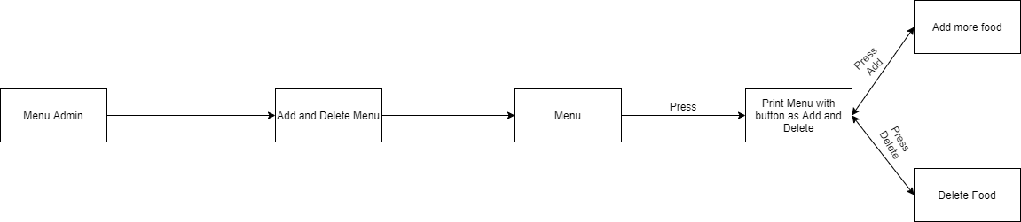
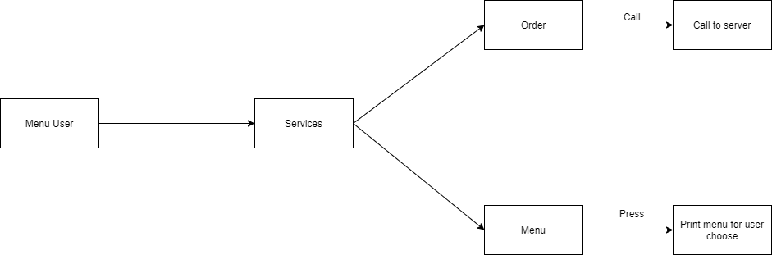
Food & Drink

Slide 12


