Slide 1
Deep Recurrent Survival Analysis
Kan Ren, Jiarui Qin, Lei Zheng, Zhengyu Yang,
Weinan Zhang, Lin Qiu, Yong Yu
Notes:
We are all from Shanghai Jiao Tong University.

Slide 2
Table of Contents
Background
Deep Recurrent Model
Loss Functions
Experiments
Notes:
I’ll show the background and the our model in detail, and discuss something about the loss functions with the corresponding experiment results.

Slide 3
Background
Time-to-event data analysis
The probability of the event over time.
May have different meanings in different areas.
Area | Time | Event | Event Probability
Medicine Research | Survival time | Disease | Survival rate
Information System | Duration time | Next visit | Visiting rate
Second-price Auction | Bid price | Winning the auction | Losing rate
Notes:
Time-to-event data distribute every where in our daily life.
And “event” and “time” may have different meanings in different fields.
In medical research, time-to-event (T2E) means the patient’s survival time to the disease/death event.
In information systems, T2E probably means the duration time until the user’s next visit.
In second-price auction of bidding, it means the bid price to win the auction.

Slide 4
Survival Analysis (SA)
Survival Analysis
To analyze the expected duration of time until one or more events happen.
Notes:
Thus people use survival analysis to represent the “time-to-event data analysis”, it is to analyze the expected duration of time until one or more events happen.

Slide 5
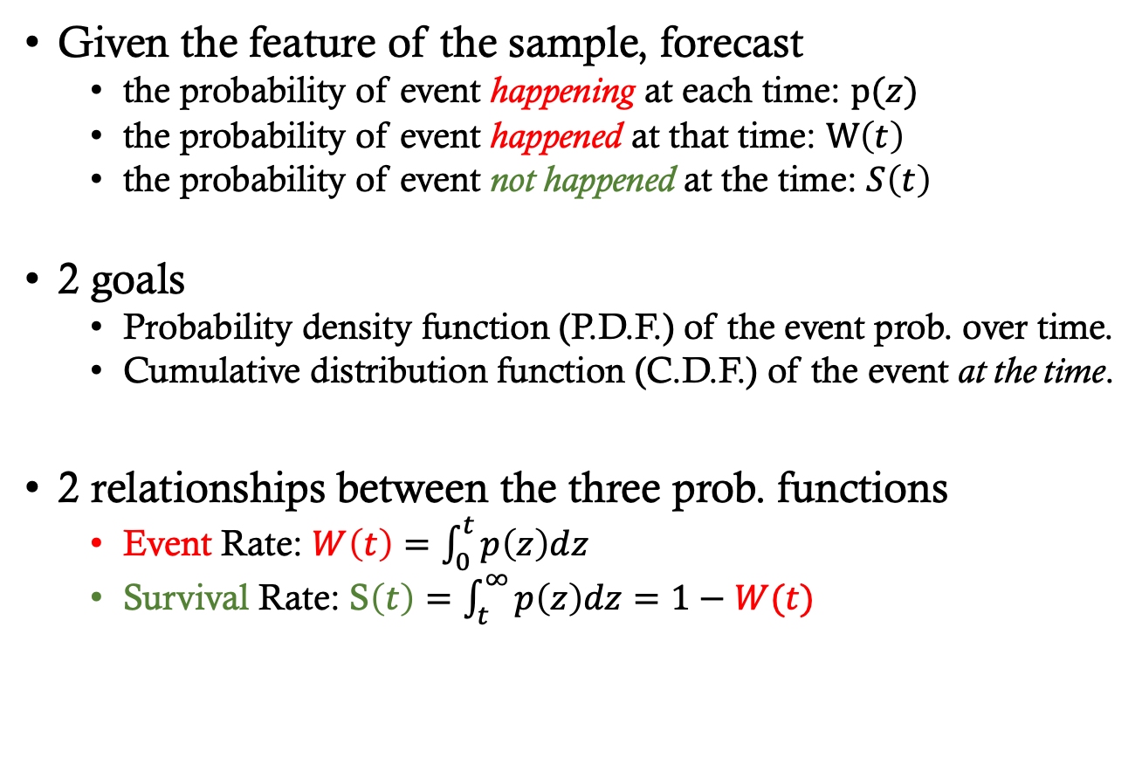
Task of SA
Given the feature of the sample, forecast
the probability of event happening at each time: $p(z)$
the probability of event happened at that time: $W\left(t\right)$
the probability of event not happened at the time: $S\left(t\right)$
2 goals
Probability density function (P.D.F.) of the event prob. over time.
Cumulative distribution function (C.D.F.) of the event at the time.
2 relationships between the three prob. functions
Event Rate: $W\left(t\right)=\int_{0}^{t}{p\left(z\right)dz}$
Survival Rate: S$\left(t\right)=\int_{t}^{∞}{p\left(z\right)dz}=1−W(t)$
Notes:
Given the feature of the observing sample, the task of survival analysis is to forecast three probabilities.
They are
the probability of event happening at each time: $p(z)$
the probability of event happened at that time: $W\left(t\right)$
The probability of event not happened at the time: $S\left(t\right)$
Overall speaking, there are two goals of survival analysis,
the 1st is the Probability density function (P.D.F.) of the event probability, over time.
the 2nd is the Cumulative distribution function (C.D.F.) of the event at the time.
Note that the PDF and CDF can be calculated from each other.
And the survival rate function S is the inverse of the CDF function W.

Slide 6
Challenges in SA
No ground truth
For the form of the event probability distribution
For the value of the event probability
Sparsity
Event is sparse, rare to happen
Censorship
Some clues are censored (without the true event time)
Notes:
There are three challenges in survival analysis.
First, there is no ground truth. We don’t know the true form of the PDF function, or the value of the event probability at each time.
Second, the event data are quite sparse.
The third challenge is the censorship issue.

Slide 7
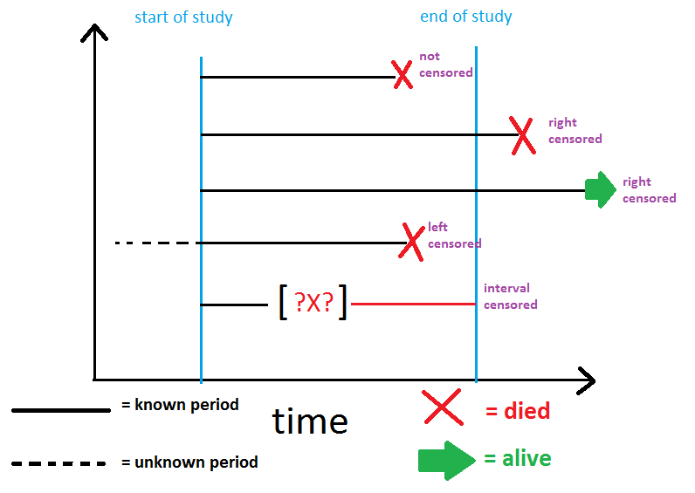
Censorship
http://www.karlin.mff.cuni.cz/~pesta/NMFM404/survival.html
Notes:
When observing the sample, due to some problems of the observation procedure, there are some censorship in the data.
We observe the samples from the start of the study to the end of the study.
If the event happens during the observation, it will be tracked in the log, that is uncensored data.
If the event would happened after the end of study, we do not know the true event time, that means right censored.
If the event happened before the start of the study, we either do not know the true event time, but it is left censorship.
If the event log is lost during the study, that means interval censored.

Slide 8
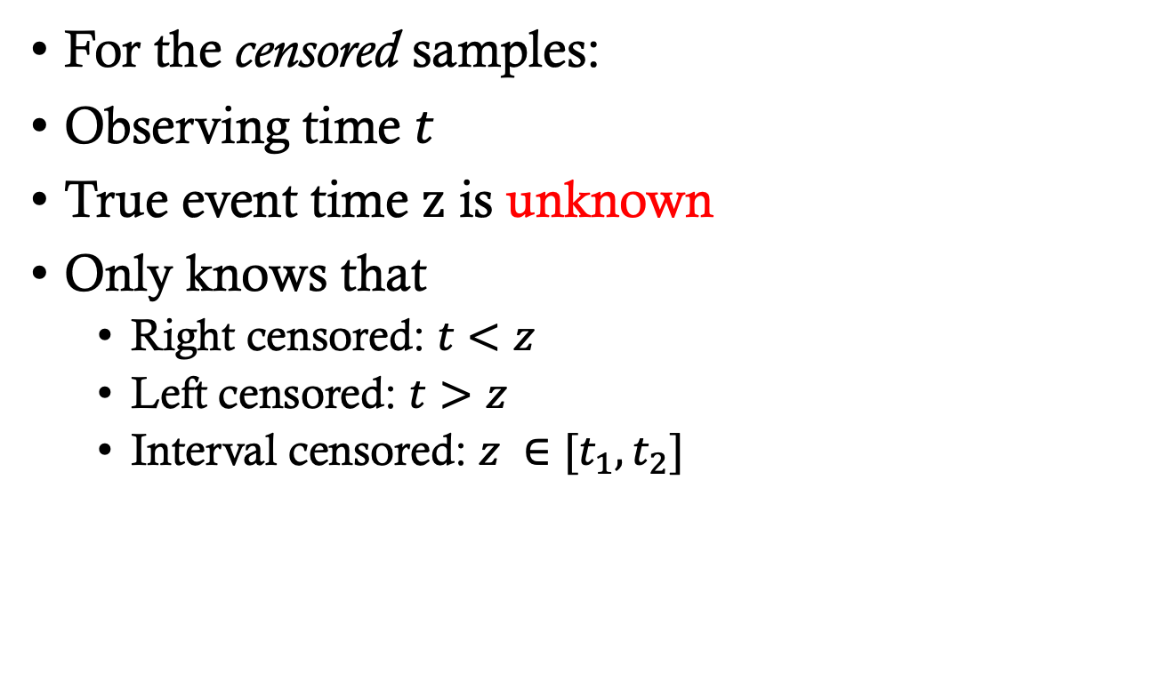
Censorship (cont.)
For the censored samples:
Observing time $t$
True event time $z$ is unknown
Only knows that
Right censored: $t<z$
Left censored: $t>z$
Interval censored: $z ∈[t_{1}, t_{2}]$
Notes:
So for the censored samples, we only have the log of the observing time t, without knowing the true event time z.
In most papers, and also in our paper, we focus on the “right censored” data.
Note that, for those right censored data, the observing time t is less than the true event time z.

Slide 9
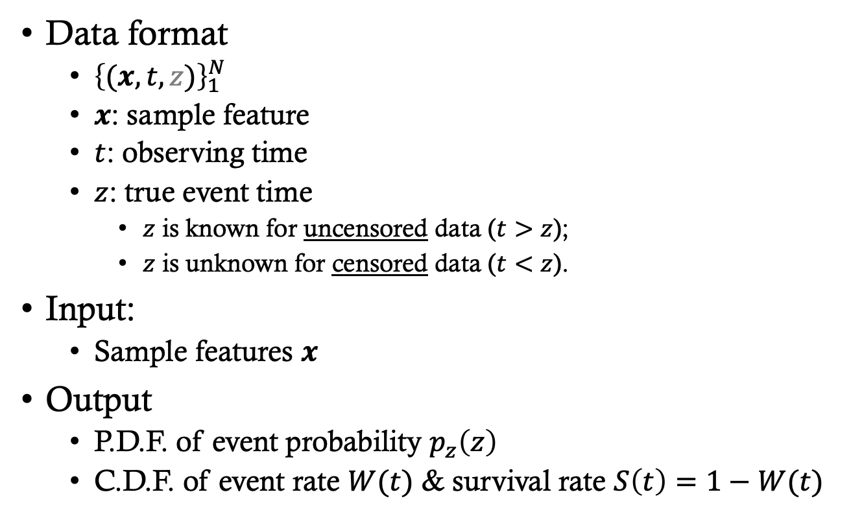
Task Formulation
Data format
${\left\{(x, t, z)\right\}}_{1}^{N}$
$x$: sample feature
$t$: observing time
$z$: true event time
$z$ is known for uncensored data ($t>z$);
$z$ is unknown for censored data ($t<z$).
Input:
Sample features $x$
Output
P.D.F. of event probability $p_{z}\left(z\right)$
C.D.F. of event rate $W(t)$ & survival rate $S\left(t\right)=1−W(t)$
Notes:
The data is formed as a set of triples, each triple contains the sample feature x and the observing time t.
For the uncensored data, we have known the true event time z and z is less than t.
For the censored data, we do not know the true event time z, we only know that z is greater than t.
The survival analysis model
takes in the sample feature x,
and output the probability density function of event time p(z)
and the cumulative density function W and survival rate function S.

Slide 10
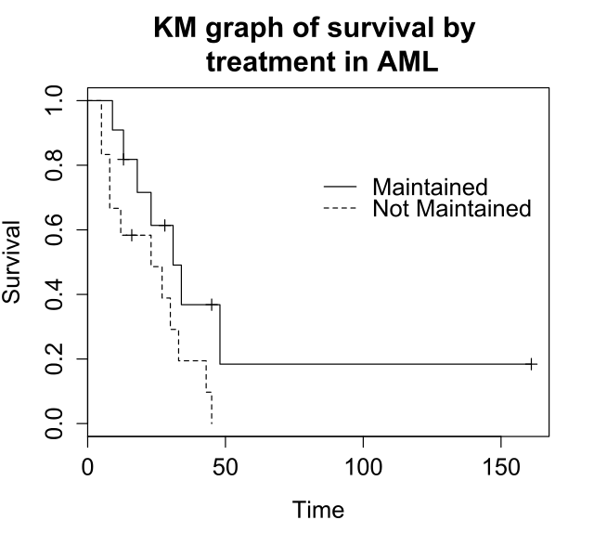
Existing Methods
Statistical methods
Kaplan-Meier method
Coarse-grained, counting-based, low generalization
﻿Kaplan and Meier 1958.
Notes:
The existing methods can be classified into two categories.
The first category is statistical methods.
The most famous one is Kaplan-Meier method, which counts the number of the survival and dead samples in the whole set, to calculate the survival rate of each sample in the same dataset.

Slide 11
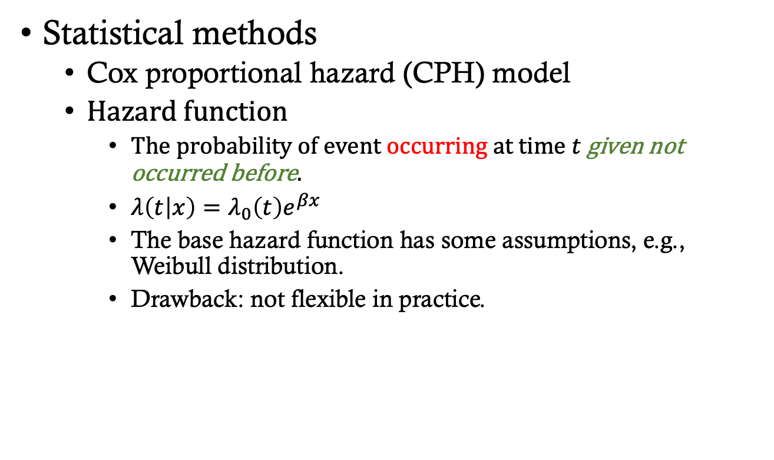
Existing Methods (cont.)
Statistical methods
Cox proportional hazard (CPH) model
Hazard function
The probability of event occurring at time $t$ given not occurred before.
$λ\left(t | x\right)=λ_{0}\left(t\right)e^{βx}$
The base hazard function has some assumptions, e.g., Weibull distribution.
Drawback: not flexible in practice.
﻿Cox 1992; ﻿Zhang and Lu 2007.
Notes:
Another notable statistical method is Cox proportional hazard model.
It predicts the hazard rate at each time, which means “the probability of event occurring given not occurred before”.
It calculate the hazard rate through a base hazard function \lambda, and tuned by an exponential factor w.r.t. the sample feature.
It makes some assumptions about the base hazard function, which may not be flexible in practice.

Slide 12
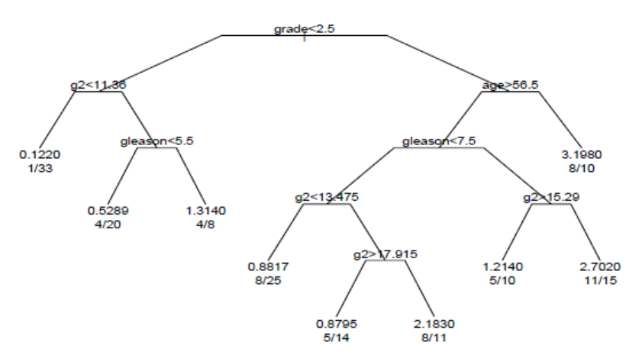
Existing Methods (cont.)
Machine learning methods
Survival tree model
Drawback:
based on segmented data
coarse-grained
﻿Wang et al. 2016.
Notes:
The second category is machine learning model, such as the survival tree models.
These tree methods predict the event probability and survival rate based on the segmented data, all the samples in the same segmented cluster share the same probability function.
Thus this approach is too coarse-grained.

Slide 13
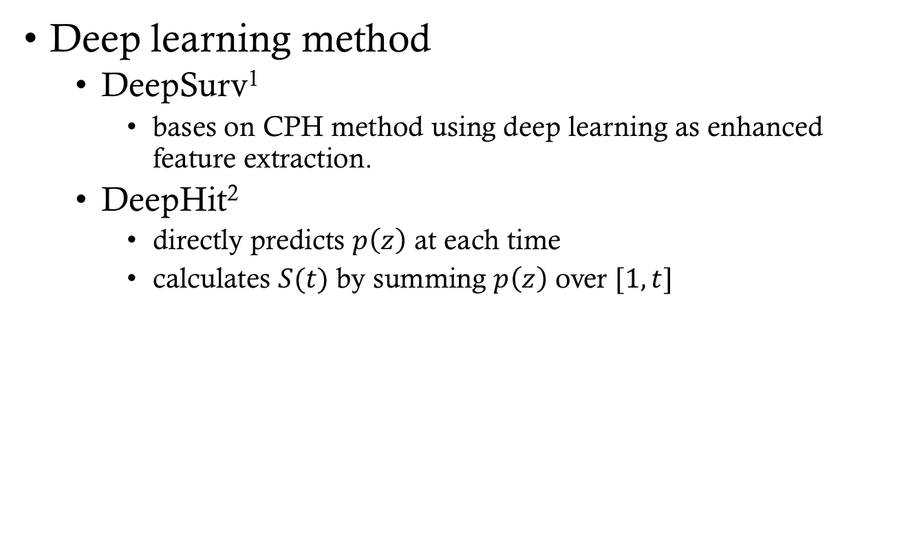
Existing Methods (cont.)
Deep learning method
DeepSurv¹
bases on CPH method using deep learning as enhanced feature extraction.
DeepHit²
directly predicts $p\left(z\right)$ at each time
calculates $S(t)$ by summing $p\left(z\right)$ over $[1,t]$
1. Katzman et al. 2018; 2. Lee et al. 2018.
Notes:
Some deep learning methods have been proposed in the recent decades.
However, ﻿they actually utilize deep neural network as the enhanced feature extraction method and, most of these models either rely on some assumptions of the base distributions for the survival rate prediction thus they share the same problem of those statistical methods.

Slide 14
Cons of the Existing Methods
Statistical methods
Counting-based statistics, loss of generality
Kaplan-Meier
Specific form of the probability distribution
CPH, Lasso-cox
Machine learning methods
Based on segmented data, too coarse-grained
Survival Trees
Assumption of the specific form of distribution
DeepSurv
No consideration about sequential patterns over time!
Notes:
And we’d like to note that none of the existing methods have considered the sequential patterns for the feature over the time space.

Slide 15
Deep Recurrent Survival Analysis (DRSA)
No assumption about distributional forms
Captures sequential patterns in the feature-time space
First work ever, utilizes auto-regressive model for SA
Handling censorship with unbiased learning
Significant improvement against both stat. methods and ML methods
Notes:
In our paper, we propose deep recurrent survival analysis, shortly DRSA model.
DRSA does not make any assumptions about distributional forms.
It captures sequential patterns in the feature-over-time space.
This is the first work utilizing auto-regressive model for Survival Analysis.
It also handles censorship with unbiased learning loss.
In the experiment, our model achieved significant improvement against both statistical methods and machine learning methods.

Slide 16

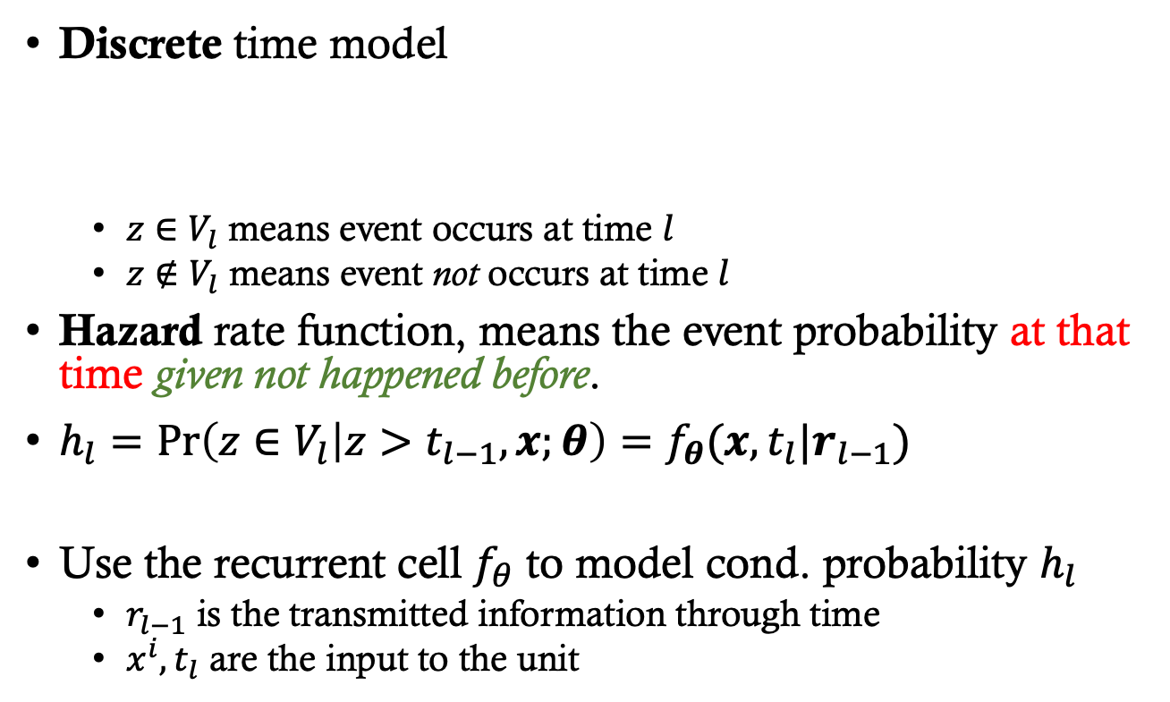







Our method
Discrete time model
$z∈V_{l}$ means event occurs at time $l$
$z∉V_{l}$ means event not occurs at time $l$
Hazard rate function, means the event probability at that time given not happened before.
$h_{l}=\operatorname{Pr}\left(z∈V_{l} | z>t_{l−1},x;θ\right)=f_{θ}(x,t_{l}|r_{l−1})$
Use the recurrent cell $f_{θ}$ to model cond. probability $h_{l}$
$r_{l−1}$ is the transmitted information through time
$x^{i}, t_{l}$ are the input to the unit
$$V_{l}$$
…
$$t_{1}$$
$$t_{2}$$
$$t_{l−2}$$
$$t_{l−1}$$
$$t_{l}$$
$$t_{l+1}$$
$$t_{l+2}$$
Notes:
In our method, we first split the continuous time space into discrete time space.
$V_{l}$ is the $l$-th time interval.
There are two cases that
Z \in V_l means the event occurs during the time interval.
Z not in V_l means the event not occurs during the time interval.
We predict the hazard rate h at each time, which means the event probability at the specific time given the event not happened before.
We use the recurrent cell to model the conditional probability h.
It is quite natural that the recurrent cell takes in the latent factor r from the last time step, and the feature x with the time label t, it will predict the hazard rate at each time.

Slide 17
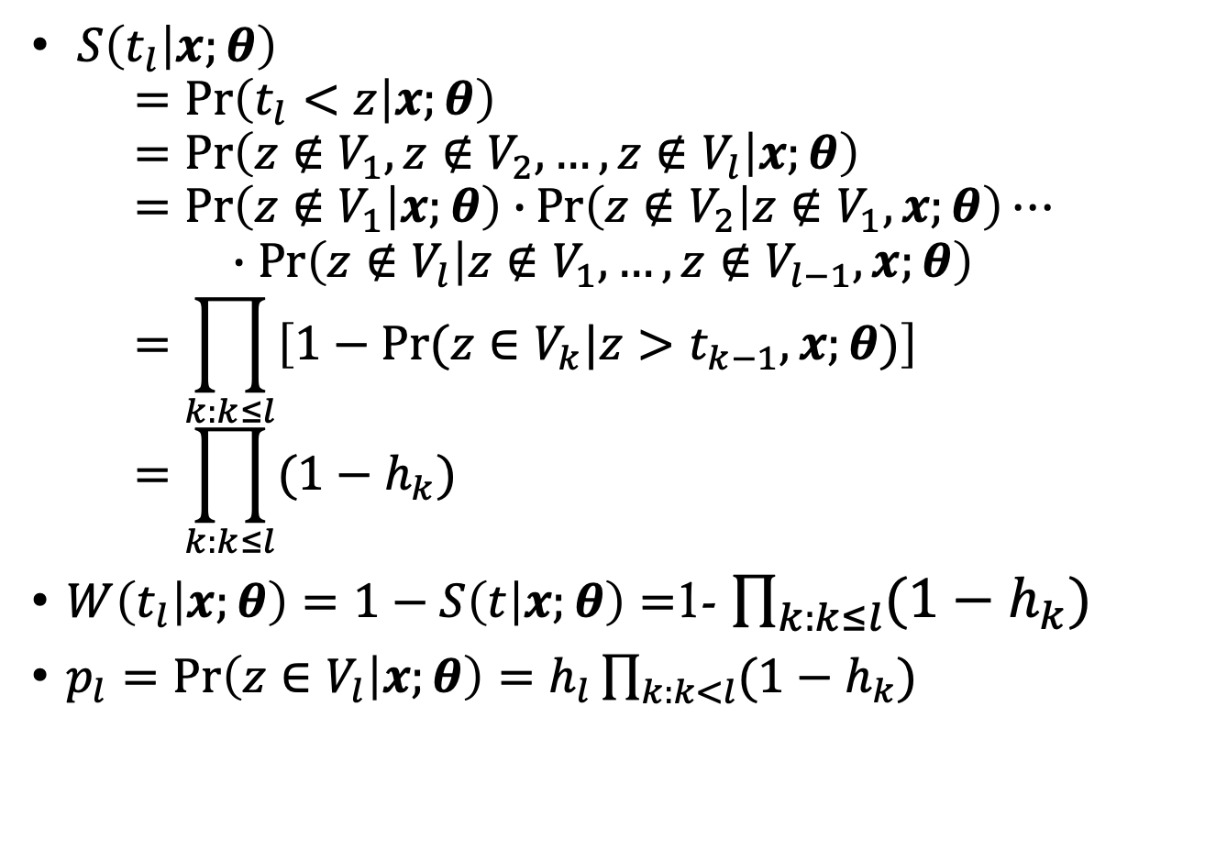
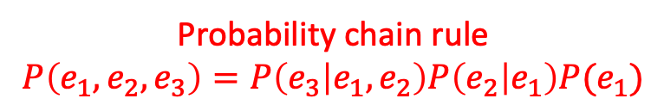
Relationships among Probability Functions
$S\left(t_{l} | x;θ\right)$ $=\operatorname{Pr}\left(t_{l}<z | x;θ\right)$ $=Pr\left(z∉V_{1},z∉V_{2},…,z∉V_{l} | x;θ\right)$ $=\operatorname{Pr}\left(z∉V_{1} | x;θ\right)∙\operatorname{Pr}\left(z∉V_{2} | z∉V_{1},x;θ\right)⋯$ $∙\operatorname{Pr}\left(z∉V_{l} | z∉V_{1},…,z∉V_{l−1},x;θ\right)$ $=\prod_{k:k≤l}{\left[1−Pr⁡(z∈V_{k}|z>t_{k−1},x;θ)\right]}$ $=\prod_{k:k≤l}{(1−h_{k})}$
$W\left(t_{l} | x;θ\right)=1−S\left(t | x;θ\right)=$1- $\prod_{k:k≤l}{(1−h_{k})}$
$p_{l}=\operatorname{Pr}\left(z∈V_{l} | x;θ\right)=h_{l}\prod_{k:k<l}{(1−h_{k})}$
Probability chain rule
$$P\left(e_{1}, e_{2}, e_{3}\right)=P\left(e_{3} | e_{1},e_{2}\right)P\left(e_{2} | e_{1}\right)P(e_{1})$$
Notes:
Note that, the survival rate means the probability of survival ,which is probability of (t less than z).
Thus we can calculate the survival rate through the probability chain rule.
Specifically, we multiply all the conditional probability at each time.
Each conditional probability means that, at that time, “event not happening given that not happened before”, that is (one minus the hazard rate).
Through the probability chain rule and some nature of the probability function, we can get the cumulative distribution function W and probability density function p, in a similar way.

Slide 18
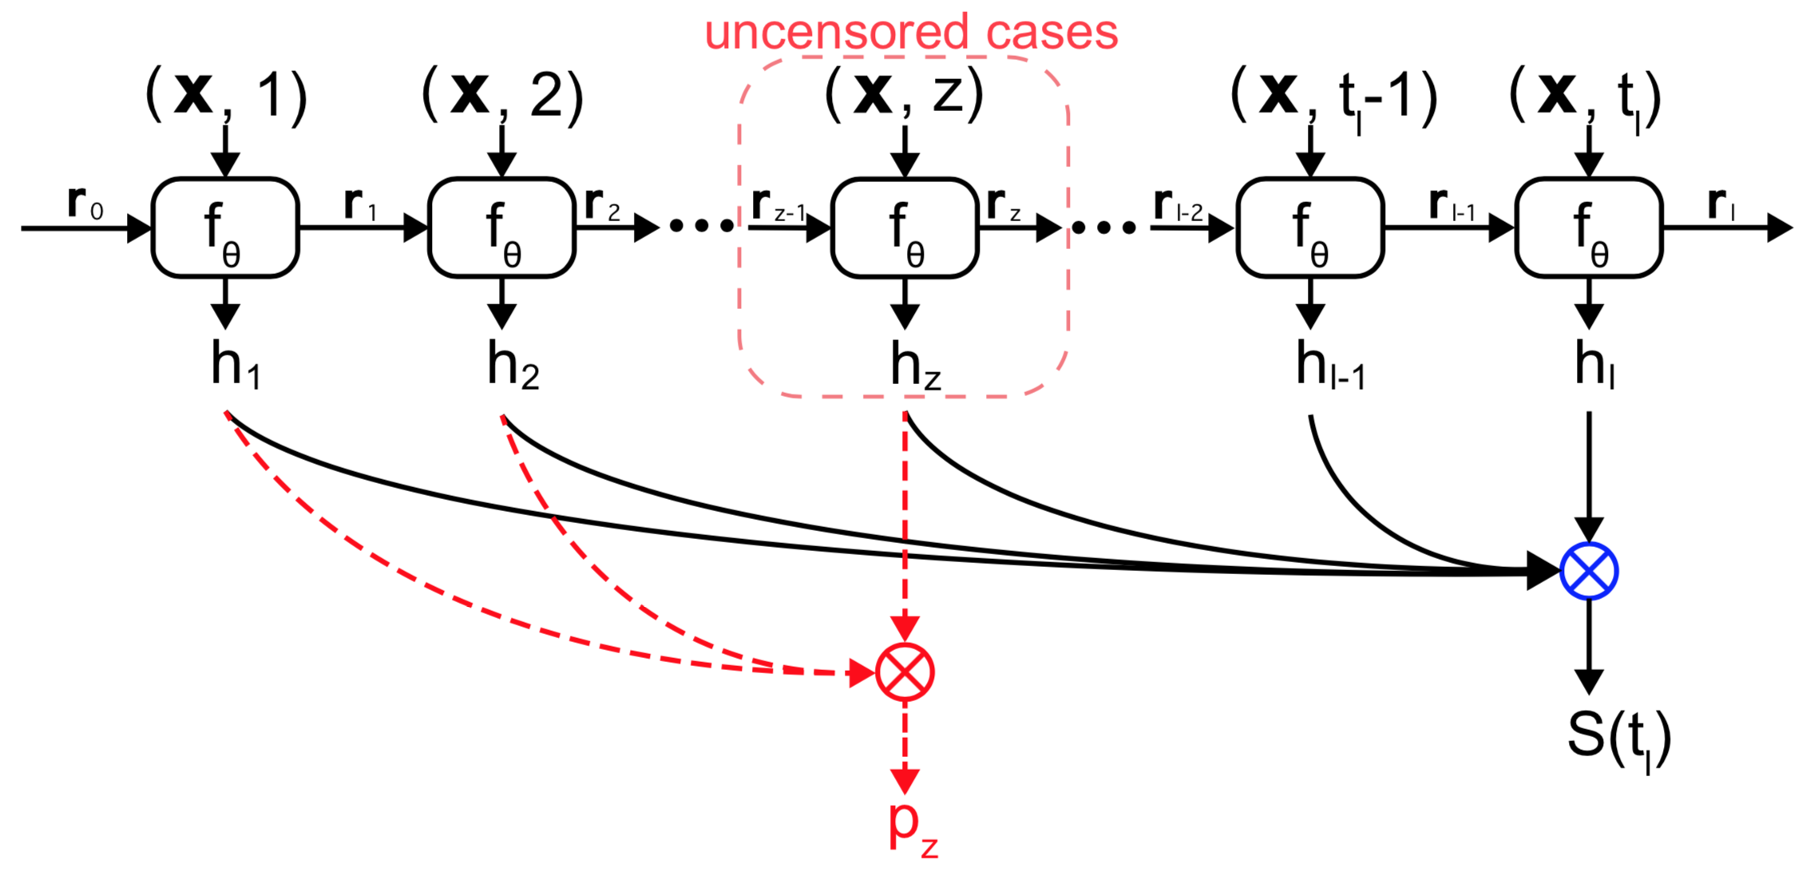
The Recurrent Model
Notes:
This is the overall architecture of the recurrent model.
Each recurrent cell predicts the hazard rate, and we use these prediction results to get the survival rate S for all the samples.
Note that we can only calculate the probability density result of the true event time for the uncensored samples.

Slide 19
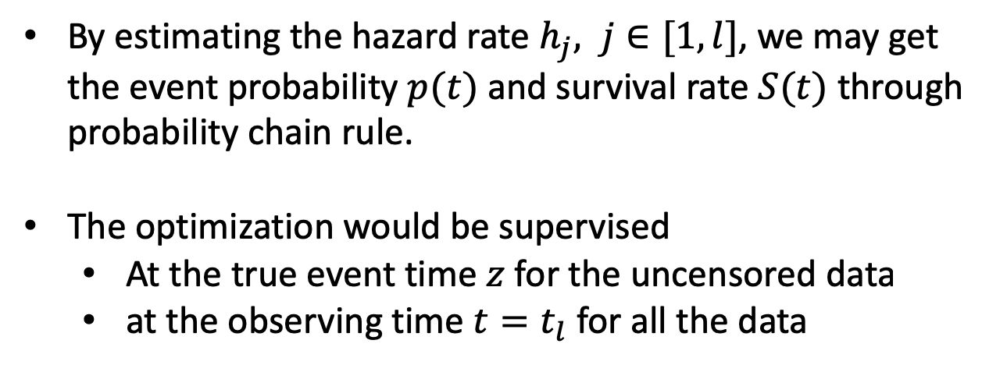
Details of Inference
By estimating the hazard rate $h_{j}, j∈[1,l]$, we may get the event probability $p(t)$ and survival rate $S(t)$ through probability chain rule.
The optimization would be supervised
At the true event time $z$ for the uncensored data
at the observing time $t=t_{l}$ for all the data
Notes:
The optimization would be supervised
At the true event time $z$ for the uncensored data
And at the observing time $t=t_{l}$ for all the data

Slide 20
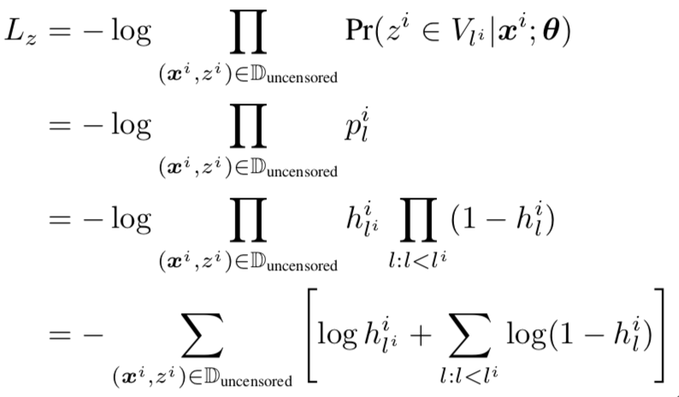

Loss Functions (1/3)
Uncensored data
P.D.F. loss on the true event time $z$
Maximize the log likelihood
Notes:
We adopted three losses.
The first loss is to maximize the log-likelihood of the true event time for the uncensored data.

Slide 21
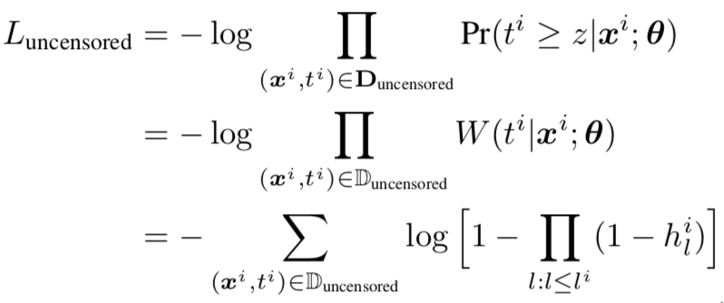

Loss Functions (2/3)
Uncensored data ($z<t$)
C.D.F. loss on the observing time $t$
Maximize the log partial likelihood
Notes:
The second loss is to maximize the log-partial likelihood of the case that true event happened before the observation time, which means t is greater than z.

Slide 22
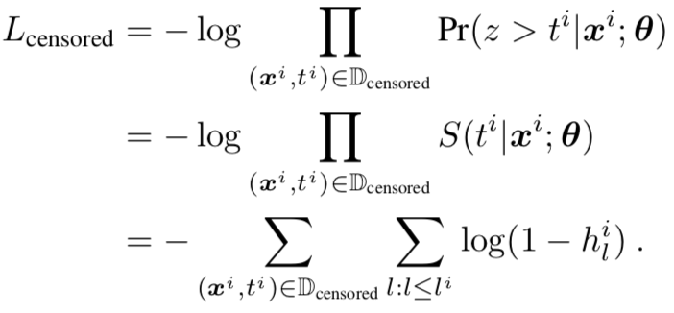

Loss Functions (3/3)
Censored data ($z$ is unknown since $z>t$)
C.D.F. loss on the observing time $t$
Maximize the log partial likelihood
Unbiased learning
Notes:
The third loss is for the censored data.
Recall that for these data, the true event time z is unknown but we only know that z is greater than t.
So this loss is to maximize the log-partial likelihood of the case that (z is larger than t).

Slide 23
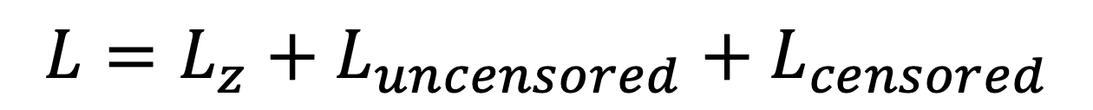
Loss Functions (cont.)
Three losses
Uncensored Data
Censored Data
$$L=L_{z}+L_{uncensored}+L_{censored}$$
P.D.F. Loss
C.D.F. Loss
Notes:
The overall loss function combines these three losses.
The first two are for the uncensored data, while the third loss is unbiased learning which is over the censored data.
More specifically, the first loss is based on Probability density function, and the last two losses are based on Cumulative distribution function.

Slide 24
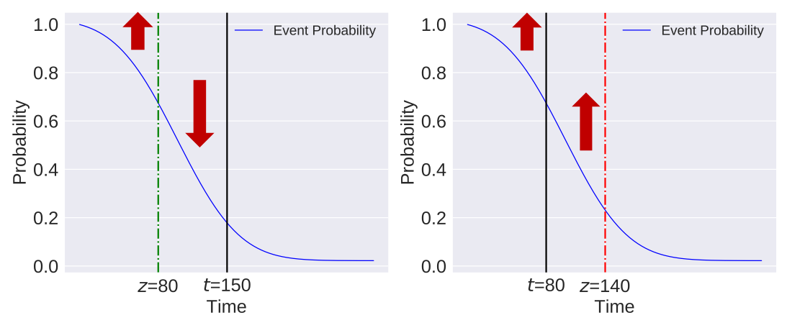
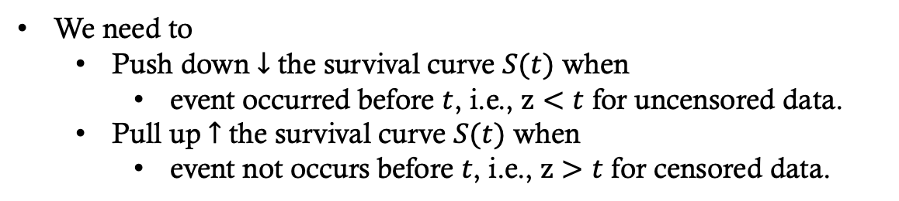
Intuition behind C.D.F. Losses
Uncensored Case
(z has been known)
Censored Case
(z is unknown)
We need to
Push down $↓$ the survival curve $S(t)$ when
event occurred before $t$, i.e., $z<t$ for uncensored data.
Pull up $↑$ the survival curve $S(t)$ when
event not occurs before $t$, i.e., $z>t$ for censored data.
Notes:
Intuitively, the goal of the two CDF losses is two-fold.
The left figure shows an example of uncensored case, here z is smaller than t.
We need to pull up the survival curve before z, and push down the curve during the time from z to t.
The right figure shows a censored case, where z is unknown but greater than t.
So we only need to pull up the survival curve over the whole time range.

Slide 25
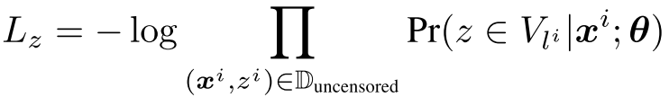
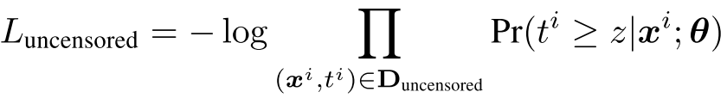
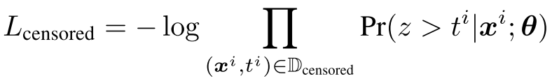

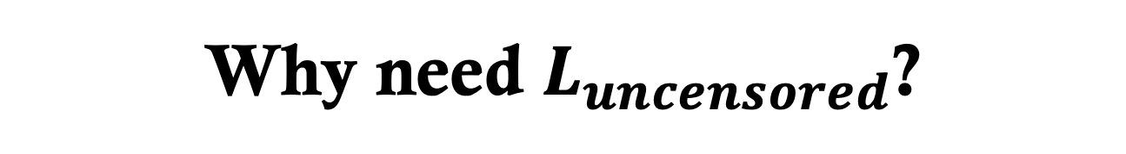
Why need $L_{uncensored}$?
Traditional methods (DeepSurv, DeepHit) use $L_{z}$ and $L_{censored}$, without $L_{uncensored}$.

Slide 26
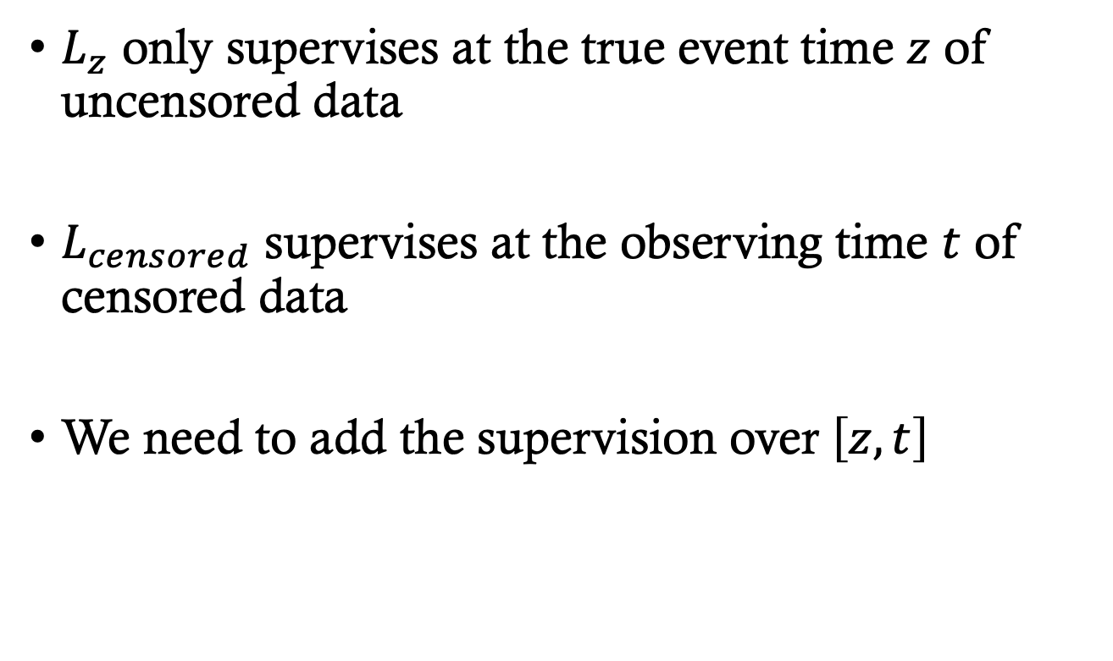
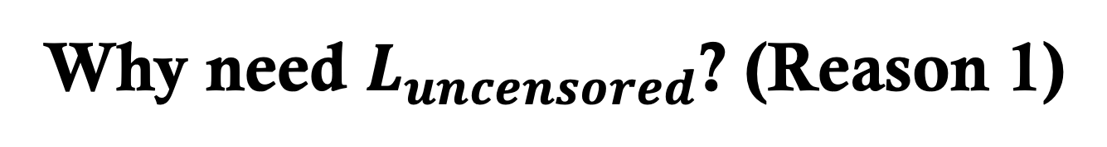
Why need $L_{uncensored}$? (Reason 1)
$L_{z}$ only supervises at the true event time $z$ of uncensored data
$L_{censored}$ supervises at the observing time $t$ of censored data
We need to add the supervision over $\left[z, t\right]$

Slide 27
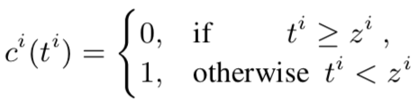
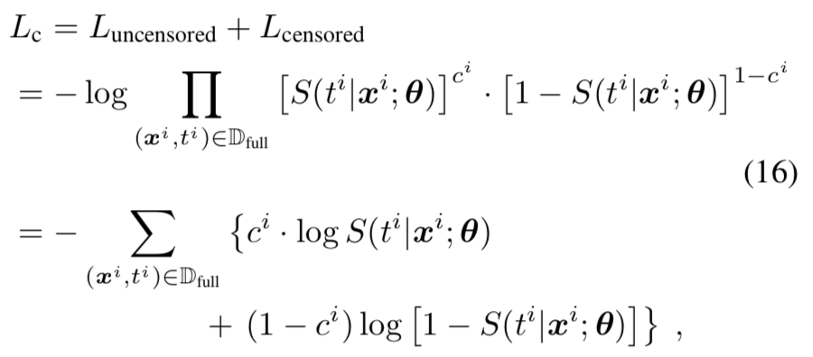

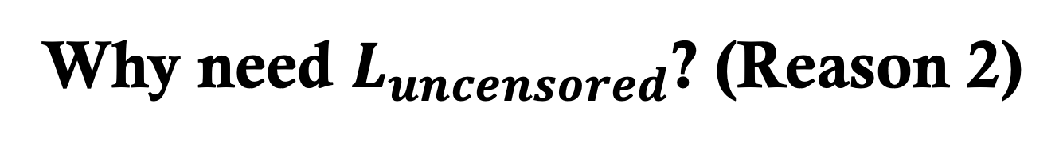
Why need $L_{uncensored}$? (Reason 2)
Combine $L_{uncensored}$ and $L_{censored}$ and get
A binary classification loss of censorship for the observed sample $\left(x^{i},t^{i}\right)$
To judge whether $z^{i}≤t^{i}$ or $z^{i}>t^{i}$.

Slide 28

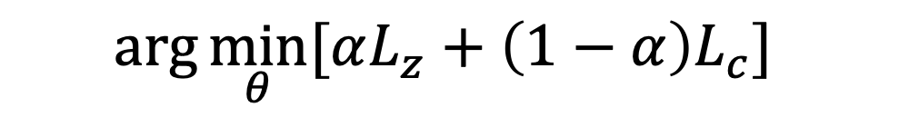
The Final Loss
$$\arg{\min_{θ}{[αL_{z}+\left(1−α\right)L_{c}]}}$$
MLE Loss
Classification Loss

Slide 29
Experiments
3 real-world large-scale datasets
2 evaluation metrics
6 compared baseline models
Notes:
We conduct an extensive experiment over three real-world large-scale datasets.
We compare our method with six baseline models including state-of-the-arts.

Slide 30
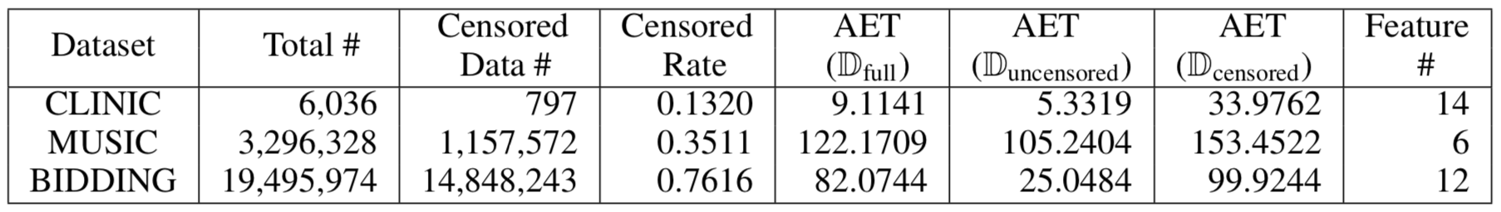
Datasets
3 real-world large-scale datasets
Download link of the processed data:
https://goo.gl/nUFND4.
CLINIC from medicine research
MUSIC from information systems
BIDDING from economics
Notes:
We have published the used datasets for further research.

Slide 31
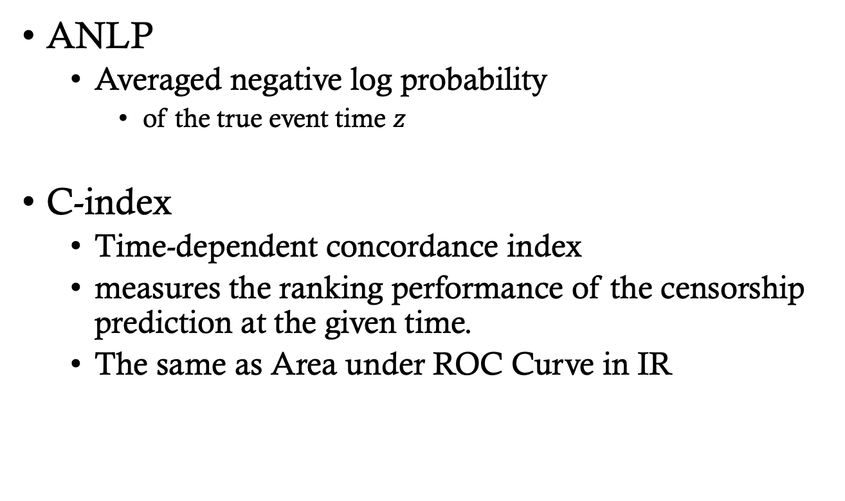
Evaluation Metrics
ANLP
Averaged negative log probability
of the true event time $z$
C-index
Time-dependent concordance index
measures the ranking performance of the censorship prediction at the given time.
The same as Area under ROC Curve in IR
Notes:
In the experiment, two evaluation metrics have been adopted.
The first is to measure the likelihood of the true event time;
The second is to measure the classification performance of survival or not survival at the given time for the test samples, which is the most widely used metric in the related works.

Slide 32
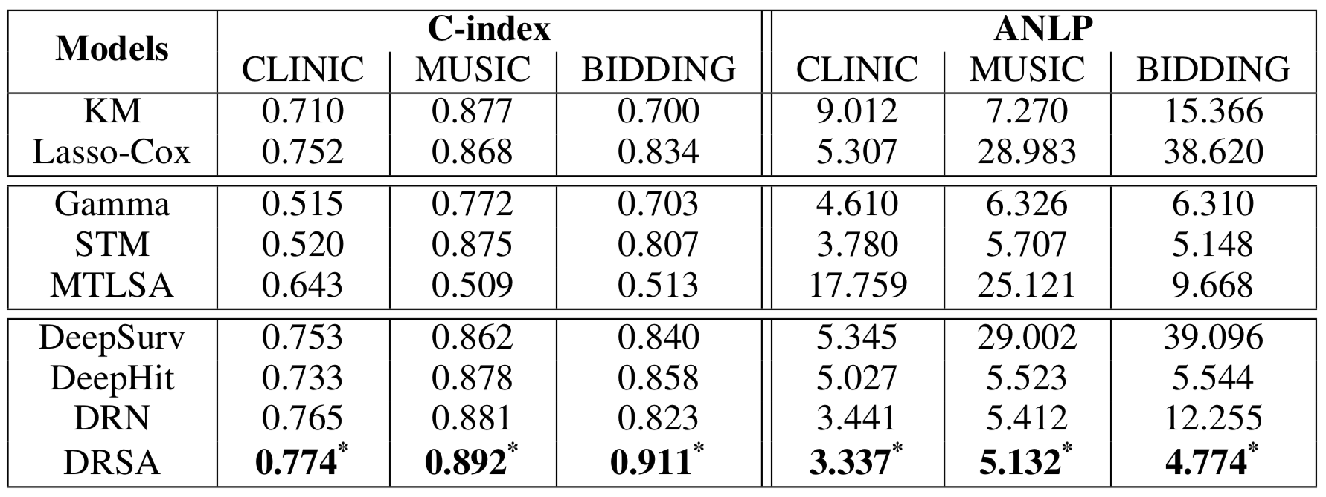
Experiment Results
Performance comparison on C-index (the higher, the better) and ANLP (the lower, the better). (* indicates p- value < 10−6 in significance test)
Notes:
From the result table, our model shows significant improvement over all the datasets against these strong baselines.

Slide 33
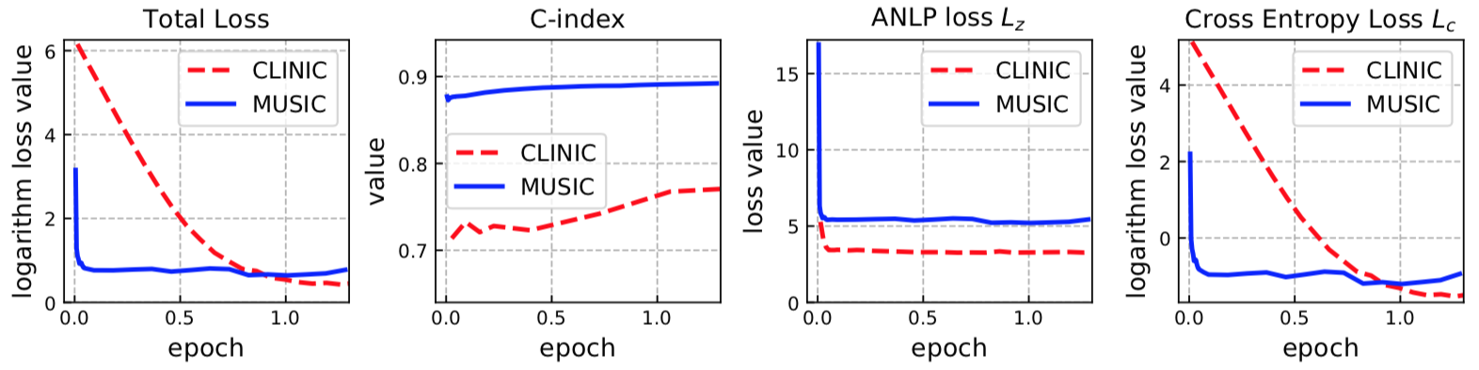
Learning Curves
Notes:
Our DRSA model also converge very quickly in about one iteration over the whole training dataset.

Slide 34
Survival Curves
Notes:
We also illustrate the predicted PDF and CDF results from the compared models.
We can easily find that our DRSA model accurately predicts the true event time and attributes the highest probability at that time point.
This demonstration reflects the effectiveness of our DRSA model.

Slide 35
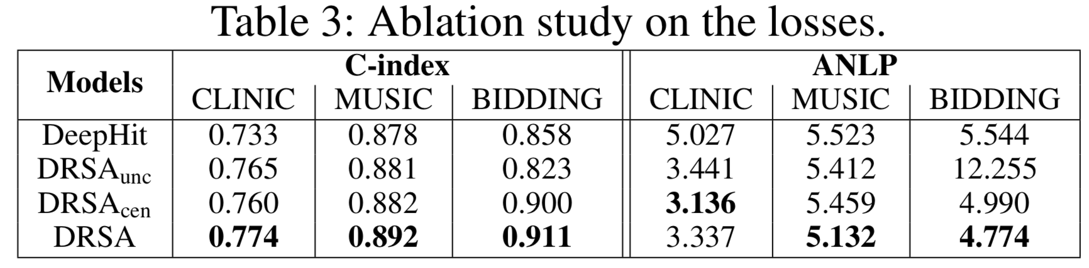
Ablation Study

Slide 36

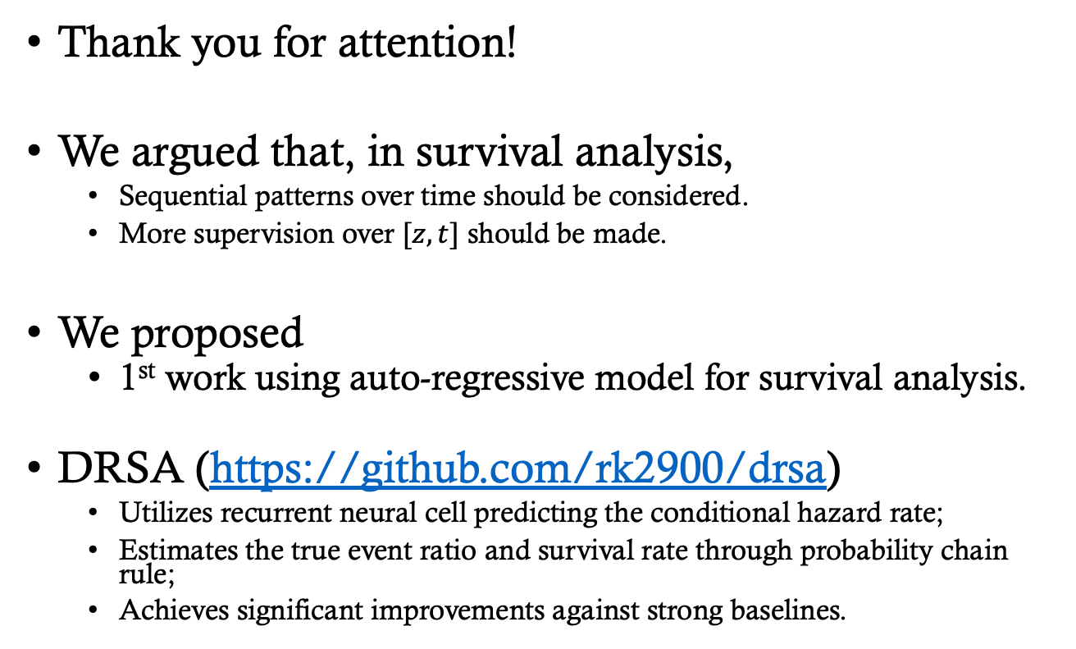
Conclusion
Thank you for attention!
We argued that, in survival analysis,
Sequential patterns over time should be considered.
More supervision over $[z, t]$ should be made.
We proposed
1st work using auto-regressive model for survival analysis.
DRSA (https://github.com/rk2900/drsa)
Utilizes recurrent neural cell predicting the conditional hazard rate;
Estimates the true event ratio and survival rate through probability chain rule;
Achieves significant improvements against strong baselines.
Notes:
Finally we conclude that the sequential patterns over time should be considered in survival analysis.
We have proposed the first work using auto-regressive model for this task.
We also published our code and the data and you can scan this QR code to get the public Github repository.
Thank you for your attention!

