Slide 1


Machine learning project
PASSWORD STRENGTH CLASSIFIER
Davide Scintu
2023

Slide 2
Davide Scintu – ML Project 2023
Introduction
ML model to classify the strength of a password given in input
Two different approaches
Neural Network
Ensemble learning

Slide 3
Davide Scintu – ML Project 2023
Dataset and password classification
Dataset
Passwords from 000webhost
PARS
(Password Analysis and Research System )
Class 0: Weak​
Class 1: Medium​
Class 2: Strong
Weak or strong?
Results based on rules
ML Algorithm
New password
Results based on ML

Slide 4

Davide Scintu – ML Project 2023
NNs vs ensemble learning
INPUT
DATA PROCESSING
MODEL
RESULTS
Password generated in characters
PyTorch
RandomForest
Class ?
Class ?

Slide 5
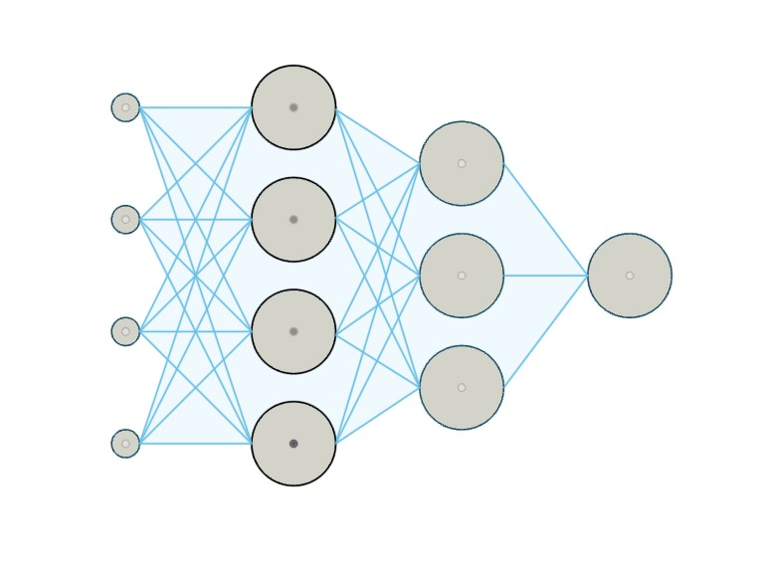
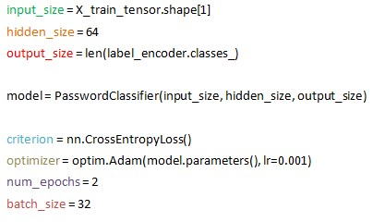
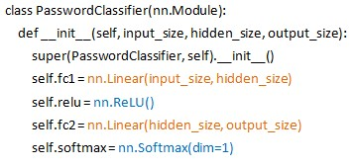
Davide Scintu – ML Project 2023
Pytorch model - first simple NN
Input ReLu Softmax

Slide 6
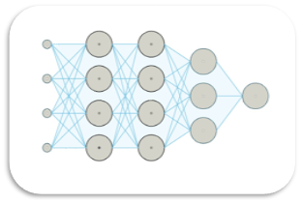
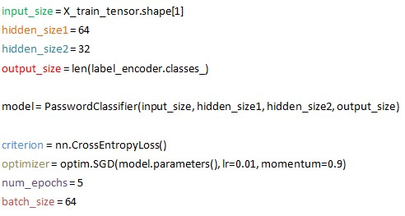
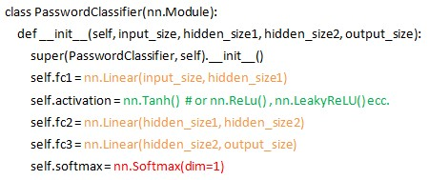
Davide Scintu – ML Project 2023
Pytorch model - more complex NN
Input
Activation function
Activation function
Softmax

Slide 7

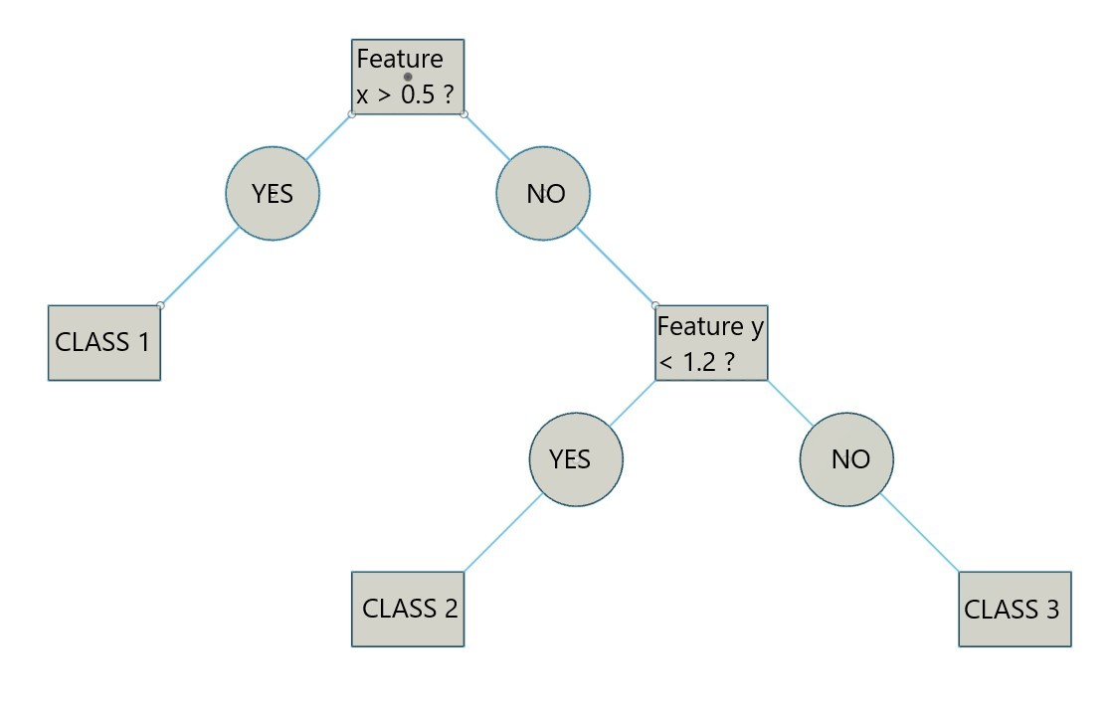
Davide Scintu – ML Project 2023
Random Forest model
Each tree is different from the others.
They are
independent

Slide 8
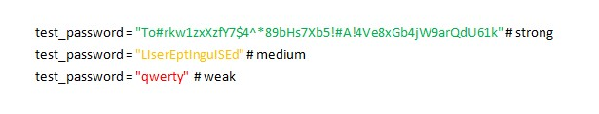
Davide Scintu – ML Project 2023
Pytorch model vs RandomForest model
Number of samples = 100k
TRAINING
PyTorch
RandomForest
TEST new passwords
Weak, Medium, Strong
RESULTS

Slide 9

Davide Scintu – ML Project 2023
Conclusion
Which one is better

Slide 10
References
Password strenght image: https://www.hostpapa.com/blog/security/how-to-create-strong-passwords-to-secure-your-website/
Password weakness: https://www.abecarolina.com/blog/test-your-password-strength
Dataset source: https://www.kaggle.com/code/alperkaraca1/password-strength-analysis
Gears image: https://it.vecteezy.com/arte-vettoriale/5511912-ingranaggi-lavoratore-meccanismo-simbolo-disegno-vettoriale
Gear image: https://it.freepik.com/vettori-premium/gear-wheel-icon-illustrazione-vettoriale_32232346.htm#query=ingranaggio&position=6&from_view=keyword&track=sph
Lamp image: https://www.istockphoto.com/it/vettoriale/lampadina-idea-vettore-icona-contorno-lampada-gm960813498-262365917
RandomForest: https://scikit-learn.org/stable/modules/generated/sklearn.ensemble.RandomForestClassifier.html
PyTorch: https://pytorch.org/tutorials/beginner/basics/tensorqs_tutorial.html

