Slide 1
Pavia & Its Delicacies
Find the best place where open a Restaurant in Pavia Province

Slide 2
It is important for a restaurateur find where to place his Restaurant
We’ll compare different type of cousine in the region of Pavia
The region cover different type of cuisine and food needs
We’ll also explore the Art and Enterteinment places

Slide 3
Data
We scrapped the region Cities from Wikipedia pages of the Pavia Province
We get location of restaurant and enterteinment places from Foursquare
We also get the number of likes a place receive from Foursquare
After Data extraction and cleaning we have two datasets : one with restaurants and one with art-enterteinment places

Slide 4
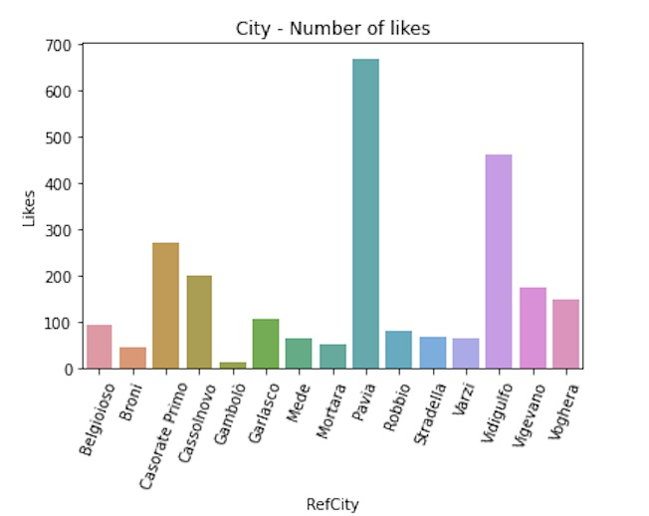
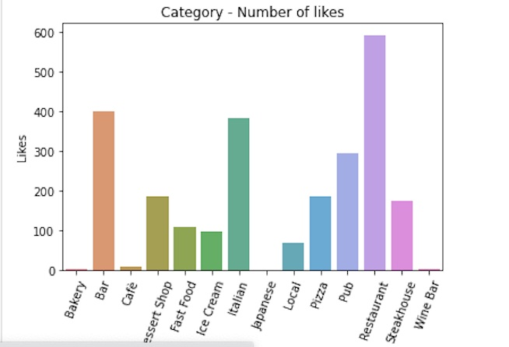
Best Categories and Cities

Slide 5
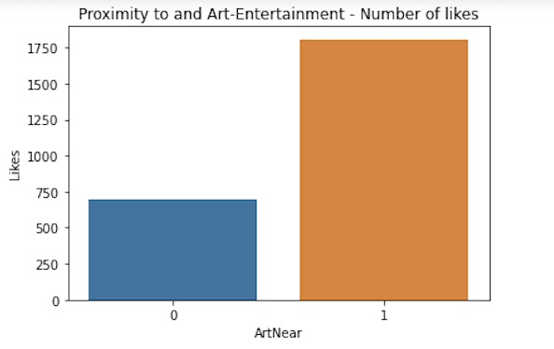
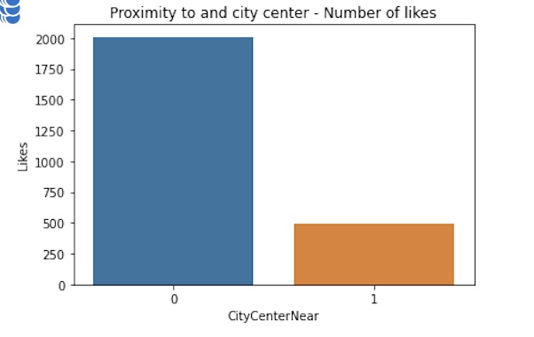
Best Restaurant are near to
Art-Enterteinment and far from the cities

Slide 6
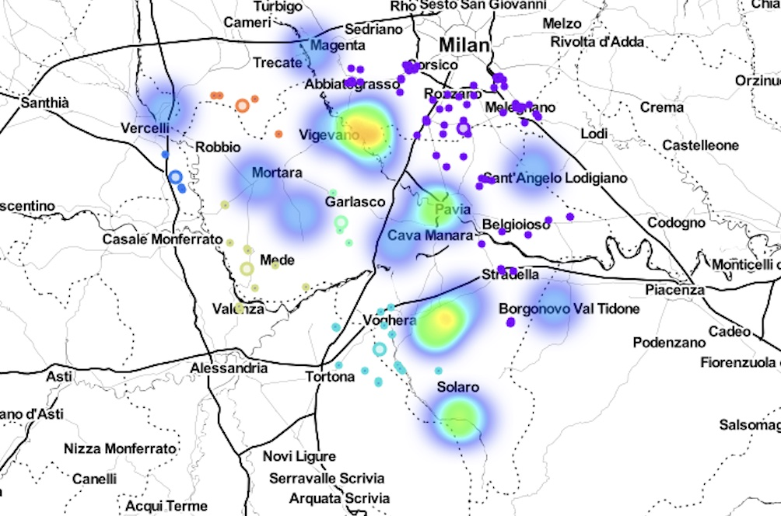
Open Local Restaurant near the city!

Slide 7
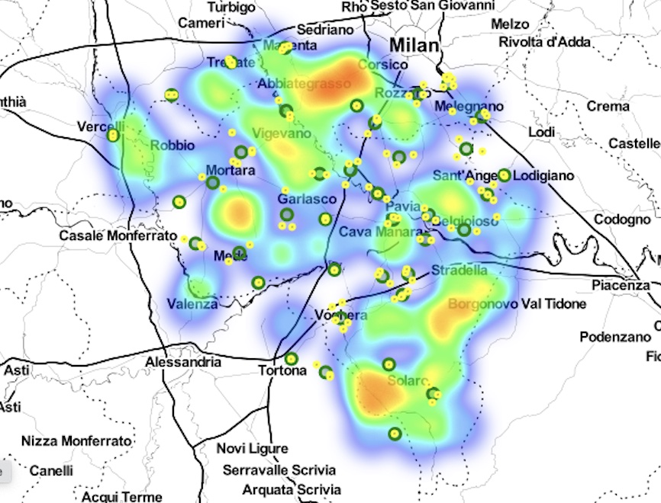
Italian restaurant are everywhere!

Slide 8
Conclusion
We used K-means and DBSCAN toghether to make conlcusion
The DBSCAN is “weak” for high dispersion category
To improve try to find a relation in the likes count of art-enterteinment and the restaurant categories

