Slide 1


MovieSearch: a smart movie search engine
Davide Liu (刘大为) 2019280806
(May 20, 2020)

Slide 2
HEADLINES:
Introduction
Motivations and related work
Datasets
Design and implementation
Challenges
Future work

Slide 3

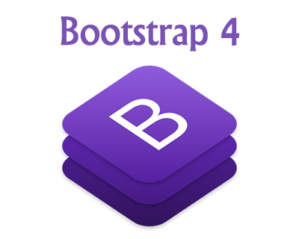


INTRODUCTION: MOVIESEARCH
Content speciﬁc search engine with the aim to retrieve movies
Search engine relies on the OkapiBM25 algorithm
Back-end developed with the framework Django
Front-end based on Bootstrap 4 and Html5
Data stored in MongoDB database
Content-based recommendation system
Deep learning model to classify movies’ reviews

Slide 4
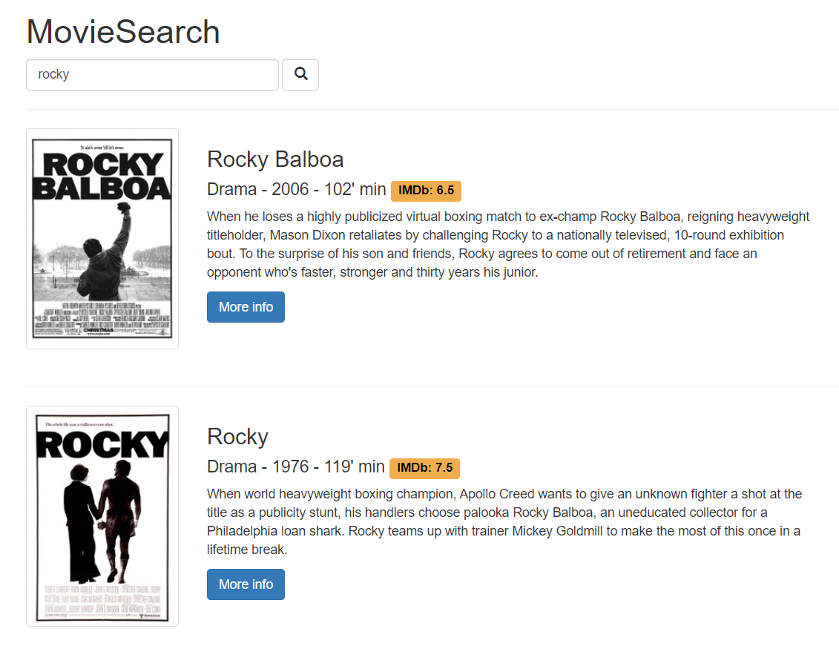
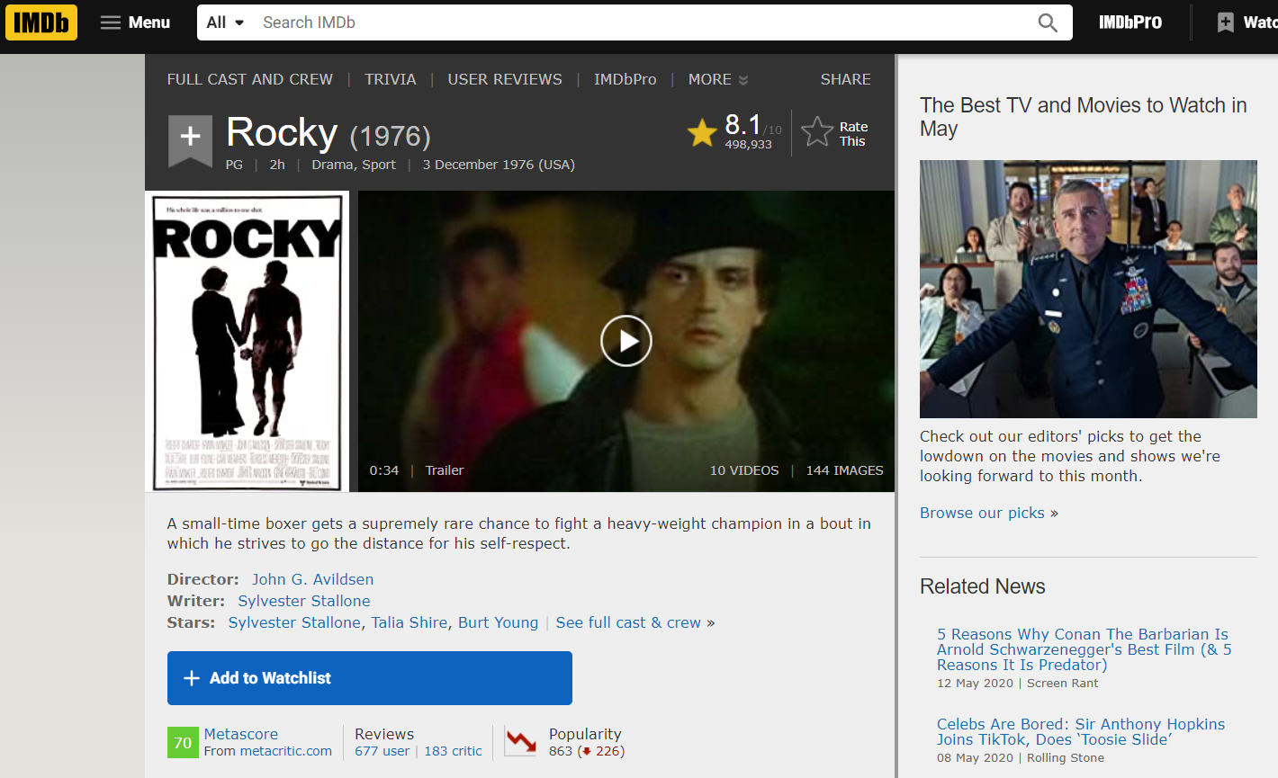
MOTIVATIONS AND RELATED WORK
Movies search engine
User friendly interface both for desktops and smartphones
Fast, powerful and efficient search algorithm
Allow users to immediately have an idea about the content of retrieved movies
IMDb movies database is the most similar work

Slide 5
MAIN DIFFERENCES BETWEEN IMDb AND MOVIESEARCH
Feature | IMDb | MovieSearch
Query search scope | Query strings matching on movies’ title. | Query strings matching on movies’ title, actors, overview...
Movies’ information | Lot of information, sometimes can be chaotic. | Less but useful information, can be read in a few seconds.
Reviews’ score | Reviews’ score given by their author. | Reviews’ score given by a deep learning model.
Front-end | Lot of pages and buttons, requires more time to explore. | Clean interface, immediate to understand.
Retriavable content | Movies, actors, companies,... | Only movies.

Slide 6

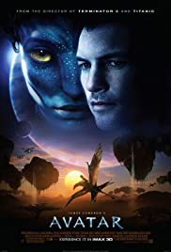

DATASETS
TMDB 5000 Movie Dataset: contains information about 5000 movies crawled from Imdb
Movies Posters: contains the poster of about 50k movies
Large Movie Review Dataset: provides a set of 25,000 highly polar movie reviews for training, and 25,000 for testing
Most of the work has been spent in preprocessing and cleaning the datasets

Slide 7
SEARCH ALGORITHM
OkapiBM25 to estimate the relevance of documents to a given search query
Represents state-of-the-art TF-IDF-like retrieval functions used in document retrieval
Takes into consideration: title, overview, cast and production companies of a movie
Machine learning based search algorithms hard to train due to the lack of an appropriate dataset

Slide 8
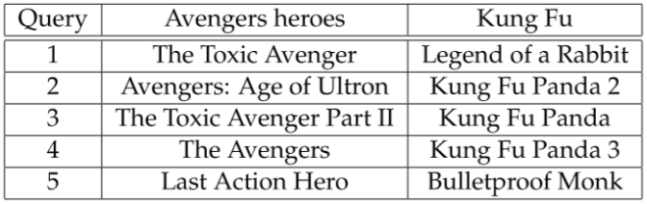
SEARCH ALGORITHM: ENHANCEMENTS
A words reverse index is used to limit the scope of the search
Retrieved movies are temporary cached by the system so to avoid having to retrieve them from the database for future
Words contained in the title of a movie have double weight: users tend to search movies by title
A query is first preprocessed: stemming, removing punctuation, stopwords, …

Slide 9
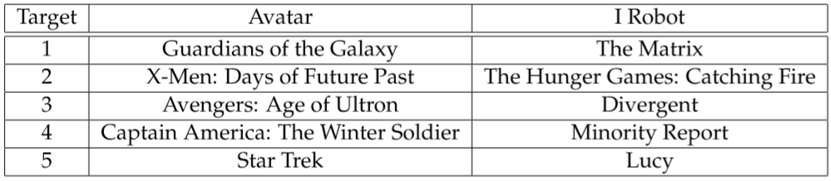
RECOMMENDATION SYSTEM
Content based recommendation system
K-neighbors to compute movies similarity (similarity matrix)
Recommendations are not real time but computed while uploading the dataset
Tries to exclude prequels and sequels: a user might already know about them

Slide 10
REVIEWS CLASSIFICATION
Reviews are classified into positive and negative
Bert model fine-tuned on the IMDb movie reviews dataset (97%+) accuracy
Same as for the recommender system, predictions are not real time but have been performed before uploading
Labeled review may reward the user with an immediate feedback of how much a specific movie has been appreciated by the public without needing to read all of them

Slide 11
CHALLENGES
Learning how to use the framework Django
Chosen Django since it gives the possibility to work with Python and its machine learning libraries
Chosen a document-oriented database over a relational database due to the heterogeneity of the data
Spent lot of time to preprocess and clean the data, many values were missing and some couldn’t be replaced
Chosen Bootstrap 4 for front-end in order to minimize CSS utilization

Slide 12
FUTURE WORK
Crawling more data: some movies are missing their poster and reviews
Login system
Allow users to write their own review
Modify the recommendation system such that recommendations would not be based only on the content of the movies but also on user interactions.

Slide 13
THANK YOU

