Slide 1
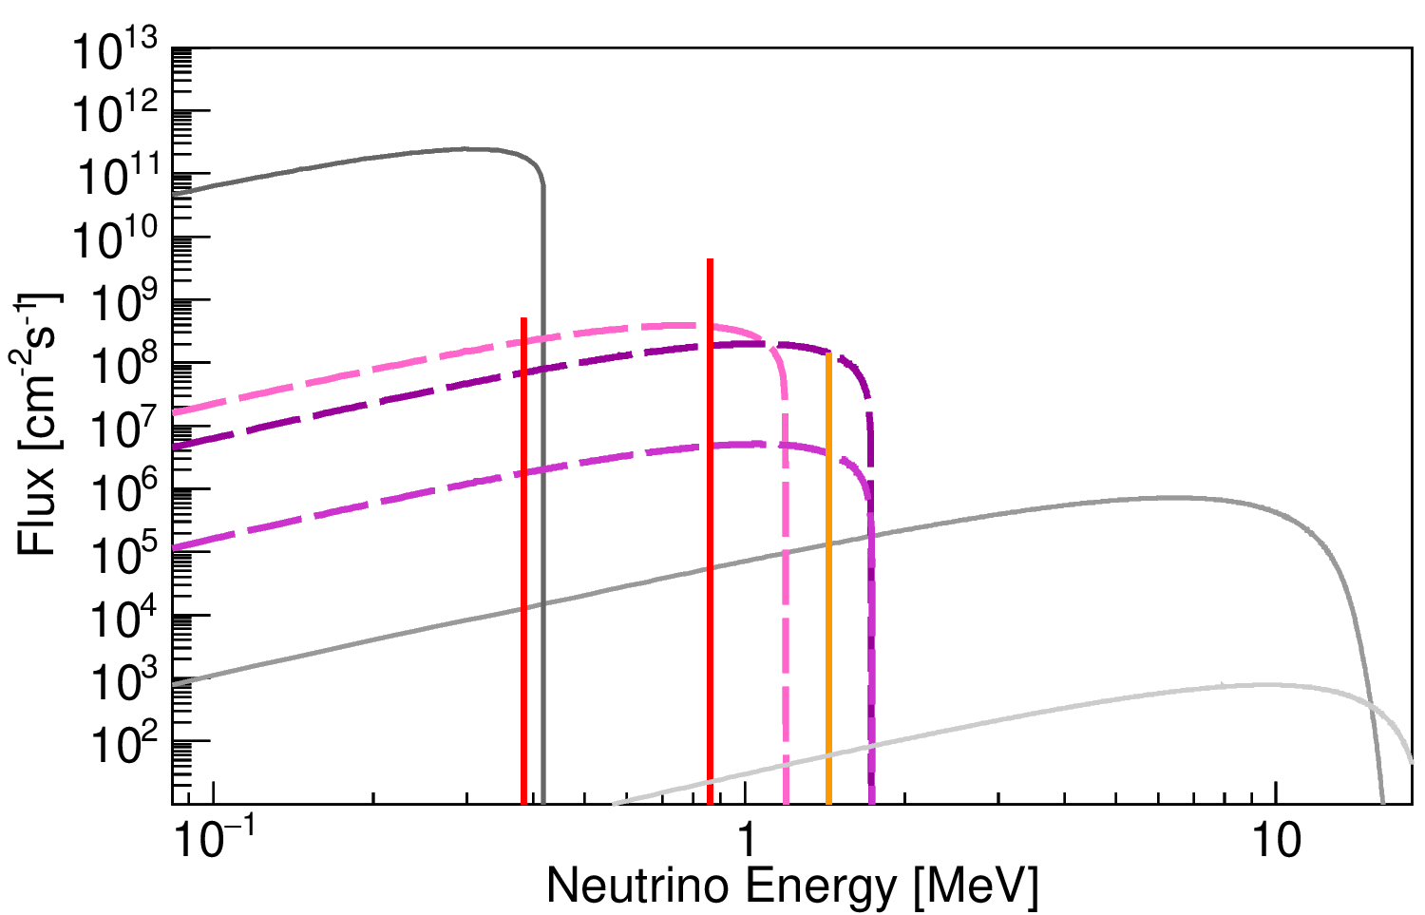
pp (±0.6%)
⁷Be (±6%)
pep (±1%)
¹³N (±15%)
¹⁵O (±17%)
⁸B (±12%)
¹⁷F (±20%)
hep (±30%)

