Slide 1
Ladder lattice antiferromagnet
S = 1/2 antiferromagnetic Heisenberg model for a 1D chain bilayer with nearest-neighbour interlayer coupling

Slide 2
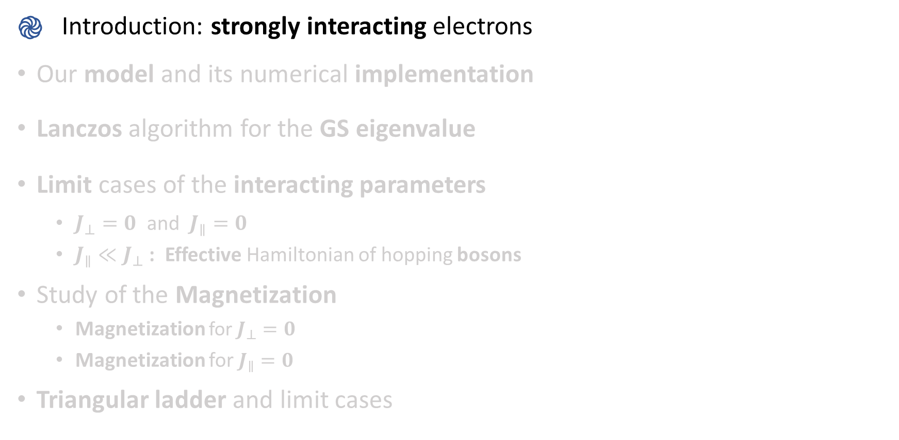
Introduction: strongly interacting electrons
Our model and its numerical implementation
Lanczos algorithm for the GS eigenvalue
Limit cases of the interacting parameters
$J_{⊥}=0$ and $J_{∥}=0$
$J_{∥}≪J_{⊥}$ : Effective Hamiltonian of hopping bosons
Study of the Magnetization
Magnetization for $J_{⊥}=0$
Magnetization for $J_{∥}=0$
Triangular ladder and limit cases

Slide 3
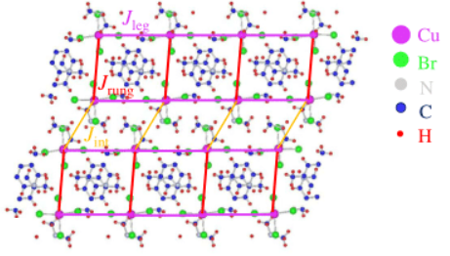
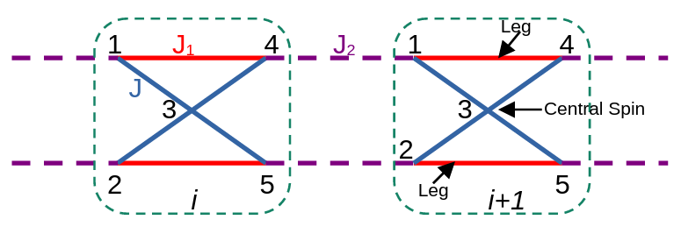
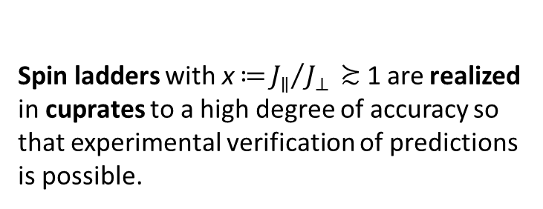
Introduction: strongly interacting electrons
Credits: Sayan Ghosh & all
Credits: Tao Hong & all
Spin ladders with $\text{x}\text{ ≔}{J_{∥}}/{J_{⊥}}\text{ ≿ 1}$ are realized in cuprates to a high degree of accuracy so that experimental verification of predictions is possible.
Recently a new class of materials were synthesized whose effective spin placements resembles the Kagome strip chain. This could shed a light on the properties of quantum spin liquids
Notes:
(->Beginning) Justification of this project: study of simple systems whose configuration resembles the shape of more complex ones with exotic behaviours. The theoretical comprehension of such materials is believed to bring potential important technological applications (superconductors hight Tc, stable qbit).
(-> Curiosity) The possible existence of quantum spin liquids (QSL) in frustrated magnetic materials and their applications have motivated intense research in the field of quantum magnetism. The QSL is a putative phase with short range magnetic order but subtle quantum orders, that has so far been elusive in real materials. In principle, the QSL state may be realized in many spin1/2 antiferromagnetic Heisenberg (HAF) models such as triangular, Kagome, and ladder systems. The ground states of spin-1/2 HAF model on a Kagome lattice have been found to exhibit features of a spin liquid. However, its precise nature remains inconclusive due to the theoretical and experimental challenges in deciphering two dimensional frustrated spin systems. There are several studies which focused on the simpler system of HAF spin-1/2 model on a Kagome-strip chain (KSC) to elucidate its properties.
Quantum spin liquids, with their unique properties and exotic excitations, hold promise for advancements in quantum computing and high-temperature superconductivity.

Slide 4
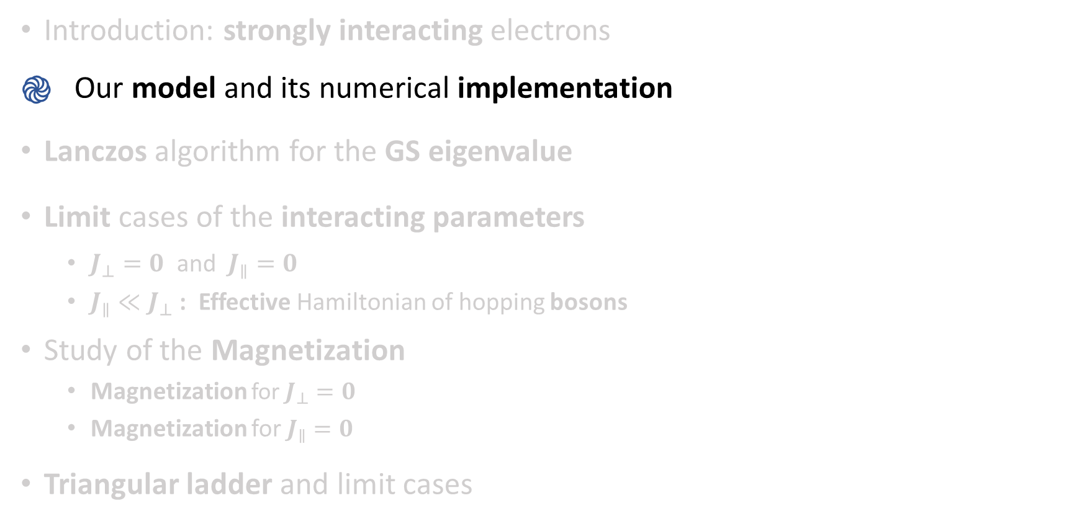
Introduction: strongly interacting electrons
Our model and its numerical implementation
Lanczos algorithm for the GS eigenvalue
Limit cases of the interacting parameters
$J_{⊥}=0$ and $J_{∥}=0$
$J_{∥}≪J_{⊥}$ : Effective Hamiltonian of hopping bosons
Study of the Magnetization
Magnetization for $J_{⊥}=0$
Magnetization for $J_{∥}=0$
Triangular ladder and limit cases

Slide 5
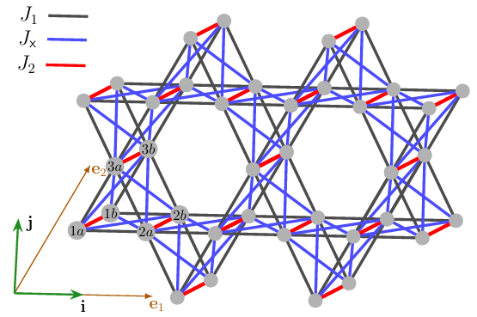
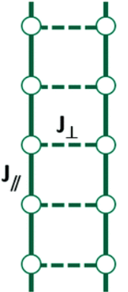
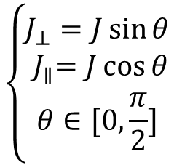
Our model and its numerical implementation
$$\left\{\begin{aligned}J_{⊥}=J\sin{θ} \\ { J}_{∥}=J\cos{θ} \\ θ∈[0,\frac{π}{2}]\end{aligned}\right.$$
Credits: Dmytro Yaremchuk & all
Credits: Rafaela Silva & all
Notes:
(->After the parameters are defined) PBC on the two legs of the ladder.
(->After the previous) Even number of rungs to avoid frustration in this simple case

Slide 6


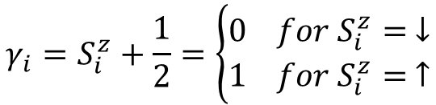

Our model and its numerical implementation
1
3
5
7
0 | 1 | 1 | 0 | 0 | 1 | 0 | 1
$$μ=166$$
0
2
4
6
$$\#_{vectors}=2^{L}$$
$$μ= \sum_{i=0}^{L−1}{γ_{i}2^{i}}$$
$$γ_{i}=S_{i}^{z}+\frac{1}{2}=\left\{\begin{aligned}0 for S_{i}^{z}= ↓ \\ 1 for S_{i}^{z}= ↑\end{aligned}\right.$$
Notes:
(->Before the first formula) Algorithm to encode the $2^{L}$ states written in the$S_{z}$-basis into integers $μ$

Slide 7






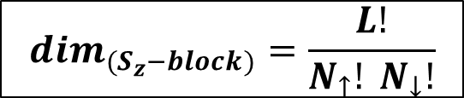


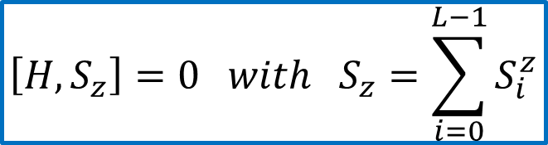






Our model and its numerical implementation
E
E
E
$$\left[H,S_{z}\right]=0 with S_{z}=\sum_{i=0}^{L−1}{S_{i}^{z}}$$
$$E_{0}(S=2)$$
$$E_{0}(S=2)$$
$$E_{0}(S=2)$$
$$E_{0}(S=1)$$
$$E_{0}(S=1)$$
$$−S_{z}^{MAX}$$
$$E_{0}(S=0)$$
…
$${(2}^{L}×2^{L})$$
$$S_{z}=0$$
$$S_{z}=1$$
$$S_{z}=2$$
$$H =$$
$$S_{z}=0$$
…
$$S_{z}^{MAX}$$
$$\dim_{{(S}_{z}−block)}=\frac{L!}{N_{↑}! N_{↓}!}$$
with $\frac{1}{2}N_{↑}−\frac{1}{2}N_{↓}=S_{z}$
Notes:
(->At the beginning) Before proceding any further, we discuss the issue of the SYMMETRIES of the HAMILTONIAN. Indeed, if H shows some symmetry (i.e. [H,A]=0 for some operator A), it can be block-diagonalized, allowing us to work on single sectors identified by each eigenvalue of A, resulting in a reduction of computational efforts and times! In our case, for instance, it can be shown that [H, Sz]=0 and so the full hamiltonian can be cast into a block diagonal form of Sz fixed sectors.
(->After showing the hamiltonian) While the total hamiltonian has dimension $2^{L}×2^{L}$, working with the blocks allows us to deal with sub-matrices of lower dimension. It is indeed this feature, along with the implementation of the sparse matrix formalism (saving just the non zero entries of a matrix that, because of the local nature of the interactions, has a lot of null elements) that allow the major speeding up of the code.
(->With the energy spectrum) An easy application of the block formalism in the case of a single S=1/2 chain with L=4. The ladder case will provide in general a reacher spectrum, but the key idea of considering the lowest-lying eigenvalues for each sector remains.

Slide 8
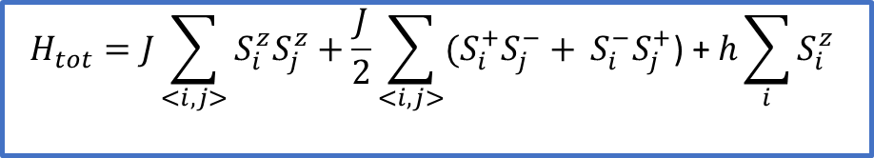







Our model and its numerical implementation
E
$$E_{0}(S=2)$$
h
$${\tilde{E}}_{0}\left(S=2, S_{z}=2\right)=E_{0}\left(S=2\right)−2h$$
$${\tilde{E}}_{0}\left(S=1, S_{z}=1\right)=E_{0}\left(S=0\right)−h$$
$$E_{0}(S=1)$$
$$E_{0}(S=0)$$
$${\tilde{E}}_{0}\left(S=0, S_{z}=0\right)=E_{0}\left(S=0\right)$$
m
$$H_{tot}=J\sum_{<i,j>}{S_{i}^{z}S_{j}^{z}}+\frac{J}{2}\sum_{<i,j>}{{(S}_{i}^{+}S_{j}^{−}+} S_{i}^{−}S_{j}^{+}\text{)}\text{ + }h\sum_{i}{S_{i}^{z}}$$
1
0
$$h_{1}$$
$$h_{2}$$
h
Notes:
(->At the beginning) Thanks to the considered symmetry, the correct lowest-lying eigenvalues $\{{\tilde{E}}_{0}\}$ for all $S_{z}$ sectors are simmply obtained summing –Sz*h to the lowest lying energy eigenvalue E0. This will allow to build a magnetization vs h plot and study its behaviour for different configurations!

Slide 9
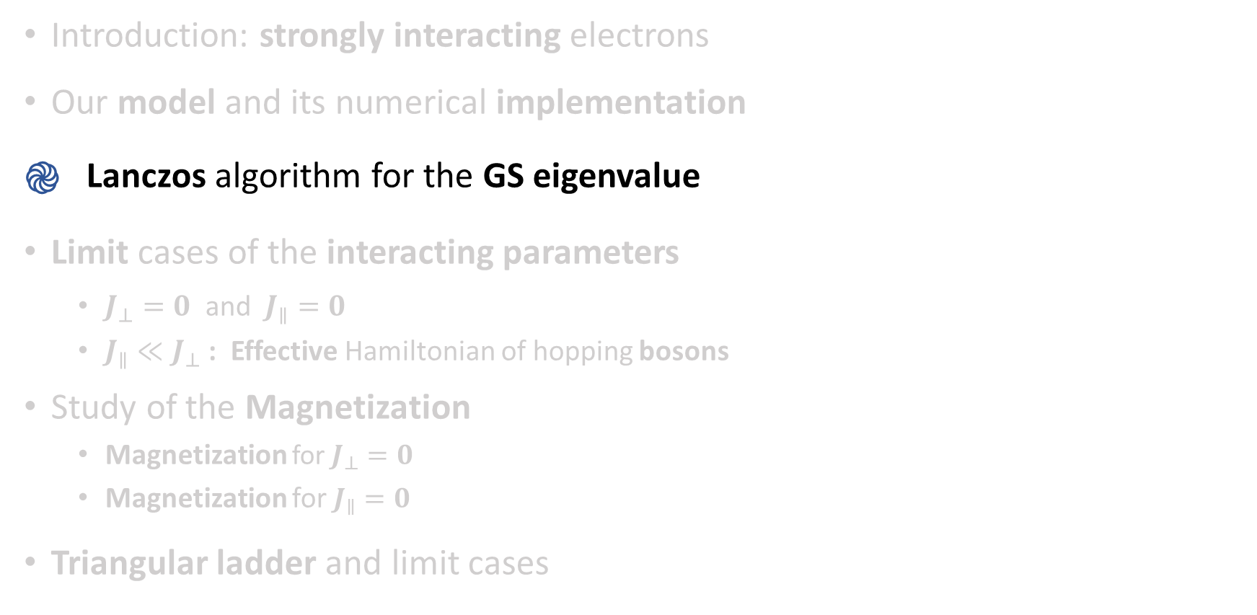
Introduction: strongly interacting electrons
Our model and its numerical implementation
Lanczos algorithm for the GS eigenvalue
Limit cases of the interacting parameters
$J_{⊥}=0$ and $J_{∥}=0$
$J_{∥}≪J_{⊥}$ : Effective Hamiltonian of hopping bosons
Study of the Magnetization
Magnetization for $J_{⊥}=0$
Magnetization for $J_{∥}=0$
Triangular ladder and limit cases

Slide 10
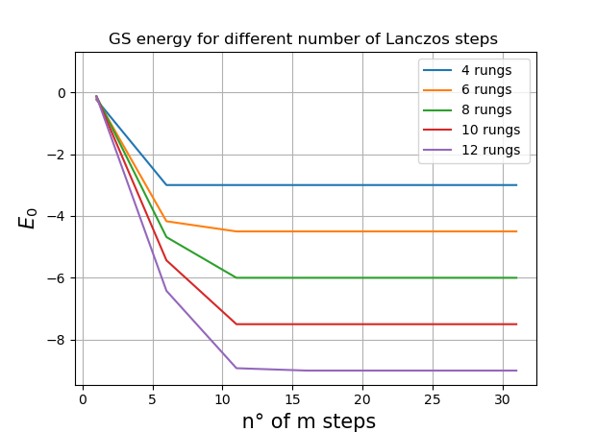
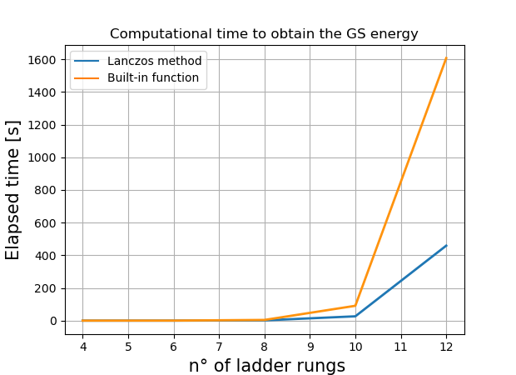



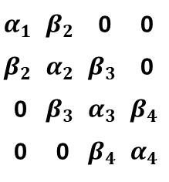
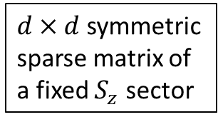

Lanczos algorithm for the GS eigenvalue
$$α_{1}$$ | $$β_{2}$$ | 0 | 0
$$β_{2}$$ | $$α_{2}$$ | $$β_{3}$$ | 0
0 | $$β_{3}$$ | $$α_{3}$$ | $$β_{4}$$
0 | 0 | $$β_{4}$$ | $$α_{4}$$
$d×d$ symmetric sparse matrix of a fixed $S_{z}$ sector
. . . . .
$$H =$$
$$\tilde{H} =$$
$$|S_{z} fixed$$
$$Lanczos$$
. . . . .
Notes:
(-> Along with first images) Briefly describe the algorithm for the tri-diagonalization of a matrix through the particular projection technique developed by Lanczos.
(-> After the first images) First plot: n° of Lanzos steps for an optimal accuracy on the GS eigenvalue.
Second plot: compare the results from my personal implementation of Lanczos algorithm with the ones from the built-in diagonalization functions in python for the GS eigenvalue. It is indeed more efficient the Self-Made Lanczos in this case, but when it comes to more elaborate application, the built-in function compensate with a more efficient management of sparce memory and so the times get very similar!

Slide 11
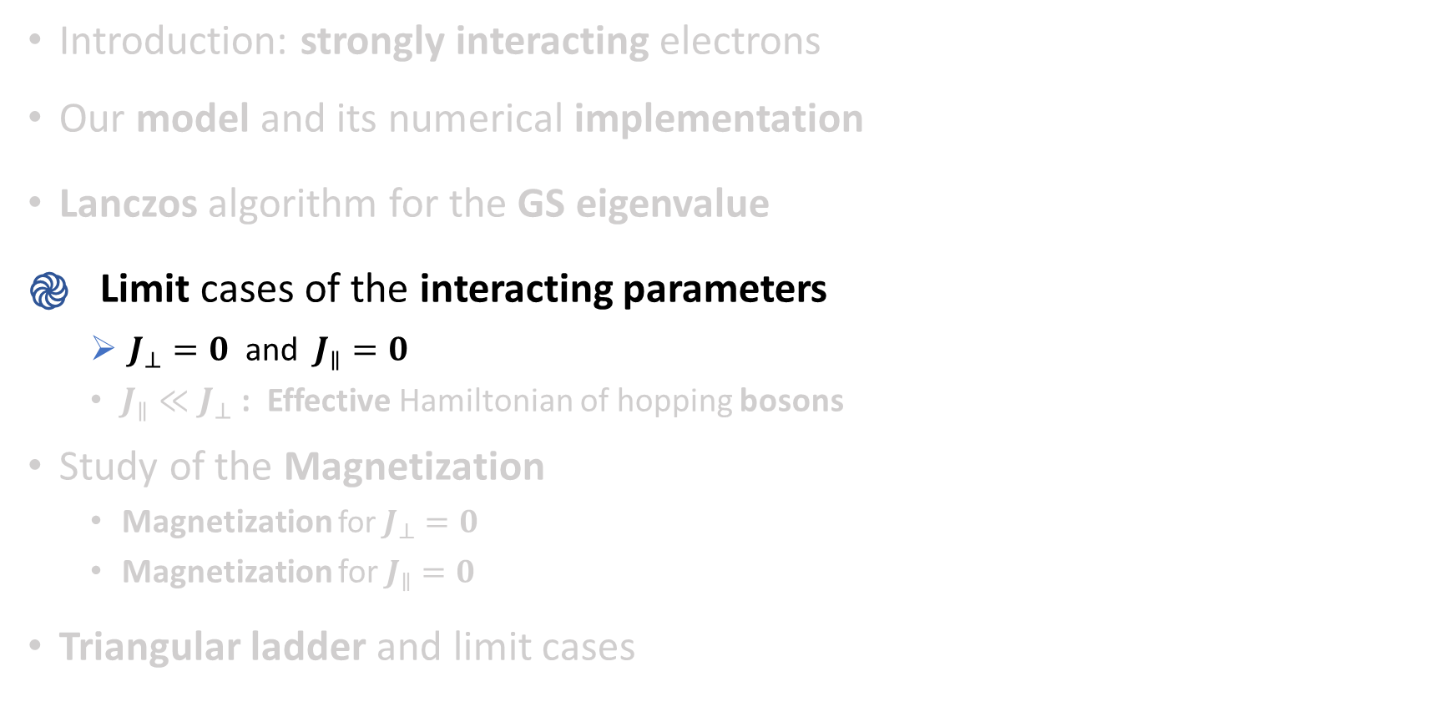
Introduction: strongly interacting electrons
Our model and its numerical implementation
Lanczos algorithm for the GS eigenvalue
Limit cases of the interacting parameters
$J_{⊥}=0$ and $J_{∥}=0$
$J_{∥}≪J_{⊥}$ : Effective Hamiltonian of hopping bosons
Study of the Magnetization
Magnetization for $J_{⊥}=0$
Magnetization for $J_{∥}=0$
Triangular ladder and limit cases

Slide 12

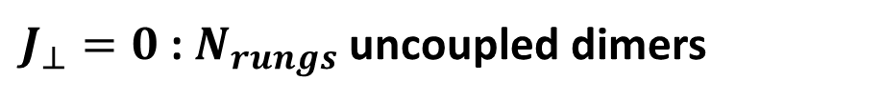
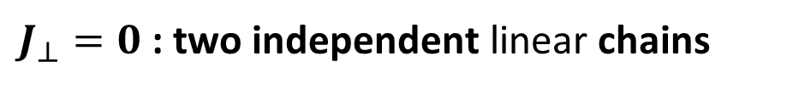
$J_{⊥}=0$ and $J_{∥}=0$
1
3
5
7
$J_{⊥}=0$ : two independent linear chains
0
2
4
6
1
3
5
7
$J_{⊥}=0$ : $N_{rungs}$ uncoupled dimers
0
2
4
6
Notes:
(->) Briefly present the two extremum cases

Slide 13
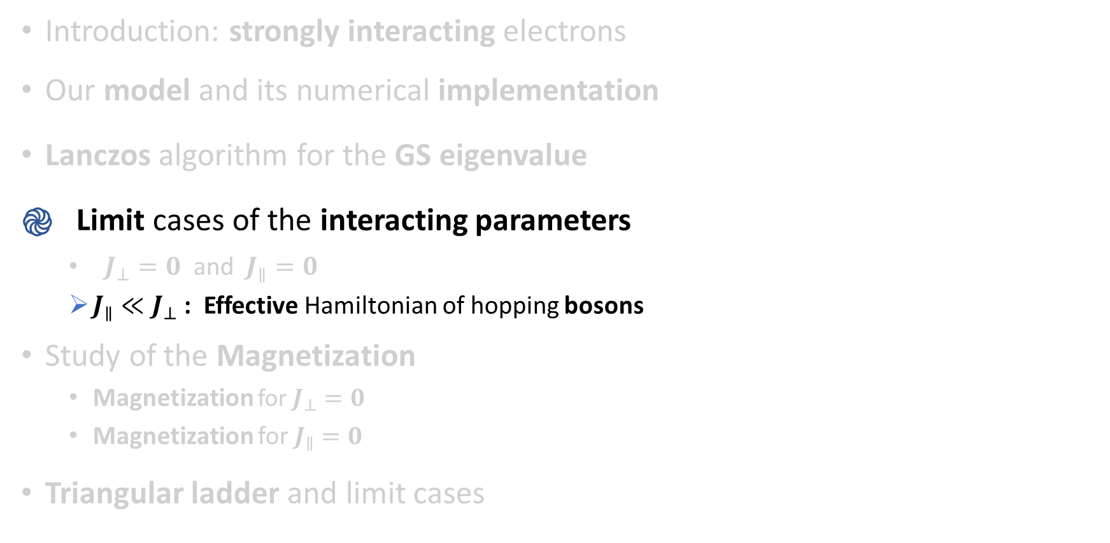
Introduction: strongly interacting electrons
Our model and its numerical implementation
Lanczos algorithm for the GS eigenvalue
Limit cases of the interacting parameters
$J_{⊥}=0$ and $J_{∥}=0$
$J_{∥}≪J_{⊥}$ : Effective Hamiltonian of hopping bosons
Study of the Magnetization
Magnetization for $J_{⊥}=0$
Magnetization for $J_{∥}=0$
Triangular ladder and limit cases

Slide 14
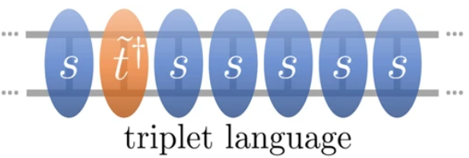
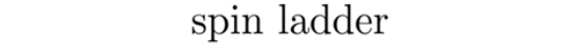
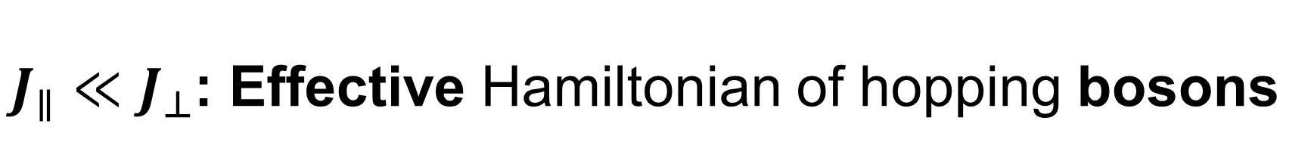
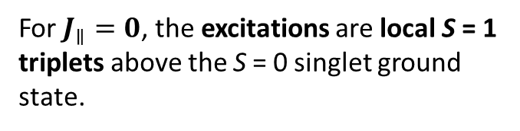
$J_{∥}≪J_{⊥}$: Effective Hamiltonian of hopping bosons
1
3
5
7
9
11
13
0
2
4
6
8
10
12
Credits: Gary Shmiedinghoff & all
For $J_{∥}=0$, the excitations are local S = 1 triplets above the S = 0 singlet ground state.
Notes:
(->) Let’s focus on the J||=0 case with uncoupled dimers.

Slide 15
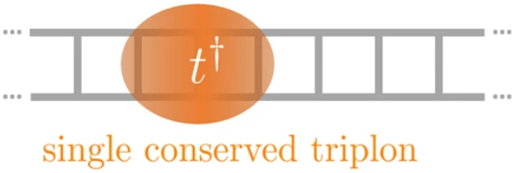
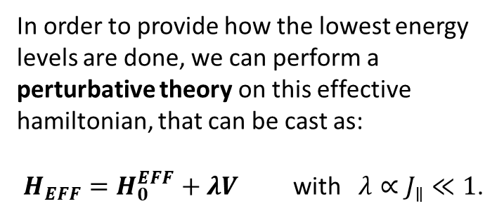
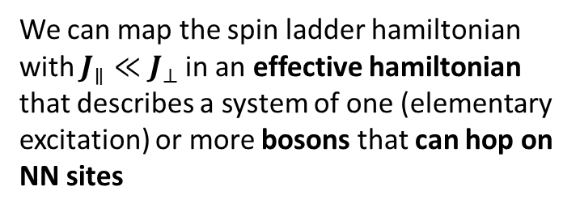
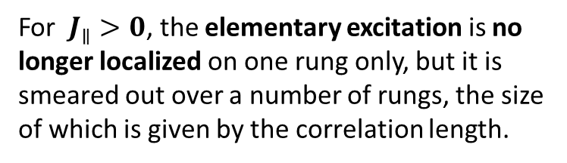
Effective Hamiltonian of hopping bosons
We can map the spin ladder hamiltonian with $J_{∥}≪J_{⊥}$in an effective hamiltonian that describes a system of one (elementary excitation) or more bosons that can hop on NN sites
Credits: Gary Shmiedinghoff & all
In order to provide how the lowest energy levels are done, we can perform a perturbative theory on this effective hamiltonian, that can be cast as:
$H_{EFF}=H_{0}^{EFF}+λV$ with $λ∝J_{∥}≪1$.
For $J_{∥}>0$, the elementary excitation is no longer localized on one rung only, but it is smeared out over a number of rungs, the size of which is given by the correlation length.
Notes:
(-> Oss after the image) We stress that the original triplets are not the appropriate elementary excitations because already in the ground state there is a non-zero number of them admixed. Hence, it does not make sense to refer to a one-, two- or three-triplet state since any eigen state comprises them. Instead, we have to use the elementary excitation resulting from Bogoliubov transformations.

Slide 16
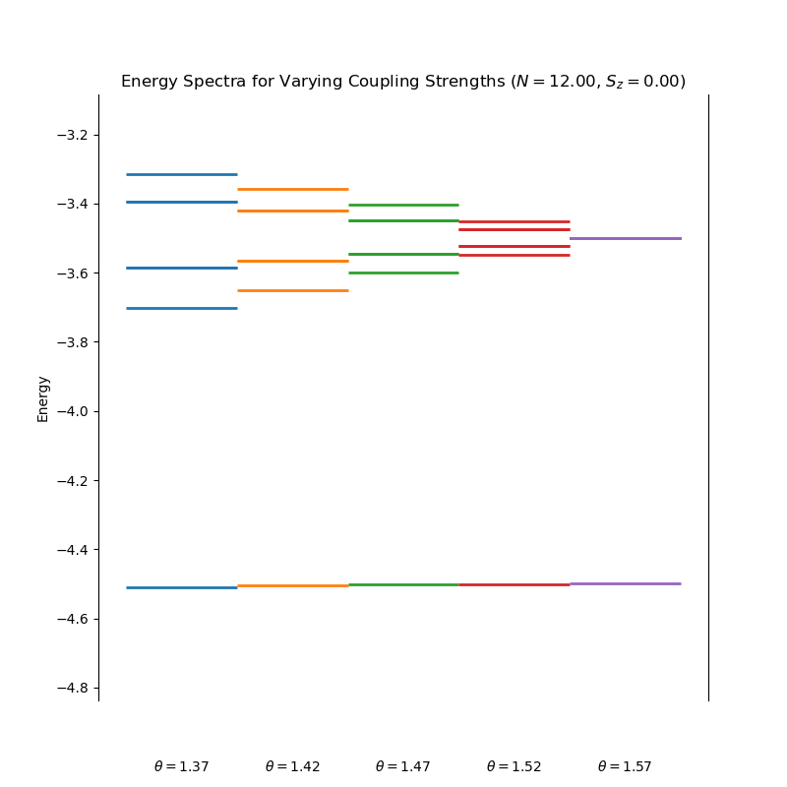

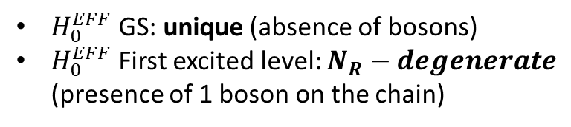
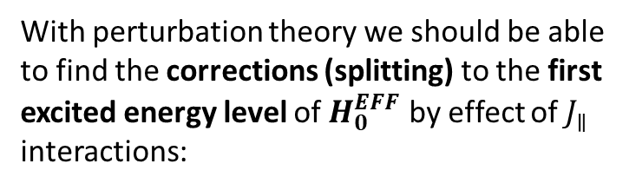
Effective Hamiltonian of hopping bosons
With perturbation theory we should be able to find the corrections (splitting) to the first excited energy level of $H_{0}^{EFF}$ by effect of $J_{∥}$ interactions:
$H_{0}^{EFF}$GS: unique (absence of bosons)
$H_{0}^{EFF}$First excited level: $N_{R}−degenerate$ (presence of 1 boson on the chain)
Introducing a perturbation $∝J_{∥}$ levels split
Notes:
(-> After the comment on pert. Theory) The fact that I don’t get a complete deceneracy-splitting is due to the invariance of k by reflection (k -> -k). This degeneracy cannot be broken by perturbation theory, unless a proper symmetry breaker is introduced (ex a magnetic field that act just at the extremi of the ladder with open boundary conditions).

Slide 17
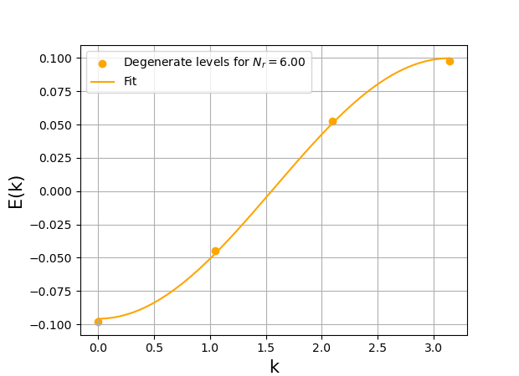
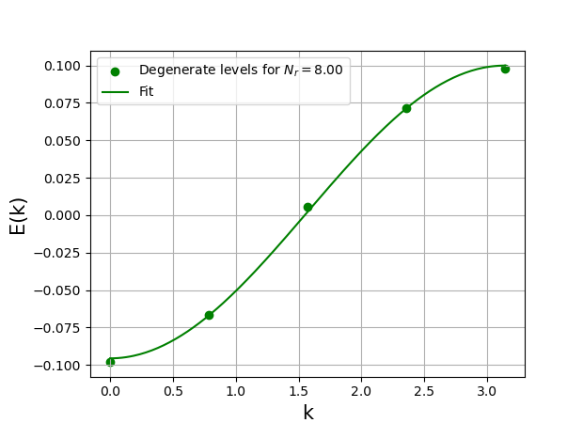
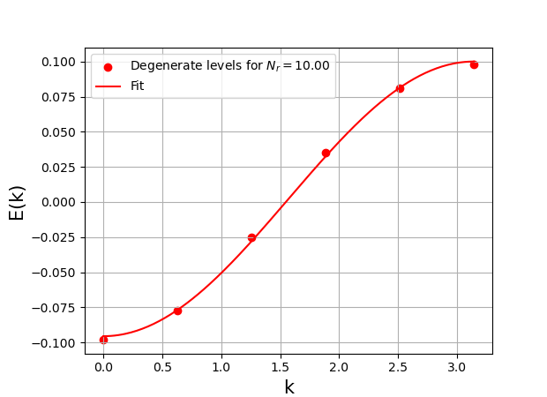
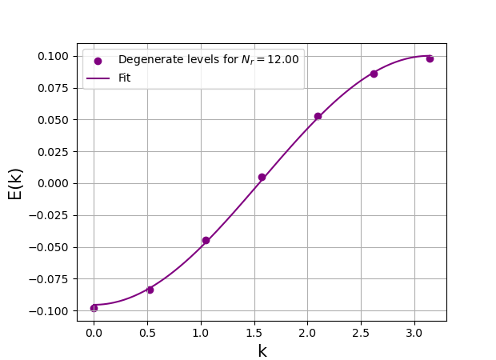
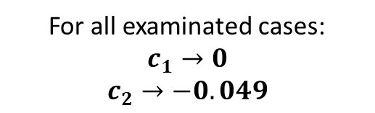
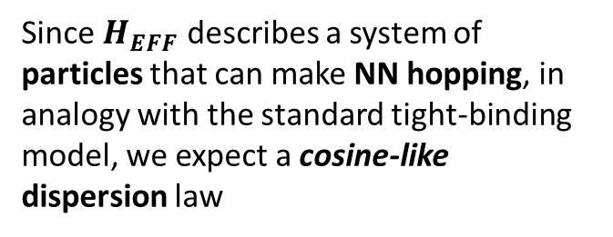
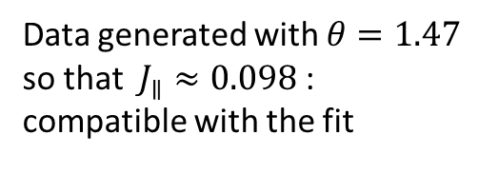

Effective Hamiltonian of hopping bosons
Since $H_{EFF}$ describes a system of particles that can make NN hopping, in analogy with the standard tight-binding model, we expect a cosine-like dispersion law
For all examinated cases:
$$c_{1}→0$$
$$c_{2}→−0.049$$
$$E\left(k\right)=2c_{2}\cos{k}∝J_{∥}\cos{k}$$
Data generated with $θ=1.47$ so that $J_{∥}≈0.098$ : compatible with the fit
Degenerate-lifted energy levels fit: $E\left(k\right)=c_{1}+2c_{2}\cos{k}$
Notes:
(-> with the plots) The fitted points are shifted so that their energy values are centered around the medium point E = 0.
The k values are built assigning to the lowest eigenvalue k=0, to the largest k=pi, and symmetric equispaced values for the remaining ones.
The fit gives something compatible with E(k) = -J*cos(k): the coefficient in front of the cosine gives the order of the coupling strength, which is here J|| = 1*cos(1.47) = 0.098.
(-> Fit results) {fit_6 = [0.002 +- 0.001, -0.049 +- 0.001], fit_8 = [0.002 +- 0.001, -0.049 +- 0.001], fit_10 = [0.002 +- 0.001, -0.049 +- 0.001], fit_12 = [0.002 +- 0.001, -0.049 +- 0.001]}

Slide 18
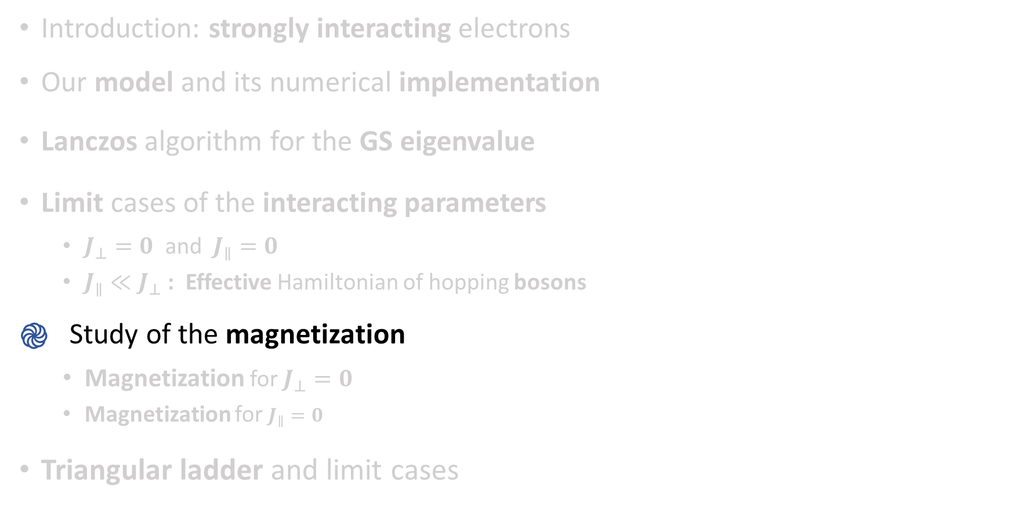
Introduction: strongly interacting electrons
Our model and its numerical implementation
Lanczos algorithm for the GS eigenvalue
Limit cases of the interacting parameters
$J_{⊥}=0$ and $J_{∥}=0$
$J_{∥}≪J_{⊥}$ : Effective Hamiltonian of hopping bosons
Study of the magnetization
Magnetization for $J_{⊥}=0$
Magnetization for $J_{∥}=0$
Triangular ladder and limit cases

Slide 19
Study of the magnetization
E
$$E_{0}(S=2)$$
h
$${\tilde{E}}_{0}\left(S=2, S_{z}=2\right)=E_{0}\left(S=2\right)−2h$$
$${\tilde{E}}_{0}\left(S=1, S_{z}=1\right)=E_{0}\left(S=0\right)−h$$
$$E_{0}(S=1)$$
$$E_{0}(S=0)$$
$${\tilde{E}}_{0}\left(S=0, S_{z}=0\right)=E_{0}\left(S=0\right)$$
m
1
0
$$h_{1}$$
$$h_{2}$$
h
Notes:
(->with the first set of animations) Remember how we calculate the magnetization for our ladder system. We then normalize to 1 by the maximum value. In order to gain a significative insight in the physical system described by a cerain model, a size scaling approach is ordinarly applied up to the highest manageble value: here, since the largest size that can be reached correspond to 24 sites, we don’t expect to get useful quantitative information, even though, at least, we should be able to make qualitative evaluation on the raw behaviour of the considered system.

Slide 20
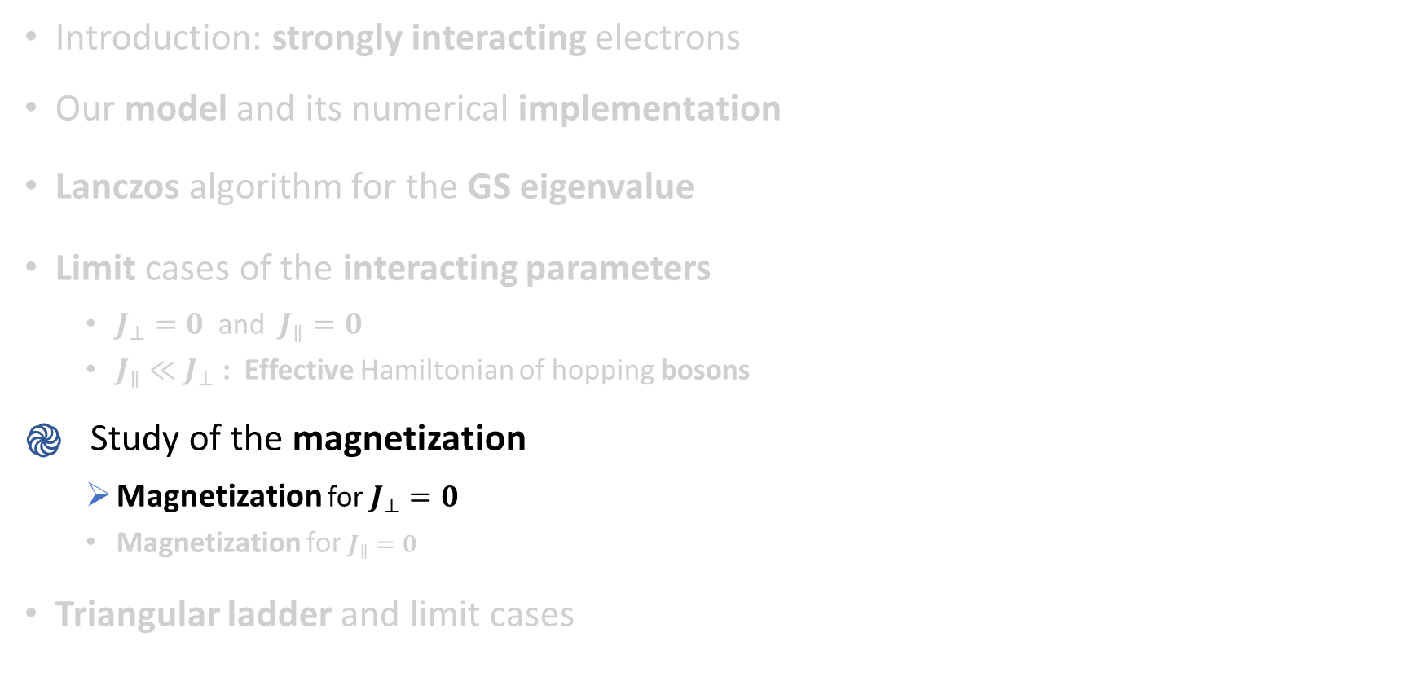
Introduction: strongly interacting electrons
Our model and its numerical implementation
Lanczos algorithm for the GS eigenvalue
Limit cases of the interacting parameters
$J_{⊥}=0$ and $J_{∥}=0$
$J_{∥}≪J_{⊥}$ : Effective Hamiltonian of hopping bosons
Study of the magnetization
Magnetization for $J_{⊥}=0$
Magnetization for $J_{∥}=0$
Triangular ladder and limit cases

Slide 21
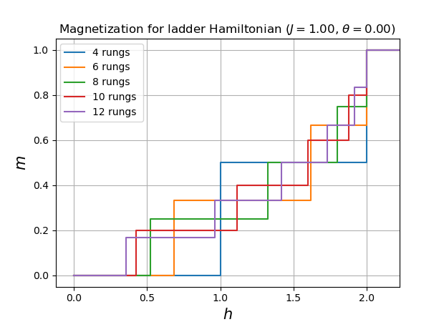

Magnetization for $J_{⊥}=0$
1
3
5
7
0
2
4
6
Notes:
(->) Comment on the plot

Slide 22
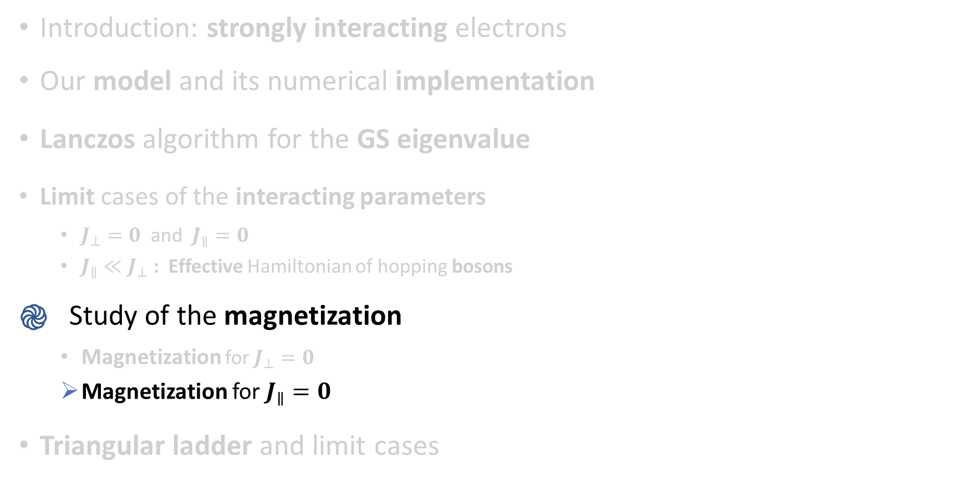
Introduction: strongly interacting electrons
Our model and its numerical implementation
Lanczos algorithm for the GS eigenvalue
Limit cases of the interacting parameters
$J_{⊥}=0$ and $J_{∥}=0$
$J_{∥}≪J_{⊥}$ : Effective Hamiltonian of hopping bosons
Study of the magnetization
Magnetization for $J_{⊥}=0$
Magnetization for $J_{∥}=0$
Triangular ladder and limit cases

Slide 23
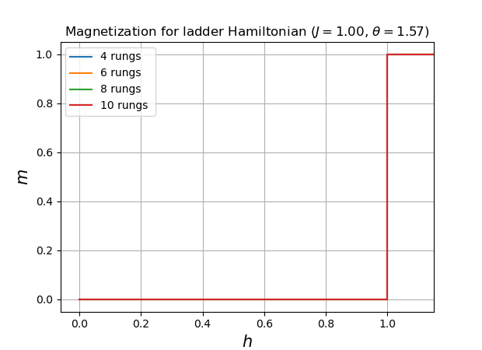

Magnetization for $J_{∥}=0$
1
3
5
7
0
2
4
6
Notes:
(->) Comment the plot

Slide 24
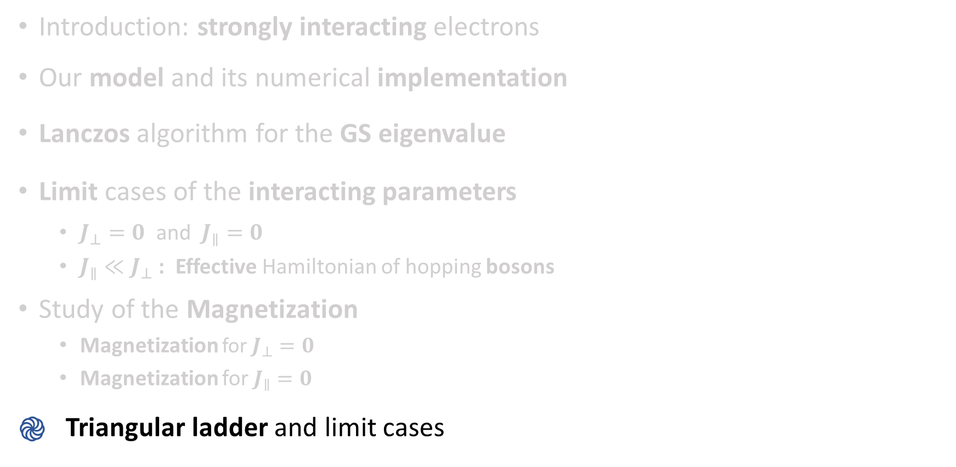
Introduction: strongly interacting electrons
Our model and its numerical implementation
Lanczos algorithm for the GS eigenvalue
Limit cases of the interacting parameters
$J_{⊥}=0$ and $J_{∥}=0$
$J_{∥}≪J_{⊥}$ : Effective Hamiltonian of hopping bosons
Study of the Magnetization
Magnetization for $J_{⊥}=0$
Magnetization for $J_{∥}=0$
Triangular ladder and limit cases

Slide 25
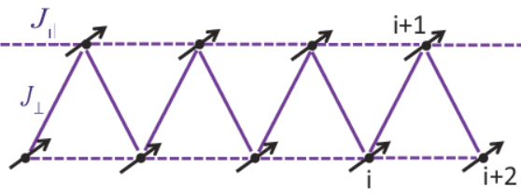
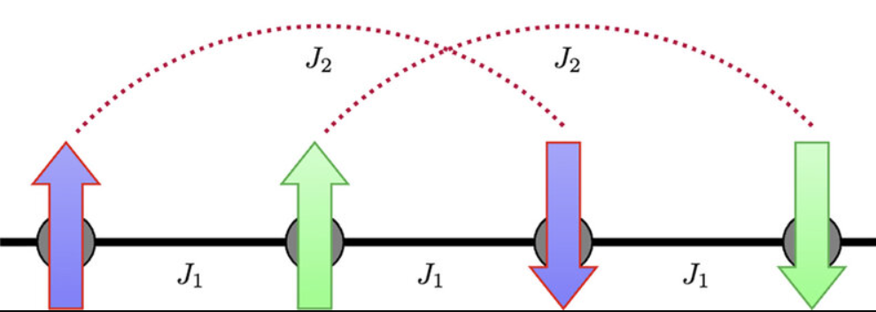
Triangular ladder and limit cases
Equivalent pictures of the simplest frustrated system in low dimension
Credits: Victoria Mazo (a), Talal Ahmed Chowdhury & all (b)
Notes:
(->With the images) In the absence of frustration, the nearest-neighbor interaction prefers the antiferromagnetic ordering. In contrast, the onset of next-nearest-neighbor interaction makes the system frustrated as it favors the antiparallel alignment of the nextnearest-neighboring spins, leading to a parallel combination between neighboring spin pairs.

Slide 26
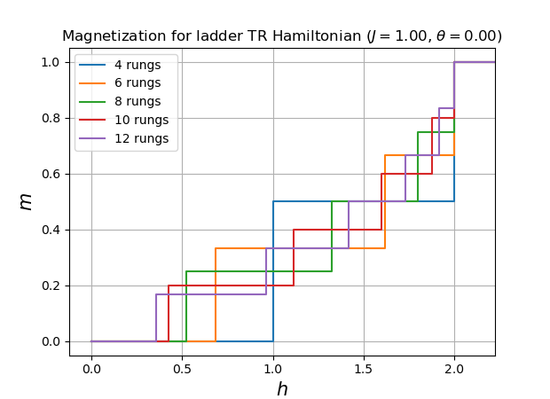
Magnetization for $J_{⊥}=0$
1
3
5
7
0
2
4
6
Notes:
(->) In the TR ladder for J_|_=0 we get two separate linear chains each of length Nrungs

Slide 27
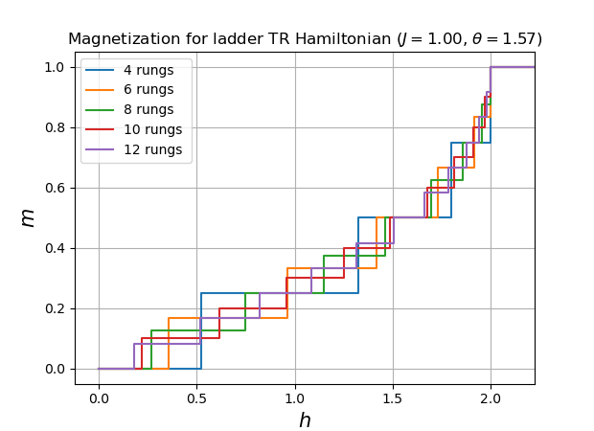
Magnetization for $J_{∥}=0$
1
3
5
7
0
2
4
6
Notes:
(->) In the TR ladder for J||=0 we get a single linear chain of length N

Slide 28
Conclusions
Notes:
With this little project I put in practice the basic formalism used to describe solid state systems studied throughout the course, along with a practical implementation of the simplest (hamiltonian) diagonalization techniques employed in computational physics. Furthermore, foundations have been laid for a possible investigation (already present in literature) of more complex models with rather immediate consequences in the study of strongly interacting electron systems, such as superconductors.

Slide 29



Introduction: strongly interacting electrons
Generic Hamiltonian of a solid state system in $2^{ND}$quantization (no ion-ion interaction here):
$$H=\sum_{i,j=1}^{N}{\sum_{σ}{T_{i,j}c_{i,σ}^{†}c_{i,σ}+\frac{1}{2}\sum_{i,j,i^{′},j^{′}}{\sum_{σ,τ,σ^{′},τ^{′}}{U_{i,j,i^{′},j^{′}}^{σ,τ,σ^{′},τ^{′}}c_{i,σ}^{†}c_{i^{′},σ^{′}}^{†}c_{j,τ}}}c_{j^{′},τ^{′}}}}$$
electron-electron interaction
Just a SINGLE ORBITAL on each lattice site (spatial part in the Wannier orbital basis )
Only NEAREST-NEIGHBOUR (short-ranged) HOPPING terms
SHORT-RANGE approximation of COULOMB INTERACTION (on site repulsion of electrons)
Hubbard Hamiltonian
Hubbard model approx.:
$$H=−T\sum_{<i,j>}{\sum_{σ}{{(c}_{i,σ}^{†}c_{j,σ}+h.c. )+ U\sum_{i}{n_{i,↑}n_{i,↓}}}}$$
Notes:
(->Formula with orange dotted term) In order to account for a series of experimental observations on the magnetic properties of solids, one must drop the assumption according to which the sources of magnetic moments do not interact one another. In fact, in solids known as antiferromagnets, although the net total moment in absence of field is zero, there is a regular spatial pattern of the individual magnetic moments due to interactions among them favoring antiparallel orientations of neighbouring moments.The theory on the origin of magnetic interactions plays a key role in condensed matter physics, and while the phenomenon is best understood in insulators where the magnetic moments can be considered well separated, the developement of a tractable model of a magnetic metal remains a great unsolved problem.
(->Hubbard approx.) Hubbard proposed an highly oversimplified model that contains the bare minimum features necessary to yield both bandlike and localized behaviours of solids in suitable limits. It assumes that on each lattice site there is only one single orbital occupied, whose spatial component can be written in a Wannier orbital basis. The hamiltonian is composed of two terms: a kinetic term due to tunnelling (hopping) of particles among the neighbour lattice sites, and a in-sito potential term that approximates in a raw way the short range electron repulsion.
(->P.S.) Besides giving a more accurate description than the non-interacting electrons models, Hubbard model can describe as well Mott insulators. These represent a particular class of metals that are indeed insulators because of the effects of the non-negligible interactions among electrons. For such materials conventional band theory predicts a conductive metal-like behaviour, though experimental results show the opposite: in fact, this effect is due to electron-electron interaction that is not taken into consideration by standard band theory.
(->P.S. 2) Taking a single spin chain as example (with n=N/L=1), in the limit of infinite interatomic distances, or equivalently for $T=0$, it becomes an ensemble of isolated magnetic moments (Mott charge insulator). When the atoms are brought a little closer (i.e. small but non-zero hopping term), the model still corresponds to an insulator, but now can describe the effect of magnetic correlation (through Coulomb electrostatic interactions) that result in phenomena such as the antiferromagnetism.

Slide 30




Introduction: strongly interacting electrons
Focus on $0$-temperature case with:
$S=1/2$ fermions
Half filling
Low-energy limit $T/U≪1$
Heisenberg effective hamiltonian
$$H=J\sum_{<i,j>}{{\overset{⃑}{S}}_{i}⋅{\overset{⃑}{S}}_{j}}=J\sum_{<i,j>}{S_{i}^{z}S_{j}^{z}}+\frac{J}{2}\sum_{<i,j>}{{(S}_{i}^{+}S_{j}^{−}+} S_{i}^{−}S_{j}^{+}\text{)}$$
For the AFM model $J=\left|J\right|=\frac{4T^{2}}{U}>0$
Notes:
(->Before anything else) When both terms are present in the Hubbard hamiltonian, even in the simplest configurations the model has proved too difficult for exact analysis, although much interesting properties has been exctracted in special cases. If, for example the total number of electrons is equal to the total number of sites (n=N/L=1) then: In the limit of neglible intrasite repulsion (U<<T) one has an ordinary half-filled metallic band; In the opposite limit (U>>T), one can derive an antiferromagnetic spin model to describe the low-lying excitations (‘Heisemberg’ hamiltonian, J=4t2/u). No one, however, has yet given rigorous solution to the transition from a non magnetic metal to an antiferromagnetic insulator as t/u is varied within this model!
(->After the Heisemberg H) Differently from the ferromagnetism, typical antiferromagnetic systems (where the interactions between magnetic moments is such as to tent to realize a configuration of minimal energy when the spins are anti-parallel) can bring to several minimum energy configurations so that the ground state is not well defined even in the very simple case of a linear chain!

