Slide 1
Momentum Crashes
and Volatility Targeting
Does risk scaling protect momentum without the dangers of leverage?
Evidence from the S&P 500 and STOXX Europe 600
Davide Francesco Caramia (882108)
d.caramia@campus.unimib.it
Final Project · Financial Markets Analytics · A.Y. 2025–2026
Financial Markets Analytics

Slide 2
MOTIVATION
Research question
Can volatility targeting reduce the crash risk of cross-sectional momentum — and when can leverage make sudden momentum crashes worse?
1. Baseline
2. Risk scaling
3. Crash mechanism
Build a standard 12–1 cross-sectional momentum strategy.
Apply volatility targeting without changing the momentum signal.
Study whether high past volatility protects and low past volatility creates leverage risk.
Main hypothesis
Volatility targeting improves momentum mainly by reducing drawdowns and volatility drag. However, Standard VT can amplify sudden crashes when it enters them with leveraged exposure.
Research design

Slide 3
BACKTEST SETUP
Data and portfolio construction
Universe
S&P 500
STOXX 600
Investable universe is defined with historical index weights, not just price availability.
Price panel
336 months · 1,355 securities
192 months · 1,255 securities
This reduces survivorship and look-ahead problems: a stock is considered eligible only when it was actually part of the index at the relevant time.
Sample
Dec 1990 – Nov 2018
Dec 2002 – Nov 2018
Avg. active names
~501
~600
Historical
prices
→
Weights
& membership
→
12–1 momentum
signal
→
Top 10% long
Bottom 10% short
→
Long–short
returns
Monthly rebalancing · top/bottom 10% · equal weights · long-short portfolio
Methodology

Slide 4
DATA PREPARATION
Preparing data to avoid look-ahead and survivorship bias
Price availability alone is not enough to define the investable universe.
We combine prices with historical index weights and lag membership by one month, so the strategy uses only information available at the decision date.
1
Load raw Excel sheets
Price panel + Peso weights
2
Clean and align identifiers
dates, tickers, numeric values
3
Reconstruct active universe
historical membership, not price availability
Active constituent at time t
wᵢ,ₜ > 0
4
Lag information by one month
decision at t uses membership from t−1
5
Apply eligibility filter
active through the 12–1 lookback window
Output: returns are computed only for securities investable at the decision date.
Data preparation

Slide 5
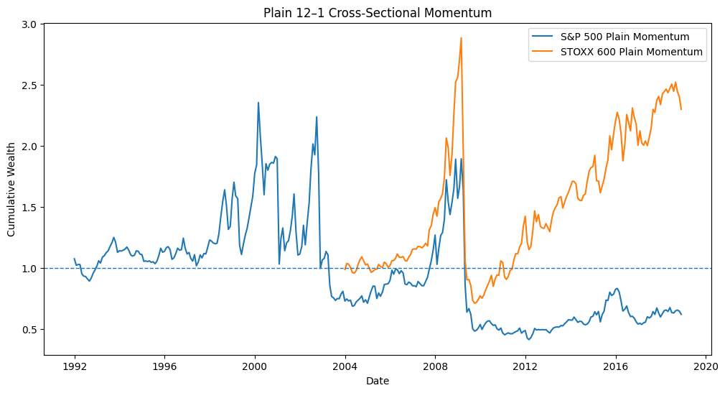
PROBLEM
Plain momentum has severe crash risk
−82.47%
−75.36%
S&P 500 max drawdown
STOXX 600 max drawdown
−1.53%
6.23%
S&P 500 plain CAGR
STOXX 600 plain CAGR
The baseline (plain momentum strategy) is not simply volatile: it can lose most of its value from a previous peak. This motivates a risk-management extension.
Baseline risk

Slide 6
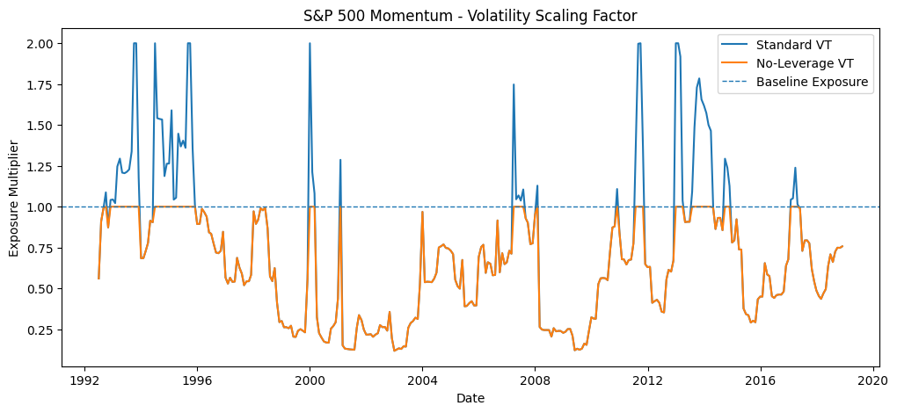
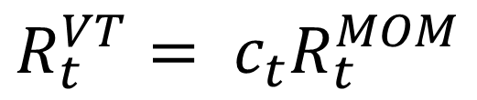
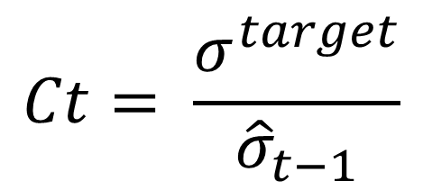
FRAMEWORK
Volatility targeting changes exposure, not the signal
The same winner and loser portfolios are kept. Only the overall exposure multiplier changes through time.
$$Ct= \frac{σ^{target}}{{\hat{σ}}_{t−1}}$$
$$R_{t}^{VT}= c_{t}R_{t}^{MOM}$$
Specification
Cap
Meaning
Standard VT
2.0×
Can reduce or increase exposure
No-Leverage VT
1.0×
Can only reduce or maintain exposure
The one-month lag is essential: exposure in month t uses volatility known up to t−1.
Risk scaling

Slide 7
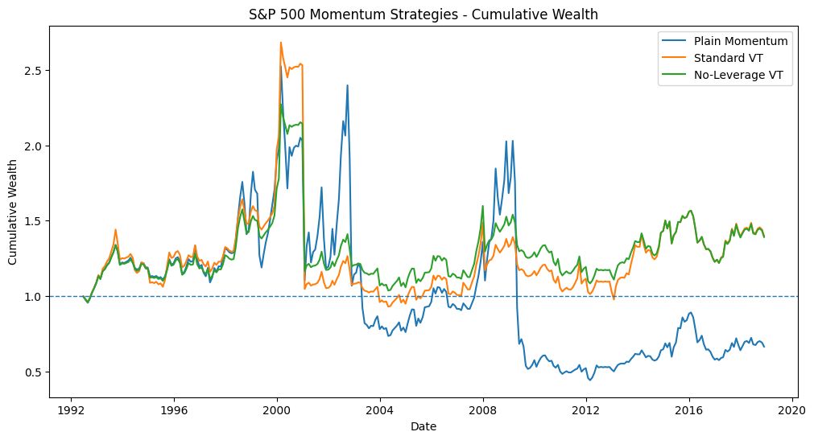
RESULTS
S&P 500: risk improves, but leverage creates a tail event
Strategy
CAGR
Vol.
Sharpe
Max DD
Worst 1M
Plain
−1.53%
28.79%
0.11
−82.47%
−47.30%
Standard VT
1.27%
18.79%
0.18
−65.31%
−58.62%
No-Leverage VT
1.25%
15.81%
0.17
−54.36%
−45.56%
VT lowers volatility and drawdowns. However, Standard VT has the worst single month because leverage amplified a sudden crash.
−58.62%
Standard VT worst month
Main results

Slide 8
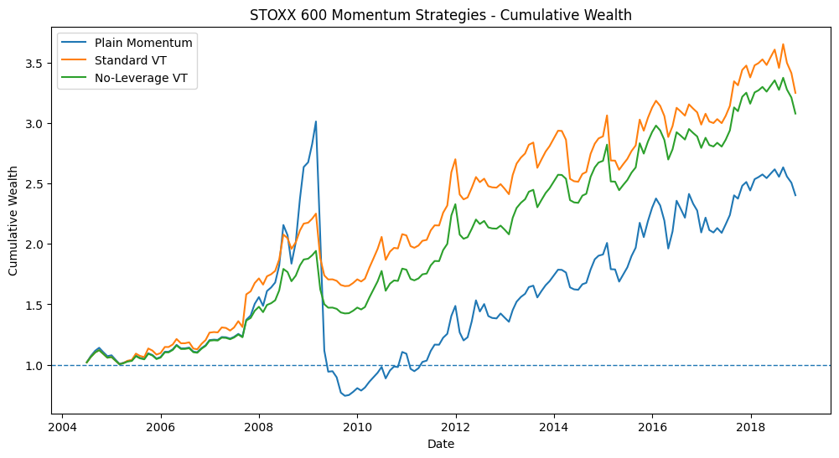
RESULTS
STOXX 600: volatility targeting is strongly effective
Strategy
CAGR
Vol.
Sharpe
Max DD
Worst 1M
Plain
6.23%
23.92%
0.39
−75.36%
−45.67%
Standard VT
8.47%
14.00%
0.65
−26.66%
−16.40%
No-Leverage VT
8.06%
12.41%
0.69
−26.66%
−16.40%
In Europe, risk scaling improves both compound growth and risk-adjusted performance. The no-leverage version is the most defensive by volatility and Sharpe.
−26.66%
VT max drawdown
Main results

Slide 9
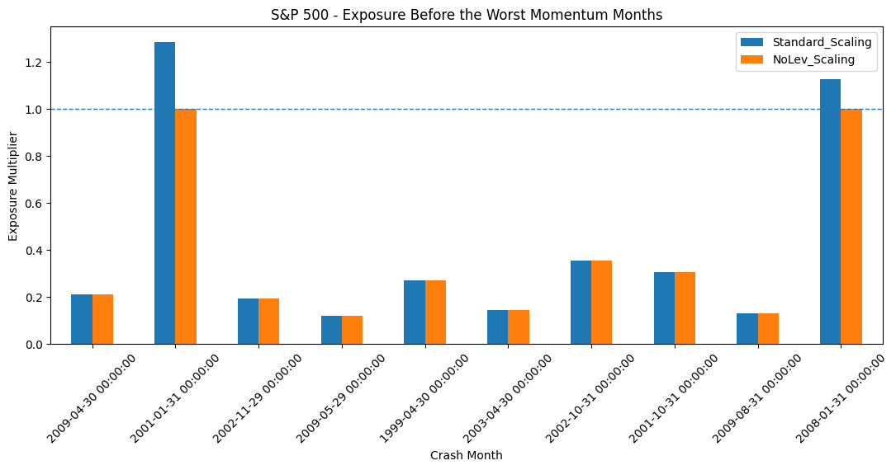
MECHANISM
When VT protects vs when leverage hurts
The crash analysis compares the same plain-momentum crash months across all strategies.
S&P 500 episode
Forecast vol.
Scaling
Plain
Standard VT
Meaning
Apr 2009
47.43%
0.21×
−47.30%
−9.97%
Risk already visible → exposure reduced
Jan 2001
7.77%
1.29×
−45.56%
−58.62%
Calm past → leverage amplifies crash
Key insight
Volatility targeting is backward-looking. It protects when risk has already risen, but can be dangerous when low past volatility justifies leverage before an unexpected crash.
Crash anatomy

Slide 10
ECONOMIC SOURCE
Momentum crashes are mostly loser rebounds
Momentum return = winners − losers. If past losers rebound sharply, the short leg loses heavily.
9 / 10
10 / 10
S&P worst months dominated by loser rebounds
STOXX worst months dominated by loser rebounds
Example
Winners
Losers
Plain momentum
Interpretation
S&P Apr 2009
+0.86%
+48.17%
−47.30%
Winners did not collapse; losers exploded upward
STOXX Apr 2009
+3.24%
+48.91%
−45.67%
Crash driven almost entirely by short leg
This changes the interpretation: the main tail risk is often not weak winners, but violent recoveries of the stocks held short.
Crash anatomy

Slide 11
PARAMETER SENSITIVITY
Robustness: 12-month window is more stable
We test volatility windows of 3, 6 and 12 months and targets of 8%, 10% and 12%. The goal is not ex-post optimization, but qualitative stability.
S&P Standard VT
Sharpe
Max DD
Worst 1M
Interpretation
3m / 12%
0.19
−84.28%
−76.60%
short window + high target creates tail risk
6m / 10%
0.18
−65.31%
−58.62%
baseline
12m / 10%
0.30
−33.71%
−12.62%
smoother volatility estimate
Finding
The 12-month window produces smoother risk estimates and smaller drawdowns in this sample. We still keep 6m/10% as the pre-defined baseline to avoid choosing parameters after seeing the results.
Robustness

Slide 12
PRACTICAL RELEVANCE
Costs and benchmark context matter
Transaction costs reduce compound performance, especially when the strategy trades a large notional every month.
CAGR after costs
0 bps
10 bps
20 bps
Benchmark
CAGR
Vol.
Sharpe
Max DD
S&P Standard VT
1.27%
0.09%
−1.08%
S&P 500 Index
7.41%
13.98%
0.58
−52.56%
S&P No-Lev VT
1.25%
0.29%
−0.67%
STOXX 600 Index
2.86%
13.69%
0.28
−56.41%
STOXX Standard VT
8.47%
7.08%
5.71%
STOXX No-Lev VT
8.06%
6.92%
5.80%
STOXX VT range
8.06–8.47%
12–14%
0.65–0.69
−26.66%
S&P: the index dominates the momentum strategies in this sample.
Europe: volatility-targeted momentum is economically stronger than the STOXX index.
The strategy is therefore not universally attractive; its usefulness is market- and sample-dependent.
Implementation

Slide 13
TAKEAWAYS
Conclusion and limitations
What we learned
Limitations
1
Volatility targeting substantially improves the risk profile of momentum.
• Results are historical and sample-specific
• Costs are simplified and exclude borrow fees, market impact and taxes
• Volatility forecasts are backward-looking
• Factor-adjusted alpha is not the focus
Lower volatility, shallower drawdowns and better compounding.
2
The main crash mechanism is loser rebound.
Past losers can rally violently, hurting the short leg.
3
Leverage is the main extra danger.
When past volatility is low, Standard VT may enter a crash overexposed.
4
No-Leverage is more defensive.
It removes the amplification mechanism, but gives up some upside exposure.
Final message
VT is valuable mainly as risk management — but its design matters. Risk scaling without additional leverage is more consistent with crash protection.
Conclusion

