Slide 1


Slide 2
Our Team
We are six students who attend the third year of Computer Science
These years have trained us on many useful aspects that allow us to develop this project in an optimal way
Ux and UI - Tiziano Colagrossi and Lucian Medrihan (mockup)
Backend - Michele Dilollo and Riccardo Pagliuca (architectural studies)
Frontend - Davide Brian Dicampi and Marco Collalti (data form analysis)

Slide 3
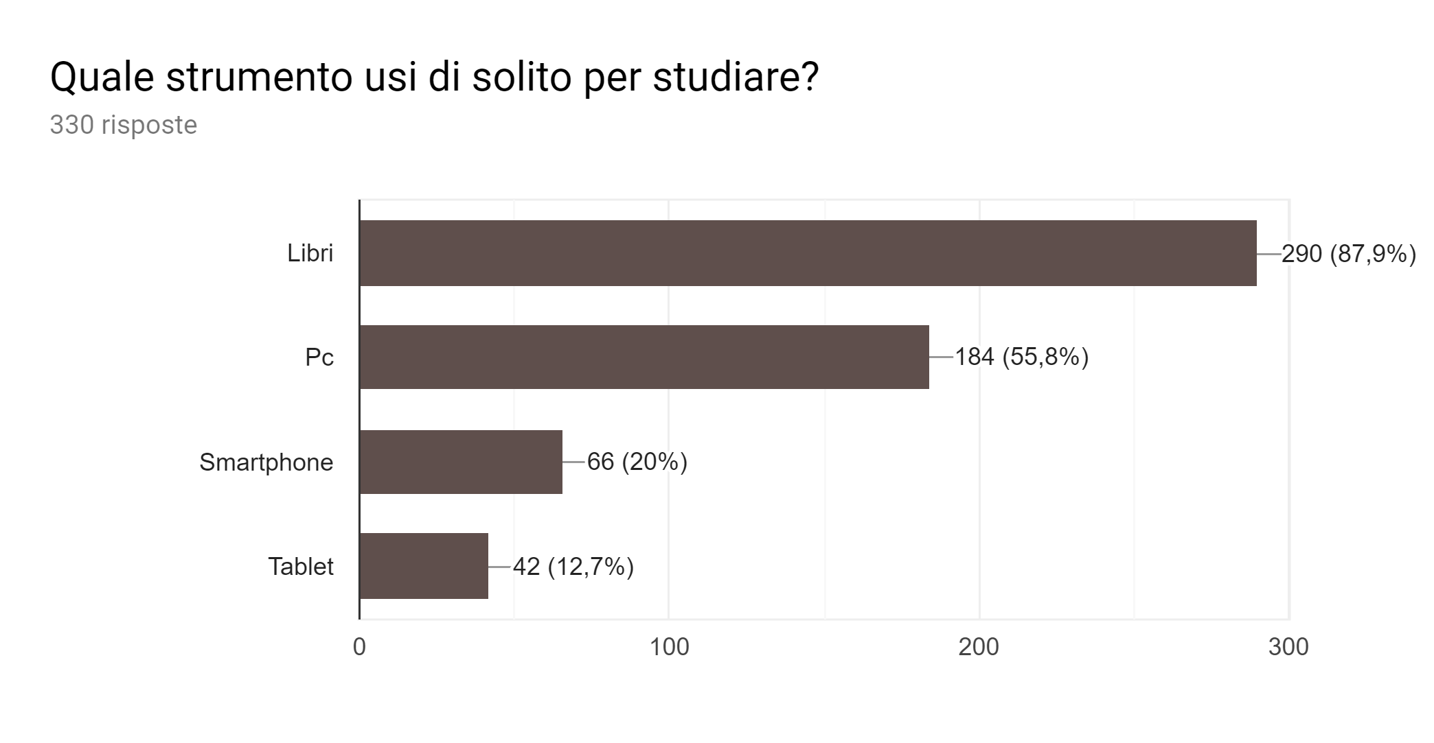
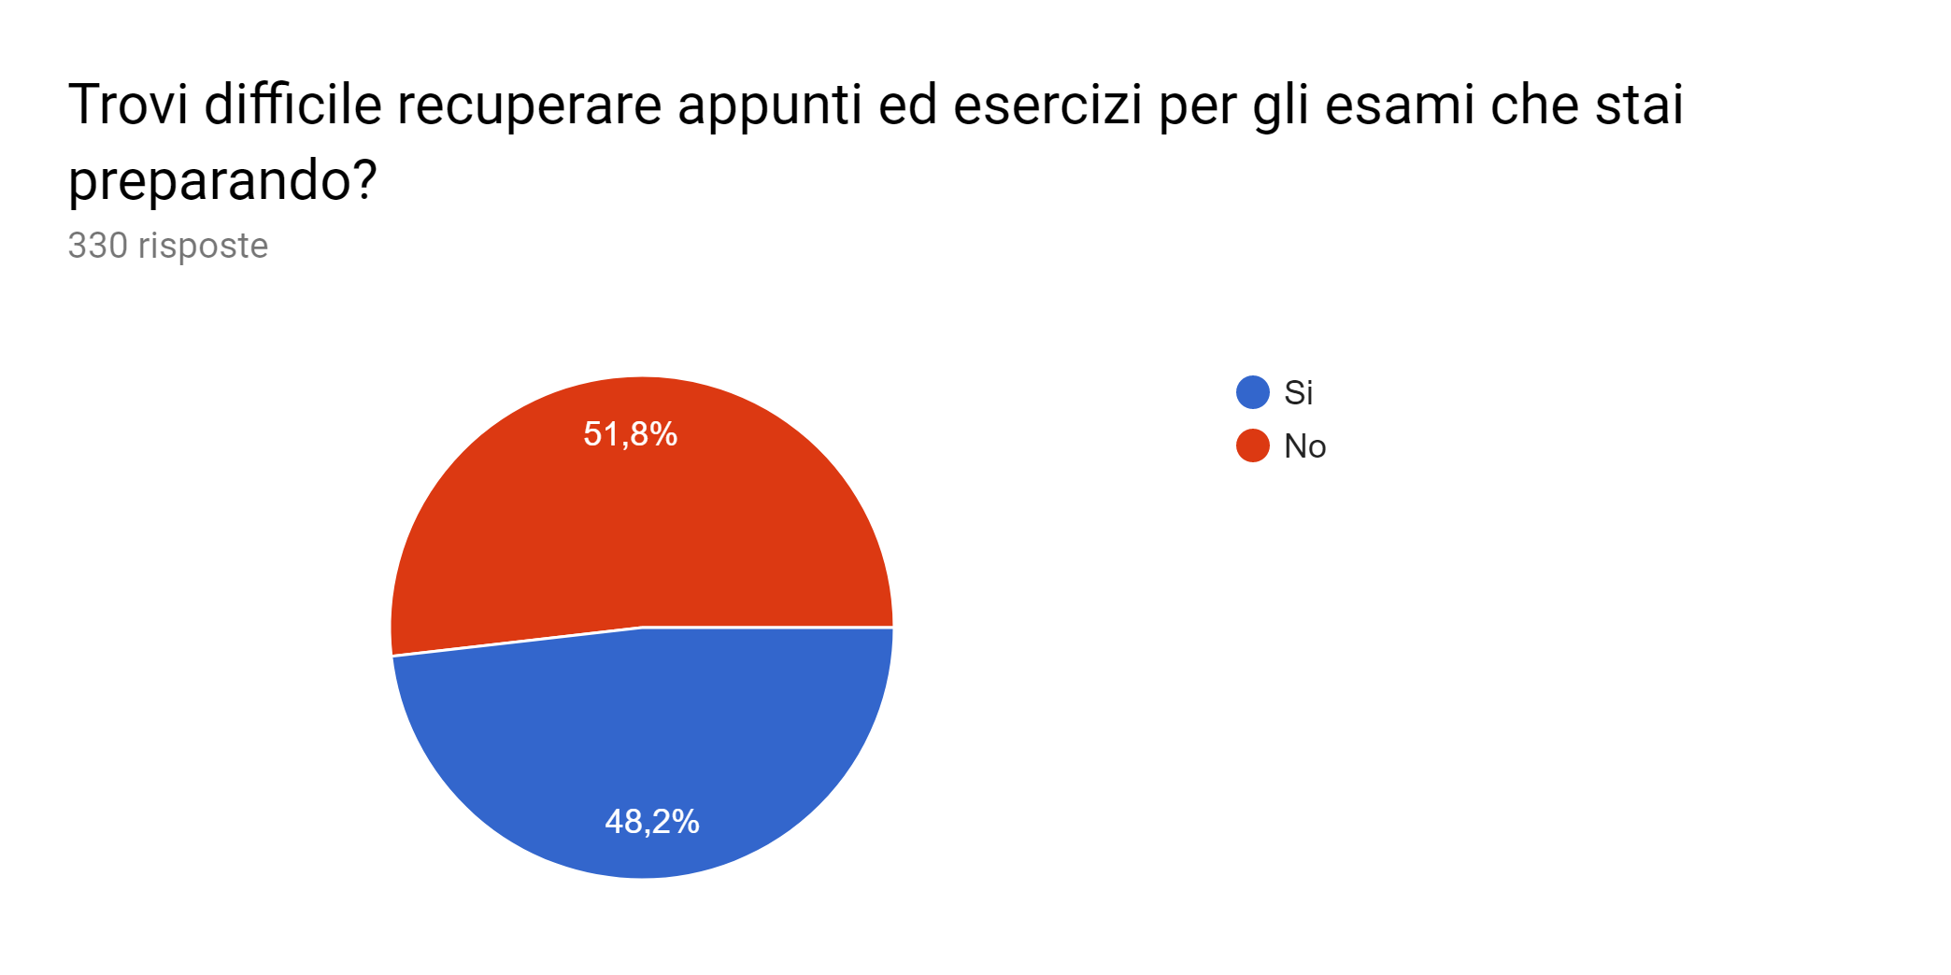
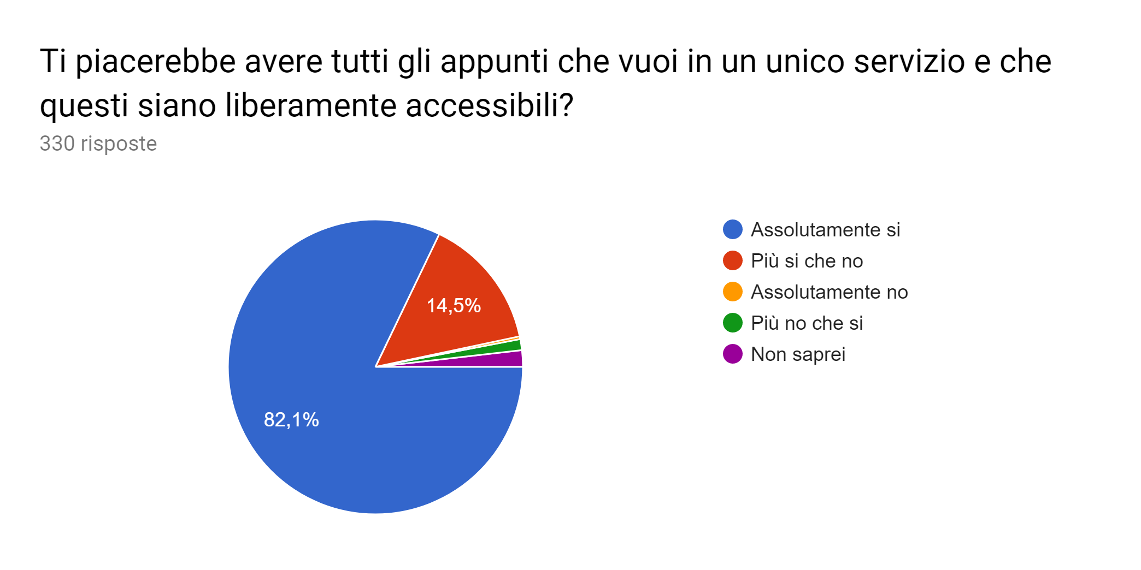
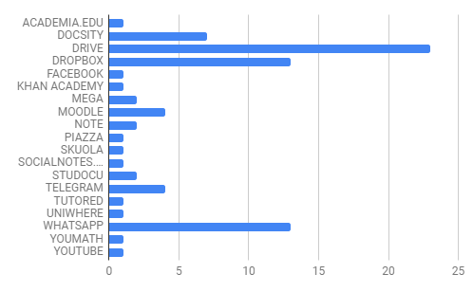
Data analysis
Conosci servizi simili?

Slide 4
Needs
We are all students and for this reason we have noticed that is very difficult for someone to find notes to prepare exams or in somehow well written notes. Some service offer notes, but sometimes are not organized in the best way

Slide 5
Target
Our target - university students between 19 and 25 years old
We deployed a form with a series of questions to collect different points of view from our future users. After analyzing the answers, we changed our first ideas and adapted basing on the opinion of interviewed people

Slide 6
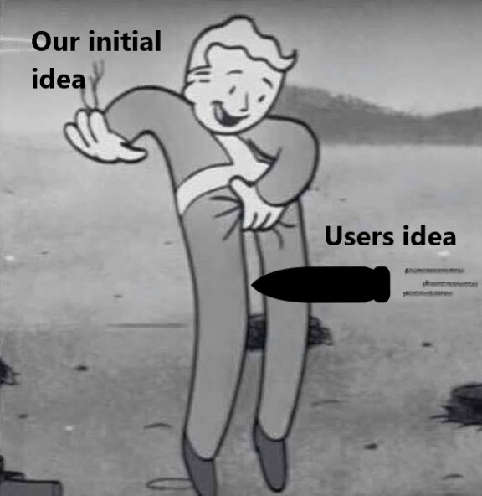
Possible solution

Slide 7
...ok really
We can offer a completely free service with good system of search, also only a part of a document and an optimized organization of notes
Everyone can find notes also from other University
Will be implemented a system of evaluation of notes, in this way you can choose the best notes from other users, mashup your favorite notes.

Slide 8

Main features SEE WIKI
Mashup of notes to guarantee the best quality of notes for everyone
Efficient indexing of notes
Automatic management of tags

Slide 9
Contacts
Email - univercitystats@gmail.com
GitHub - https://github.com/davidedc97/UniverCity.git

