Slide 1
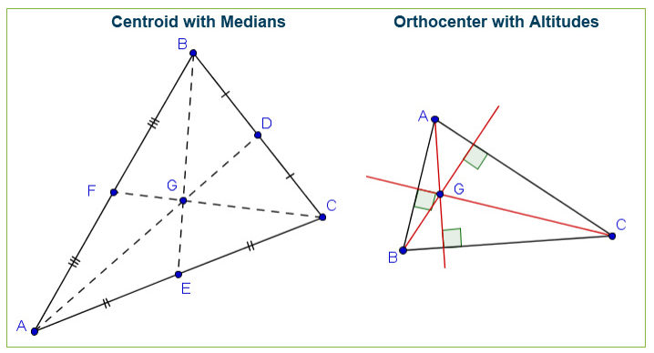
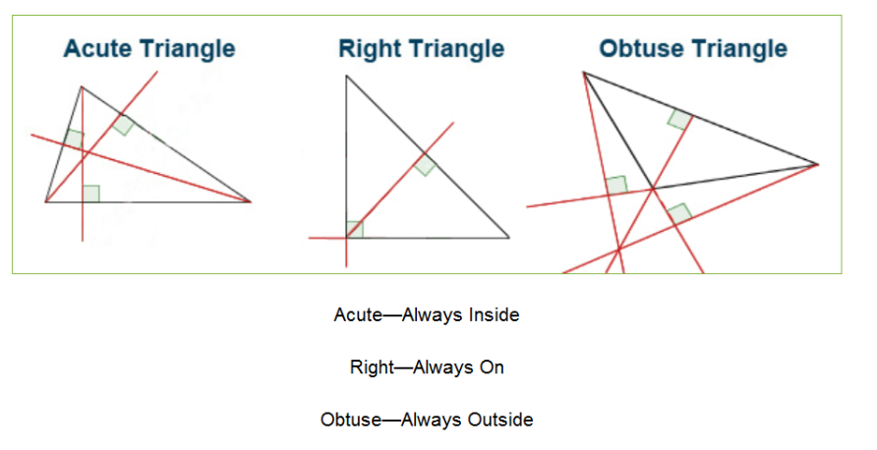
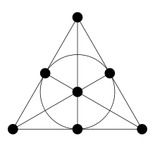
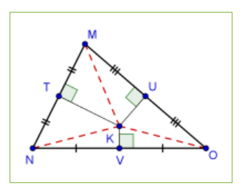
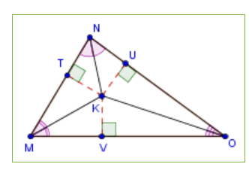
Triangle Concurrency
Mrs. Wedgwood

Slide 2
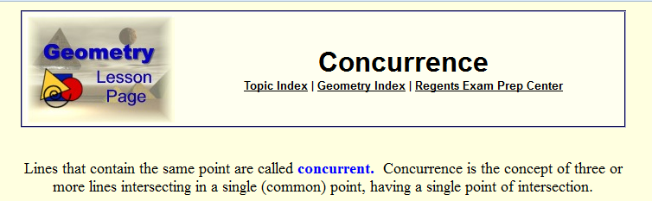
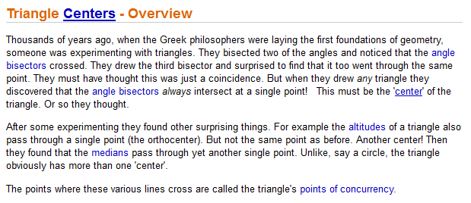

Slide 3

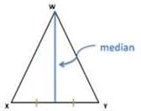
Triangle Constructions
Point of Concurrency
Altitude
Angle Bisector
Median
Perpendicular Bisector

Slide 4
Triangle Constructions
Point of Concurrency
Altitude
Angle Bisector
Median
Perpendicular Bisector
Construction | Start | Stop | Do | See | Concurrency
A
B
M
P

Slide 5
Triangle Constructions
Point of Concurrency
Altitude
Angle Bisector
Median
Perpendicular Bisector
Construction | Start | Stop | Do | See | Concurrency
Altitude
Angle Bisector
Median
Perpendicular Bisector

Slide 6
Triangle Constructions
Point of Concurrency
Altitude
Angle Bisector
Median
Perpendicular Bisector
Construction | Start | Stop | Do | See | Concurrency
Altitude |  |  |  |  | O
Angle Bisector |  |  |  |  | I
Median |  |  |  |  | C
Perpendicular Bisector |  |  |  |  | C

Slide 7
Triangle Constructions
Point of Concurrency
Altitude
Angle Bisector
Median
Perpendicular Bisector
Construction | Start | Stop | Do | See | Concurrency
Altitude |  |  |  |  | Orthocenter
Angle Bisector |  |  |  |  | Incenter
Median |  |  |  |  | Centroid
Perpendicular Bisector |  |  |  |  | Circumcenter

Slide 8
Triangle Constructions
Point of Concurrency
Altitude
Angle Bisector
Median
Perpendicular Bisector
Construction | Start | Stop | Do | See | Concurrency
Altitude | vertex | opposite side | forms 90° angles | 3 right angle boxes | Orthocenter
Angle Bisector |  |  |  |  | Incenter
Median |  |  |  |  | Centroid
Perpendicular Bisector |  |  |  |  | Circumcenter

Slide 9
Triangle Constructions
Point of Concurrency
Altitude
Angle Bisector
Median
Perpendicular Bisector
Construction | Start | Stop | Do | See | Concurrency
Altitude | vertex | opposite side | forms 90° angles | 3 right angle boxes | Orthocenter
Angle Bisector | vertex | opposite side | bisects the angle of origin creates two smaller triangles of equal area | 3 pairs of angle congruence marks | Incenter
Median |  |  |  |  | Centroid
Perpendicular Bisector |  |  |  |  | Circumcenter

Slide 10
Triangle Constructions
Point of Concurrency
Altitude
Angle Bisector
Median
Perpendicular Bisector
Construction | Start | Stop | Do | See | Concurrency
Altitude | vertex | opposite side | forms 90° angles | 3 right angle boxes | Orthocenter
Angle Bisector | vertex | opposite side | bisects the angle of origin creates two smaller triangles of equal area | 3 pairs of angle congruence marks | Incenter
Median | vertex | midpoint of opposite side | bisects the opposite side | 3 pairs of side-by-side side congruence marks | Centroid
Perpendicular Bisector |  |  |  |  | Circumcenter

Slide 11
Triangle Constructions
Point of Concurrency
Altitude
Angle Bisector
Median
Perpendicular Bisector
Construction | Start | Stop | Do | See | Concurrency
Altitude | vertex | opposite side | forms 90° angles | 3 right angle boxes | Orthocenter
Angle Bisector | vertex | opposite side | bisects the angle of origin creates two smaller triangles of equal area | 3 pairs of angle congruence marks | Incenter
Median | vertex | midpoint of opposite side | bisects the opposite side | 3 pairs of side-by-side side congruence marks | Centroid
Perpendicular Bisector | n/a | midpoint of opposite side | forms 90° angles and bisects the opposite side | 3 right angle boxes and 3 pairs of side-by-side side congruence marks | Circumcenter

Slide 12
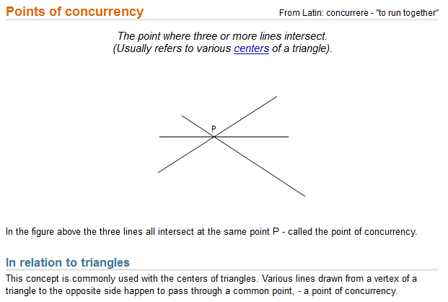

Slide 13
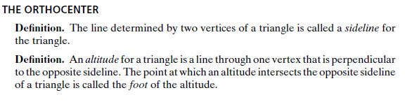
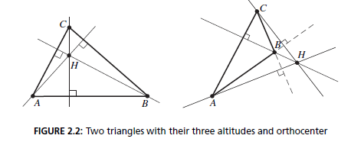
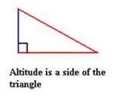
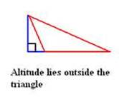

Slide 14
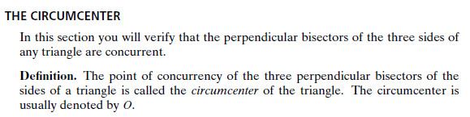
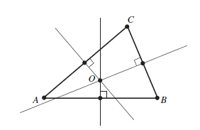

Slide 15

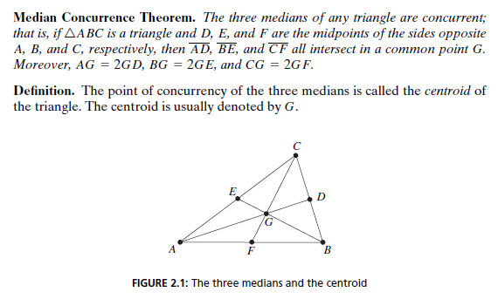
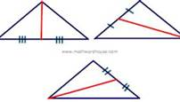
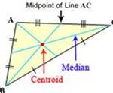

Slide 16
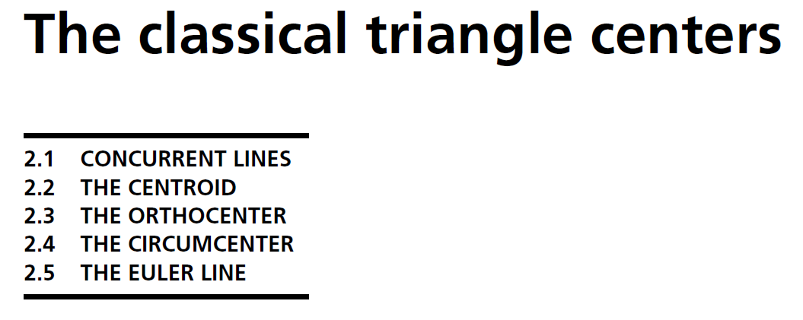
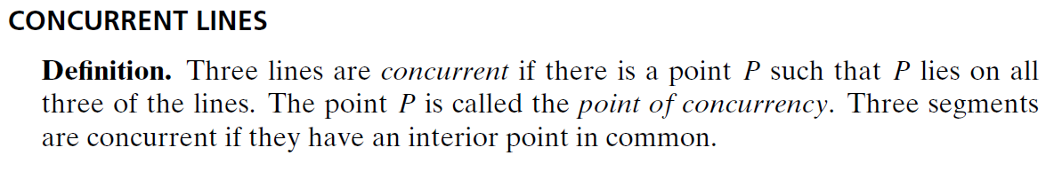


Slide 17

Ajima-Malfatti Points | First Isogonic Center | Parry Reflection Point
Anticenter | First Morley Center | Pedal-Cevian Point
Apollonius Point | First Napoleon Point | Pedal Point
Bare Angle Center | Fletcher Point | Perspective Center
Bevan Point | Fuhrmann Center | Perspector
Brianchon Point | Gergonne Point | Pivot Theorem
Brocard Midpoint | Griffiths Points | Polynomial Triangle Ce...
Brocard Points Centroid *** | Hofstadter Point | Power Point
Ceva Conjugate | Incenter ** | Regular Triangle Center
Cevian Point | Inferior Point | Rigby Points
Circumcenter **** | Inner Napoleon Point | Schiffler Point
Clawson Point | Inner Soddy Center | Second de Villiers Point
Cleavance Center | Invariable Point | Second Eppstein Point
Complement | Isodynamic Points | Second Fermat Point
Congruent Incircles Point | Isogonal Conjugate | Second Isodynamic Point
Congruent Isoscelizers... | Isogonal Mittenpunkt | Second Isogonic Center
Congruent Squares Point | Isogonal Transformation | Second Morley Center
Cyclocevian Conjugate | Isogonic Centers | Second Napoleon Point
de Longchamps Point | Isogonic Points | Second Power Point
de Villiers Points | Isoperimetric Point | Simson Line Pole
Ehrmann Congruent Squa... | Isotomic Conjugate | Soddy Centers
Eigencenter | Kenmotu Point | Spieker Center
Eigentransform | Kimberling Center | Steiner Curvature Cent...
Elkies Point | Kosnita Point | Steiner Point
Eppstein Points | Major Triangle Center | Steiner Points
Equal Detour Point | Medial Image | Subordinate Point
Equal Parallelians Point | Mid-Arc Points | Sylvester's Triangle P...
Equi-Brocard Center | Miquel's Pivot Theorem | Symmedian Point
Equilateral Cevian Tri... | Miquel Point | Tarry Point
Euler Infinity Point | Miquel's Theorem | Taylor Center
Euler Points | Mittenpunkt | Third Brocard Point
Evans Point | Morley Centers | Third Power Point
Excenter | Musselman's Theorem | Triangle Center
Exeter Point | Nagel Point | Triangle Center Function
Far-Out Point | Napoleon Crossdifference | Triangle Centroid
Fermat Points | Napoleon Points | Triangle Triangle Erec...
Fermat's Problem | Nine-Point Center | Triangulation Point
Feuerbach Point | Oldknow Points | Trisected Perimeter Point
First de Villiers Point | Orthocenter * | Vecten Points
First Eppstein Point | Outer Napoleon Point | Weill Point
First Fermat Point | Outer Soddy Center | Yff Center of Congruence
First Isodynamic Point | Parry Point

Slide 18
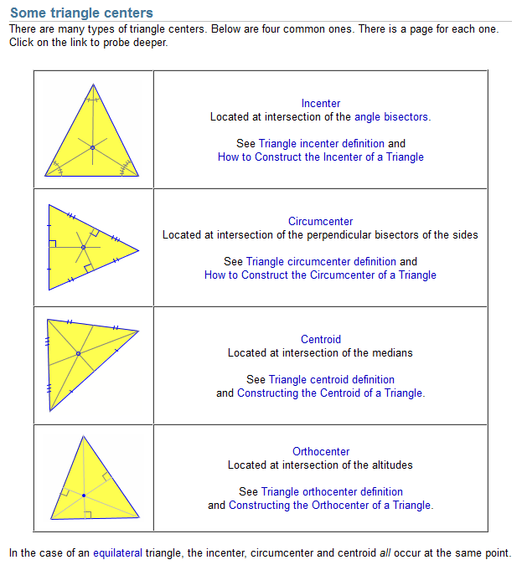

Slide 19
Mnemonic (Memory Enhancer)
Construction: ABMP
Concurrency: OICC
Altitude
(angle) Bisector
Median
Perpendicular bisector
Orthocenter
Incenter
Centroid
Circumcenter
Sandwich
Bun
Burger
Burger
Bun
Construction | Location of Point of Concurrency
Altitudes | acute/right/obtuse …… In/On/Out
(angle) Bisectors | ALL IN
Medians (midpoints) | ALL IN
Perpendicular bisectors | acute/right/obtuse …… In/On/Out

Slide 20
Altitude - Orthocenter
The vowels go together
The orthocenter is the point of concurrency of the altitudes in a triangle. A point of concurrency is the intersection of 3 or more lines, rays, segments or planes.
The orthocenter is just one point of concurrency in a triangle. The others are the incenter, the circumcenter and the centroid.

Slide 21
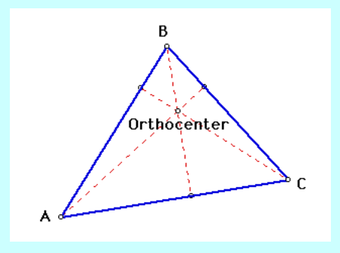
In – located inside of an acute triangle
On – located at the vertex of the right angle on a right triangle
Out – located outside of an obtuse triangle

Slide 22
(angle) Bisector - Incenter
The bisector angle construction is equidistant from the sides
The point of concurrency of the three angle bisectors of a triangle is the incenter.
It is the center of the circle that can be inscribed in the triangle, making the incenter equidistant from the three sides of the triangle.
To construct the incenter, first construct the three angle bisectors; the point where they all intersect is the incenter.
The incenter is ALWAYS located within the triangle.

Slide 23

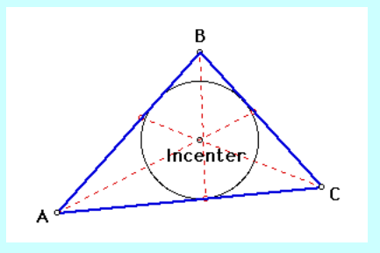
ALL IN
In – located inside of an acute triangle
In – located inside of a right triangle
In – located inside of an obtuse triangle

Slide 24
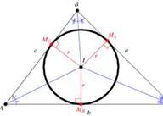
The center of the circle is the point of concurrency of the bisector of all three interior angles.
The perpendicular distance from the incenter to each side of the triangle serves as a radius of the circle.
All radii in a circle are congruent.
Therefore the incenter is equidistant from all three sides of the triangle.

Slide 25
Median - Centroid
The 3rd has thirds
The centroid is the point of concurrency of the three medians in a triangle.
It is the center of mass (center of gravity) and therefore is always located within the triangle.
The centroid divides each median into a piece one-third (centroid to side) the length of the median and two-thirds (centroid to vertex) the length.
To find the centroid, we find the midpoint of two sides in the coordinate plane and use the corresponding vertices to get equations.

Slide 26

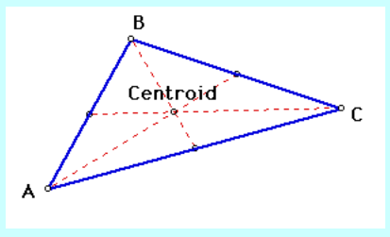
ALL IN
In – located inside of an acute triangle
In – located inside of a right triangle
In – located inside of an obtuse triangle

Slide 27
Perpendicular Bisectors → Circumcenter
The perpendicular bisector of the sides equidistant from the angles (vertices)
The point of concurrency of the three perpendicular bisectors of a triangle is the circumcenter.
It is the center of the circle circumscribed about the triangle, making the circumcenter equidistant from the three vertices of the triangle.
The circumcenter is not always within the triangle.
In a coordinate plane, to find the circumcenter we first find the equation of two perpendicular bisectors of the sides and solve the system of equations.

Slide 28

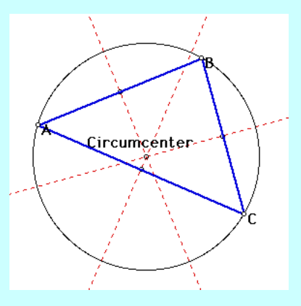
In – located inside of an acute triangle
On – located on (at the midpoint of) the hypotenuse of a right triangle
Out – located outside of an obtuse triangle

Slide 29
Got It?
Ready for a quiz?
You will be presented with a series of four triangle diagrams with constructions.
Identify the constructions (line segments drawn inside the triangle).
Identify the name of the point of concurrency of the three constructions.
Brain Dump the mnemonic to help you keep the concepts straight.

Slide 30
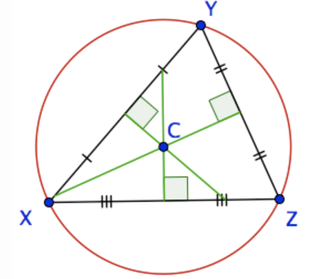
Name the Constructions

Slide 31
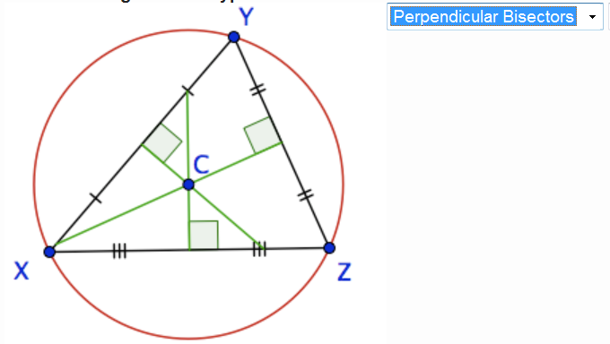
Name the Point of Concurrency

Slide 32
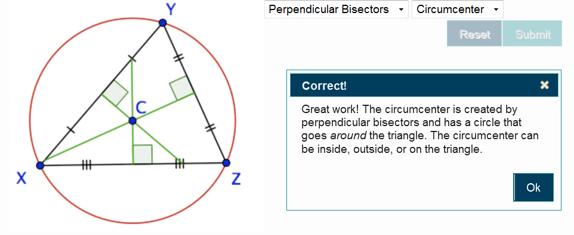
Perpendicular Bisectors → Circumcenter

Slide 33
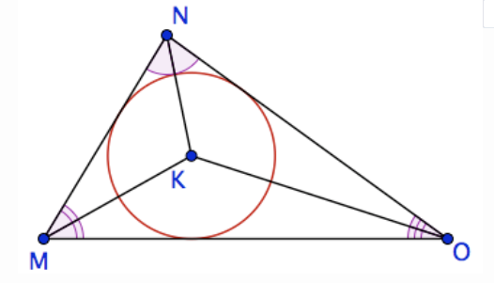
Name the Constructions

Slide 34
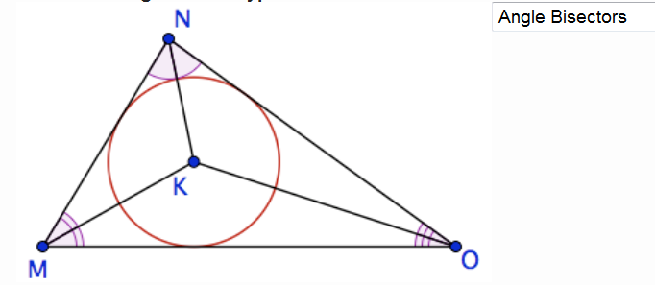
Name the Point of Concurrency

Slide 35
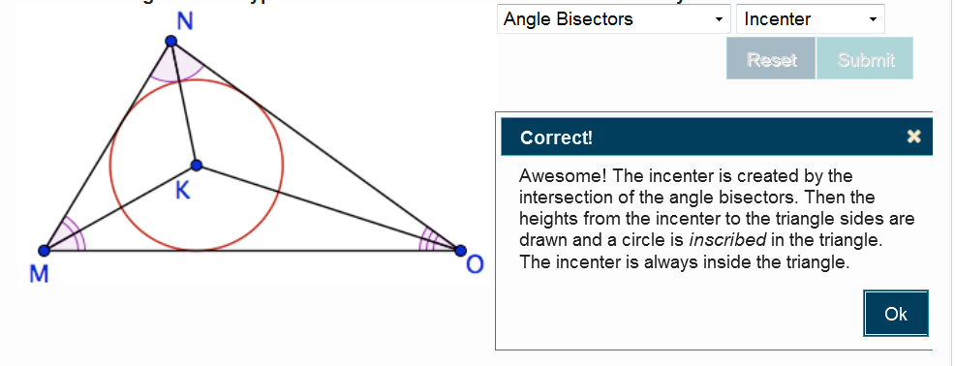
Angle Bisectors → Incenter

Slide 36
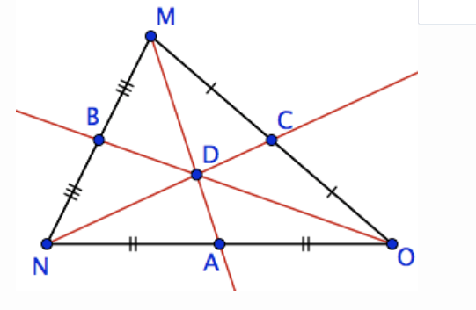
Name the Constructions

Slide 37
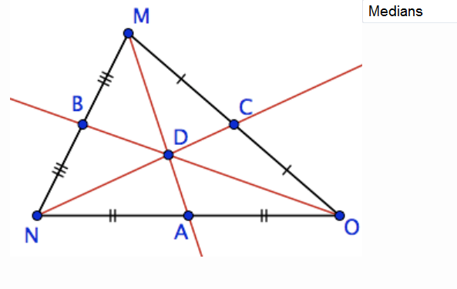
Name the Point of Concurrency
Messy Markings Midpoints and Medians

Slide 38
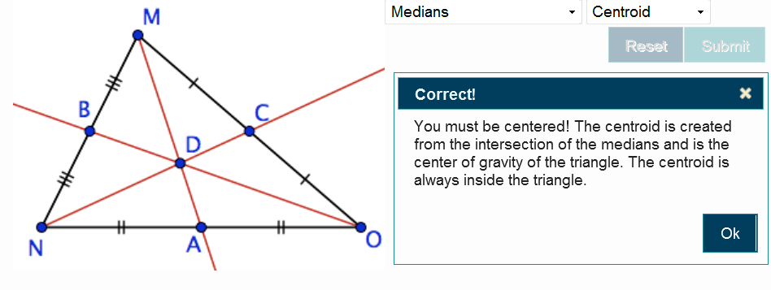
Medians→ Centroid

Slide 39
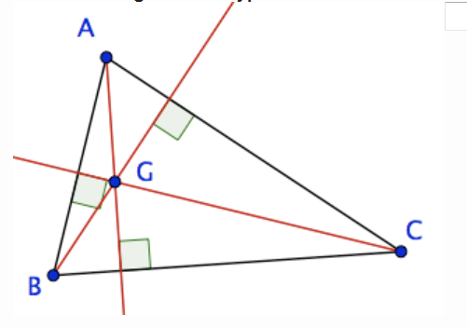
Name the Constructions

Slide 40
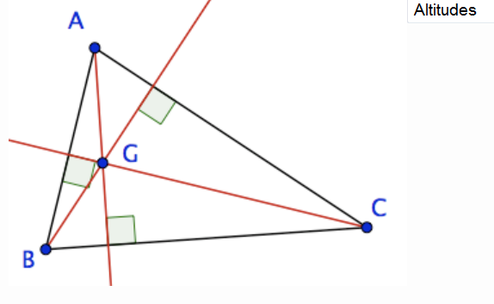
Name the Point of Concurrency

Slide 41
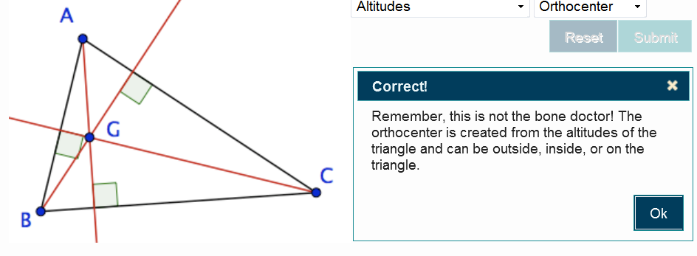
Altitudes→ Orthocenter

Slide 42
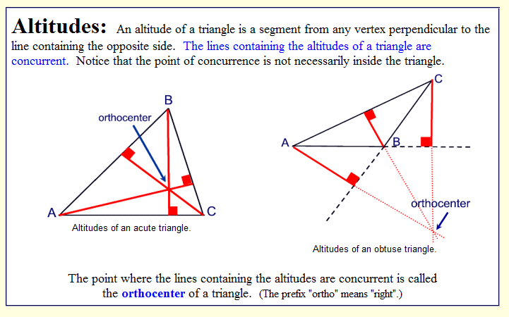
ABMP / OICC

Slide 43
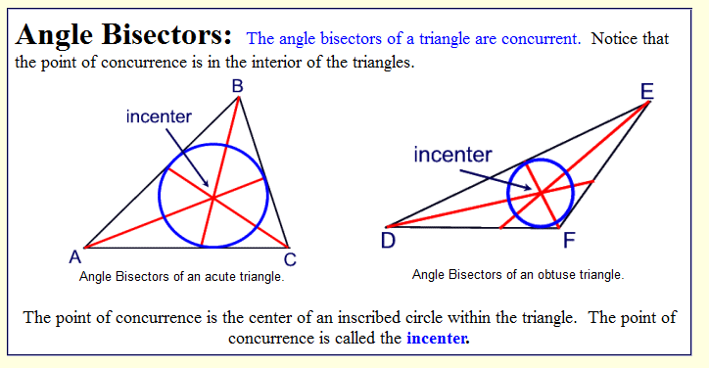
ABMP / OICC

Slide 44
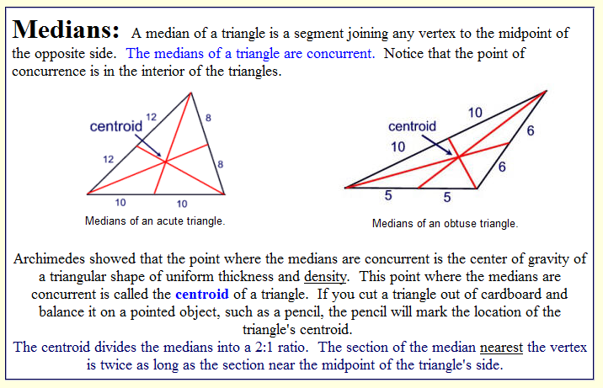
ABMP / OICC

Slide 45
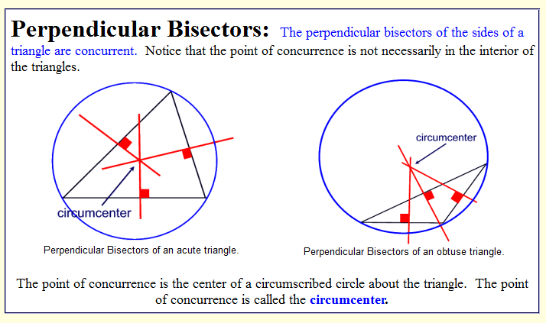
ABMP / OICC

Slide 46


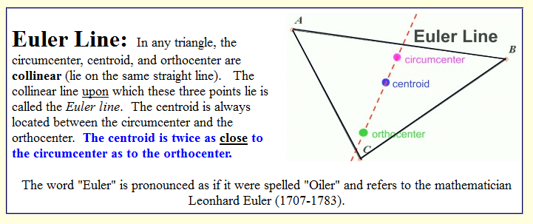
Euler’s Line does NOT contain the Incenter (concurrency of angle bisectors)

Slide 47
Recapitualtion
Ready for another quiz?
You will be presented with a series of fifteen questions about triangle concurrencies.
Brain Dump the mnemonic to help you keep the concepts straight.
Remember to use the burger-bun, for the all-in vs. the [in/on/out] for [acute/right/obtuse].
Remember which construction was listed in the third position and why it’s the third.

Slide 48
Triangle Concurrency Review of Quiz
Q.1) | What is the point of concurrency of perpendicular bisectors of a triangle called?
Q.2) | In a right triangle, the circumcenter is at what specific location?
Q.3) | The circumcenter of a triangle is equidistant from the _____________ of the triangle.
Q.4) | When the centroid of a triangle is constructed, it divides the median segments into parts that are proportional. What is the fractional relationship between the smallest part of the median segment and the larger part of the median segment?
Q.5) | The centroid of a triangle is (sometimes, always, or never) inside the triangle.

Slide 49
Q.6) | The circumcenter of a triangle is the center of the circle that circumscribes the triangle, intersecting each _______ of the triangle.
Q.7) | What is the point of concurrency of angle bisectors of a triangle called?
Q.8) | What is the point of concurrency of the medians of a triangle called?
Q.9) | What is the point of concurrency of the altitudes of a triangle called?
Q.10) | The incenter of a triangle is the center of the circle that is inscribed inside the triangle, intersecting each ______ of the triangle.

Slide 50
Q.11) | The circumcenter of a triangle is (sometimes, always or never) inside the triangle.
Q.12) | The incenter of a triangle is equidistant from the ________ of the triangle.
Q.13) | The incenter of a triangle is (sometimes, always, or never) inside the triangle.
Q.14) | The orthocenter of a triangle is (sometimes, always, or never) inside the triangle.
Q.15) | In a right triangle, the orthocenter is at what specific location?

Slide 51
Answers
Circumcenter
Midpoint of the hypotenuse
Vertices
½ or 1:2 or 1/3to 2/3
Always
Vertex
Incenter
Centroid
Orthocenter
Side
Sometimes
Sides
Always
Sometimes
Vertex of the right angle

