Slide 1
Visual Analytics Project
Master Degree Engineering in Computer Science
Sapienza University of Rome
A.Y. 2024-2025
Davide Fortunato 1936575 – Davide Mazzatenta 2140428

Slide 2
What we will cover
Brief introduction
Related works
Dataset
Visualizations
Conclusions and future work

Slide 3
Introduction
Why this work?
Soccer analytics gained significant importance
Scouting is shifting to computational and analytical approaches
Our solution
Interactive dashboard for analysis
Dimensionality reduction and clustering algorithms
For scouts, coaches, and fans

Slide 4
Related works
COTTA, Leonardo, et al. Using fifa soccer video game data for soccer analytics. In: Workshop on large scale sports analytics. 2016. p. 1-4.
How does it relate to our work?
Cotta et al. demonstrate FIFA data’s utility for team and style analysis, aligning with our dashboard’s use of EA Sports data and, like us, they apply clustering and dimensionality reduction techniques on it. However, their work is not focused on providing an interactive dashboard but more on validate some real events through the game data.
Content summary
FIFA Video Game as a Data Source: The paper uses FIFA video game data to analyze and validate real-world soccer phenomena.
Germany’s 2014 World Cup Win: Analyzed attribute trends from 2007–2014 using linear regression. Found significant improvement in German midfielders' offensive skills (e.g., finishing, shot power). Brazilian defenders focused on non-defensive skills (e.g., crossing), highlighting tactical imbalances.
Barcelona’s Tiki-Taka Style: Applied PCA and k-means clustering to midfielders’ attributes from the 2012/13 season.Identified Barcelona’s midfielders as a distinct cluster with superior vision, passing, and ball control. Demonstrated how player attributes aligned with the tactical identity of Tiki-Taka.
Broader Implication: Video game datasets can offer valid, empirical insights into historical sports trends and team strategies.

Slide 5
Related works
A. Cao, X. Xie, R. Zhang, Y. Tian, M. Fan, H. Zhang, and Y. Wu, Team-Scouter: Simulative Visual Analytics of Soccer Player Scouting, IEEE Transactions on Visualization and Computer Graphics, vol. 31, no. 1, pp. 1-11, 2025.
How does it relates to our work?
Visual Analytics for Soccer Intelligence: Both systems aim to transform complex soccer data into actionable insights through interactive visualizations. Our dashboard enables exploration of player attributes and league trends, while Team-Scouter simulates tactical compatibility.
Interactive Exploration: Both tools prioritize user-driven interaction (e.g., filtering, brushing, linked views). However, while our dashboard focuses on statistical exploration (e.g., t-SNE clustering, temporal trends), Team-Scouter: Emphasizes predictive simulation (e.g., modeling how players adapt to new team tactics).
Content summary
Team-Scouter is a visual analytics system designed to improve soccer player scouting by simulating how players adapt to new teams. It employs a two-level framework:
Match Result Prediction: Estimates how a player’s addition impacts a team’s win probability.
Behavior Simulation: Predicts detailed actions (e.g., passes, tackles) in new tactical contexts.
The system provides interactive tools to compare a player’s historical performance with simulated outcomes and explore tactical fits (e.g., visualizing how a midfielder’s role changes in a high-pressing system). Validated through case studies—such as identifying replacements for Cristiano Ronaldo at Real Madrid—and expert feedback, Team-Scouter reduces transfer risks by bridging predictive modeling with visual exploration. It aids clubs in avoiding costly mismatches and optimizing squad-building strategies.

Slide 6
Related works
C. Soto-Valero, A Gaussian Mixture Clustering Model for Characterizing Football Players Using the EA Sports' FIFA Video Game System, 2017.
How does it relates to our work?
Similar dataset, based on FIFA video game
Same methodology framework, which consists in applying a dimensionality reduction technique and then clustering
Content summary
Objective: Classify 7,705 European football players into distinct roles using FIFA game data and machine learning techniques.
Data & Features: Used 40 player attributes from EA Sports’ FIFA dataset. Principal Component Analysis (PCA) reduced data to two main components explaining 61.1% of variance.
Clustering Approach: Applied a Gaussian Mixture Model (GMM) to classify players. Identified four main roles: defenders, midfielders, forwards, and goalkeepers. Model selection validated with Bayesian Information Criterion (BIC).
Attribute Importance: Gradient Boosting model ranked feature importance. Dribbling emerged as the most discriminative skill overall.
Findings: Goalkeepers showed distinct attributes (e.g., reflexes). Outfield roles were differentiated by technical abilities (e.g., passing, ball control). Confirmed that performance indicators are position-specific.
Implications: Demonstrates the potential of machine learning to derive tactical insights. Offers practical applications in player scouting and team strategy design.

Slide 7
Dataset
5
Main EA Sports FC 25
contains data of football players in 2025
Personal information, characteristics ratings, market values and images
over 18000 players
Other EA Sports FC 24 to FIFA 15
For recent versions of the game
Used for visualization over time

Slide 8
Data pre-processing
Filter players by overall bigger or equal than 65
Drop 15 columns useless for future work
Handle missing values by dropping or replacing
Choose 29 main attributes for clustering
Scale them with a standard scaler
End up with 10878 players and 61 attributes with AS=663741

Slide 9
VISUALIZATIONS
Soccer Field line up
Radar Chart
Line Chart
Scatterplot
Player profile
Bar Chart

Slide 10
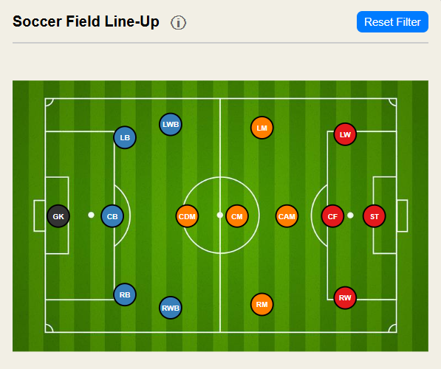
SOCCER FIELD LINE UP
Represents every possible role in FC 25 (15)
Uses a qualitative colorBrewer2 palette for each major role
Allows to filter scatterplot based on role selection
"Reset Filter" button

Slide 11
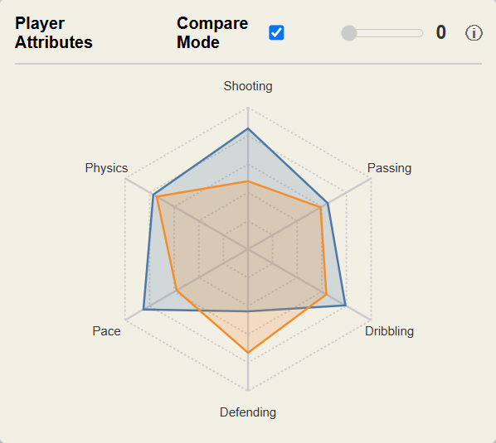
RADAR CHART
Represents areas of player main attributes
5 for GK and 6 for others
Uses d3.js standard palette
Tooltip and infobox
Compare Mode with another player
Top 5 nearest players with slider

Slide 12
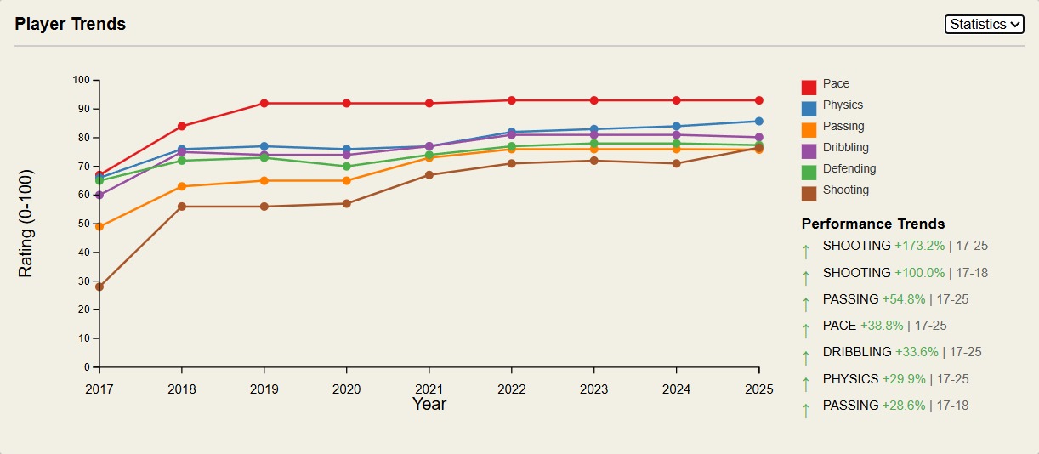
LINE CHART
Tracks player financial and performance evolution over time, from 2015 to 2025
Menu with 3 metrics
X and Y axis are dynamic
Colors same as scatterplot
Trend explainer
Tooltip and legend

Slide 13
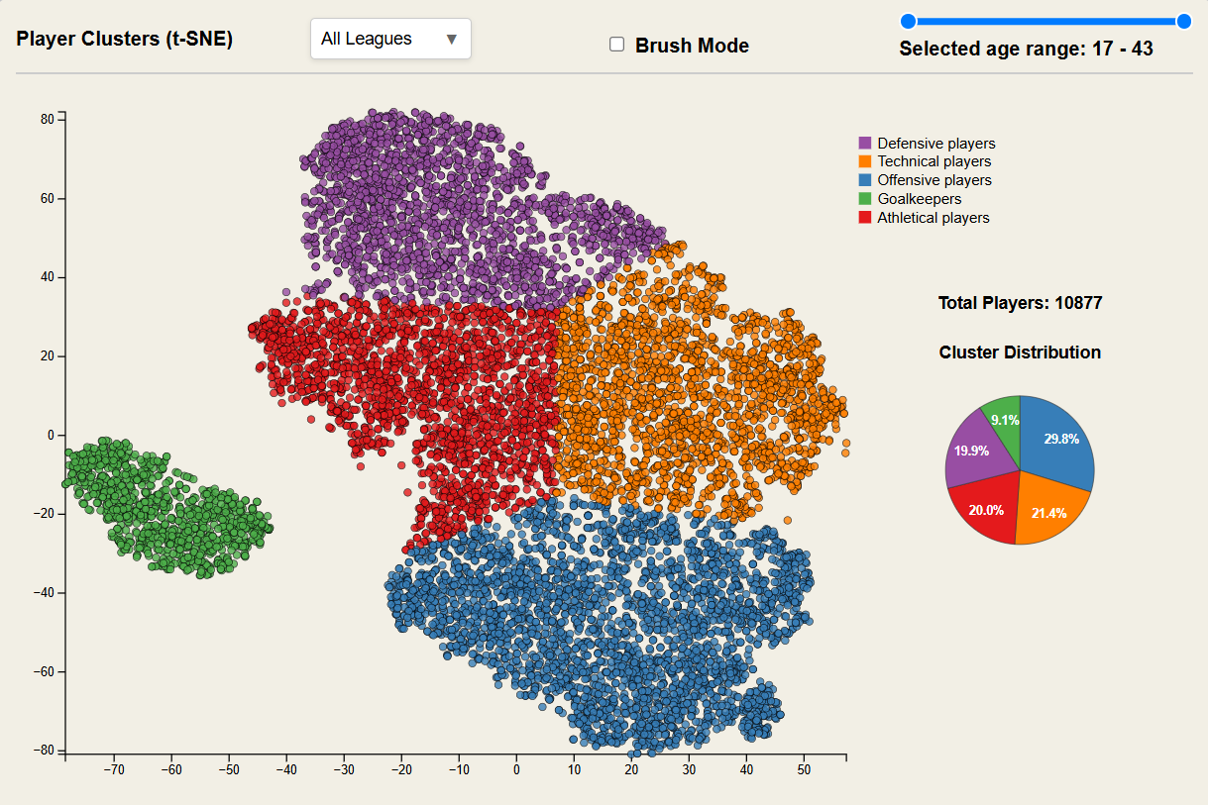
SCATTERPLOT
Represent player arrangement based on dimensionality reduction and clustering
Proximity indicates similarity among players
Clusters are color-coded by a standard colorbrewer2 qualitative palette
3 kinds of filters: league, age, brush
Pie chart shows distributions

Slide 14
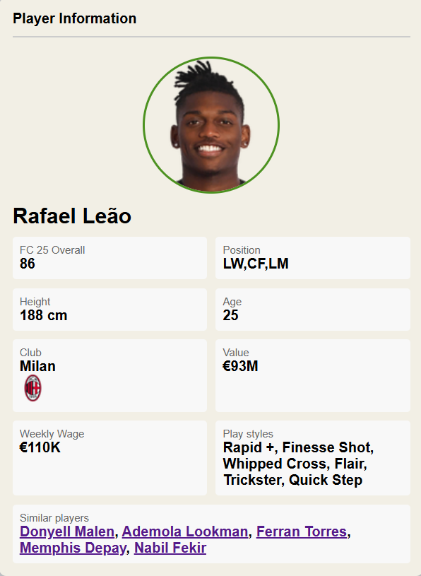
PLAYER PROFILE
Displays a complete player profile
Overall rating, positions, club with its logo
Personal and financial info
Play styles
Top 5 most similar players

Slide 15
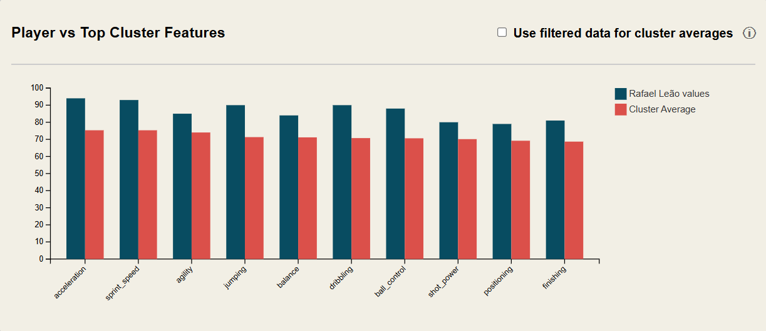
Bar chart
Compare a player with a cluster
Shows top 10 attributes with highest cluster averages
Checkbox allows to visualize averages of filtered player

Slide 16
CONCLUSIONS
FUTURE WORKS
Data driven analysis with intuitive interface
Support to soccer analytics
Tools for different evaluations
Integrate advanced stats from real matches
Line-up simulator
Predict characteristics with ML
Team comparisons
Advanced clustering techniques

Slide 17
Thanks for your attention
GitHub
https://github.com/davidef24/VisualAnalytics

