Slide 1

AT&T: Deep Learning
David Garcia

Slide 2
American telecommunications company
About AT&T
Annual revenues of $168.6 billion dollars
Ranked 13th of 500 US companies in Fortune 500 rankings

Slide 3
Goal: reduce spam SMS messages received by customers
Scope of the Project
Build a Deep Learning model to identify spam and ham text messages
Ham (good content) = 0
Spam (bad content) = 1

Slide 4
Exploratory Data Analysis
Project Steps
Data Preprocessing
Model Building
Model Comparison & Evaluation

Slide 5
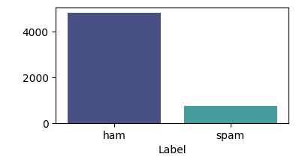
13.41% of mails are spam, while 86.59% are ham
Insight

Slide 6
Remove special characters, stopwords & white spaces
Preprocessing
Lowercase words
Lemmatization
Train-Test Split (60-20-20)
Encoding & Padding
Slicing & Batching

Slide 7
Built Models Machine Learning
Logistic Regression (baseline)
Decision Tree
Random Forest
AdaBoost

Slide 8
Built Models Deep Learning
Baseline
(Embedding, Pooling, Dense (16 neurons), Dense (Output)
Experiment 1
Add 1 Dense Layer (16 neurons)
Experiment 2
Increase neurons in both Dense layers to 128
Experiment 3
Add 2 Dropout layers of 20%
Experiment 4
3 Dense Layers (128 neurons) and 3 Dropout layers of 20%

Slide 9
Built Models Deep Learning
Experiment 5
Increase size of Word Embedding
Experiment 6
Increase Training data from 60% to 80%
Experiment 7
Baseline model with increased data
Experiment 8
Early Stopping at 10 epochs

Slide 10
Parameters Deep Learning
Optimizer: Adam
Loss: Binary Cross Entropy
Metric: Accuracy
Epochs: 30
Positive Threshold: 0.50

Slide 11
Model Evaluation Metrics
Recall – True Positive Rate
“Out of all spams, how many of them can the model identify?”
Binary Cross Entropy Loss
Metric that penalizes wrong predictions

Slide 12
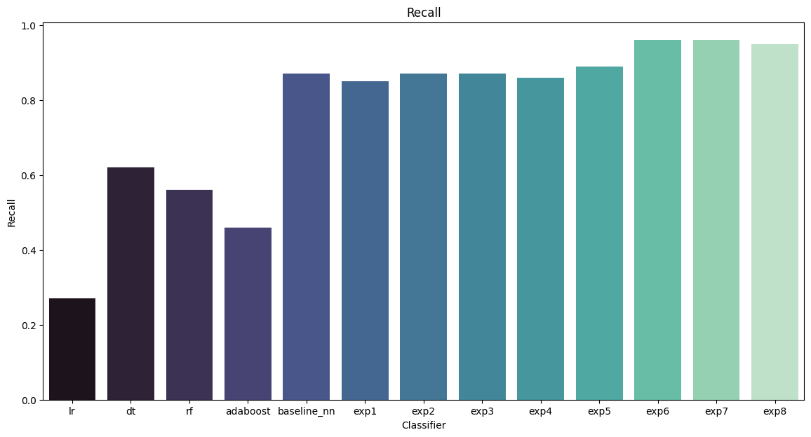
Model Evaluation Recall

Slide 13
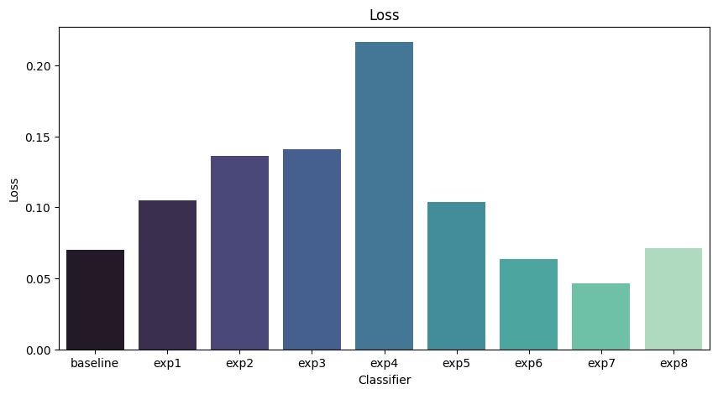
Model Evaluation Binary Cross Entropy Loss

Slide 14
Best Model
Experiment 7
Baseline Model with increased training data (80%, compared to previous 60%)
Recall: 0.97
Validation Loss: .0469

Slide 15
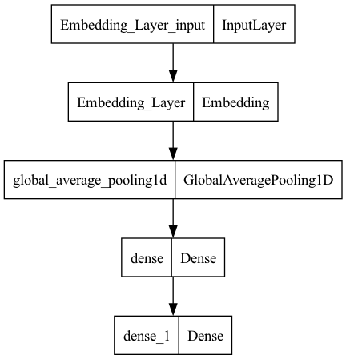
Best Model
Architecture

Slide 16
Conclusions
“Simplicity is the ultimate sophistication”
In this case our model architecture cannot be too complex, as training data size is relatively small
More training data leads to better results
Baseline model with increased training data was the model with best performance
For future improvements I would suggest to increase training data, by increasing samples or through data augmentation techniques

