Slide 1

Gstore
Customer analysis and potential future business
5.5.2021
Davide Della Valle

Slide 2
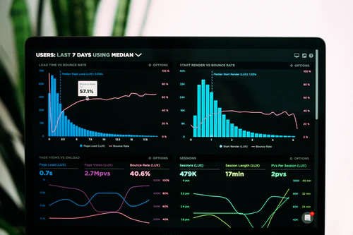
Contents
1
About GStore
2
About the Data
3
Audience overview
4
Buyers behaviour
5
Forecast
6
Conclusions

Slide 3

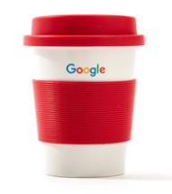
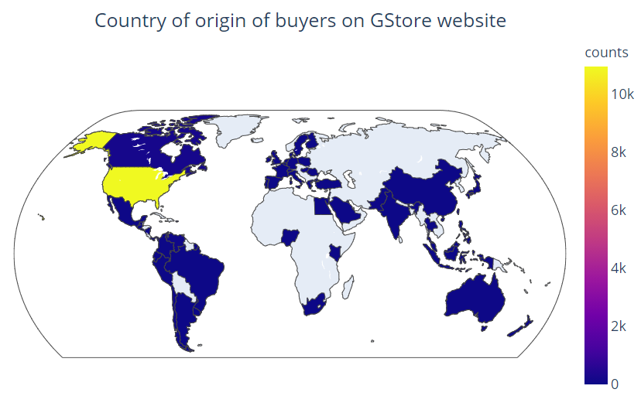
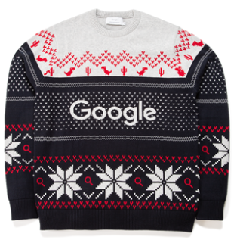
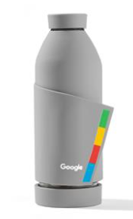
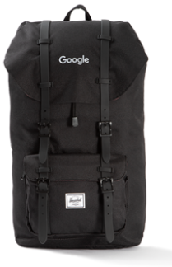

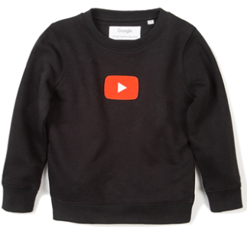
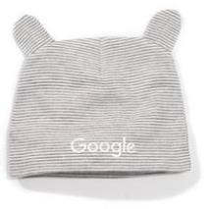
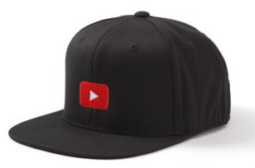


Google Merchandise Store
Notes:
2015 a real ecommece store
one country that accounts for almost all of the turnover achieved in the period of analysis.
The Google Merchandise Store sells Google branded merchandise.

Slide 4
Google Analytics
1 M
records
742735
Unique Users
11515
Buyers
1,27%
CR
8 – 2016 to 7 – 2017
Timeframe
Traffic Source Data
Information about where website visitors originate
Organic, referral…
Medium: google, youtube
Content Data
Behaviour of users on the site
Hits and Page viewed
Bounces
Visits:
date, count
Transactional Data
Transaction that occur on the Gstore
Transaction Revenue
Location
Where are the visitors and customers coming from?
Location
Notes:
The sample dataset contains Google Analytics 360 data from the Google Merchandise Store
VERDE
The data is typical of what you would see for an ecommerce website. It includes the following kinds of information:
No info about the products that were purchased on every transactions
motori di ricerca e i siti referer
It won‘t be an analysis on best selling products, customer wishes or preferences
The data is typical of what you would see for an ecommerce website. It includes the following kinds of information:
BLU

Slide 5
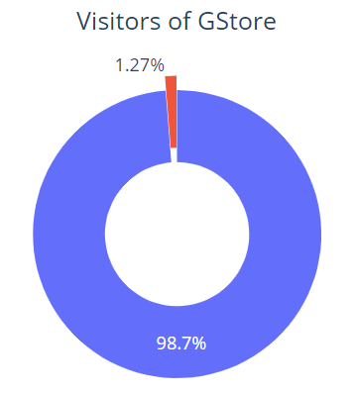
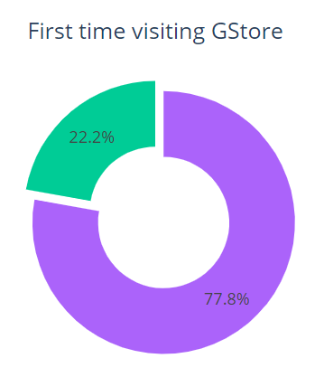


Audience overview
Buyers
11515
Total visitors
903653
New visitors
703060
Notes:
Audience helps you explore who your customers are, including information such as demographics, location, retention, and device technology. With these metrics, you can interpret the impact of your marketing efforts on various user segments.
Low conversion rate – this sounds like a small amount but actually is quite common for all ecommerce shops

Slide 6
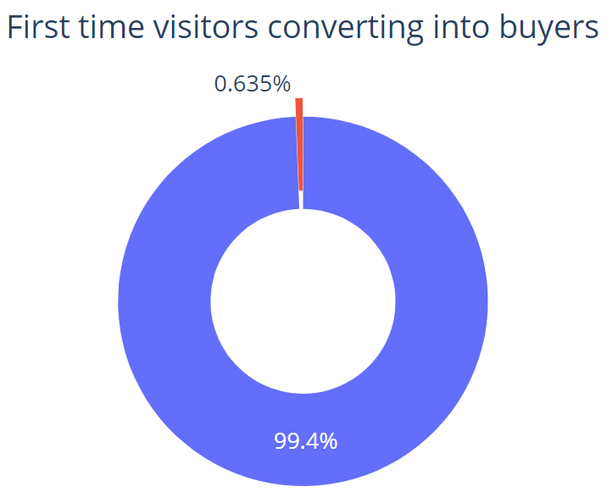
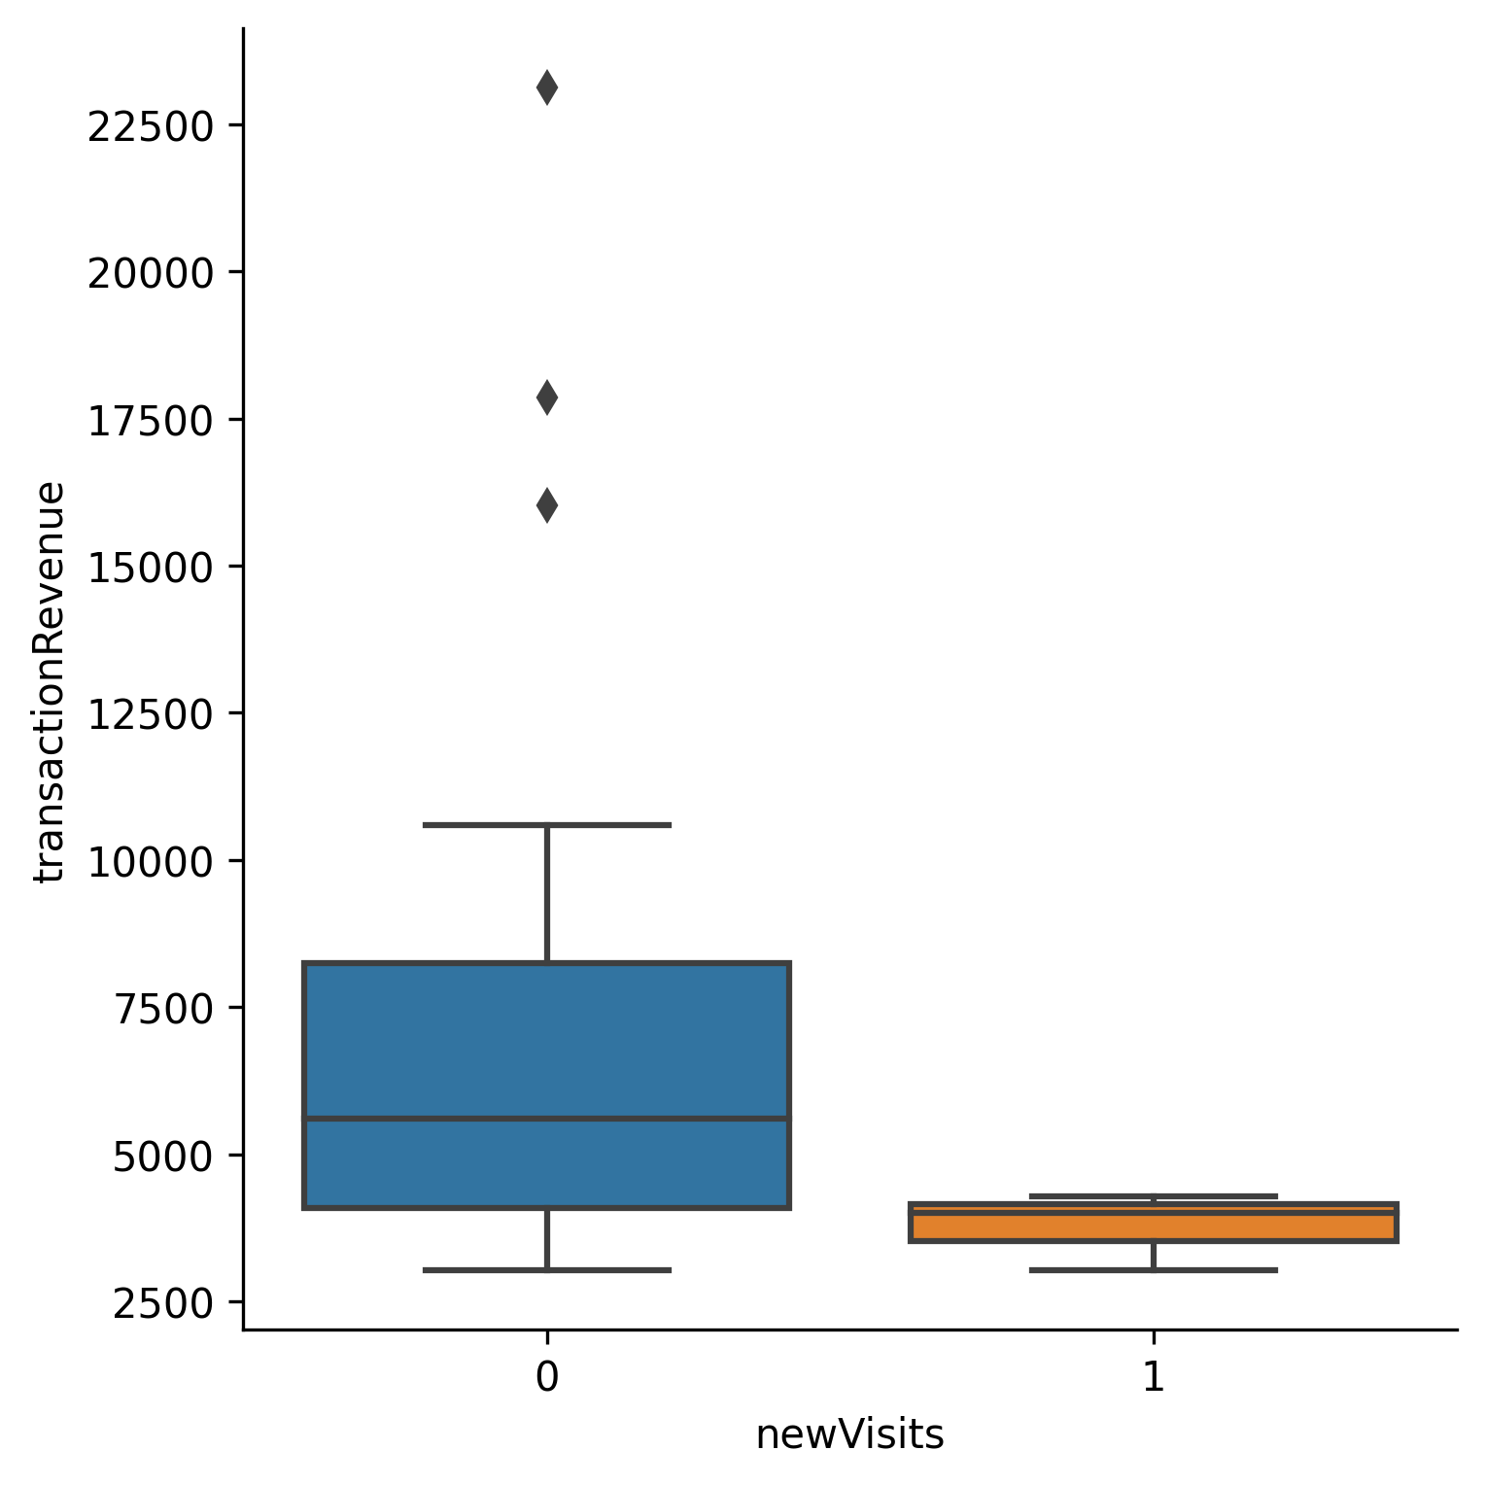
Impact on business of New Visitors
User type | Count | AOV | Tot. revenue
New users | 4465 | 85,6$ | 382325$
Usual | 7050 | 164,21$ | 1157745$
New Users Bounces = 365403 or 60%
Notes:
Acquiring new users is very difficult, time-consuming, and expensive. That’s why should try to convert new visitors to usual and get them to return to your site again and again.
Bounce rate is the percentage of users who visit only one page on a website before leaving.
targeting the right audience with the wrong content (low-quality content), or
good content, but you’re targeting the wrong audience (low-quality audience)
How’s the usability of the page?
Do you have a menu that’s easy to use?
Does the page invite people to look further on your site?
Free shipping
Limited coupon codes on first visit
10% discount

Slide 7
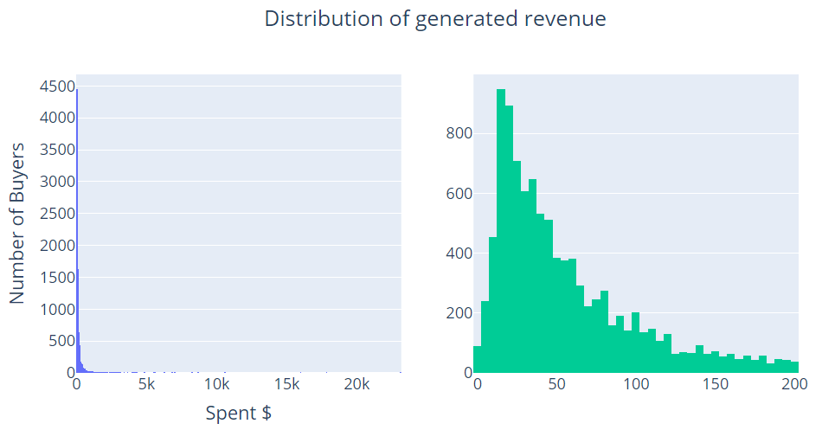
More about the revenue
Total
1.5M
AOV
133,7$
RPV
1,7$

Slide 8
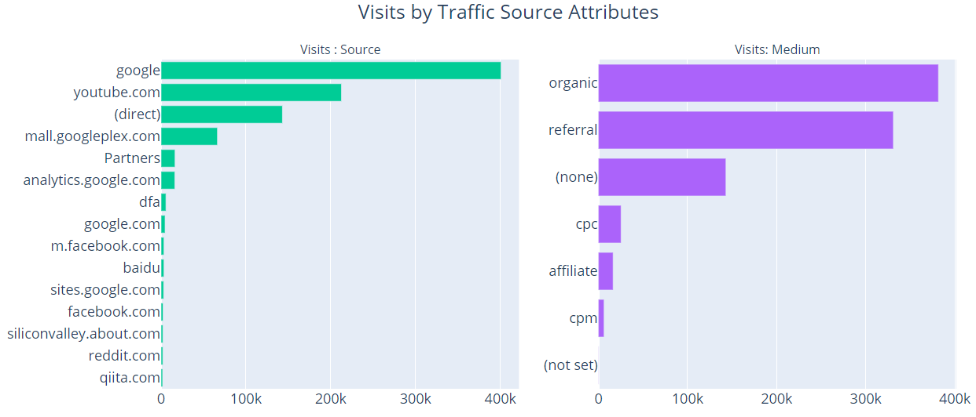
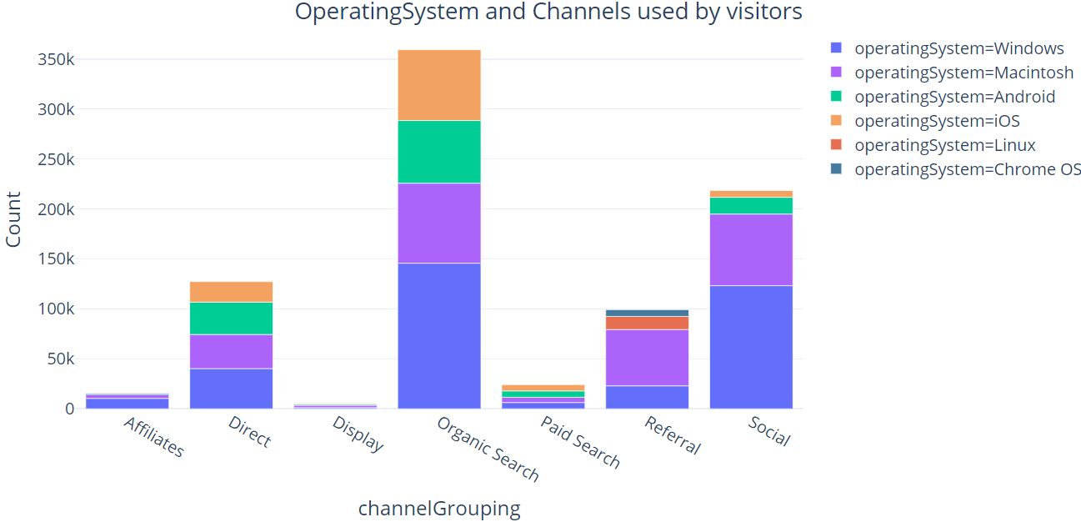
Acquisition
Low bounce rate 18%
mall.googleplex.com
EMAIL?
5% transactions
Notes:
An important thing to note for a marketer would be to understand where our users found us - how customer get to your website.
compare from Facebook vs youtube, determine the efficacy of your SEO efforts on organic search traffic, and see how well your email campaigns are running.
second step of the podium
Display – click on paid advertisement – banner
Organic search – google, yahoo, bing
Paid search – Adwords
Referral – link on another site, mail.googlepex.com
Social
Affiliates – affiliate site where we market
Email – not listed……
If we see a large number of visitors using a specific OS or device, then we need to optimize our site for them, because they’re a significant part of your overall traffic.

Slide 9
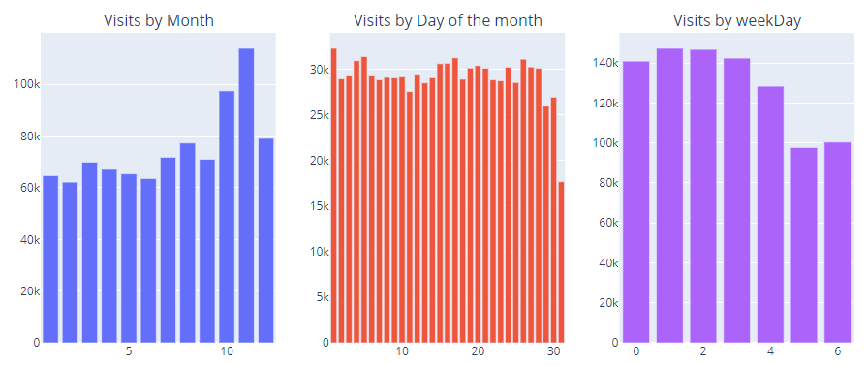
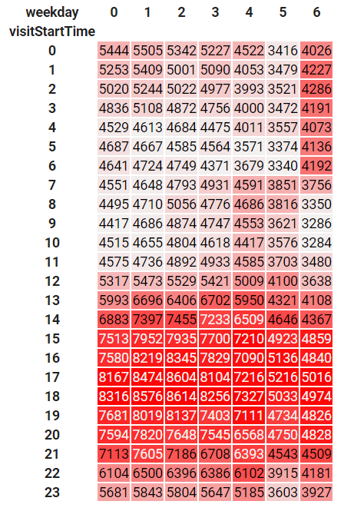
Visits over time
Notes:
Christmas event - Email reminders are sent out, and a dedicated team promotes the event before the day
10% on all goods on birthday

Slide 10
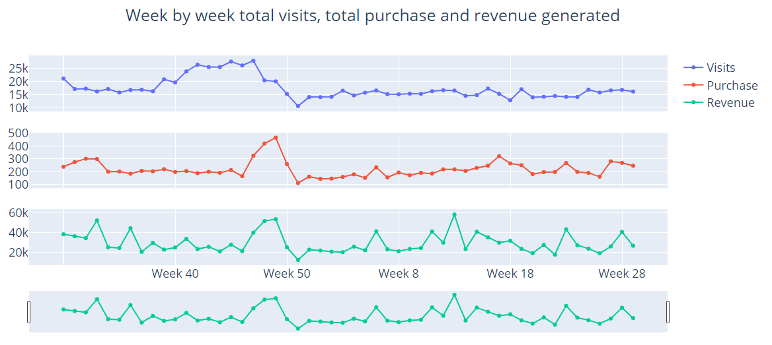

Slide 11
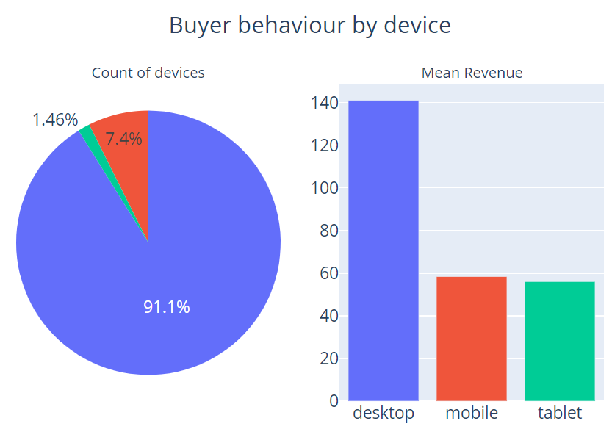
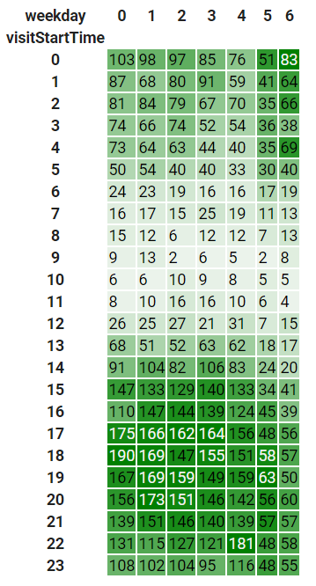
Buyers behaviour
Notes:
Even though we live in a era of mobile device – focus on development of desktop experience

Slide 12
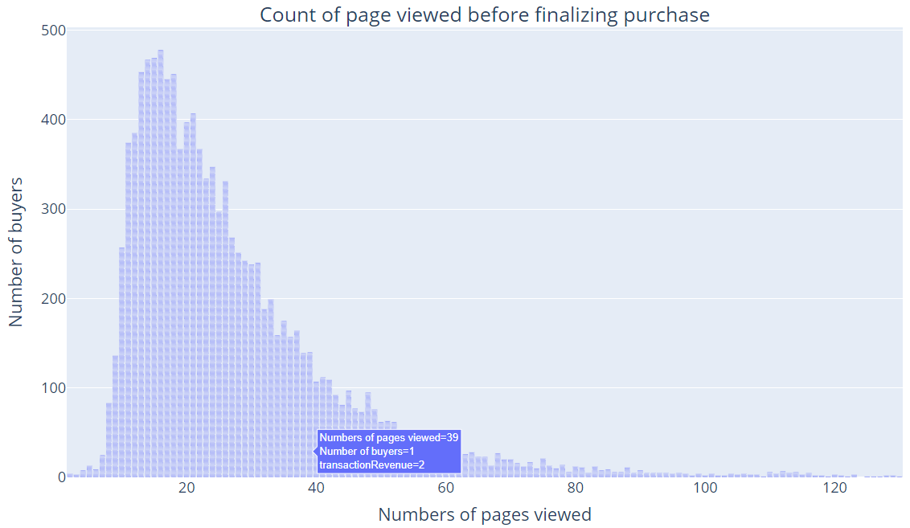
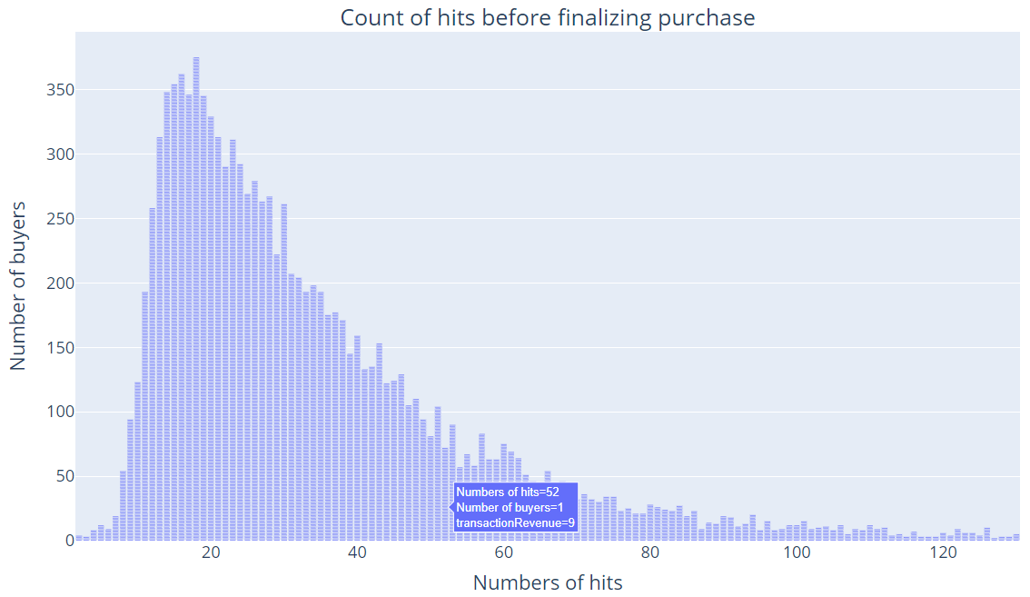
Click and Page viewed
Notes:
Average pages and click per session

Slide 13
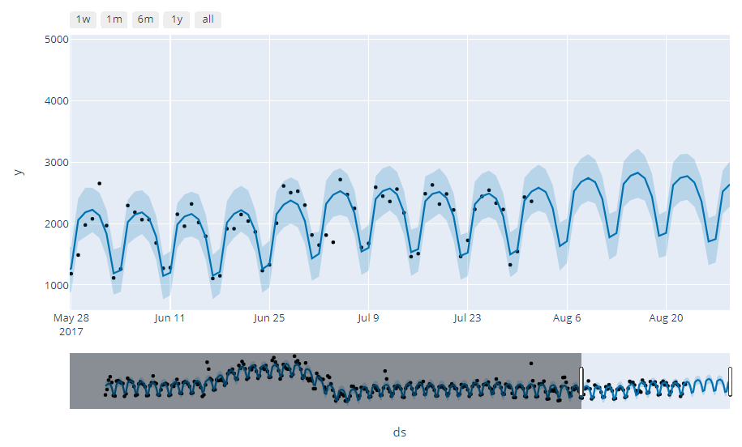
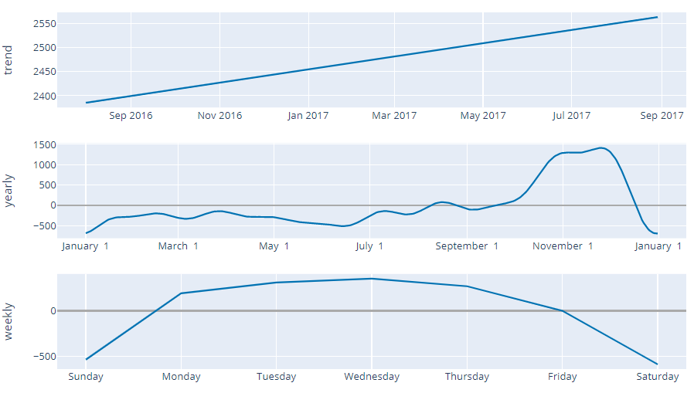
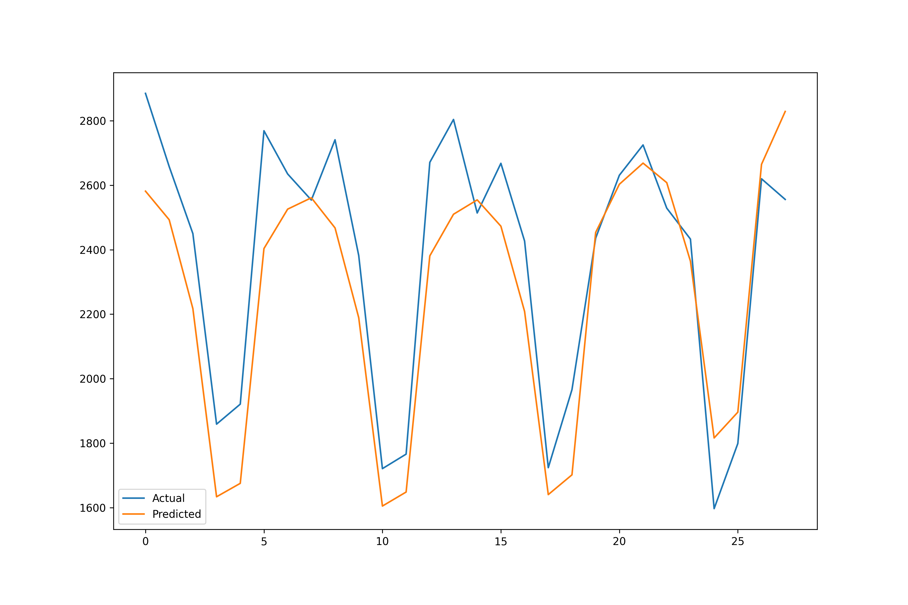
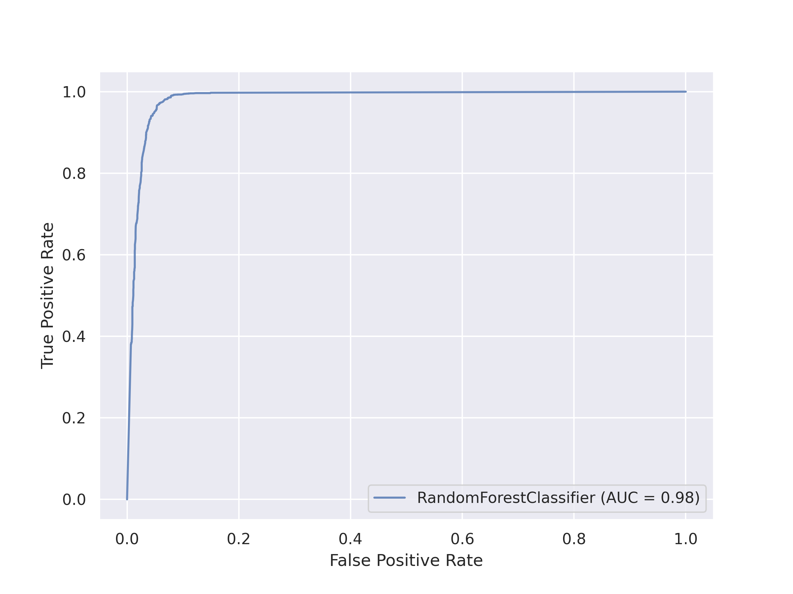
Forecast on Visits
MAE
165 Visits
Accuracy
98%
Notes:
Mean absolute error
evaluation metric for binary classification problems
Area Under the Curve

Slide 14
Conclusions and Suggestions
Low conversion rate, typical of Ecommerce.
New users contributed less revenue than usual users.
Focus on customer retention.
High Bounces rate
Adopt strategy to extend market borders
Ads use on Visits pick up time to attract more new users.
Use some promotion to increase conversion rate during weekdays.
Focus on perfectionate Desktop experience
Improve the website interface and payment process, less click and pageview.
Notes:
Analyzing your performance is a key part of your digital marketing strategy. You need to optimize and improve your strategy based on your past results.
detailed insights into how both your site and your digital marketing is performing. So, you can make data-driven decisions
Bounces Rate
Either you’re targeting the right audience with the wrong content (low-quality content), or
You have good content, but you’re targeting the wrong audience (low-quality audience)
How’s the usability of the page?
Do you have a menu that’s easy to use?
Does the page invite people to look further on your site?

Slide 15




