Slide 1

Sentiment Analysis
on
Big Data
Notes:
BigData & Social Media Analytics

Slide 2
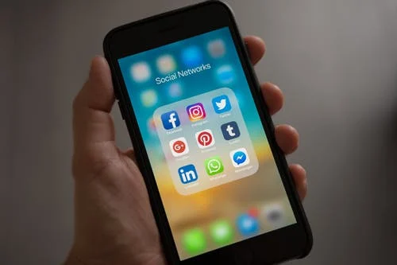
The Social media analytics case
BigQuery
CRISP
Data Studio
Twitter
Deep Learning
Pub/Sub
NLP – Sentiment analysis

Slide 3





The Social media analytics case
Faster decisions
Persona-
lisation
Product Insights
Social media campaigns
Plan future events
Sentiment Analysis
Notes:
Through big data analysis, marketers better understand their online communities and predict their behaviours so they can deliver personalised services as well as quickly solve any issue.
better understanding of the customer behavior, target audience groups and engagement
faster decisions - identify the latest trends in the social media sector and take better and quicker decisions accordingly.
Personalisation – Brands, approach their customers in a more personalised way based on their desires- Personlaised ads
Product Insights - future trends and consumers’ behaviours
Effective social media campaign evaluation - track the effectiveness of their social media campaigns
Plan future events - what worked in the past and didn’t
SA – classify emotions into classes – positive or negative ->feeling about products, companies, brands

Slide 4
The data scientist process
6 Presentation
1 Business Understanding
5 Evaluation
2 Data Understanding
4 Modelling
3 Data Preparation
Notes:
Simple and pragmatic
BU: precise business problem that will be solved by the predictive model
critical to understand data sources and the structure of the data itself
set of hypothesis of what range of business “questions” can be answered predictively
DU – Data source, gathering data
EV – are the results any good? Review the process –determine next steps
Supervised Learning: a process of inferring a function to adequately predict a specific result based on the labeled training dataset.
Unsupervised Learning: a type of machine learning algorithm used to find patterns within an unlabeled dataset.

Slide 5
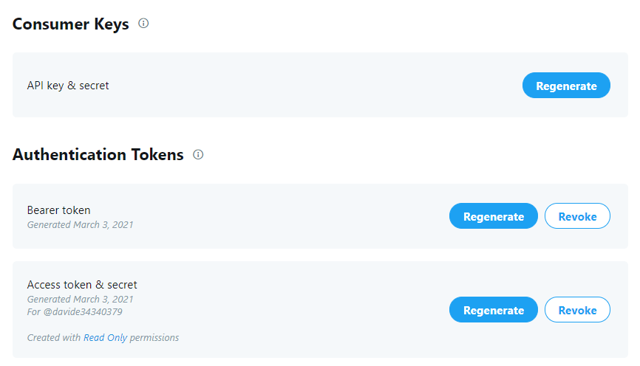

Twitter Developer Account
330 million a.p.m.
500 million tweets a day

Slide 6
Google cloud Pub/sub
Real-time messaging ingestion service allowing exchange of messages between applications
Publisher
1
Message
Cloud Pub/Sub
Topic
Message Storage
2
3
Subscritpion
4
Message
5
Ack
Subscriber
Notes:
1 - A publisher application creates a topic in the Pub/Sub service and sends messages to the topic. A message contains a payload and optional attributes that describe the payload content.
2 - Messages retained for a subscription until it is acknowledged by any subscriber consuming messages from that subscription.
3 - Pub/Sub forwards messages from a topic to all of its subscriptions, individually.
4 – either pushed to subscriber or pulled by him
5 - The subscriber sends an acknowledgement to the Pub/Sub service for each received message.
6 - The service removes acknowledged messages from the subscription's message queue
Topic: A named resource to which messages are sent by publishers.
Subscription: A named resource representing the stream of messages from a single, specific topic, to be delivered to the subscribing application. For more details about subscriptions and message delivery semantics, see the Subscriber Guide.
Message: The combination of data and (optional) attributes that a publisher sends to a topic and is eventually delivered to subscribers.
Message attribute: A key-value pair that a publisher can define for a message. For example, key iana.org/language_tag and value en could be added to messages to mark them as readable by an English-speaking subscriber.

Slide 7
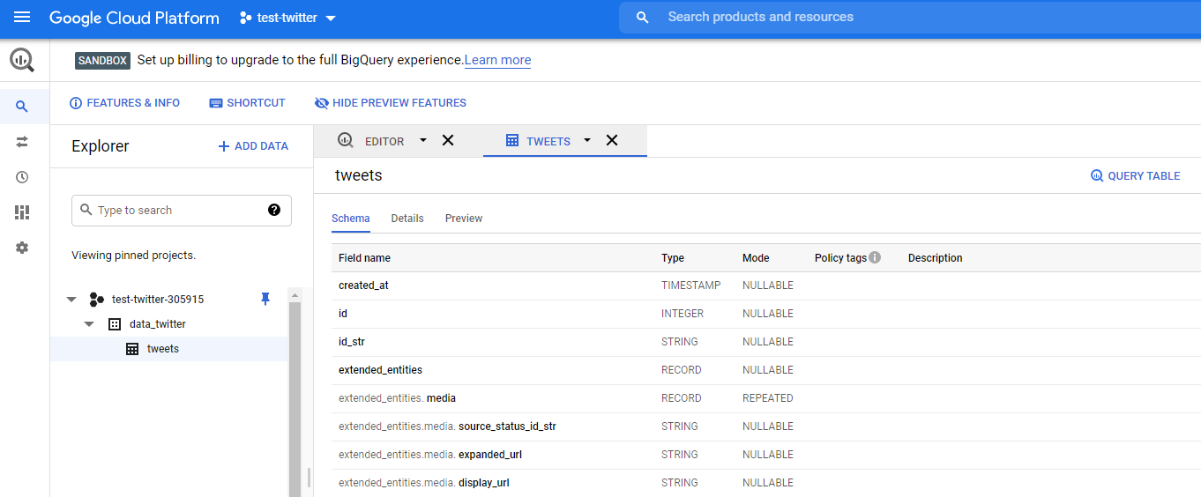
Bigquery
Serverless, highly scalable, and cost-effective multi-cloud data warehouse designed for business agility

Slide 8
Field Name | Type | Mode |  | Field Name | Type | Mode
id | INTEGER | NULLABLE |  | user. name | STRING | NULLABLE
text | STRING | NULLABLE |  | user | RECORD | NULLABLE
lang | STRING | NULLABLE |  | user. id_str | STRING | NULLABLE
timestamp_ms | STRING | NULLABLE |  | user. Description | STRING | NULLABLE
retweeted_status. created_at | TIMESTAMP | NULLABLE |  | user. location | STRING | NULLABLE
retweeted_status. reply_count | INTEGER | NULLABLE |  | place. name | STRING | NULLABLE
retweeted | BOOLEAN | NULLABLE |  | place. country | STRING | NULLABLE

Slide 9
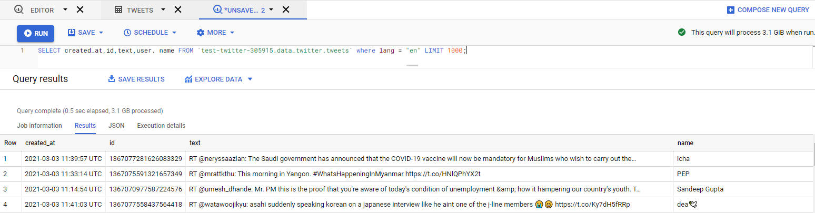
Total 22 million

Slide 10
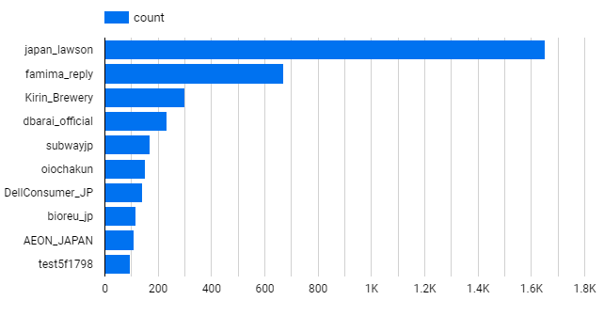
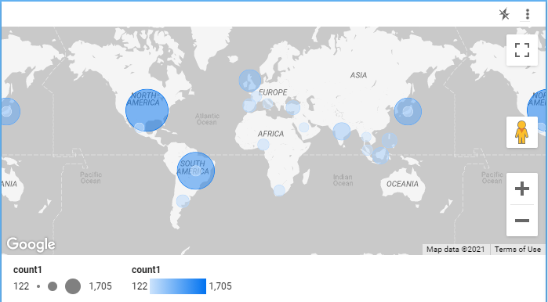
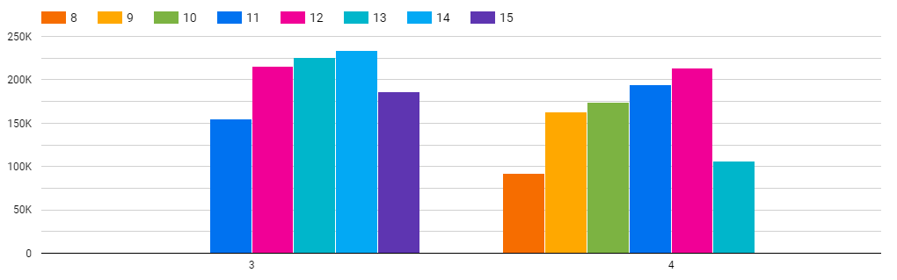
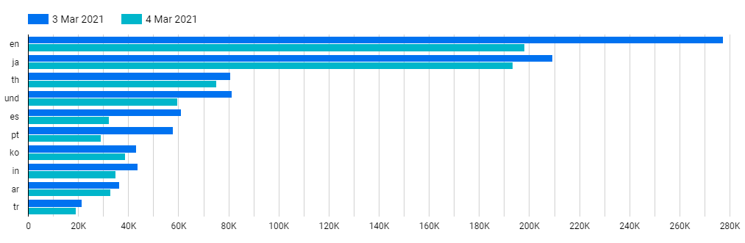
Data studio
Google's free data visualization tool: Visualize, Connect, Share, Collaborate, Create

Slide 11
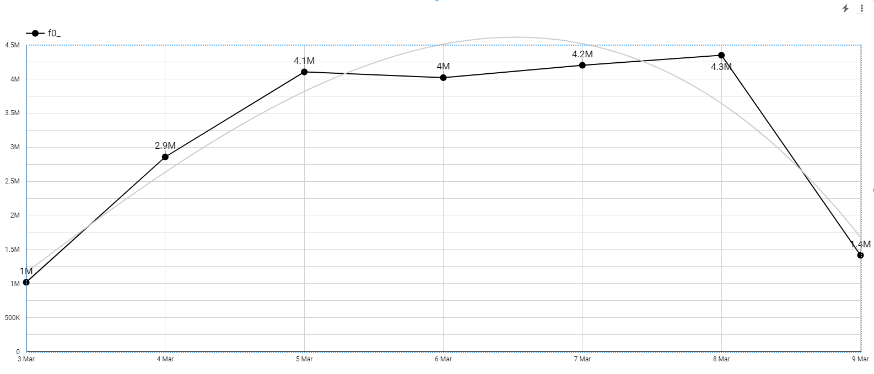
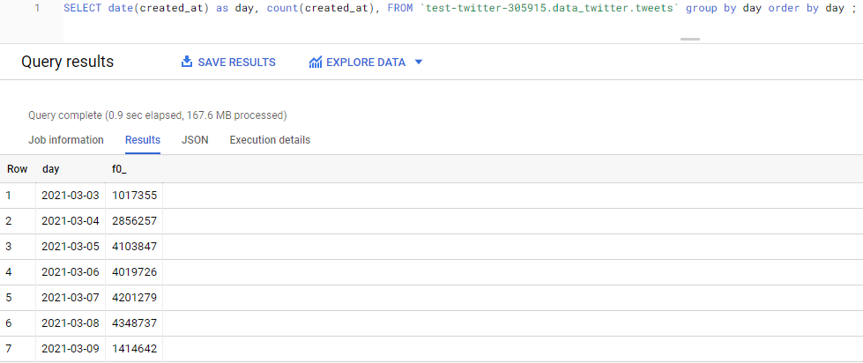
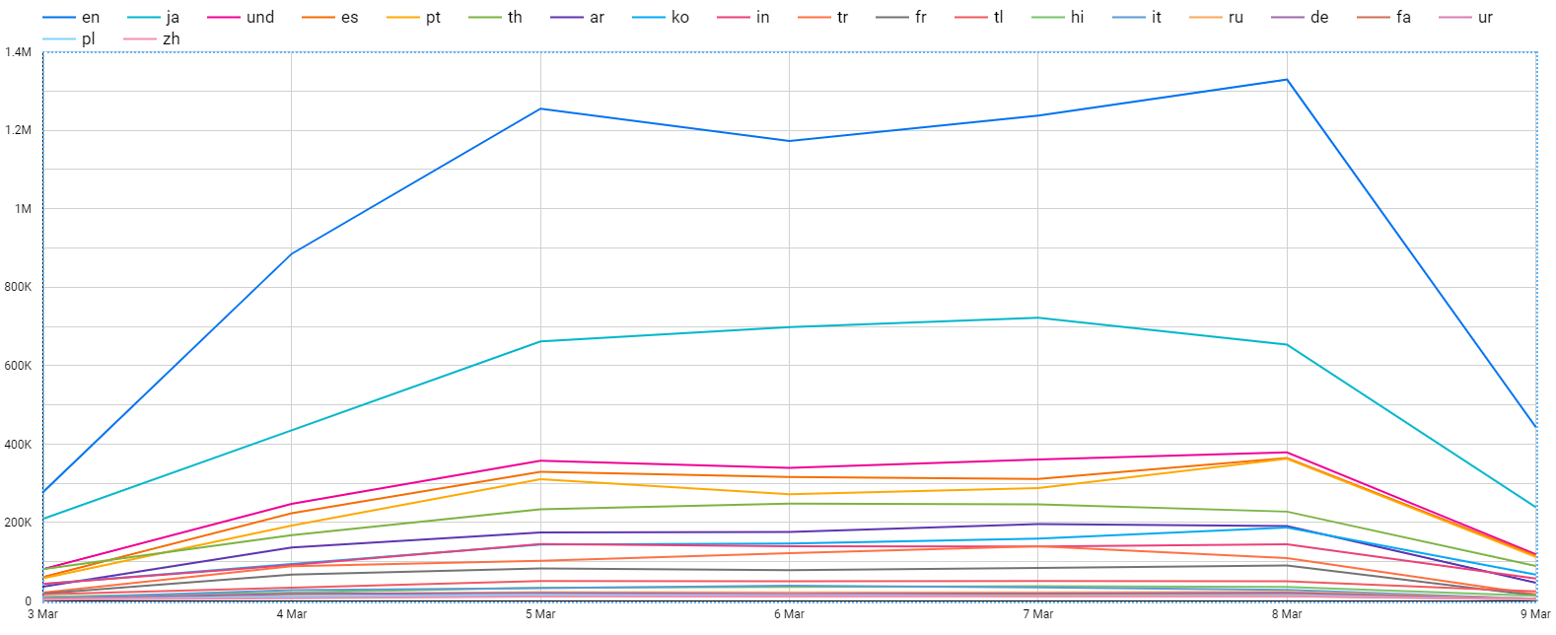

Slide 12

Deep Learning
AI
ML
DL
Data Requirement
Training Time
Hardware Dependency
Human intervention
ANN
Notes:
Deep Learning is a branch of Machine Learning that leverages artificial neural networks (ANNs)to simulate the human brain’s functioning. An artificial neural network is made of an interconnected web of thousands or millions of neurons stacked in multiple layers, hence the name Deep Learning.
A neural network functions something like this – you feed the neural network with massive volumes of data that will then run through the neurons. Each neuron has an activation function. When a specific threshold is reached, the neurons get activated, and their values are disseminated throughout the neural network.
Deep Learning focuses on training large neural networks on voluminous amounts of data. Since the daily global data generation is off the charts right now (and it will only increase in the future), it presents an excellent opportunity for Deep Learning. This is because the more data you feed into an extensive neural network, the better it performs.
An activation function is simply some function we apply to each of a layer's outputs (its activations). Convert the output to a format for the input to the next layer
Automated Driving:
Aerospace and Defense
Medical Research

Slide 13
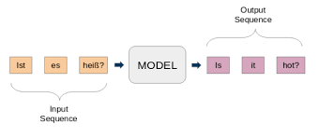
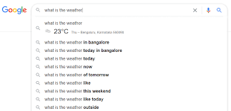



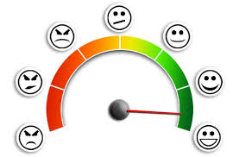
Natural language processing
MT
NWP
Voice Recognition
Sentiment Analysis
Notes:
NLP analyze large amounts of natural language data in the textual or verbal forms.
NLP breaks into shorter elements, tries to understand the relationships between these pieces, explores how they fit together to create meaning
Translation – preserve the meaning of the input text and producing an output in a different language
NWP next word prediction

Slide 14
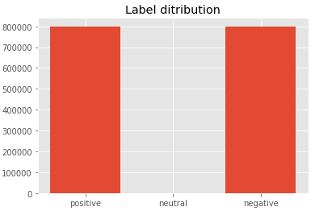
The dataset
label: the polarity of the tweet (0 = negative, 2 = neutral, 4 = positive)
Id: the id of the tweet
date: the date of the tweet (Mon Apr 06 22:19:45 PDT 2009)
flag: the query. If there is no query, then this value is NO_QUERY.
username: the user that tweeted (TheSpecialOne)
text: the text of the tweet (my whole body feels itchy and like its on fire)
Notes:
Labelled data in order to train a classifier

Slide 15
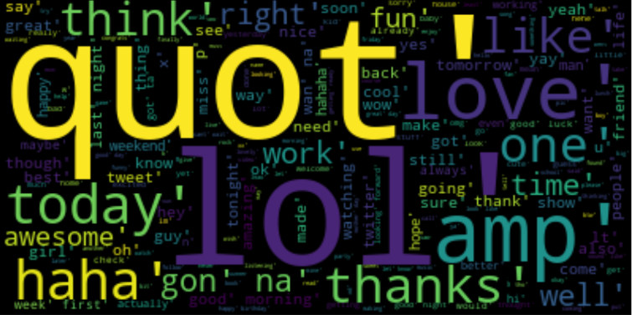
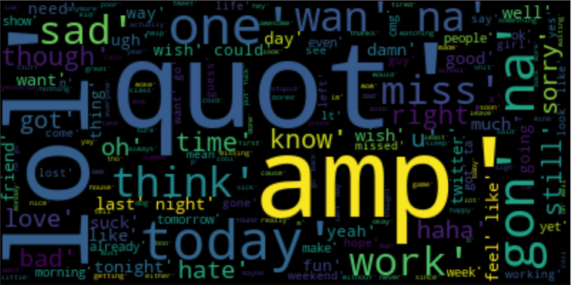
Data preprocessing
Check on data structure – 1.6 million, 6
Reduce to column to be used – label, text
Remove null data
Conversion of labeled classes (0 = negative, 4 = positive) to 0 and 1
All string values to lower case
Remove punctuations from dataset
Remove Urls
Remove digits.
Remove stopwords
Tokenization splitting sentences into words
Stemming or Lemmatization
Notes:
Remove null data: since I am using sentiment as target (the variable I will be predicting) I cannot have any null values so these are dropped, luckily no null values were present in the database.
Remove stopwords: most common words in a language like “the”, “a”, “on”, “is”, “all”. These words do not carry important meaning and are usually removed from texts
Tokenization splitting sentences into words.
Text normalization techniques within the field of Natural language Processing (NLP) that are used to prepare text, words, and documents for further processing. Lemmatize and stem both generate the root form of the word except stem may generate a word that doesn’t exist in the dictionary therefore lemmatization is used more widely than stemming. The core principal behind these 2 approaches is that we need to convert all words to their base form in order to reduce the number of unique words.

Slide 16
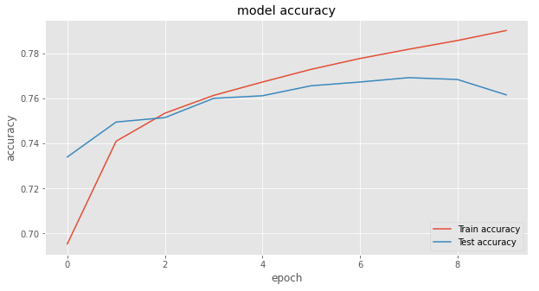
The model
recurrent neural network (RNN) architecture that REMEMBERS values over arbitrary intervals, well-suited to classify.
LSTM
Avoid overfitting.
Drop some fractions of layer to avoid “conspiracy”
Dropout
Optimizer
Algorithm that adjust parameters to reduce loss
adam
Notes:
keras.Sequential, which creates a neural network as a stack of layers.
LSTM is a recurrent neural network (RNN) architecture that REMEMBERS values over arbitrary intervals, well-suited to classify. IT remembers words said before
One application Autocorrection!!
A "loss function" that measures how good the network's predictions are.
An "optimizer" that can tell the network how to update its weights.
BatchNormalization(),

Slide 17
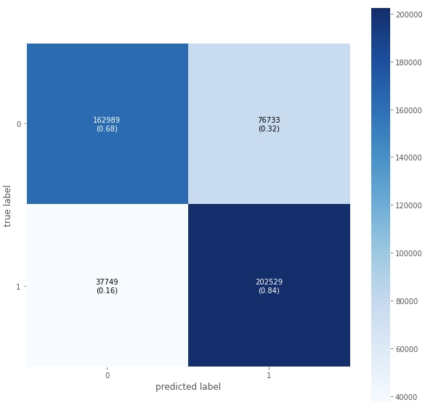
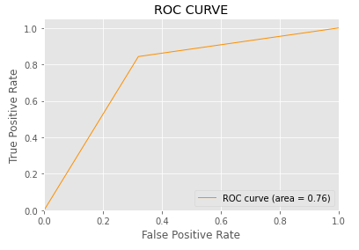

Slide 18


Slide 19
