Slide 1
ACE NODE

Slide 2
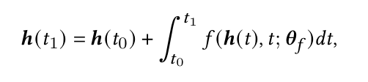

Background

Slide 3

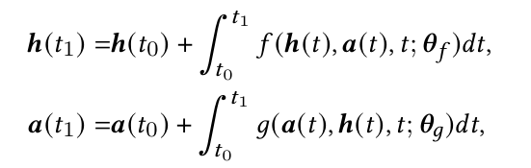



General Idea
NCDE:
ACE-NODE:
Pairwise Attention:
Elementwise Attention:

Slide 4
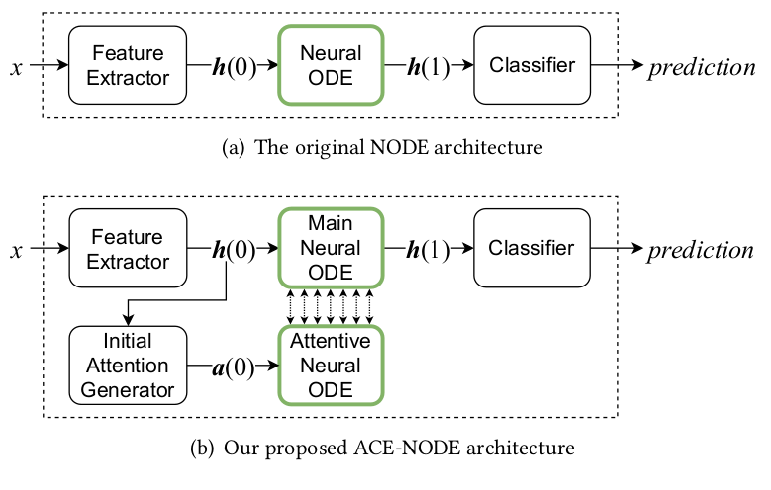
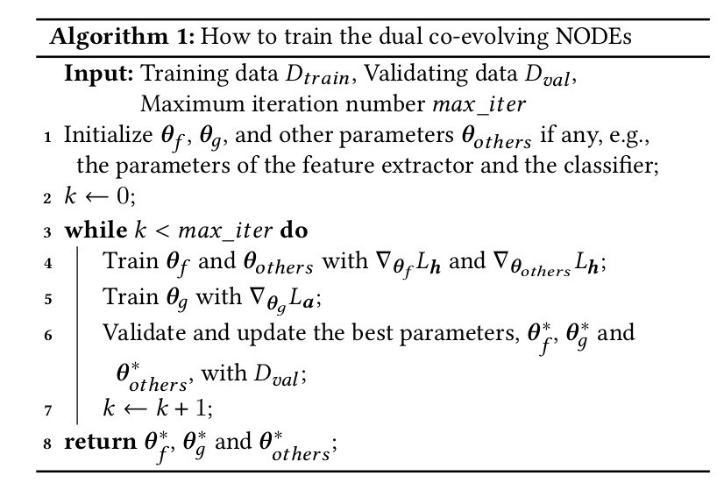
Inputs & Outputs

Slide 5
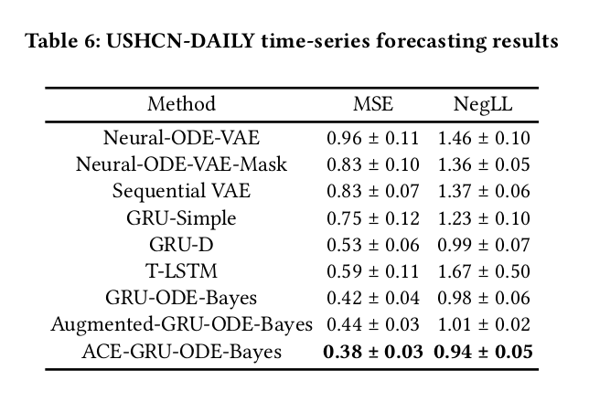
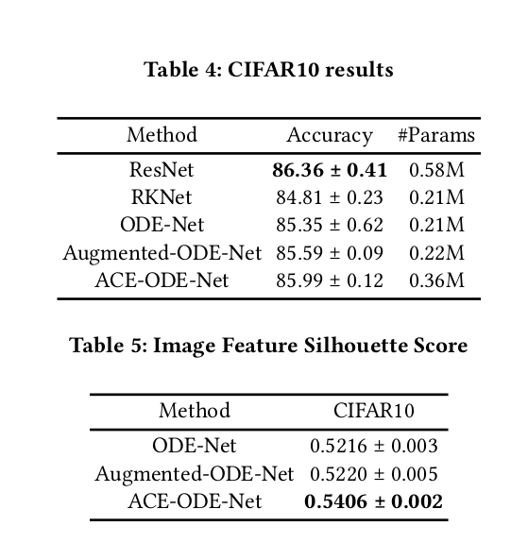
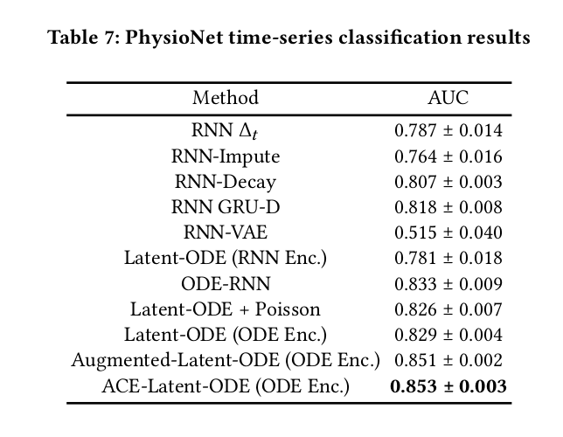
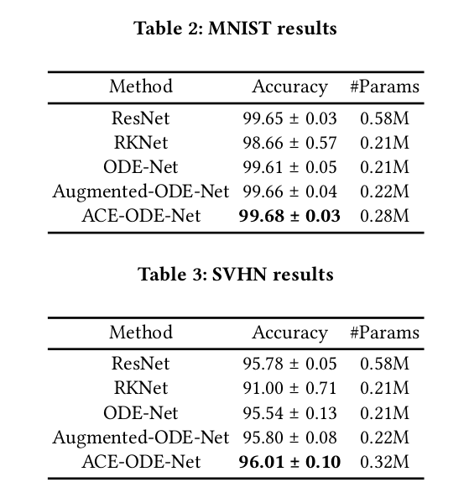
Example Applications

Slide 6
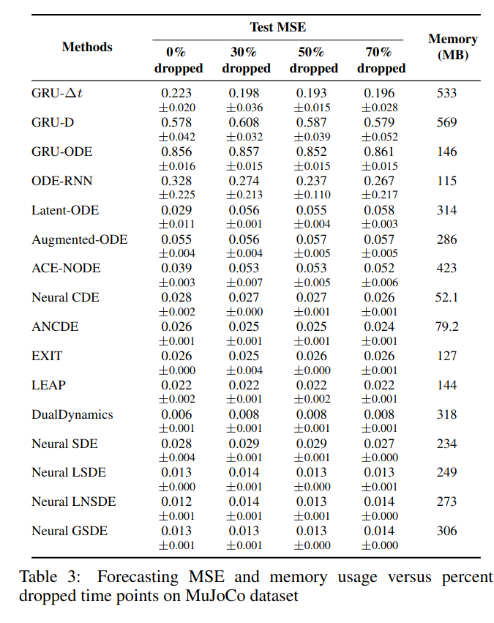
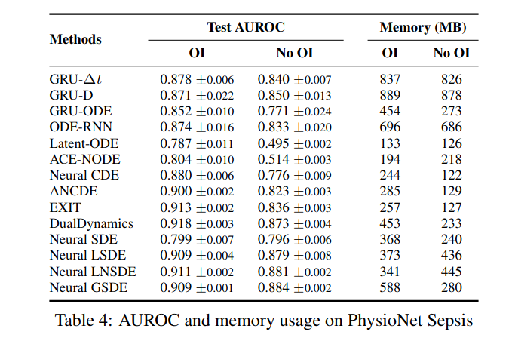
Strengths & Weaknesses

Slide 7
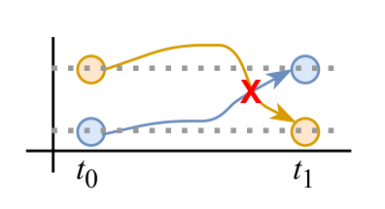
Open Questions

Slide 8
Sources
Comprehensive Review of Neural Differential Equations for Time Series Analysis - YongKyung Oh, Seungsu Kam , Jonghun Lee , Dong-Young Lim , Sungil Kim2 and Alex A. T. Bui
ACE-NODE: Attentive Co-Evolving Neural Ordinary Differential Equations - Sheo Yon Jhin, Minju Jo, Taeyong Kong, Jinsung Jeon, and Noseong Park
https://www.youtube.com/watch?v=nJphsM4obOk
https://www.youtube.com/watch?v=p_di4Zn4wz4

