Slide 1
Integrity – the light within
Dr. Samson Gandhi

Slide 2

What is integrity?
Integrity is a foundational life-value
Integrity is choosing to think and behave based on Biblical values and not for personal gain

Slide 3

Integrity . . .
Gives direction in life
Gives meaning to life
Holds a person together

Slide 4
Integrity is most tested in . . .
Money
Sex
Power
Jesus spoke . . . .
More about money
Firmly about sex, and
Powerfully about power

Slide 5
Money
“It’s all about money, honey.” – Modern mantra
“For the love of money is the root of all evil, for which some have strayed from the faith in their greediness, and pierced themselves through with many sorrows.” – 1 Tim. 6:10

Slide 6
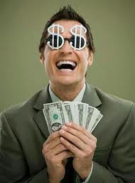
Integrity breakers - Love of money
Making money a pursuit in life. It is idolatry
You become like it – lifeless
You cannot serve God and Mammon – but you can serve God with Mammon.
The Rich Young Ruler

Slide 7
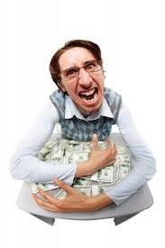
Integrity breakers – Black & White Philosophy
Transparency before God and men
There cannot be a number 2 account.
Ananias and Sapphira

Slide 8
Integrity breakers – Fudging figures
Claiming more expenses than due
Filing proper tax returns
Give unto Caesar what is Caesar’s . . .

Slide 9
Biblical Financial Policy
Do not wear yourself out to become rich.
Give your tithes
Be a giver than a receiver
Lend to the poor
Plan, and avoid impulsive purchases
Avoid buying on credit, plan your loans
Let your standard of living be below your means
Become accountable to spouse/parent/responsible person

Slide 10
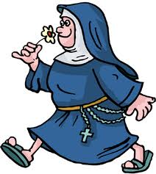
Sex
The story of a Nun giving a sex education class

Slide 11
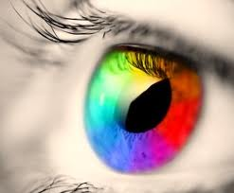
Sex
Our world view shapes our behaviour
Freudian view
Puritan’s view
Hippie view
Asian view
Notes:
Freudian view
At the core of our being we are sexual
All our decisions are driven by sexual impulses
Puritan’s view
At best it is what is done between the sheets
At worst it is dirty, a taboo
Hippe view
Liberate sex
Free sex
Rajaneesh
Asian veiw
Hippocrisy
Pati Patni aur who
Chinna ellu and pedda ellu
Estharaku and kancham

Slide 12

What is our Biblical view of sex?
Sex is God’s idea – Gen. 2:24
Sex is for procreation – Gen. 1:28
Sex is for pleasure – Song of Solomon
Sex is to be within marriage – Heb. 13:4
Marriage bed kept pure – Heb. 13:4
Notes:
Freudian view
At the core of our being we are sexual
All our decisions are driven by sexual impulses
Puritan’s view
At best it is what is done between the sheets
At worst it is dirty, a taboo
Hippe view
Liberate sex
Free sex
Rajaneesh
Asian veiw
Hippocrisy
Pati Patni aur who
Chinna ellu and pedda ellu
Estharaku and kancham

Slide 13
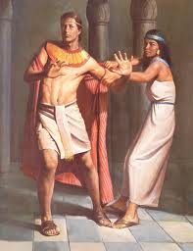
1. Joseph’s Principle
“How can I do this great wickedness, and sin against God?” Genesis 39:9
Fear of God
How can I sin against God?
Notes:
Freudian view
At the core of our being we are sexual
All our decisions are driven by sexual impulses
Puritan’s view
At best it is what is done between the sheets
At worst it is dirty, a taboo
Hippe view
Liberate sex
Free sex
Rajaneesh
Asian veiw
Hippocrisy
Pati Patni aur who
Chinna ellu and pedda ellu
Estharaku and kancham

Slide 14

2. Daniel’s Principle
“Purposed in his heart not to defile himself.” 1:8
Proactive
Choice
Prayer
Notes:
Freudian view
At the core of our being we are sexual
All our decisions are driven by sexual impulses
Puritan’s view
At best it is what is done between the sheets
At worst it is dirty, a taboo
Hippe view
Liberate sex
Free sex
Rajaneesh
Asian veiw
Hippocrisy
Pati Patni aur who
Chinna ellu and pedda ellu
Estharaku and kancham

Slide 15
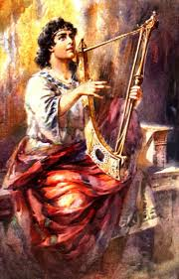
3. David’s Principle
Past victories are no guarantee for future battles – 2 Sam. 11:4
Be occupied with right priorities 11:1
Be mindful of the glory of God 11:4
Be prepared for a life-long battle
Notes:
Freudian view
At the core of our being we are sexual
All our decisions are driven by sexual impulses
Puritan’s view
At best it is what is done between the sheets
At worst it is dirty, a taboo
Hippe view
Liberate sex
Free sex
Rajaneesh
Asian veiw
Hippocrisy
Pati Patni aur who
Chinna ellu and pedda ellu
Estharaku and kancham

Slide 16
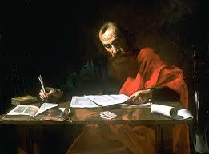
4. Paul’s Principle
“Look upon older women as mothers, younger women as sisters with all purity.” - 1 Timothy 5:2
Sight
Relate
conduct
Notes:
Freudian view
At the core of our being we are sexual
All our decisions are driven by sexual impulses
Puritan’s view
At best it is what is done between the sheets
At worst it is dirty, a taboo
Hippe view
Liberate sex
Free sex
Rajaneesh
Asian veiw
Hippocrisy
Pati Patni aur who
Chinna ellu and pedda ellu
Estharaku and kancham

Slide 17

Millionaire and his chauffer
Notes:
Freudian view
At the core of our being we are sexual
All our decisions are driven by sexual impulses
Puritan’s view
At best it is what is done between the sheets
At worst it is dirty, a taboo
Hippe view
Liberate sex
Free sex
Rajaneesh
Asian veiw
Hippocrisy
Pati Patni aur who
Chinna ellu and pedda ellu
Estharaku and kancham

Slide 18

Power – Caution 44,000 volts!
“Power corrupts; absolute power corrupts absolutely.” – Lord Acton
Political power – power of popularity
Positional power
Corrupt time keeper

Slide 19

Put off your coat and put on your towel
Know your identity
Receive your power
Receive your spiritual gifts

Slide 20
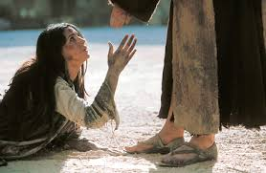
Power: Does it destroy or deliver
The unjust steward
The woman caught in adultery

Slide 21

Know the difference
Ministry
&
Manipulation
Those who are secure in the Lord minister; others manipulate.

Slide 22
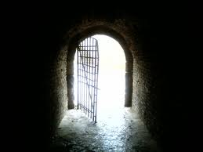
Integrity – your light within
Christ in you the hope of glory.
Let Christ give you your integrity.

