Slide 1

THE TEAM: Florian Klement, Felix Sellmair, Mercy Lio, Tihomir Vachkov

Slide 2
THE IDEA
A USER REACHES A SPECIFIC LOCATION AND IS ABLE TO LISTEN TO THE SOUND OF THE PLACE
THE USER SHOULD TAKE A MOMENT AND ENJOY THE MUSIC OF THE PLACE
FOR THIS,
A MOBILE APPLICATION FOR ANDROID
HAS BEEN DEVELOPED

Slide 3

MAIN IDEA
TRACK THE USER‘S LOCATION BY USING THE GPS OF HIS / HER PHONE
You are within 176m of the sound
♬♪♫♪

Slide 4
MAIN IDEA
PLAY THE FULL SOUND WHEN THE USER IS WITHIN 10m OF THE LOCATION
You are within 9m of the sound
♬♪♫♪

Slide 5

HELP US TO CREATE
A CONTEMPORARY-SOUND-CULTURE
FOR EACH CITY
LET EVERYONE DISCOVER
THE POETRY
OF YOUR FAVOURITE PLACE

Slide 6
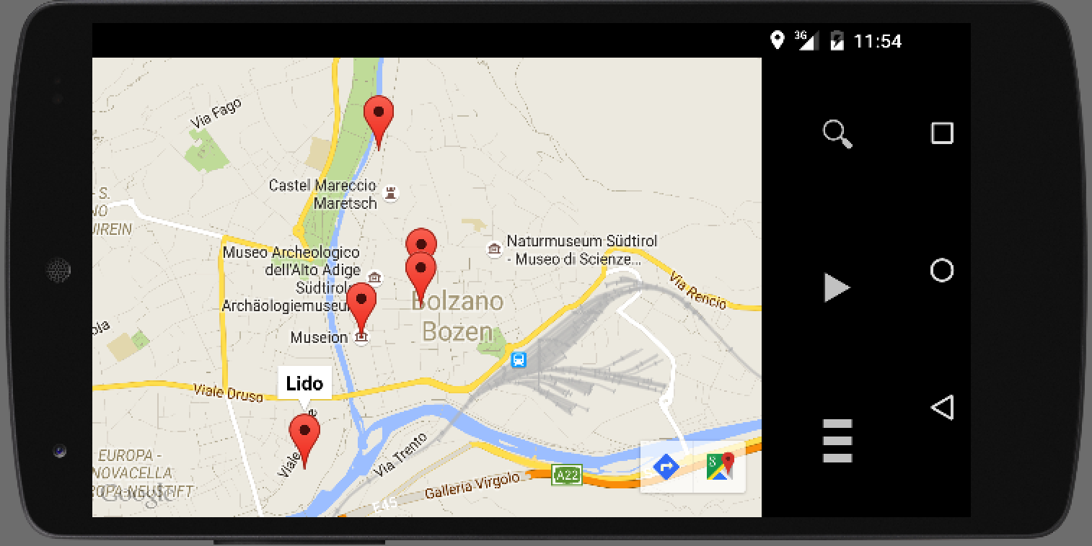
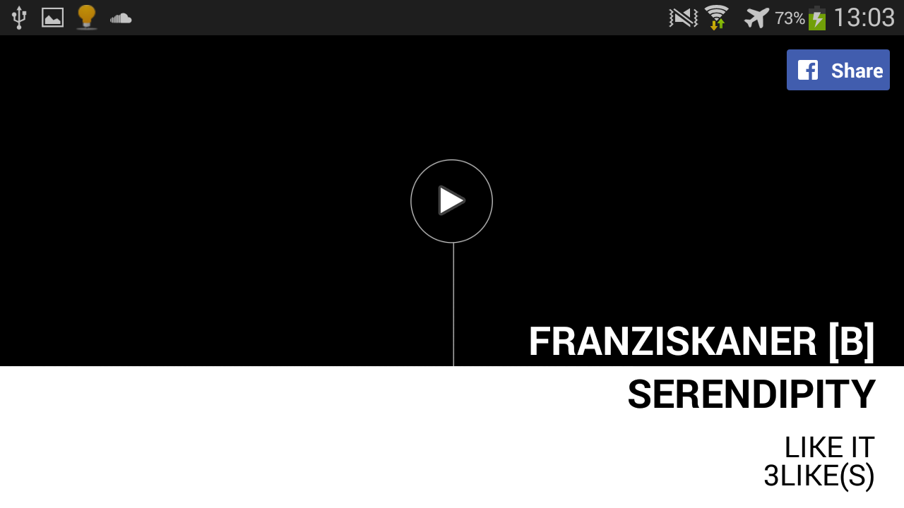
LISTEN & ENJOY

Slide 7
MAP

Slide 8
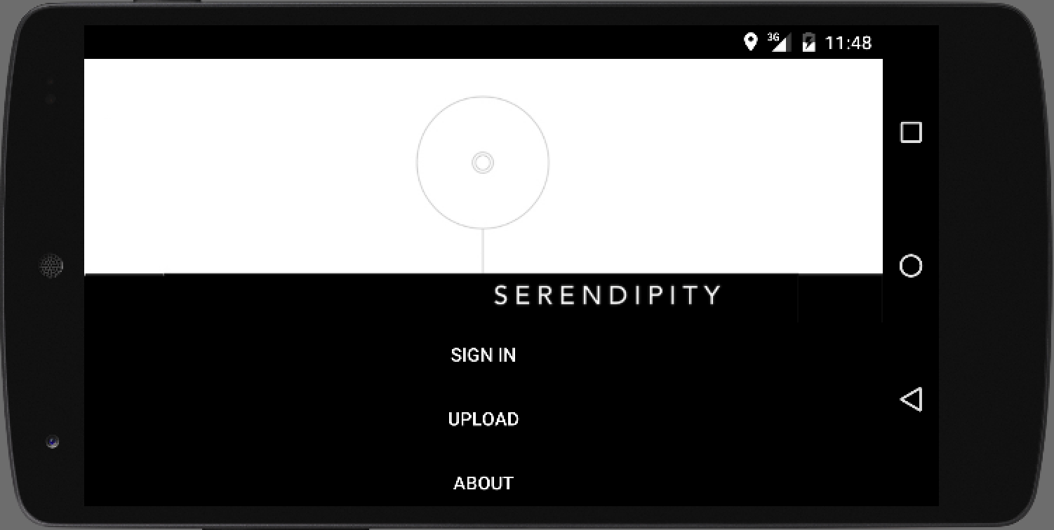
MAIN MENU
SIGN IN
UPLOAD
ABOUT
EXPLORE
LISTEN
RULES
CITIES
CONTACTS

Slide 9
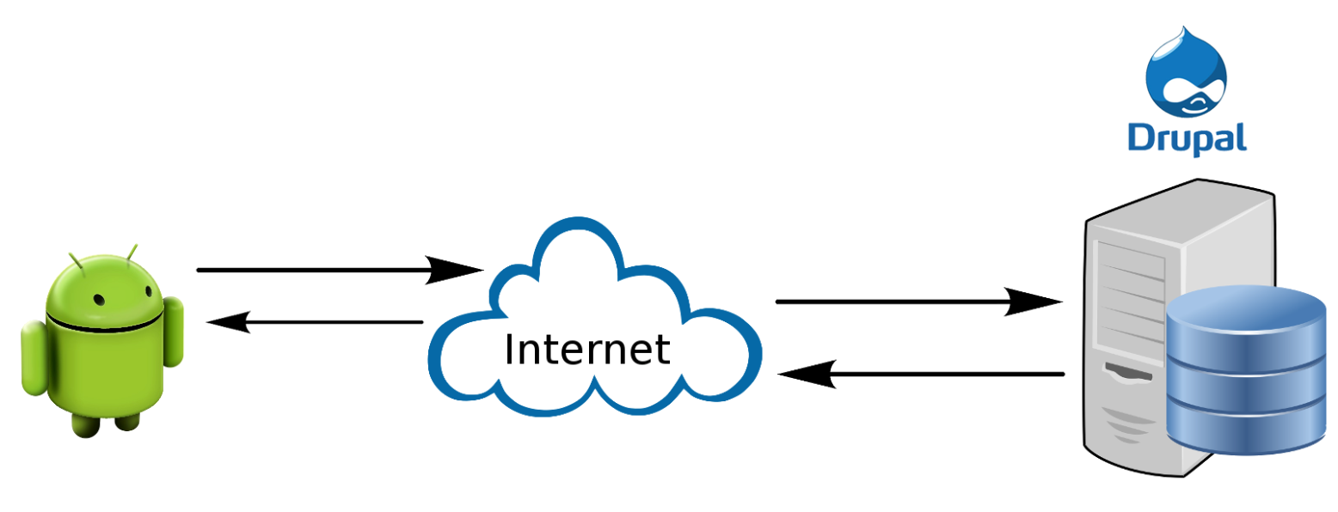
REALIZATION
CLIENT-SERVER APPLICATION
CLIENT: NATIVE ANDROID APP
SERVER: DRUPAL CMS

Slide 10
LESSONS LEARNED...
How to produce a business project while working in an agile process (scrum)
How to communicate with the customer and find out what the customer really wants
How to communicate as a team of developers
We discovered new and suitable techniques

Slide 11
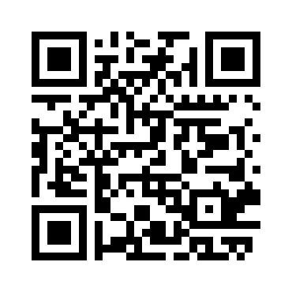
TO FIND OUT MORE...
VISIT THE WEBSITE
http://goo.gl/OgXkkW
OR
DOWNLOAD SERENDIPITY FROM
hhttp://sf.inf.unibz.it/serendipity.apk

Slide 12
Team
CUSTOMER
TEAM
SUPERVISORS
Maria Teresa Scarabello
Florian Klement
Felix Sellmair
Mercy Lio
Tihomir Vachkov
Prof. Davide Taibi
Prof. Matteo Moretti
Prof. Simone Simonelli
Andrea Maragno

