Slide 1


Slide 2
THE IDEA
A USER REACHES A SPECIFIC LOCATION AND IS ABLE TO LISTEN TO THE SOUND OF THE PLACE
THE USER SHOULD TAKE A MOMENT AND ENJOY THE MUSIC OF THE PLACE
FOR THIS,
A MOBILE APPLICATION FOR ANDROID
HAS BEEN DEVELOPED

Slide 3
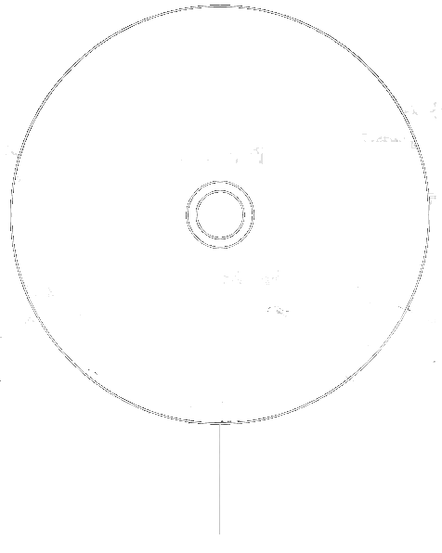
HELP US TO CREATE
A CONTEMPORARY-SOUND-CULTURE
FOR EACH CITY
LET EVERYONE DISCOVER
THE POETRY
OF YOUR FAVOURITE PLACE

Slide 4
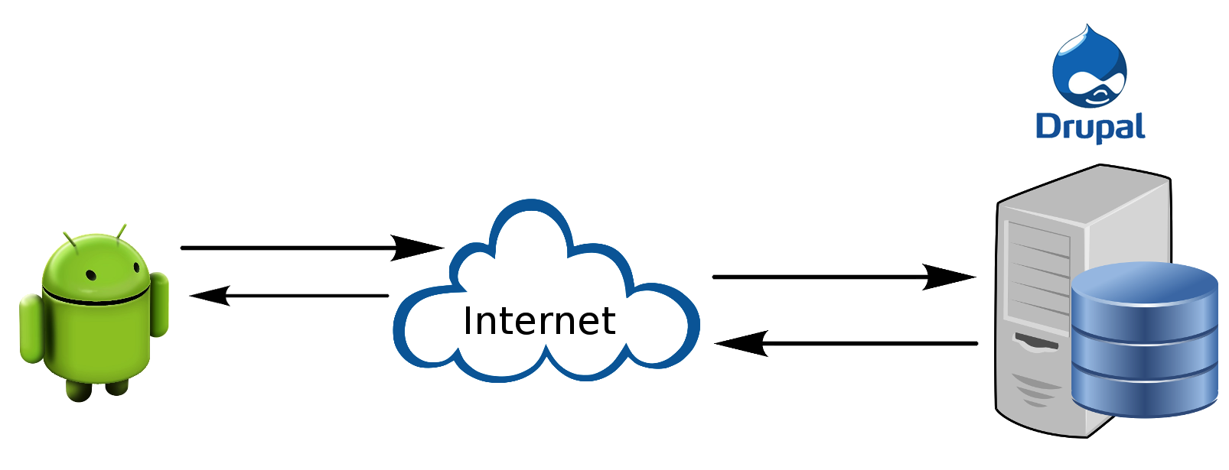
REALIZATION
CLIENT-SERVER APPLICATION
CLIENT: NATIVE ANDROID APP
SERVER: DRUPAL CMS

Slide 5
MAIN FEATURE
TRACK THE USER‘S LOCATION BY USING THE GPS OF HIS / HER PHONE
♬♪♫♪

Slide 6
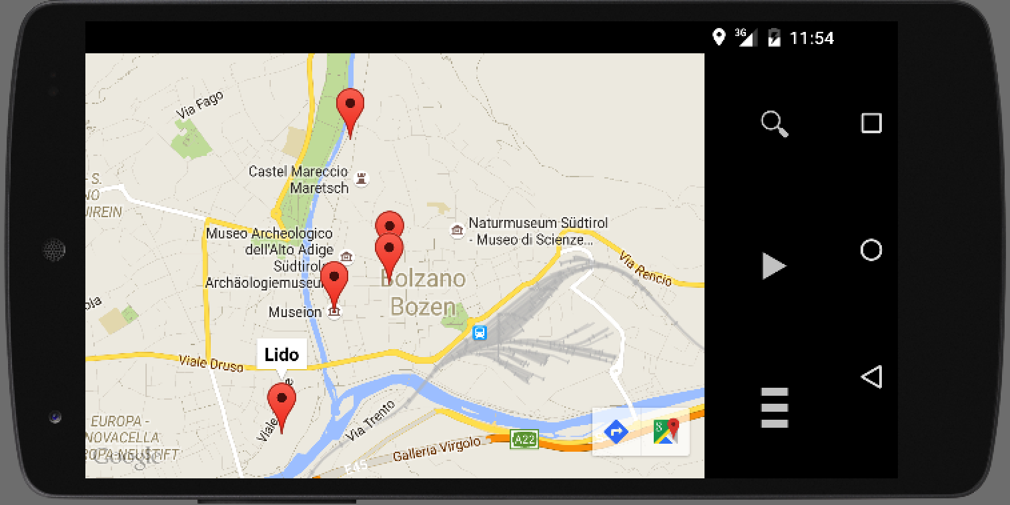
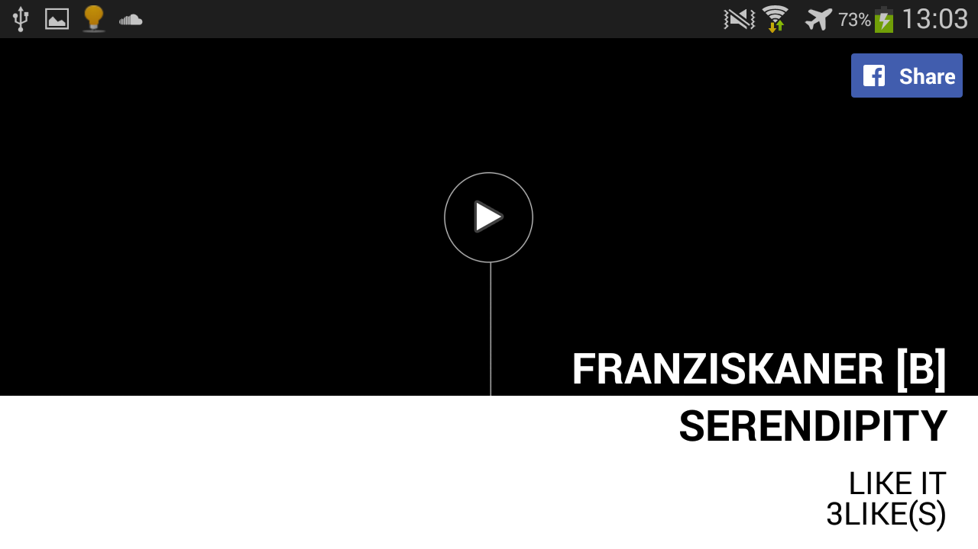
LISTEN & ENJOY

Slide 7
MAP

Slide 8
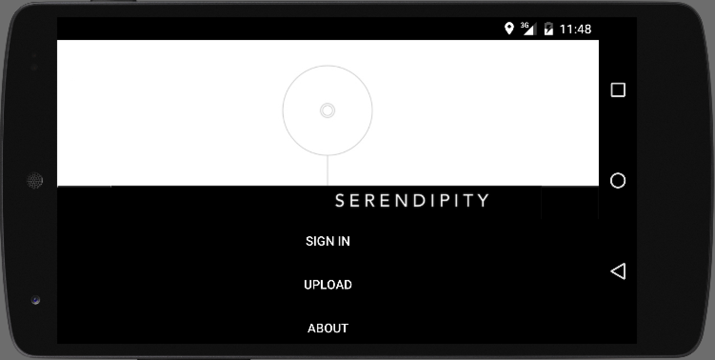
MAIN MENU
SIGN IN
UPLOAD
ABOUT
EXPLORE
LISTEN
RULES
CITIES
CONTACTS

Slide 9
LESSONS LEARNED...
HOW TO PRODUCE A BUSINESS PROJECT
WHILE WORKING IN AN AGILE PROCESS (SCRUM)
HOW TO COMMUNICATE WITH THE CUSTOMER AND FIND OUT WHAT THE CUSTOMER REALLY WANTS
HOW TO COMMUNICATE AS A TEAM OF DEVELOPERS
WE DISCOVERED NEW AND SUITABLE TECHNIQUES

Slide 10
TO FIND OUT MORE...
VISIT THE WEBSITE
http://sf.inf.unibz.it/sf2015/serendipity.html
OR
DOWNLOAD SERENDIPITY FROM
http://sf.inf.unibz.it/serendipity.apk

Slide 11
Team
CUSTOMER
TEAM
SUPERVISORS
Maria Teresa Scarabello
Florian Klement
Felix Sellmair
Mercy Lio
Tihomir Vachkov
Prof. Davide Taibi
Prof. Matteo Moretti
Prof. Simone Simonelli
Andrea Maragno

