Slide 1


Slide 2

HELP US TO CREATE
A CONTEMPORARY-SOUND-CULTURE
FOR EACH CITY
LET EVERYONE DISCOVER
THE POETRY
OF YOUR FAVOURITE PLACE

Slide 3
THE PROJECT
SERENDIPITY WAS CREATED WITH THE AIM OF SHARING SENTIMENTAL MOMENTS WITH PEOPLE
THE PROJECT WAS STARTED IN SUMMER 2015
AT THE DESIGN FACULTY OF UNIBZ
IN WINTER 2015 THE PROJECT WAS INTRODUCED
TO THE SOFTWARE FACTORY COURSE
AFTER THIS,
A MOBILE APPLICATION FOR ANDROID
HAS BEEN DEVELOPED

Slide 4
OPEN YOUR EYES AND LISTEN

Slide 5
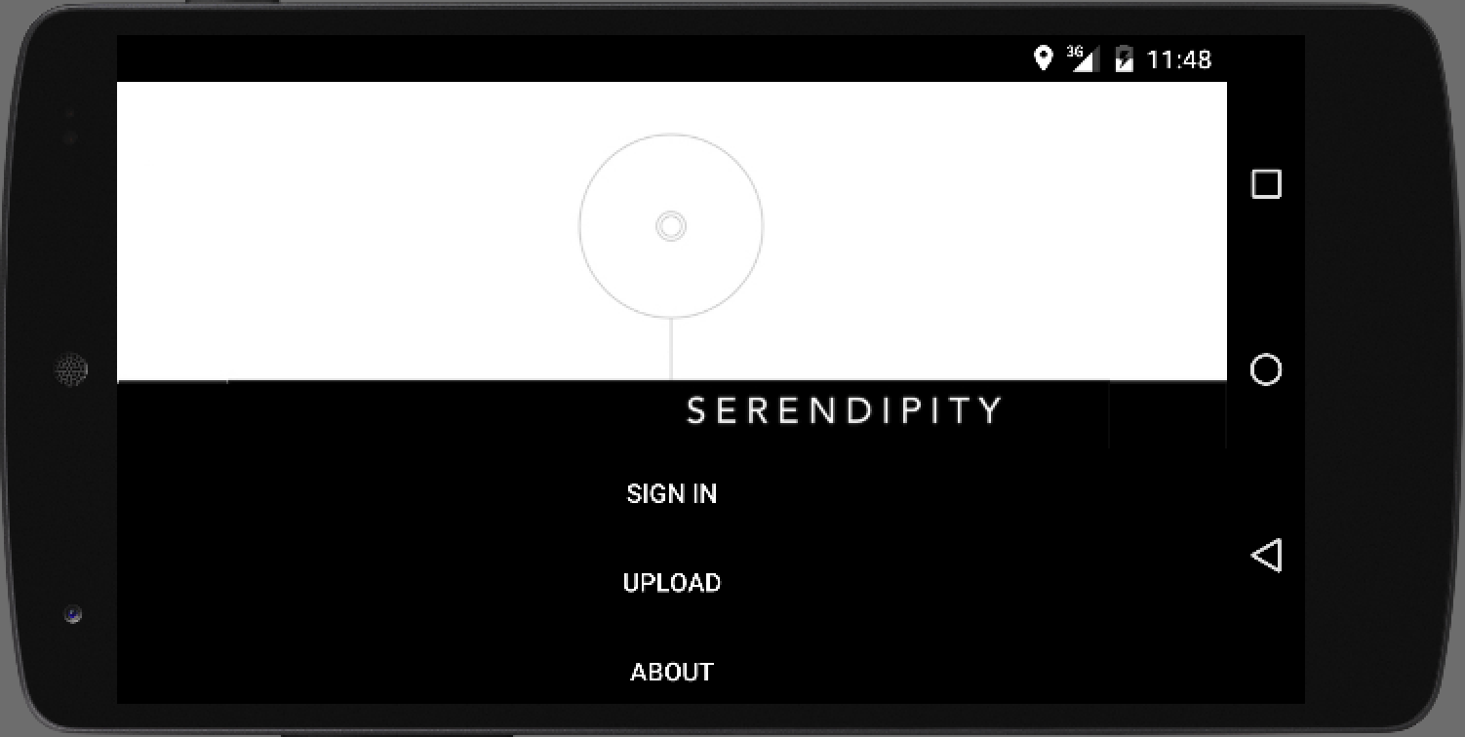
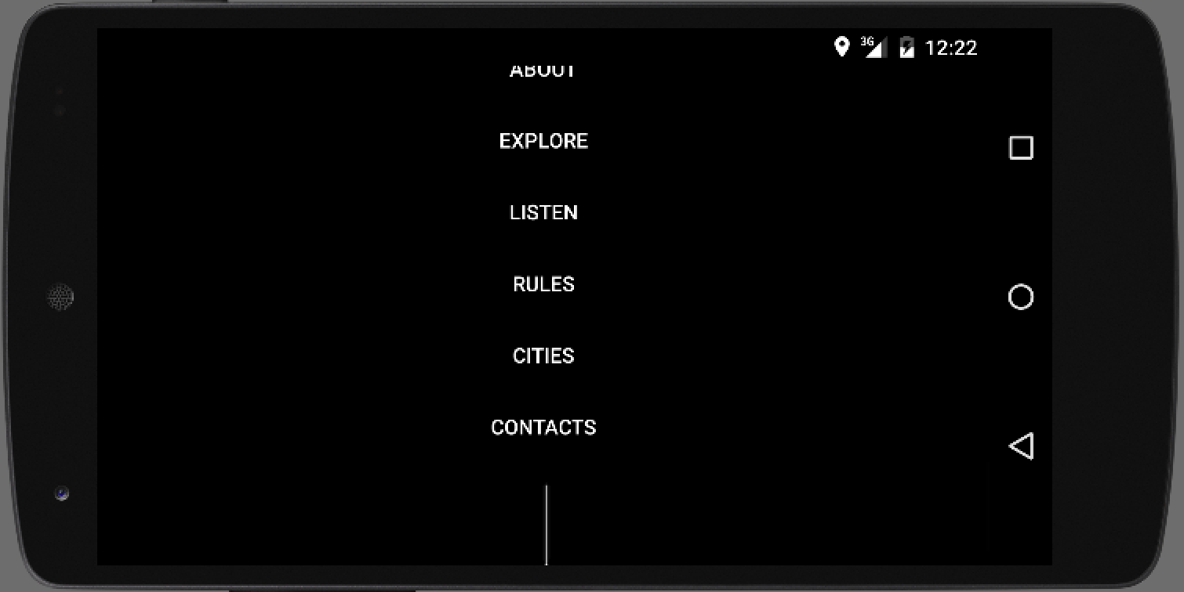
main screen

Slide 6
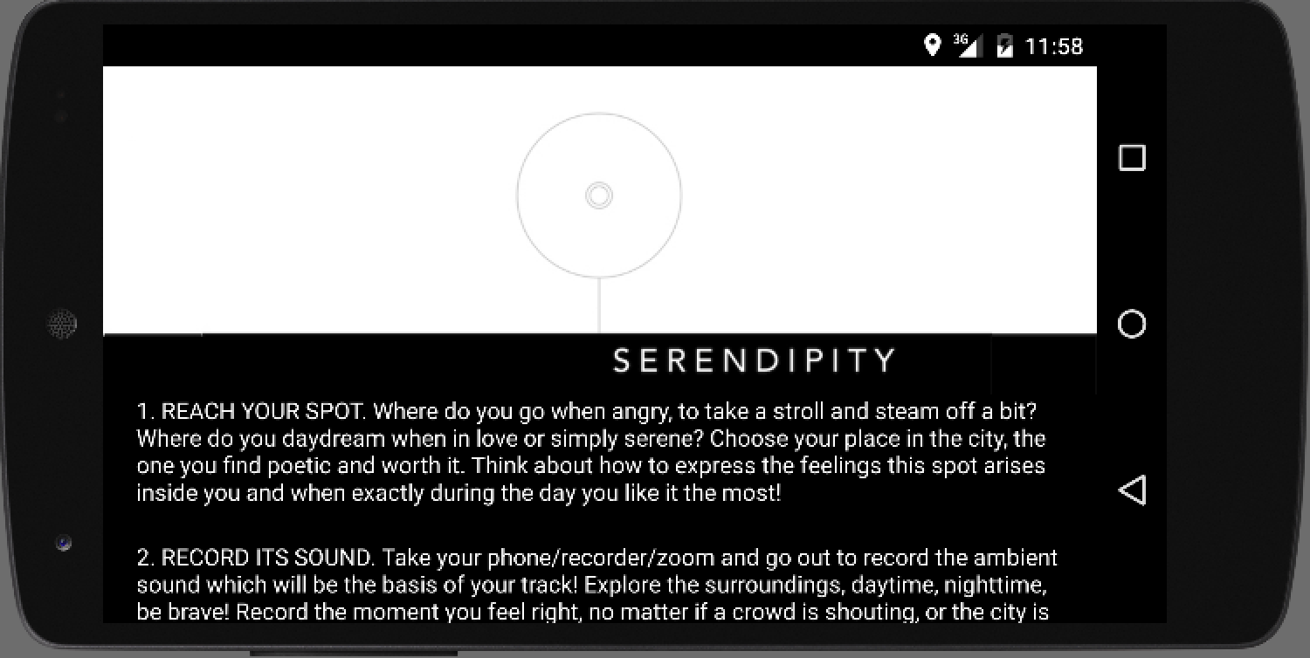
rules

Slide 7
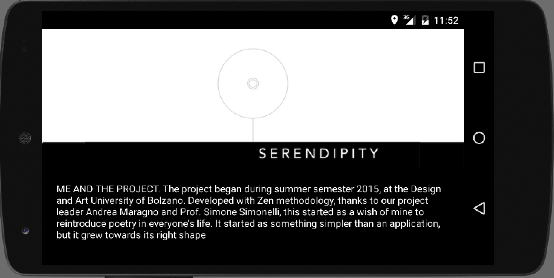
about

Slide 8
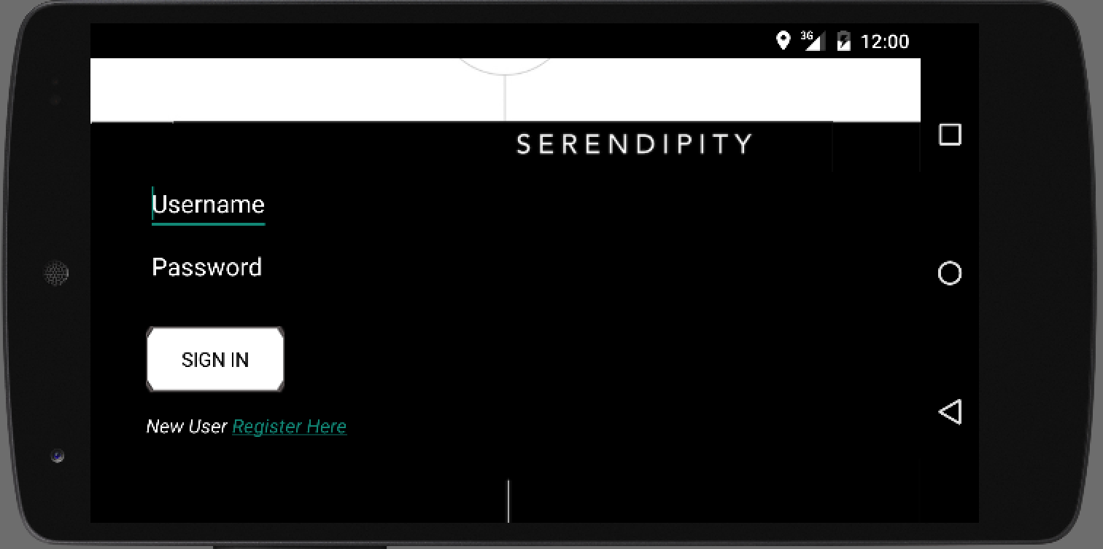
sign in

Slide 9
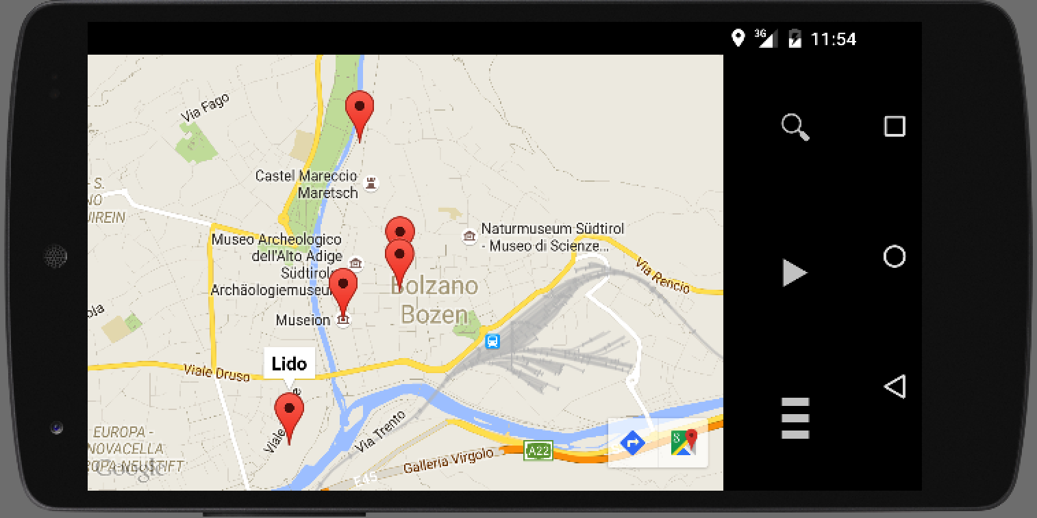
map

Slide 10
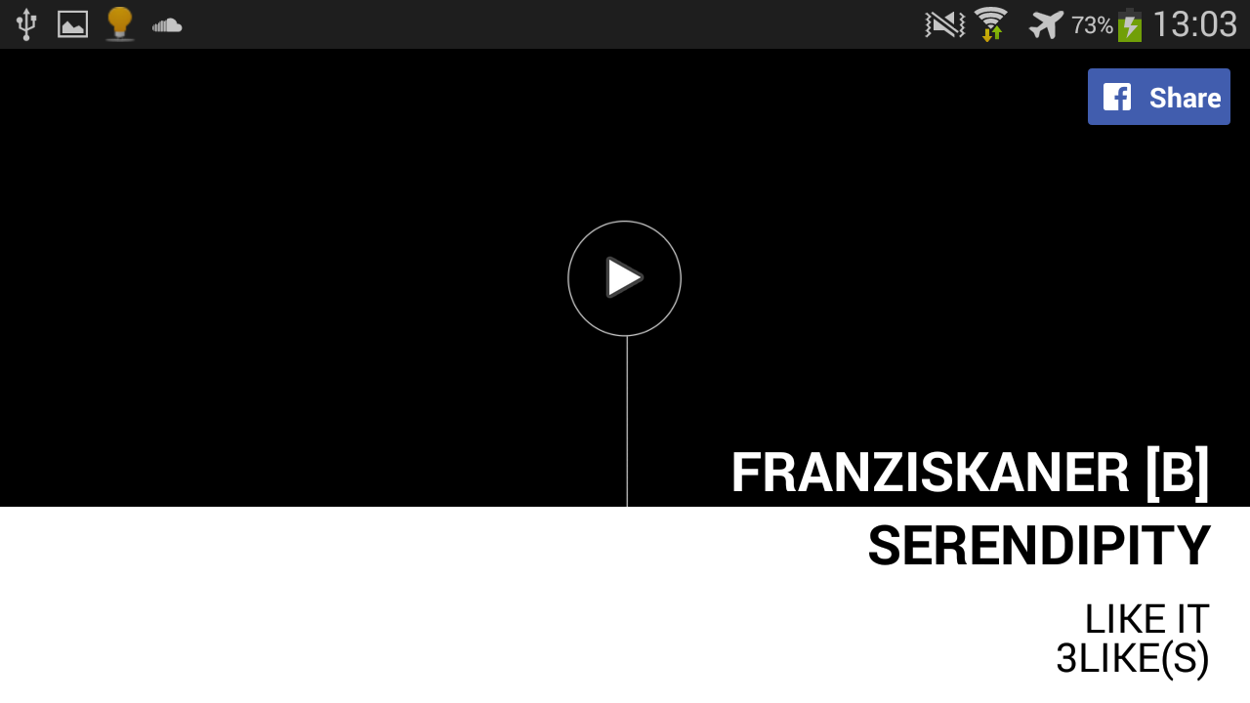
Listen & share

Slide 11
TO FIND OUT MORE...
VISIT THE WEBSITE
http://sf.inf.unibz.it/sf2015/serendipity.html
OR
DOWNLOAD SERENDIPITY
FROM <<LINK>>

Slide 12
Team
CUSTOMER
TEAM
SUPERVISORS
Maria Teresa Scarabello
Florian Klement
Felix Sellmair
Mercy Lio
El Tisho
Prof. Davide Taibi
Prof. Matteo Moretti
Prof. Simone Simonelli
Andrea Maragno

