Slide 1

Larry cai <larry.caiyu@gmail.com>

Slide 2

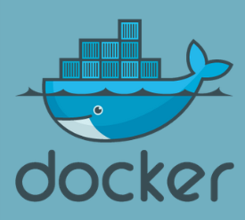
Agenda
Ansible Introduction
Exercise 1: Setup environment using docker
Exercise 2: Inventory and ad-hoc command
Exercise 3: Playbooks - install apache
Exercise 4: Playbooks – variables
Exercise 5: Playbooks – Template using Jinja2
Summary
Code:
https://github.com/larrycai/codingwithme-ansible
Learn Ansible in Docker in 90 minutes

Slide 3

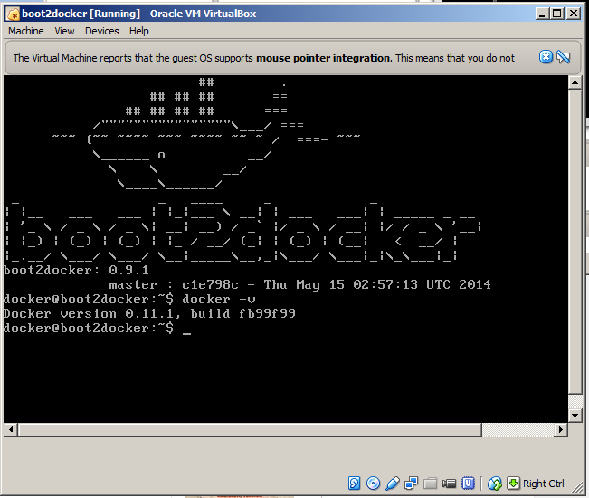
Environment (docker/fig)
Boot2docker Installer (127M)
  Contains latest docker already, fast
  Container persistence via disk automount on /var/lib/docker
  Add proxy /var/lib/boot2docker/profile if needed
    $ sudo vi /var/lib/boot2docker/profile
    export http_proxy=<your proxy>
    $ sudo /etc/init.d/docker restart
  $ docker -v
  User/Passwd: docker/tcuser
  (Optional) replace with boot2docker.iso
  (fig/share folder support)
http://boot2docker.io/
https://github.com/larrycai/boot2docker-vbga-fig/releases
Learn Ansible in Docker in 90 minutes

Slide 4

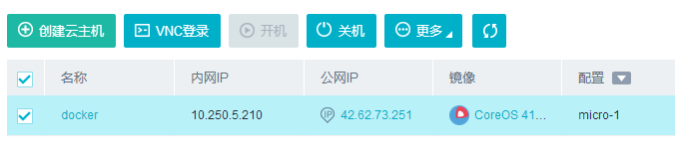
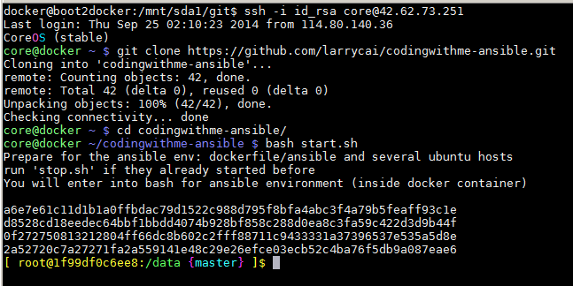
Environment use online service
Create docker VM using CoreOS image, and assign public IP to access
http://ustack.com or
https://cloud.digitalocean.com
Clone code & Start them
$ git clone https://github.com/larrycai/codingwithme-ansible.git
$ cd codingwithme-ansible
$ bash start.sh
# ./update.sh
# ansible all –a “uname –a”
Learn Ansible in Docker in 90 minutes

Slide 5
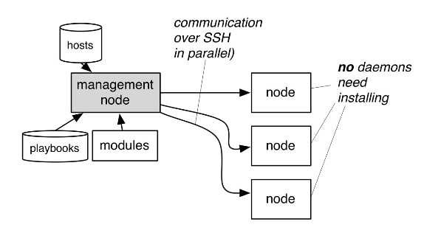
What is Ansible
Ansible is a radically simple IT orchestration engine that automates configuration management, application deployment, and many other IT needs.
Similar to Cfengine/Puppet/Chef/Saltstack
Features:
  Agentless with ssh
  Very simple language (YAML).
  Lots of modules to execute task.
  Python
Image source: page21
from http://www.slideshare.net/NETWAYS/jp-mensansible
Learn Ansible in Docker in 90 minutes

Slide 6
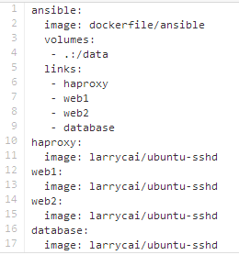

Exercise 1:
Setup environment using docker
Clone code from https://github.com/larrycai/codingwithme-ansible
$ fig run ansible bash # or ./start.sh
(ansible) # ./update.sh & cd exercise
(ansible) # ansible all –a “uname –a”
Docker Engine Server (VM)
Ansible environment
Haproxy
web1
web2
80
1080
haproxy
Database
80
80
web1
web2
Learn Ansible in Docker in 90 minutes

Slide 7
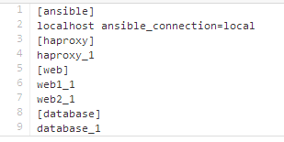

Inventory & ad-hoc command
hosts: Inventory is host list
ansible.cfg: define
An ad-hoc command is something that you might type in to do something really quick, but don’t want to save for later.
$ ansible <host patterns> [options]
$ ansible web –m command –a “uname –a”
-m module name, default is command
-I inventory name, defaults is set in ansible.cfg or /etc/ansible/hosts
-a module args
See http://docs.ansible.com/intro_adhoc.html
Learn Ansible in Docker in 90 minutes

Slide 8
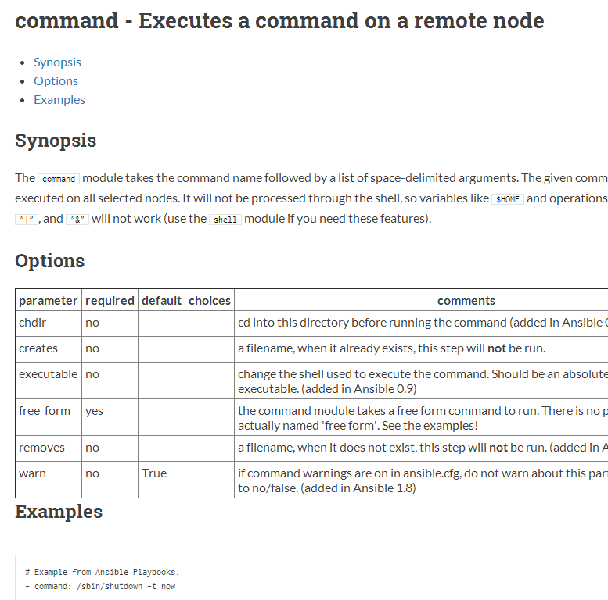
Module
Ansible ships with a number of modules (called the ‘module library’) that can be executed directly on remote hosts
Modules can control system resources, like services, packages, or files (anything really), or handle executing system commands.
All modules technically return JSON format data
See http://docs.ansible.com/modules.html
Learn Ansible in Docker in 90 minutes

Slide 9
Exercise 2: ad-hoc command
Check free memory in `all` hosts `-a “free –m”`
Check all facts in `web` host pattern using module setup
Create `/ansible` directory is created in web
  Using file module http://docs.ansible.com/file_module.html
  -m file -a “path=/ansible state=<?>”
Run command again (check changed)
ssh to remote web1 to remove `/ansible` and do it again
–i /ansible/id_rsa root@web1
Take a look at module /usr/share/ansible/files/file
Learn Ansible in Docker in 90 minutes

Slide 10
Idempotency
Idempotence is the ability to run an operation which produces the same result whether run once or multiple times
Ansible has ability to ensure the same configuration is maintained whether you run it once or a thousand times.
In fact, almost every aspect of Ansible modules and commands is idempotent.
$ ansible web –m file –a “path=/ansible state=directory”
Declarative: Define what instead of how
path=/ansible state=directory
vs.
mkdir /ansible
Learn Ansible in Docker in 90 minutes

Slide 11
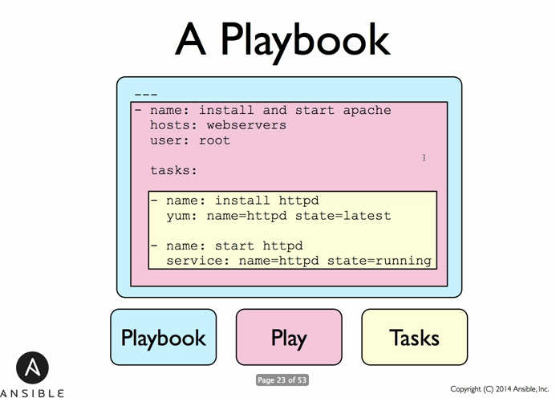
Playbook
Playbooks are Ansible’s configuration, deployment, and orchestration language. They can describe a policy you want your remote systems to enforce, or a set of steps in a general IT process.
$ ansible-playbook site.yml
Each task is one module
command
- file: path=/ansible state=directory
or
- name: make sure /ansible exist
file: path=/ansible state=directory
YAML format
key/value format
http://docs.ansible.com/playbooks.html
Learn Ansible in Docker in 90 minutes

Slide 12


Exercise 3：Playbook – Install apache
Turn file command into playbook exer3.yml
Install apache2 and make them running into web hosts
$ ansible-playbook exer3.yml
Use curl command to verify apache2 is running
$ curl http://web1_1:80
Run ansible-playbook in debug mode using –vvvv
notice the color for changed=true/false
If work in firewall, run below command before exercise
$ ansible-playbook proxy.xml –e “http_proxy=http://<company_proxy>”
80
web2
Learn Ansible in Docker in 90 minutes

Slide 13
Variable
Variable is used to abstract data in ansible
  Define variable and use it with “{{ }}”
  - host: web
  vars:
  http_port:80
  tasks:
  - debug: msg=“hello {{ http_port }}”
  Default variables can be put under group_vars/all
  Pass variable from command line –e “key=value”
Ansible provides a few variables for you automatically. ‘hostvars’, ‘group_names’, and ‘groups’.
with_items for multi key/value
- name: touch files with an optional mode
file: dest={{ item.path }} state=touch
with_items:
- path: /tmp/foo
- path: /tmp/bar
Learn Ansible in Docker in 90 minutes

Slide 14
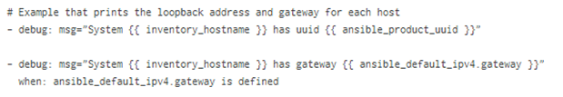
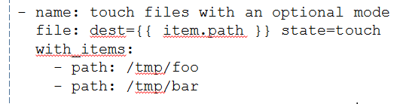
Exercise 4: Variables
Install haproxy (understand)
check web ip (understand)
  Print ip address (system variable “hostvars”)
Install extra packages (curl) using variables
  Variable in yaml
  In group_vars
  Pass in command line
  Install extra packages with_items (wget/socat)
Haproxy
80
80
web1
web2
Learn Ansible in Docker in 90 minutes

Slide 15
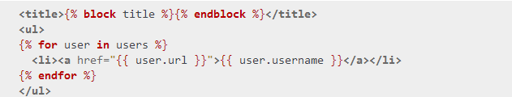

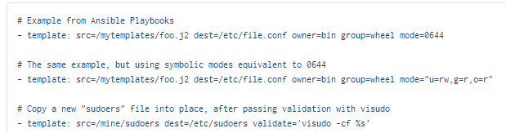
File/Template
Template using Jinja2 (http://jinja.pocoo.org/), which is a modern and designer-friendly templating language for Python
Template module
template: src=templates/haproxy.cfg.j2 dest=/etc/haproxy/haproxy.cfg
Learn Ansible in Docker in 90 minutes

Slide 16
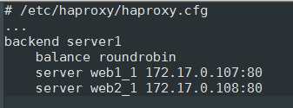
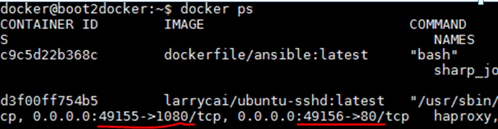
Exercise 5: Template
See result
    Add web1/web2 into haproxy backend using loop haproxy.cfg.j2
    Add stats port 1080 in haproxy
Check it in haproxy server
  docker ps to check haproxy’s port for 80/1080
  http://192.168.59.103:49155 & http://192.168.59.103:49156
Update /var/www/html/index.html in each web for to its hostname
80
1080
haproxy
80
80
web1
web2
Learn Ansible in Docker in 90 minutes

Slide 17
Others not touched
Dynamic Inventory
Roles
Write own module
Ansible-Galaxy
Ansible-Tower
Learn Ansible in Docker in 90 minutes

Slide 18
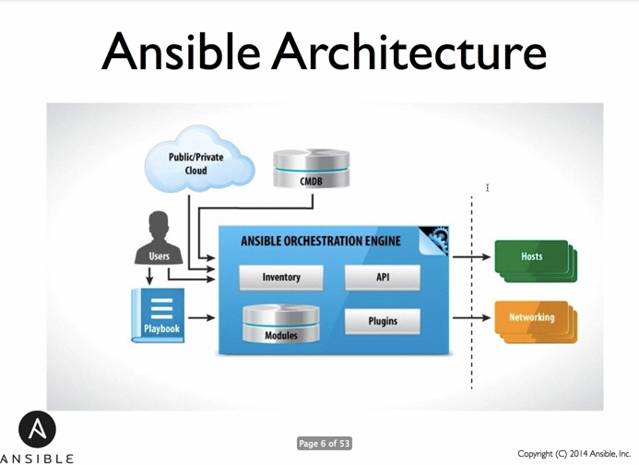
Summary
Ansible is the orchestration engine to manage your infrastructure
Automate your own tasks using Ansible
Just do it !
Learn Ansible in Docker in 90 minutes

Slide 19

Reference
http://docs.ansible.com/
https://serversforhackers.com/editions/2014/08/26/getting-started-with-ansible/
Practice online
  http://ustack.com
Learn Ansible in Docker in 90 minutes

