Slide 2
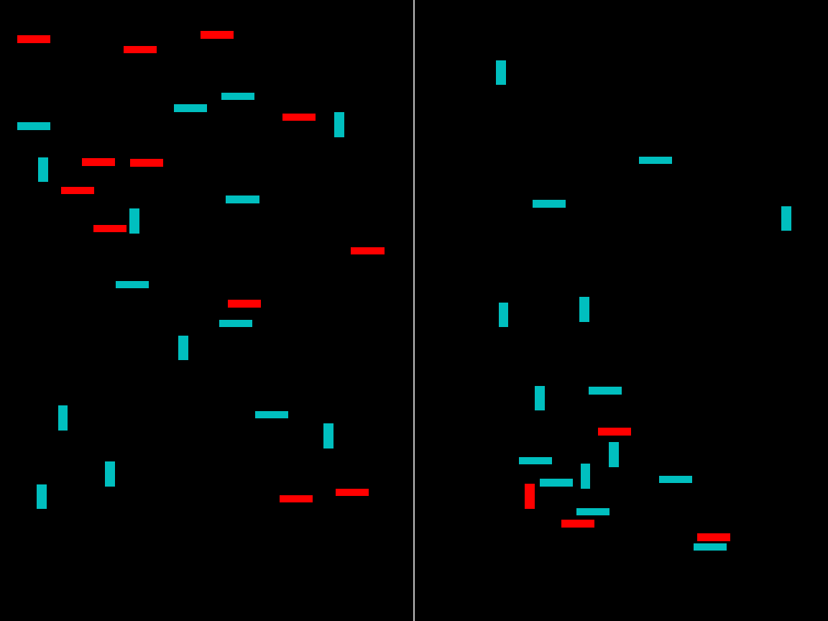

Slide 3
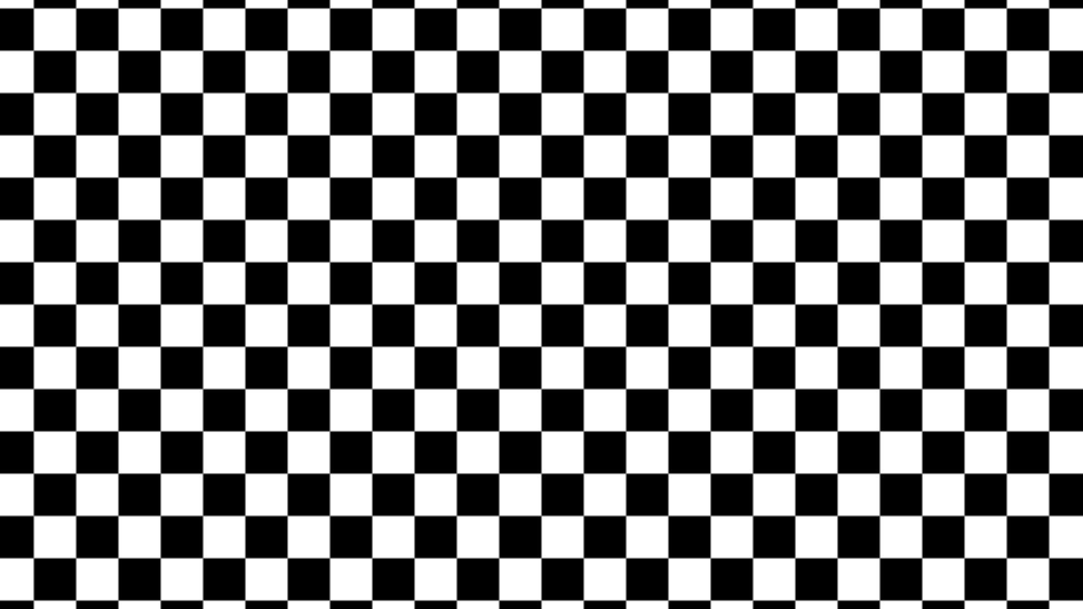

Slide 4
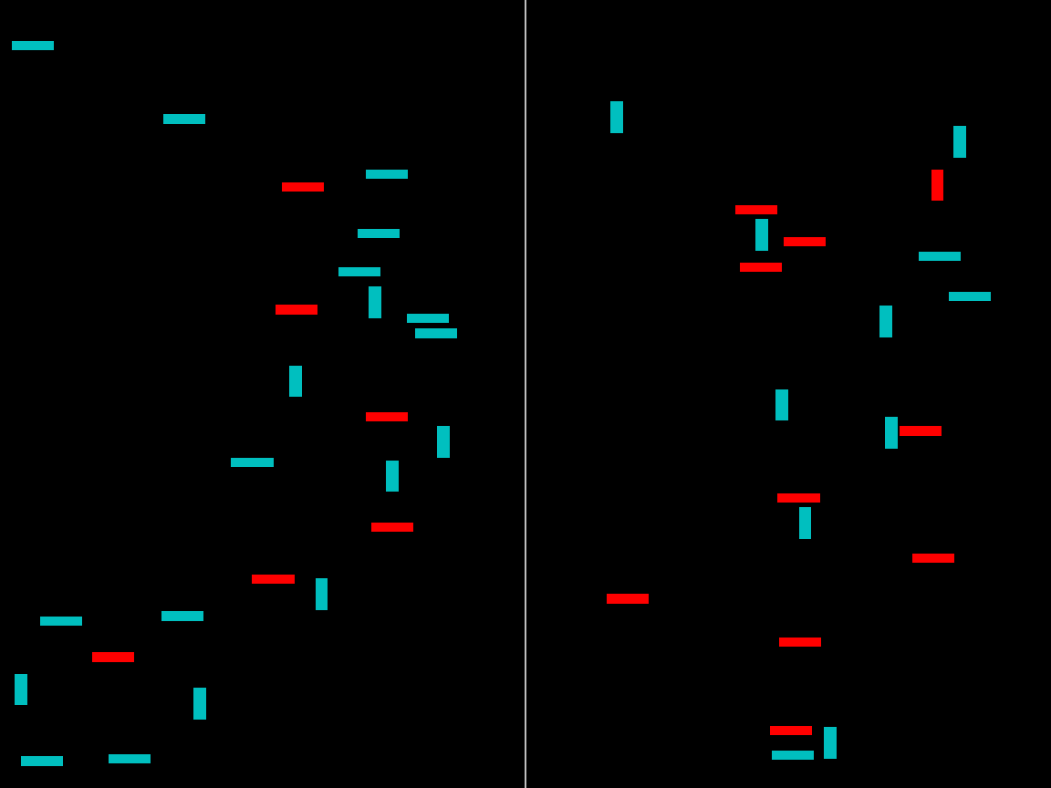

Slide 6
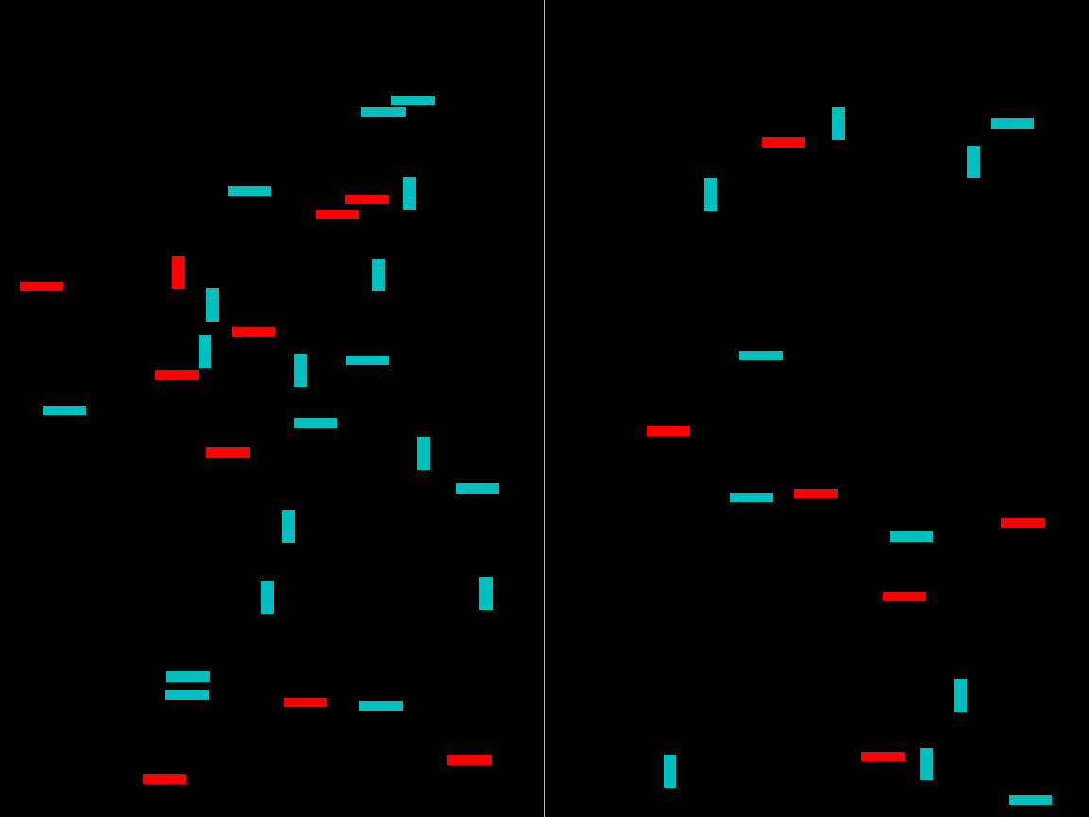

Slide 8
Was the vertical red bar more present on the LEFT or on the RIGHT?
Certainly LEFT
Maybe LEFT
Maybe RIGHT
Certainly RIGHT

