Slide 1
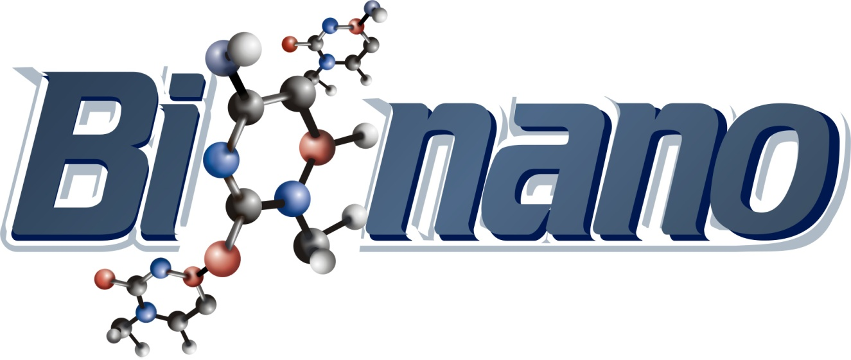
Advanced Digital System Design Course

Slide 2


Slide 3
1. Logarithm: Y = log₂X
El algoritmo para obtener Y=log₂X consta de dos partes: calculo de la parte entera y calculo de la parte decimal
Calculo de la parte entera:
  el número X se divide entre 2 y se cuentan las veces que se puede dividir el número antes de alcanzar el valor a, tal que 1≤ a <2.
  El número de veces corresponde la parte entera del valor de Y
  https://swebse12.univalle.edu.co/nomina/

Slide 4
1. Shor’s algorithm
Modern cryptography relies on the extreme difficulty computers have in factoring huge numbers, but an algorithm that works only on a quantum computer finds factors easily. Today in Science, researchers at the University of Bristol, in England, report the first factoring using this method—called Shor’s algorithm—on a chip-scale quantum computer, bringing the field a tiny step closer to realizing practical quantum computation and code cracking.
Quantum computers are based on the quantum bit, or qubit. A bit in an ordinary computer can be either a 1 or a 0, but a qubit can be 1, 0, or a ”superposition” of both at the same time. That makes solving certain problems—like factoring—exponentially faster, because it lets the computer try many more solutions at once. The race is on to find the ideal quantum computer architecture, with qubit contenders that include ions, electrons, superconducting circuits, and photons

Slide 5
Fundamentals of Mixed-Signal FPGAs
The analog domain describes the way things typically work in the real world. By comparison, the digital domain is useful when it comes to storing and manipulating data and making complex decisions based on the results of its data-processing operations. Most people think of FPGAs as being primarily digital devices, but a certain class of mixed-signal FPGAs provide a mixture of programmable analog fabric combined with programmable digital fabric. This opens the door to a wide range of applications along with some very interesting techniques, such as using a soft microprocessor core in the digital fabric to reconfigure the programmable analog fabric on-the-fly.
In this webinar you will learn:
What are mixed-signal FPGAs?
Why do you need mixed-signal FPGAs?
How do you use mixed-signal FPGA?

Slide 6
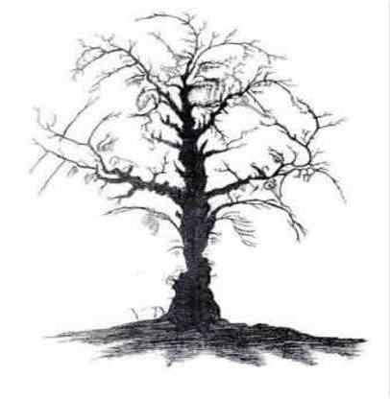
Fundamentals of Mixed-Signal FPGAs

