Slide 1


Advanced Digital System Design Course
Notes:
1
1

Slide 2

Advanced Digital System Design Course
Notes:
2

Slide 3
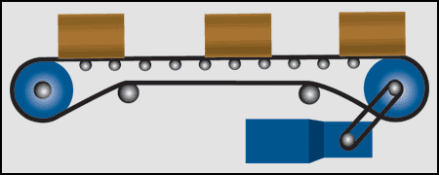
Parcial 1: Punto 4 Ivan Gonzalez
Diseñar una maquina de estados síncrona para controlar los motores de dos bandas de transporte: El proceso se detiene si por la banda 2 (B2) pasan 5 objetos o si por las dos bandas (B2 y B1) pasan 6 objetos .

Slide 4
Codificación
Cuando M2M1 = 11 ambas bandas están funcionando.
Cuando M2M1 = 00 ambas bandas están apagadas. Las entradas de la FSM son X1 y X2
Cuando X2X1 = 00 por las bandas no pasan objetos.
Cuando X2X1 = 01 por las banda B1 pasa un objeto.
Cuando X2X1 = 10 por las banda B2 pasa un objeto.
Cuando X2X1 = 11 por las bandas B1 y B2 pasa 1 objeto.

Slide 5
Diagrama de Estados
S0
01
S1
01
S2
01
S3
01
S4
01
S5
0.0
0.1
0.2
0.3
0.4
0.5
11
10
11
10
11
10
11
10
01
10
11
10
S6
01
S7
01
S9
01
11
01
S8
S10
1.1
1.2
1.3
1.4
1.5
01
11
10
11
10
11
10
10
10
11
11
S11
01
S12
01
S13
01
S14
01
2.2
2.3
2.4
2.5
10
11
10
11
10
11
10
11
S20
S15
01
S16
01
S17
01
10
11
5.6
3.3
3.4
3.5
10
11
10
11
S18
01
S19
4.5
01
10
11
4.4
10
11

Slide 6
Diagrama de Estados
___
01
__
01
__
01
__
01
__
01
__
0.0
0.1
0.2
0.3
0.4
0.5
11
10
11
10
11
10
11
10
01
10
11
10
__
01
__
01
__
01
11
01
__
___
1.1
1.2
1.3
1.4
1.5
01
11
10
11
10
11
10
10
10
11
11
___
01
___
01
___
01
___
01
2.2
2.3
2.4
2.5
10
11
10
11
10
11
10
11
____
___
01
___
01
___
01
10
11
5.6
3.3
3.4
3.5
10
11
10
11
___
01
___
4.5
01
10
11
4.4
10
11

Slide 7
Diagrama de Estados
___
01
___
01
___
01
___
01
___
0.0
0.2
0.3
0.4
11
0.1
11
10
11
10
11
10
11
10
01
10
___
01
___
01
___
01
___
1.1
1.2
1.3
1.4
11
10
11
10
11
10
01
10
11
___
01
___
01
___
2.2
2.3
2.4
01
10
10
11
10
11
____
01
10
11
X.5
____
___
01
___
01
10
5.6
3.3
3.4
11
10
11
11
___
01
4.4
10
11

Slide 8
Diagrama de Estados
___
01
___
01
___
01
___
01
___
0.0
0.2
0.3
0.4
11
0.1
11
10
11
10
11
10
11
10
01
10
___
01
___
01
___
01
___
1.1
1.2
1.3
1.4
11
10
11
10
11
10
01
10
11
___
01
___
01
___
2.2
2.3
2.4
01
10
10
11
10
11
____
01
10
11
X.5
____
___
01
___
01
10
5.6
3.3
3.4
11
10
11
11
___
01
4.4
10
11

Slide 9
Diagrama de Estados
___
01
___
01
___
01
___
0.0
0.1
0.2
0.3
11
10
11
10
11
10
01
11
10
___
01
___
01
___
1.1
1.2
1.3
11
10
11
01
11
10
10
___
01
___
01
,10
11
01
2.2
2.3
____
10
11
X.4
01
10
11
____
___
X.5
01
10
11
3.3
01
10
11
____
5.6
___
01
4.4
10
11

Slide 10
Diagrama de Estados
___
01
___
01
___
01
___
0.0
0.1
0.2
0.3
11
10
11
10
11
10
01
11
10
___
01
___
01
___
1.1
1.2
1.3
11
10
11
01
11
10
10
___
01
___
01
,10
11
01
2.2
2.3
____
10
11
X.4
01
10
11
____
___
X.5
01
10
11
3.3
01
10
11
____
5.6
___
01
4.4
10
11

Slide 11
Diagrama de Estados
___
01
___
01
___
11
0.0
0.1
0.2
10
11
10
01
11
10
___
01
___
1.1
1.2
01
11
10
11
11
___
___
2.2
01
X.3
01,
10
10
____
11
X.4
___
01,
10
3.3
01
___
10
X.5
01,
10,
11
11
___
01
___
4.4
11
5.6
10,
11

Slide 12
Diagrama de Estados
___
01
___
01
___
11
0.0
0.1
0.2
10
11
10
01
11
10
___
01
___
1.1
1.2
01
11
10
11
11
___
___
2.2
01
X.3
01,
10
10
____
11
X.4
___
01,
10
3.3
01
___
10
X.5
01,
10,
11
11
___
01
____
4.4
11
5.6
10,
11

Slide 13
Diagrama de Estados
S0
S
S1
01
S6
00
11
11
_
S
10
11
01
11
10
S2
01
S7
11
11
10
01,
10
11
11
11
S3
S8
11
01
11
01,
10
10
S9
11
11
S4
01,
10
11
01
S10
10
11
01,
10,
11
11
S5
01
S11
11
11
00
10,
11

Slide 14
Tabla de Estados
X1X0=00 |  |  |  |  |  |  |  |  |  |  | X1X0=01
EP |  |  |  | PE |  |  |  | Z1 | Z2 |  | EP |  |  |  | PE |  |  |  | Z1 | Z2
Q3 | Q2 | Q1 | Q0 | Q3* | Q2* | Q1* | Q0* |  |  |  | Q3 | Q2 | Q1 | Q0 | Q3* | Q2* | Q1* | Q0*
0 | 0 | 0 | 0 | 0 | 0 | 0 | 0 | 1 | 1 |  | 0 | 0 | 0 | 0 | 0 | 1 | 0 | 1 | 1 | 1
0 | 0 | 0 | 1 | 0 | 0 | 0 | 1 | 1 | 1 |  | 0 | 0 | 0 | 1 | 0 | 1 | 1 | 0 | 1 | 1
0 | 0 | 1 | 0 | 0 | 0 | 1 | 0 | 1 | 1 |  | 0 | 0 | 1 | 0 | 0 | 1 | 1 | 1 | 1 | 1
0 | 0 | 1 | 1 | 0 | 0 | 1 | 1 | 1 | 1 |  | 0 | 0 | 1 | 1 | 1 | 0 | 0 | 0 | 1 | 1
0 | 1 | 0 | 0 | 0 | 1 | 0 | 0 | 1 | 1 |  | 0 | 1 | 0 | 0 | 1 | 0 | 0 | 1 | 1 | 1
0 | 1 | 0 | 1 | 0 | 1 | 0 | 1 | 1 | 1 |  | 0 | 1 | 0 | 1 | 0 | 1 | 1 | 0 | 1 | 1
0 | 1 | 1 | 0 | 0 | 1 | 1 | 0 | 1 | 1 |  | 0 | 1 | 1 | 0 | 0 | 1 | 1 | 1 | 1 | 1
0 | 1 | 1 | 1 | 0 | 1 | 1 | 1 | 1 | 1 |  | 0 | 1 | 1 | 1 | 1 | 0 | 0 | 0 | 1 | 1
1 | 0 | 0 | 0 | 1 | 0 | 0 | 0 | 1 | 1 |  | 1 | 0 | 0 | 0 | 1 | 0 | 0 | 1 | 1 | 1
1 | 0 | 0 | 1 | 1 | 0 | 0 | 1 | 1 | 1 |  | 1 | 0 | 0 | 1 | 1 | 0 | 1 | 0 | 0 | 0
1 | 0 | 1 | 0 | 0 | 0 | 0 | 0 | 0 | 0 |  | 1 | 0 | 1 | 0 | 0 | 0 | 0 | 0 | 0 | 0
1 | 0 | 1 | 1 | X | X | X | X | X | X |  | 1 | 0 | 1 | 1 | X | X | X | X | X | X
1 | 1 | 0 | 0 | X | X | X | X | X | X |  | 1 | 1 | 0 | 0 | X | X | X | X | X | X
1 | 1 | 0 | 1 | X | X | X | X | X | X |  | 1 | 1 | 0 | 1 | X | X | X | X | X | X
1 | 1 | 1 | 0 | X | X | X | X | X | X |  | 1 | 1 | 1 | 0 | X | X | X | X | X | X
1 | 1 | 1 | 1 | X | X | X | X | X | X |  | 1 | 1 | 1 | 1 | X | X | X | X | X

Slide 15
Tabla de Estados
X1X0=10 |  |  |  |  |  |  |  |  |  |  | X1X0=11
EP |  |  |  | PE |  |  |  | Z1 | Z2 |  | EP |  |  |  | PE |  |  |  | Z1 | Z2
Q3 | Q2 | Q1 | Q0 | Q3* | Q2* | Q1* | Q0* |  |  |  | Q3 | Q2 | Q1 | Q0 | Q3* | Q2* | Q1* | Q0*
0 | 0 | 0 | 0 | 0 | 0 | 0 | 1 | 1 | 1 |  | 0 | 0 | 0 | 0 | 0 | 1 | 1 | 0 | 1 | 1
0 | 0 | 0 | 1 | 0 | 0 | 1 | 0 | 1 | 1 |  | 0 | 0 | 0 | 1 | 0 | 1 | 1 | 1 | 1 | 1
0 | 0 | 1 | 0 | 0 | 0 | 1 | 1 | 1 | 1 |  | 0 | 0 | 1 | 0 | 1 | 0 | 0 | 0 | 1 | 1
0 | 0 | 1 | 1 | 0 | 1 | 0 | 0 | 1 | 1 |  | 0 | 0 | 1 | 1 | 1 | 0 | 0 | 1 | 1 | 1
0 | 1 | 0 | 0 | 1 | 0 | 1 | 0 | 1 | 1 |  | 0 | 1 | 0 | 0 | 1 | 0 | 1 | 0 | 1 | 1
0 | 1 | 0 | 1 | 0 | 1 | 1 | 0 | 1 | 1 |  | 0 | 1 | 0 | 1 | 0 | 1 | 1 | 1 | 1 | 1
0 | 1 | 1 | 0 | 0 | 1 | 1 | 1 | 1 | 1 |  | 0 | 1 | 1 | 0 | 1 | 0 | 0 | 0 | 1 | 1
0 | 1 | 1 | 1 | 1 | 0 | 0 | 0 | 1 | 1 |  | 0 | 1 | 1 | 1 | 1 | 0 | 0 | 1 | 1 | 1
1 | 0 | 0 | 0 | 1 | 0 | 0 | 1 | 1 | 1 |  | 1 | 0 | 0 | 0 | 1 | 0 | 1 | 0 | 1 | 1
1 | 0 | 0 | 1 | 1 | 0 | 1 | 0 | 1 | 1 |  | 1 | 0 | 0 | 1 | 1 | 0 | 1 | 0 | 1 | 1
1 | 0 | 1 | 0 | 0 | 0 | 0 | 0 | 0 | 0 |  | 1 | 0 | 1 | 0 | 0 | 0 | 0 | 0 | 0 | 0
1 | 0 | 1 | 1 | X | X | X | X | X | X |  | 1 | 0 | 1 | 1 | X | X | X | X | X | X
1 | 1 | 0 | 0 | X | X | X | X | X | X |  | 1 | 1 | 0 | 0 | X | X | X | X | X | X
1 | 1 | 0 | 1 | X | X | X | X | X | X |  | 1 | 1 | 0 | 1 | X | X | X | X | X | X
1 | 1 | 1 | 0 | X | X | X | X | X | X |  | 1 | 1 | 1 | 0 | X | X | X | X | X | X
1 | 1 | 1 | 1 | X | X | X | X | X | X |  | 1 | 1 | 1 | 1 | X | X | X | X | X | X

Slide 16
Código AHDL: FSM
SUBDESIGN FSM
(
CLK,START,RST,B2,B1 : INPUT;
M2,M1: OUTPUT;
)
VARIABLE % estado salida %
% actual actual %
SS: MACHINE OF BITS (
M2,M1)
WITH STATES (
S0=B"00",
S1=B"11",
S2=B"11",
S3=B"11",
S4=B"11",
S5=B"11",
S6=B"11",
S7=B"11",
S8=B"11",
S9=B"11",
S10=B"11",
S11=B"00");
BEGIN
SS.CLK=CLK;
SS.RESET=RST;
TABLE % estado entrada%
SS,START, B2,B1=> SS;
S0, 0, X, X => S0;
S0, 1, X, X => S1;
S1, X, 0, 0 => S1;
S1, X, 0, 1 => S6;
S1, X, 1, 0 => S2;
S1, X, 1, 1 => S7;
S2, X, 0, 0 => S2;
S2, X, 0, 1 => S7;
S2, X, 1, 0 => S3;
S2, X, 1, 1 => S8;
S3, X, 0, 0 => S3;
S3, X, 0, 1 => S8;
S3, X, 1, 0 => S4;
S3, X, 1, 1 => S9;
S4, X, 0, 0 => S4;
S4, X, 0, 1 => S9;
S4, X, 1, 0 => S5;
S4, X, 1, 1 => S10;
S5, X, 0, 0 => S5;
S5, X, 0, 1 => S10;
S5, X, 1, 0 => S11;
S5, X, 1, 1 => S11;
S6, X, 0, 0 => S6;
S6, X, 0, 1 => S7;
S6, X, 1, 0 => S7;
S6, X, 1, 1 => S8;
S7, X, 0, 0 => S7;
S7, X, 0, 1 => S8;
S7, X, 1, 0 => S8;
S7, X, 1, 1 => S9;
S8, X, 0, 0 => S8;
S8, X, 0, 1 => S9;
S8, X, 1, 0 => S9;
S8, X, 1, 1 => S10;
S9, X, 0, 0 => S9;
S9, X, 0, 1 => S10;
S9, X, 1, 0 => S10;
S9, X, 1, 1 => S11;
S10, X, 0, 0 => S10;
S10, X, 0, 1 => S11;
S10, X, 1, 0 => S11;
S10, X, 1, 1 => S11;
S11, X, X, X => S0;
END TABLE;
END;

Slide 17
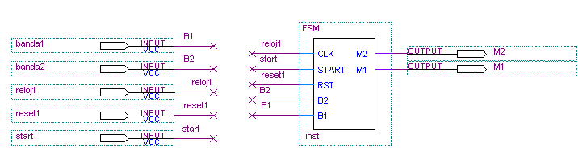
Implementación en Quartus

Slide 18
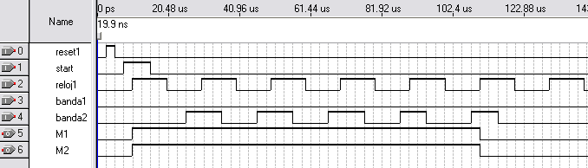
RESULTADO 1:
Pasan 5 Objetos por la Banda 2
La banda esta encendida
Después del 5 objeto la banda se apaga

Slide 19
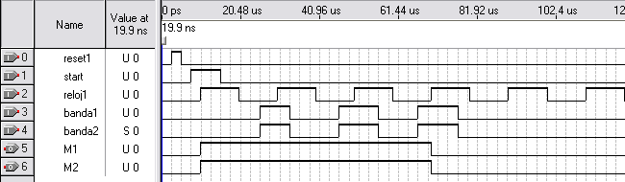
RESULTADO 2:
Pasa un objeto por la banda 1 y por la banda 2
La banda esta encendida
Después del 6 objeto (banda total) la banda se apaga

Slide 20
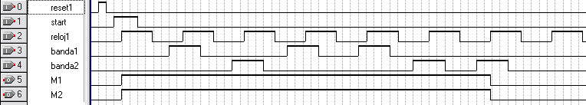
RESULTADO 3:
Por la banda 1 pasan 3 objetos
Por la banda 2 pasan 3 objetos
Como han pasado 6 objetos, la banda se apaga

Slide 21
Parcial 2: Punto 1
Diseñar una FSM Mealy para detectar dos secuencias:
Cuando se detecta la secuencia X1 X2 X1 X1, las salidas Z1Z2=10 y las salidas permanecen en 10 hasta detectar la secuencia X1 X2 X2 X1 entonces Z1Z2=00.
Cuando se detecta la secuencia X1 X2 X2 las salidas Z1Z2=01 y las salidas permanecen en 01 hasta detectar la secuencia X2 X1 X1 X2 entonces Z1Z2=00.
X2
X1
FSM
Z2
Z1
Reset

Slide 22
Diagrama de Estados
X2/00
X1/00
X1/10
X1/00
X2/00
X1/00
X1/10
X2/10
X2/00
X2/01
X1/10
X2/01
X2/01
X2/00
X1/01
X2/01
X1/10
X1/01
X2/01
X1/01
X1/01
X2/01
X1/01
X2/01

Slide 23
Diagrama de Estados
X2/00
X1/00
X1/10
S0
X1/00
S1
X2/00
S2
X1/00
S3
X1/10
S4
X2/10
S5
X2/00
X2/01
X1/10
X2/01
S6
X2/01
X2/00
X1/01
X2/01
X1/10
S7
X1/01
S8
X2/01
S9
X1/01
S10
X1/01
X2/01
S11
X1/01
X2/01

Slide 24
Tabla de Estados
 |  |  |  | X1
EP |  |  |  | PE |  |  |  | Z2 | Z1
Q3 | Q2 | Q1 | Q0 | Q3* | Q2* | Q1* | Q0* |  |  | D3 | D2 | D1 | D0 | C3 | C2 | C1 | C0
0 | 0 | 0 | 0 | 0 | 0 | 0 | 1 | 0 | 0 | X | X | X | 1 | 0 | 0 | 0 | 1
0 | 0 | 0 | 1 | 0 | 0 | 0 | 1 | 0 | 0 | X | X | X | X | 0 | 0 | 0 | 0
0 | 0 | 1 | 0 | 0 | 0 | 1 | 1 | 0 | 0 | X | X | X | 1 | 0 | 0 | 0 | 1
0 | 0 | 1 | 1 | 0 | 1 | 0 | 0 | 1 | 0 | X | 1 | 0 | 0 | 0 | 1 | 1 | 1
0 | 1 | 0 | 0 | 0 | 1 | 0 | 0 | 1 | 0 | X | X | X | X | 0 | 0 | 0 | 0
0 | 1 | 0 | 1 | 0 | 1 | 0 | 0 | 1 | 0 | X | X | X | 0 | 0 | 0 | 0 | 1
0 | 1 | 1 | 0 | 1 | 0 | 0 | 0 | 0 | 1 | 1 | 0 | 0 | X | 1 | 1 | 1 | 0
0 | 1 | 1 | 1 | 1 | 0 | 1 | 1 | 0 | 1 | 1 | 0 | X | X | 1 | 1 | 0 | 0
1 | 0 | 0 | 0 | 0 | 1 | 1 | 1 | 0 | 1 | 0 | 1 | 1 | 1 | 1 | 1 | 1 | 1
1 | 0 | 0 | 1 | 1 | 0 | 1 | 0 | 0 | 1 | X | X | 1 | 0 | 0 | 0 | 1 | 1
1 | 0 | 1 | 0 | 0 | 1 | 0 | 0 | 1 | 0 | 0 | 1 | 0 | X | 1 | 1 | 1 | 0
1 | 0 | 1 | 1 | 1 | 0 | 1 | 1 | 0 | 1 | X | X | X | X | 0 | 0 | 0 | 0
1 | 1 | 0 | 0 | X | X | X | X | X | X | X | X | X | X | X | X | X | X
1 | 1 | 0 | 1 | X | X | X | X | X | X | X | X | X | X | X | X | X | X
1 | 1 | 1 | 0 | X | X | X | X | X | X | X | X | X | X | X | X | X | X
1 | 1 | 1 | 1 | X | X | X | X | X | X | X | X | X | X | X | X | X | X

Slide 25
Tabla de Estados
 |  |  |  | X2
EP |  |  |  | PE |  |  |  | Z2 | Z1
Q3 | Q2 | Q1 | Q0 | Q3* | Q2* | Q1* | Q0* |  |  | D3 | D2 | D1 | D0 | C3 | C2 | C1 | C0
0 | 0 | 0 | 0 | 0 | 0 | 0 | 0 | 0 | 0 | X | X | X | X | 0 | 0 | 0 | 0
0 | 0 | 0 | 1 | 0 | 0 | 1 | 0 | 0 | 0 | X | X | 1 | 0 | 0 | 0 | 1 | 1
0 | 0 | 1 | 0 | 0 | 1 | 1 | 0 | 0 | 1 | X | 1 | X | X | 0 | 1 | 0 | 0
0 | 0 | 1 | 1 | 0 | 0 | 1 | 0 | 0 | 0 | X | X | X | 0 | 0 | 0 | 0 | 1
0 | 1 | 0 | 0 | 0 | 1 | 0 | 1 | 1 | 0 | X | X | X | 1 | 0 | 0 | 0 | 1
0 | 1 | 0 | 1 | 0 | 1 | 1 | 0 | 0 | 1 | X | X | 1 | 0 | 0 | 0 | 1 | 1
0 | 1 | 1 | 0 | 0 | 1 | 1 | 0 | 0 | 1 | X | X | X | X | 0 | 0 | 0 | 0
0 | 1 | 1 | 1 | 0 | 0 | 1 | 0 | 0 | 0 | X | 0 | X | 0 | 0 | 1 | 0 | 1
1 | 0 | 0 | 0 | 1 | 0 | 0 | 1 | 0 | 1 | X | X | X | 1 | 0 | 0 | 0 | 1
1 | 0 | 0 | 1 | 0 | 1 | 1 | 0 | 0 | 1 | 0 | 1 | 1 | 0 | 1 | 1 | 1 | 1
1 | 0 | 1 | 0 | 1 | 0 | 0 | 1 | 0 | 1 | X | X | 0 | 1 | 0 | 0 | 1 | 1
1 | 0 | 1 | 1 | 1 | 0 | 0 | 1 | 0 | 1 | X | X | 0 | X | 0 | 0 | 1 | 0
1 | 1 | 0 | 0 | X | X | X | X | X | X | X | X | X | X | X | X | X | X
1 | 1 | 0 | 1 | X | X | X | X | X | X | X | X | X | X | X | X | X | X
1 | 1 | 1 | 0 | X | X | X | X | X | X | X | X | X | X | X | X | X | X
1 | 1 | 1 | 1 | X | X | X | X | X | X | X | X | X | X | X | X | X | X

Slide 26
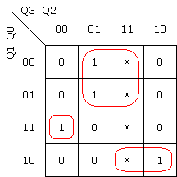
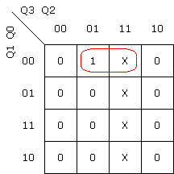
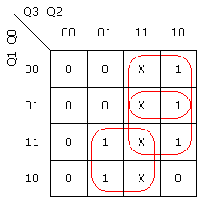
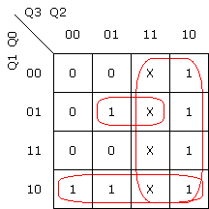
MAPAS DE KARNAUGH
X1
X2
X1
X2

Slide 27
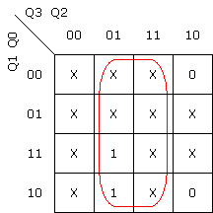
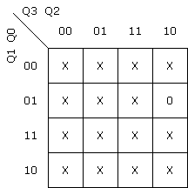
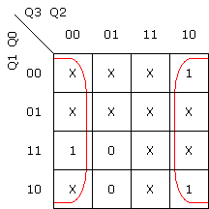

MAPAS DE KARNAUGH
X1
X2
X1
X2

Slide 28
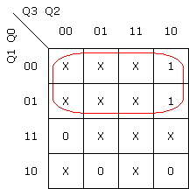

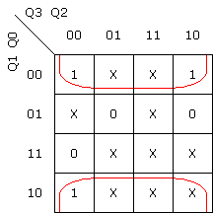

MAPAS DE KARNAUGH
X1
X2
X1
X2

Slide 29
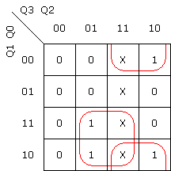
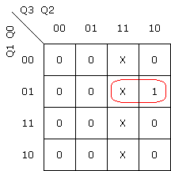
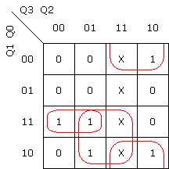
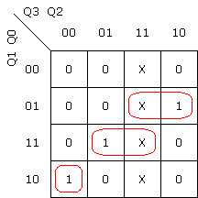
MAPAS DE KARNAUGH
X1
X2
X1
X2

Slide 30
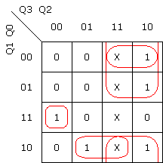
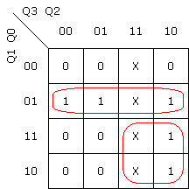
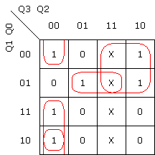
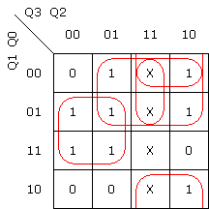
MAPAS DE KARNAUGH
X1
X2
X1
X2

Slide 31
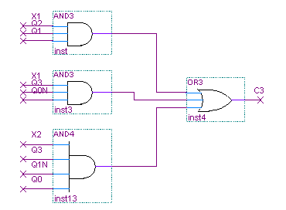
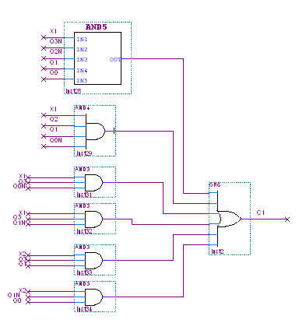
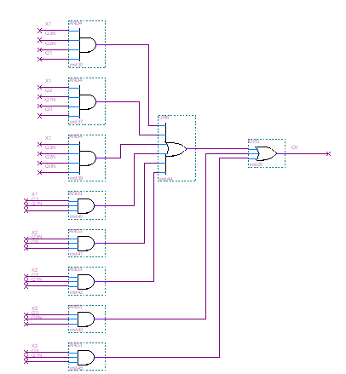
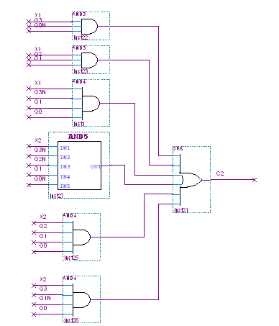
IMPLEMENTACIÓN EN QUARTUS

Slide 32
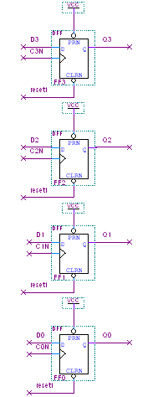
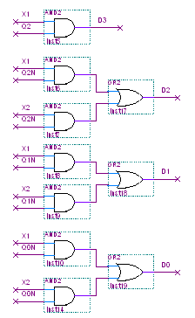
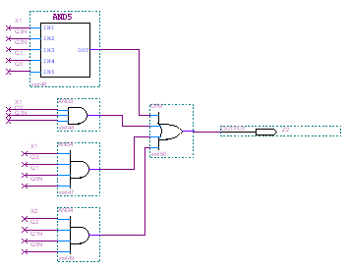
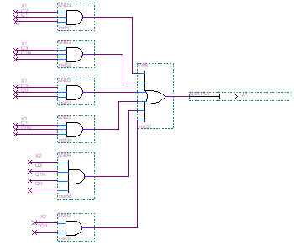
IMPLEMENTACIÓN EN QUARTUS
Z2
Z1

Slide 33

RESULTADO 1:
Se introduce la secuencia:
X1X2X1X1
La salida Z2Z1=10

Slide 34

RESULTADO 2:
Se introduce la secuencia:
X1X2X2
La salida Z2Z1=01

Slide 35

RESULTADO 3:
Se introduce la secuencia:
X1X2X2X1X1X2
La salida Z2Z1=00

Slide 36

RESULTADO 4:
Se introduce la secuencia:
X1X2X1X1X2X2
La salida Z2Z1=01

