Slide 1
Beyond the Batter’s Box
Analyzing the Winners & Losers of America’s Pastime

Slide 2
Overview
In this presentation, we will be analyzing a deep pool of data focused on Major League Baseball teams.
We have created a machine learning model that is capable of predicting performance as a function of salary - specifically in regards to:
Batting: Hits, Average, Runs, Home Runs, Extra Base Hits, Strike Outs, Walks
Pitching: Strike Outs, Outs, FIP, BAA, Innings, and ERA

Slide 3

Why Baseball?
This topic was selected not just for our love of baseball, but because America’s Pastime has been around for over 120 years, and has an immense volume of data available for a machine learning model to incorporate. Between fans of the game, historians, front-office types and gamblers, there will always be people interested in this data and the answers it holds.
Some teams like the New York Yankees have a strong legacy of both spending money and winning championships. Other teams like the Tampa Bay Rays have had significant success (still chasing their championship), and have barely spent anything. We want to find out which strategy makes the most sense, and we’re going to use machine learning to do it.

Slide 4
Data Source
We’re leveraging an amazing open-source data center for Major League Baseball, the Lahman Database, which can be found here: http://www.seanlahman.com/baseball-archive/statistics/
Each zip file contains CSV documents that cover topics of interest in baseball. The data goes back all the way to 1871, so we can have confidence in the model’s depth of information.
For this project, we’re only using data from 1988-2016, due to the quickly increasing rate of pay for baseball players starting in the late 80’s.

Slide 5
Asking Questions
Now that we have our model – what questions should we ask of it?
Our initial approach is to examine the impact of salary on the success of a team.
Baseball’s biggest teams – from the New York Yankees to the 2020 World Champion Los Angeles Dodgers – spend big bucks to field teams with famous names and Hall of Fame potential. But does this always result in success?
Speaking of salary – what statistics do the players with the highest salaries have in common? Which statistic is the most significant indicator of how much a player should earn, based on historical data?
Can we predict if a team should win the world series, based on certain statistics? And what statistics should they be?

Slide 6
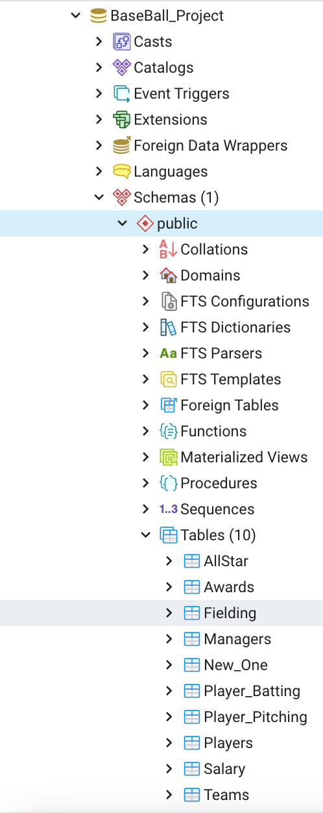
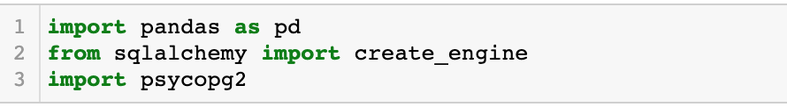
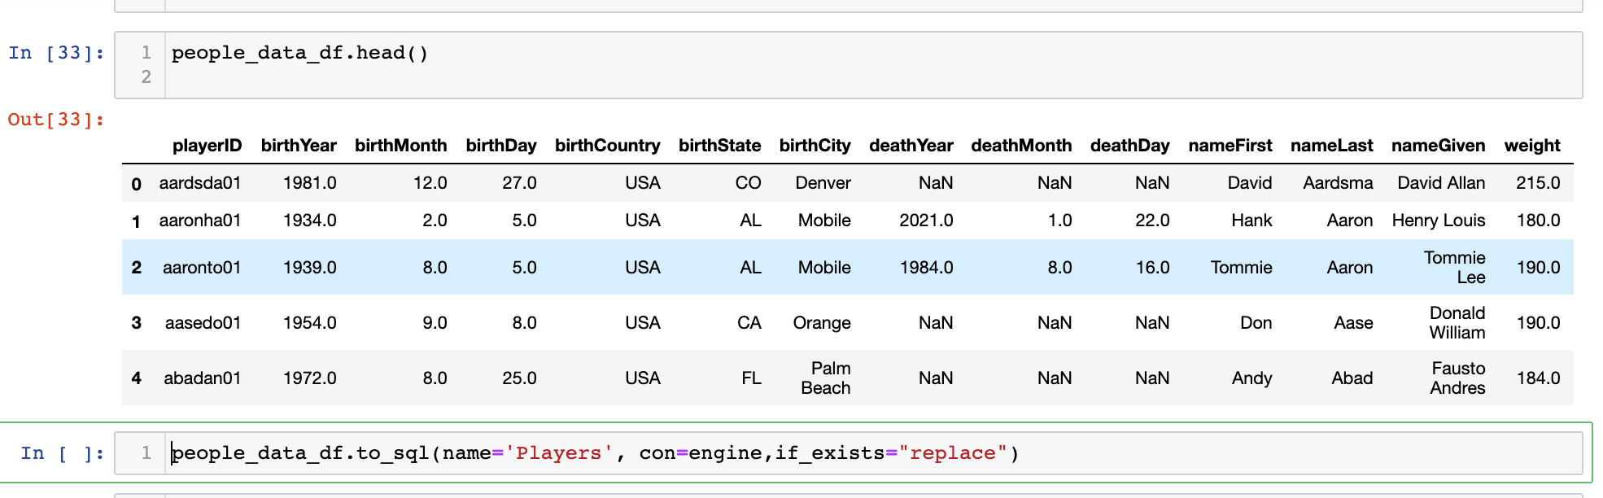
Database Implementation
PostgreSQL
Jupyter Notebook
Pandas
SQLAlchemy

Slide 7
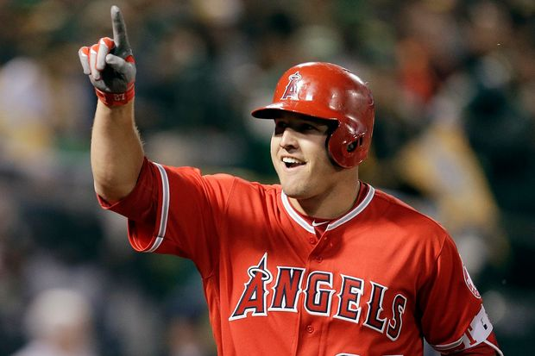
Machine Learning Model
Through pre-processing the data, we chose supervised learning via a Random Forest Model.
The Random Forest Model uses classification to predict based on our salary target and our features which are year, team, stats (like strikeouts), and birth year. By pairing down the data, through combining and cleaning the csv files, it really dialed in to the details of what we wanted to measure.
Basing the main measures on Mike Trout's core statistics(SO,AB,R,H,HR,G,R and RBIs), we used his metrics as a baseline to look for when deciding our final goal. Also, including the ‘awardID’, which shows which award each player won, and ‘lgID’, which shows the league in to see if that had any impact.
Then the Random Forest Model interprets this information and gives an accuracy score based on what is the most impactful in deciding the salary of a player. The confusion matrix and list of importances each show the logic behind what determines how much to pay each player.
Four-Time American League MVP Mike Trout

Slide 8
Technology & Tools
Collaboration
Github
Github Desktop
Slack
Coding & Data Management
Jupyter Notebook
pgAdmin
Presentation
Tableau Public
Microsoft PowerPoint
Analysis Tools & Languages
Python Pandas
Matplotlib
Tableau
NumPy
SciPy
RandomForest

Slide 9
Answering Questions
As we begin to analyze our data, we will be using a combination of Machine Learning and Data Visualization to answer our key questions:
Does a higher team salary spend equate to more wins?
What statistics are the most significant in determining the salary of an individual player, based on historical data?
Can we predict the likelihood of a team winning the World Series based on certain statistical information?

Slide 10
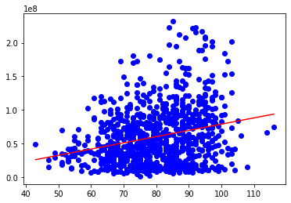
Answering Questions
Does Team Salary equal Team Success?
Let’s look at regular season wins from 1985 to 2016.
On this scatter plot, we can see a positive correlation between the money spent and the amount of wins a team gets.
However, it’s not a very strong correlation – the R value is only .25
The P-value is also extremely high – over 5.0 – meaning that the relationship doesn’t seem to have an impact on the result.
This could be due to various factors, including the ballooning of salaries in the 21st century. But one thing’s clear, your overall team expenditure doesn’t always equal success, especially in the regular season.

Slide 11
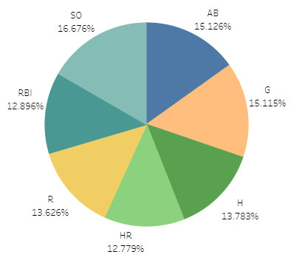
Answering Questions
Based on historical data, what statistic is the most important indicator of a player’s earnings?
The feature set we have chosen for this machine learning task includes:
SO: Strike-Outs
AB: At-Bats
G: Games Played
RBI: Runs Batted-In
R: Runs Scored
HR: Home Runs
H: Total Hits
Surprisingly, this model indicates that SO’s are the most significant indicator of salary – the only statistic in this set that would be deemed a ‘negative’ on a player’s performance.

Slide 12
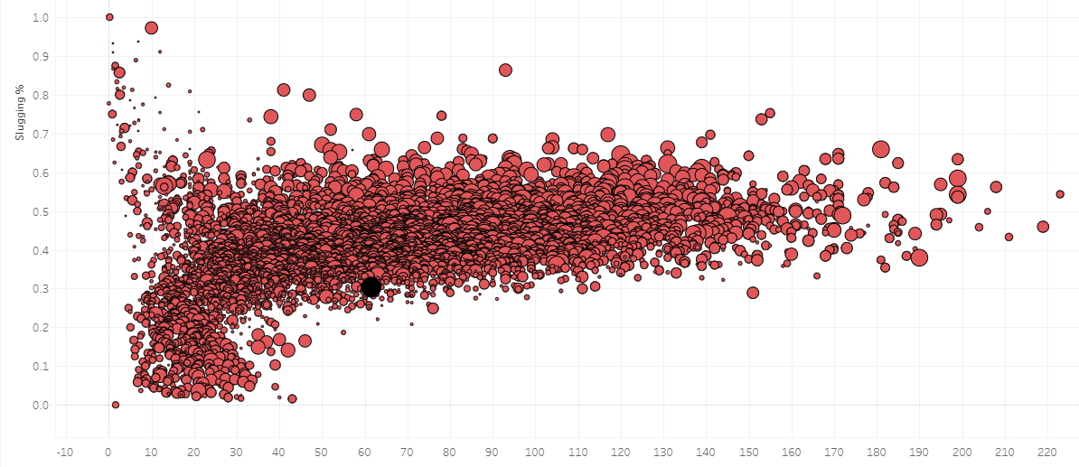
Answering Questions
Just because SO’s are the biggest indicator that predicts salary in our model, doesn’t mean that a player with the most SO’s should earn the highest pay.
Slugging Percentage (SLG) is the reflection of Strike-Outs in the game’s highest paid players.
Total Bases = (Singles) + (2 x Doubles) + (3 x Triples) + (4 x Home Runs)
In this scatterplot, we can see that the players on the right side – who have the most SO’s – have larger circles than the players on the left. This means they have larger salaries. This tracks with teams wanting to pay players with the most HR-potential large salaries.
SLG = Total Bases / At-Bats

