Slide 1

NotiFree
www.notifree.ml
The search engine for free items in your area

Slide 2
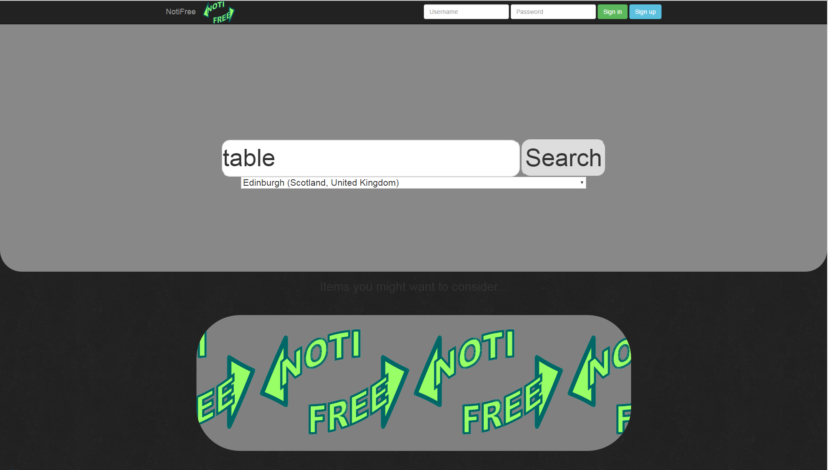
What is NotiFree?
It is a search engine
It pulls together results from different sites
Sends notifications to user
NotiFree is a search engine for free items in your area. It pulls results from Gumtree and Freecycle, allowing the user to browse through them all. It also sends the user notifications when an item they have recently been looking for becomes available.
(describe notification system)

Slide 3
What problems does it solve?
NotiFree is designed to save users the trouble of searching through many different sites for an item. It enables the user to view the available items from both sites at once.
The notification system also means that the user does not have to be constantly viewing the site to check what new items have become available, because they will receive an email whenever there is a new item related to their previous searches.

Slide 4
Intended client/customer
The site is targeted towards someone who has just arrived in a new home, with no or relatively low income and may be working under time constraints. Take for example, a student. They would want furniture that is easy to access without searching through several different sites, they would want to be able to do it quickly, and without too much effort. However, they wouldn’t want to receive too many notifications or have to enter lots of personal information.

Slide 5
How we made it:
The vast majority of our site is written in HTML, with PHP used for the servers. There was a small amount of javascript and a reasonable amount of python used for the scripting necessary to perform searches and dynamically affect HTML. We used CSS3 to style the website and create animations, such as the one on the home page.

Slide 6
What we’ve learned
Harry - CSS3 (keyframes + gradients) + HTML5 forms
Christina - a lot about HTML + CSS including input types + transitions
David - POST and GET requests + BeautifulSoup
Lewis - using GitHub, SQL + PHP

Slide 7
Home - Harry
Sign up - Christina
Sign in + Results - David
Settings - Lewis

