Slide 1

NotiFree
www.notifree.ml
The search engine for free items in your area

Slide 2
What is NotiFree?
Search engine for free items in your area
It pulls together results from different sites
Sends notifications to user

Slide 3
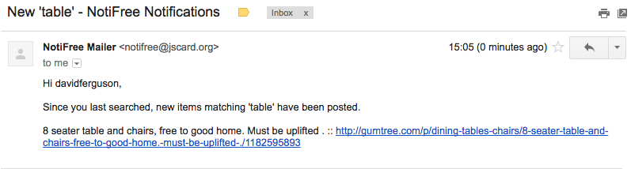
What problems does it solve?
No need to search multiple sites
No need to constantly check for items you want

Slide 4
Intended client/customer
Targeted towards someone who:
has just moved into a new home
is struggling for money
Who would want:
Quick and easy access
Not to be bombarded with notifications

Slide 5
How we made it:
Frontend:
HTML
CSS3
Javascript
Backend:
PHP for accounts
Python for getting results
Apache WSGI to link to Python
Cron to check for new posts
Postfix for mail server

Slide 6
What we’ve learned
David - Git + BeautifulSoup
Lewis - MySQL + PHP, sessions + cookies
Harry - CSS3 keyframes + gradients + HTML5 forms
Christina - HTML + CSS including input types + transitions

Slide 7
NotiFree
www.notifree.ml
The search engine for free items in your area

Slide 8
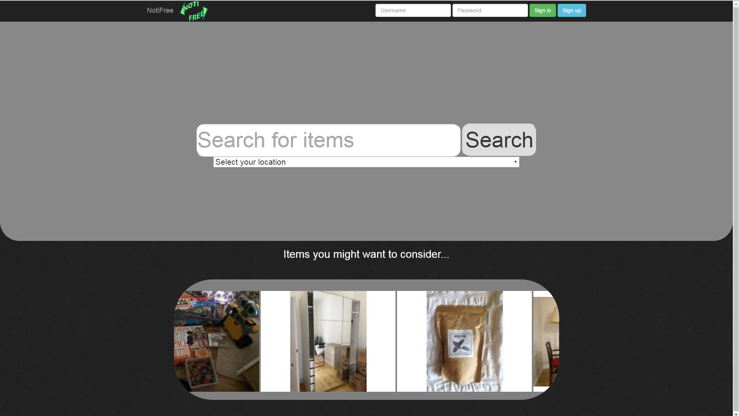

Slide 9
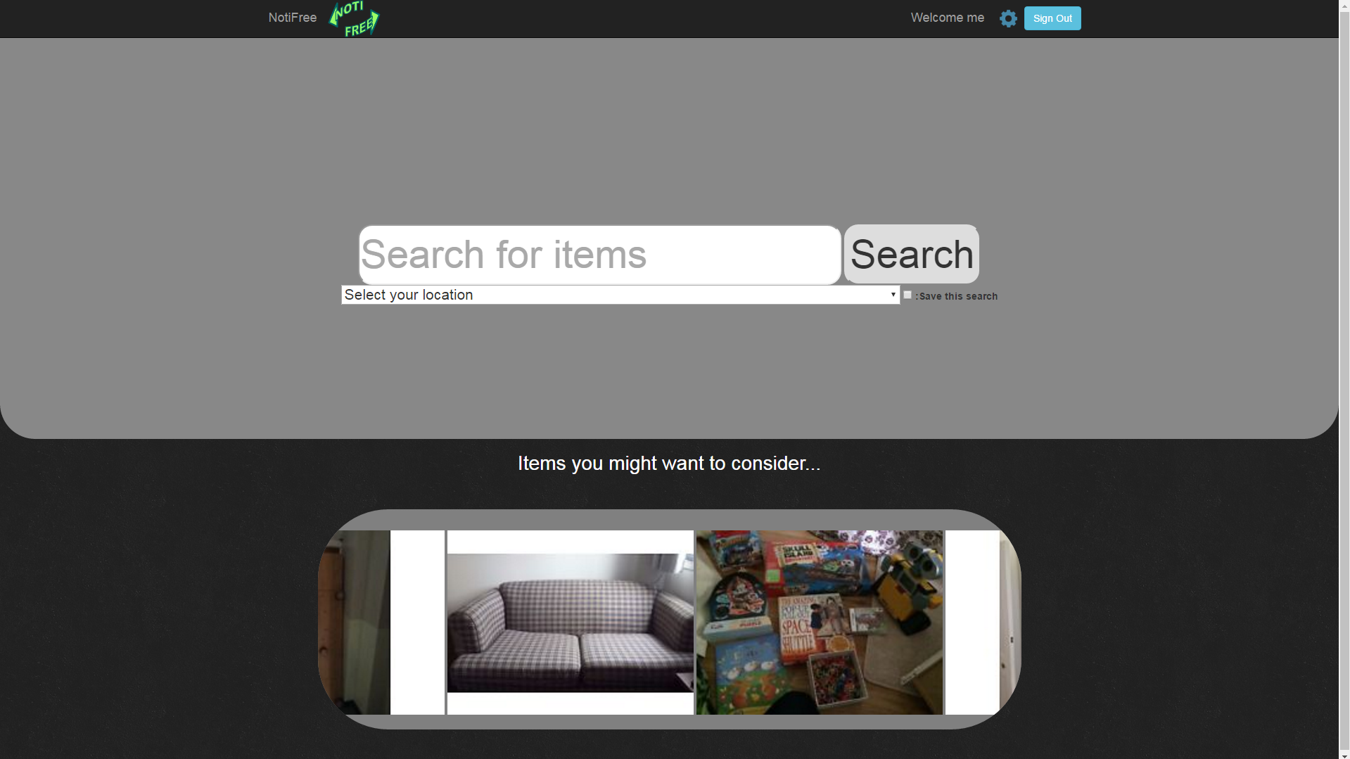

Slide 10
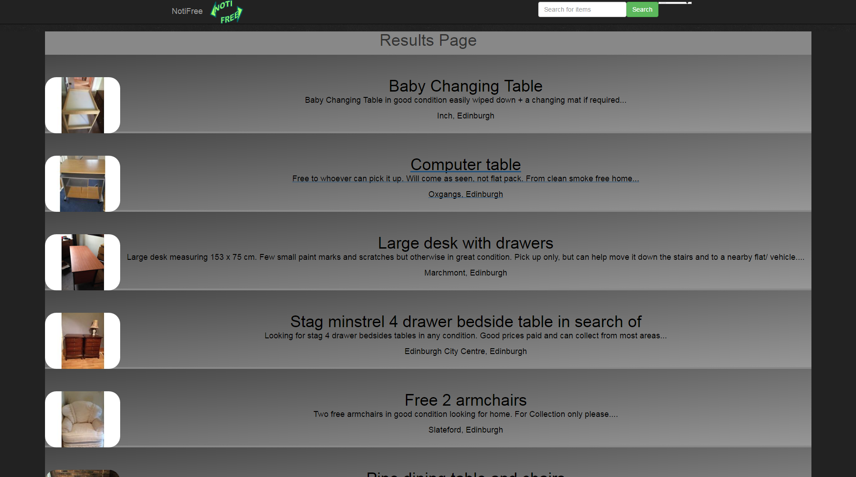

Slide 11
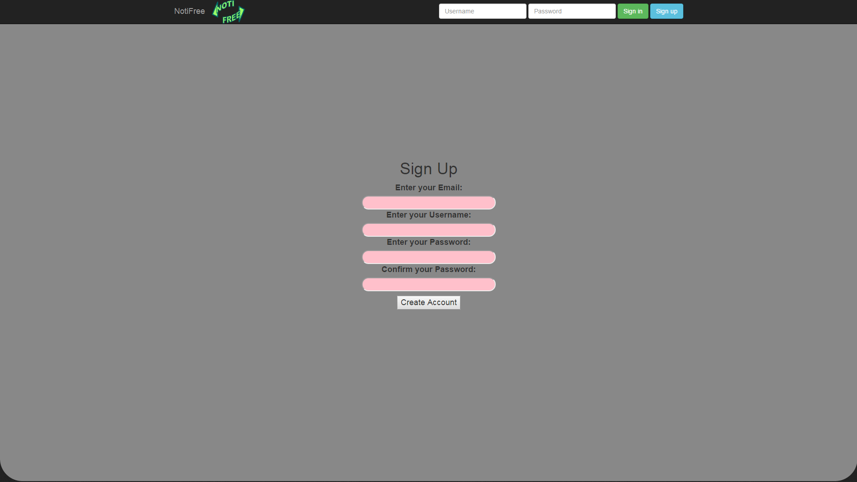

Slide 12
