Slide 1

NotiFree
www.notifree.ml
The search engine for free items in your area

Slide 2
What is NotiFree?
It is a search engine
It pulls together results from different sites
Sends notifications to user

Slide 3
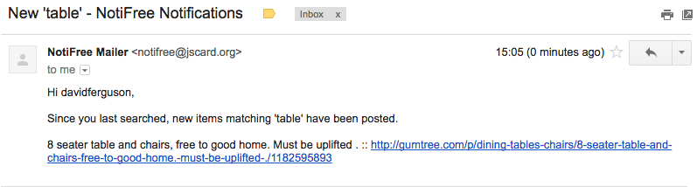
What problems does it solve?
It saves the trouble of searching through multiple sites
The user doesn’t have to be constantly checking the site for new items

Slide 4
Intended client/customer
Targeted towards someone who:
has just moved into a new home
is struggling for money
They would want quick and easy access, but they wouldn’t want to enter too many details or receive too many notifications.

Slide 5
How we made it:
Languages we used:
HTML
PHP
Javascript
Python
CSS3

Slide 6
What we’ve learned
Harry - CSS3 keyframes + gradients + HTML5 forms
Christina - a lot about HTML + CSS including input types + transitions
David - POST and GET requests + BeautifulSoup
Lewis - using GitHub, SQL + PHP

Slide 7
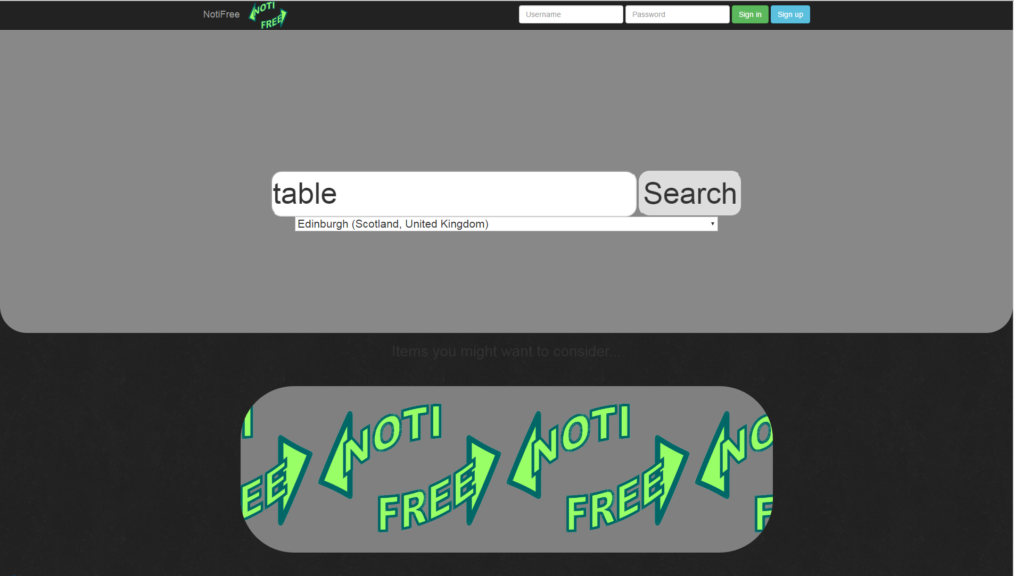

Slide 8
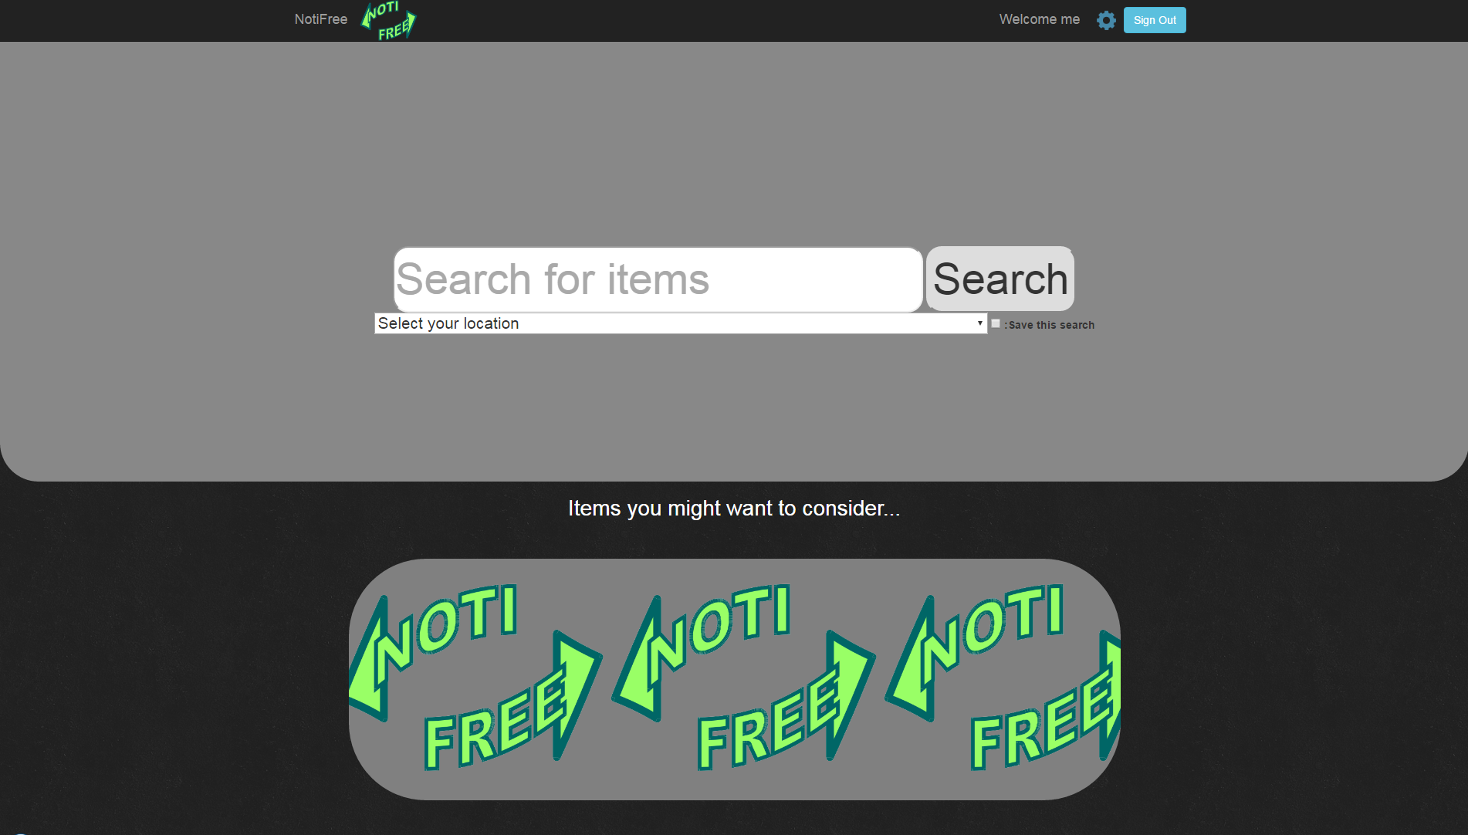

Slide 9
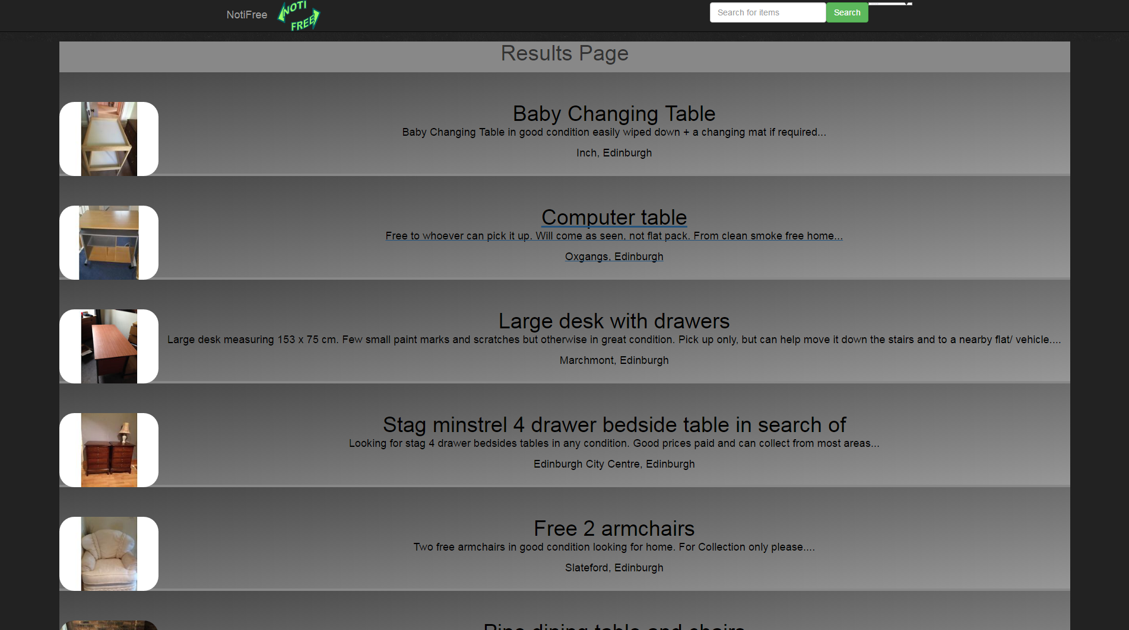

Slide 10
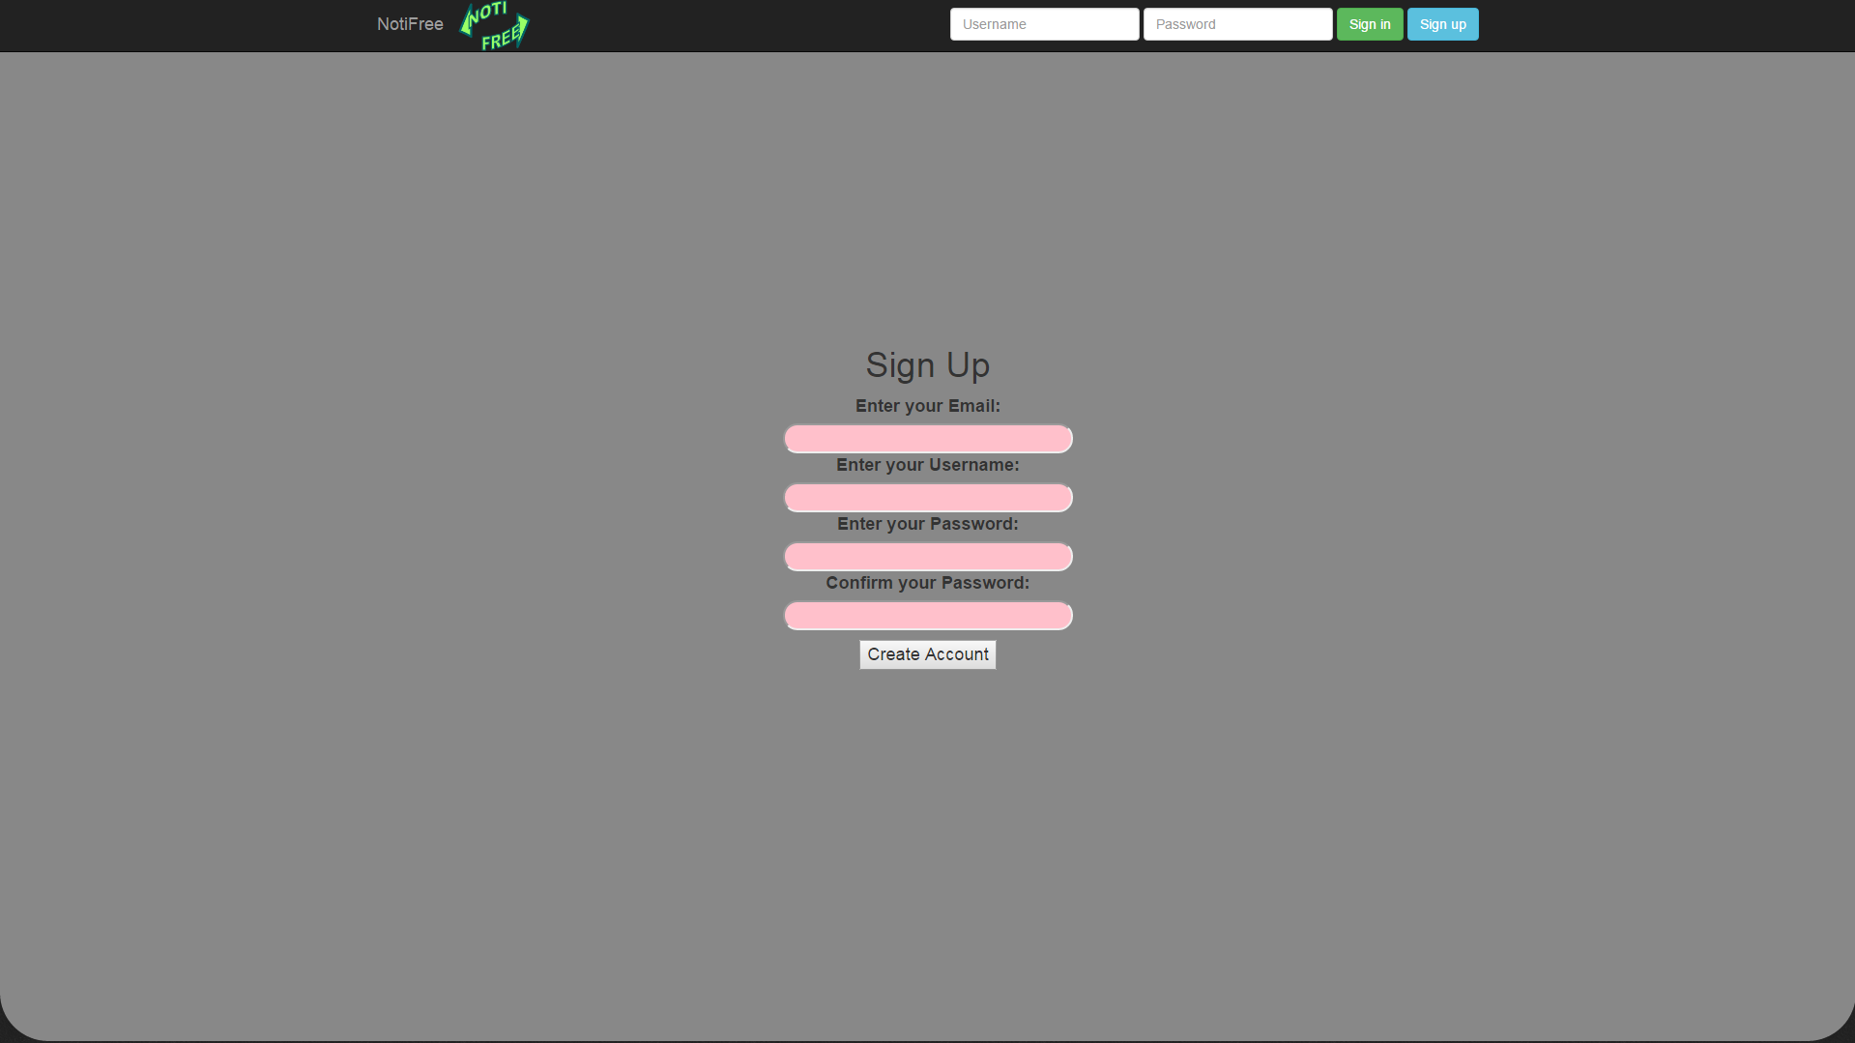

Slide 11
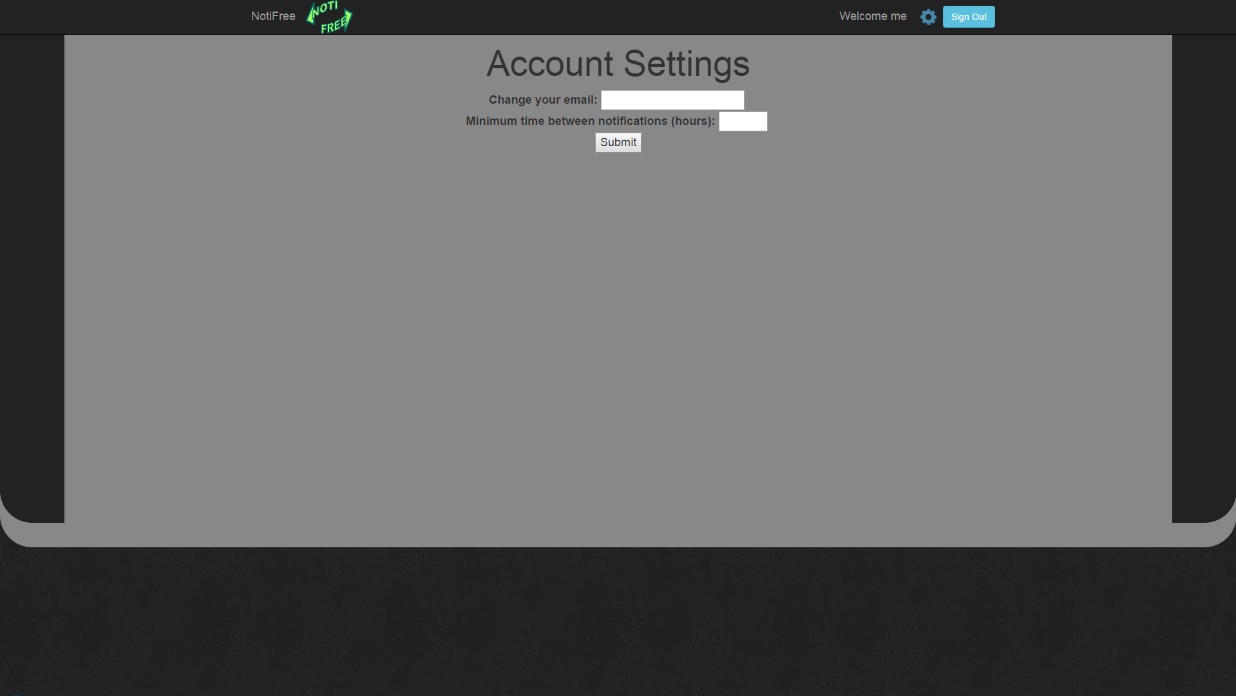

Slide 12
Home - Harry
Sign up - Christina
Sign in + Results - David
Settings - Lewis

