Slide 1
TBW Financial Model Structure
David Gorelick and Christina Petagna
February 2022 Update

Slide 2
TBW Financial Model
Goal: explicitly model financial impacts of
Future changes to water supply system infrastructure and operations (including CIP and debt scheduling)
Changes in demand and hydrologic conditions
Management intervention (e.g. maintaining a low uniform rate)
Outcomes: measure annual performance based on
Debt and rate covenants (coverage ratios)
Reserve fund balances
Uniform Rate predictability and growth
Ability to meet CIP needs

Slide 3
TBW Financial Model – Basic Model Structure
TBW Infrastructure Planning Scenario
Follow CIP or SWRE Investment Timing?
Historic Daily Water Deliveries (2010-2021)
SWRE Hydrologic and Demand Future Realizations (1,000 runs from 2021-2040 per Scenario)
Future Water Supply Infrastructure Cost Estimates
10-Year CIP Schedule
(FY 2021-2031)
Approved Budgets and Actuals (FY 2013-2022)
Management and Board Decisions
Financial Model
Historical (2015-2021) or Future (2021-2040) Run?
Monthly Water Deliveries and Revenues
Annual Actuals
Annual Budget Projections
Debt and Rate Covenants
Operating Costs and Revenues
Reserve Fund Balances
Reserve Fund
Transfers and Deposits
Uniform Rate
Output Data
Modeling Toggle
Decision Variable or Uncertain Factor
Input Data
Model Function or Data Processing

Slide 4
TBW Financial Model – Decision Variables
Manage Uniform Rate growth?
Allow Emer. Deviations from CIP Plan?
Following 10-year CIP Plan?
Floor on Uniform Rate Annual Rate of Increase
Cap on Uniform Rate Annual Rate of Increase
Ratio of Budgeted-to-Actual Funding Flows
Required Deposit to CIP Fund
Energy Fund Transfers In
Rate Stabilization Transfers In
R&R Fund Transfers In
Non-Sales Revenues
Ratio of Budgeted-to-Actual FY Operating Costs
Budgeted Operating Cost Inflation Rate
Covenant Threshold
Fixed Costs
Variable Costs
Floor on Size of Reserve Funds (as fraction of Gross Revenues)
Debt
Rate
Energy Fund
CIP Fund
Rate Stabilization Fund
R&R Fund
Utility Reserve Fund
Output Data
Modeling Toggle
Decision Variable or Uncertain Factor
Input Data
Model Function or Data Processing

Slide 5
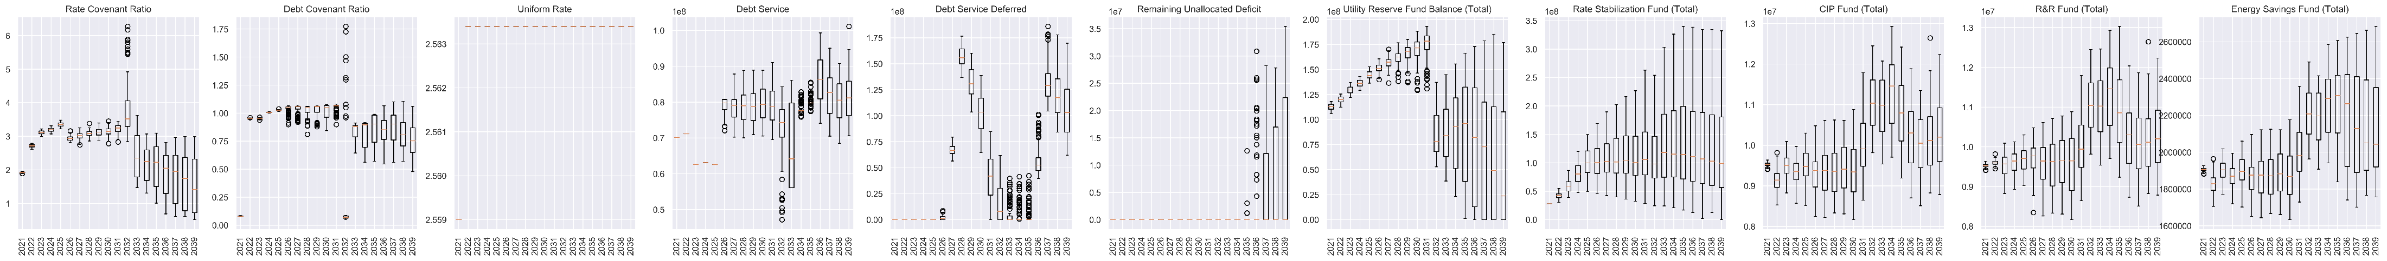
TBW Financial Model – Decision Variables
Unaccounted Enterprise Finances
(as fraction of Enterprise Fund size)
Size of Budgeted Unencumbered Income (as fraction of Net Revenues)
Example: Cap at 40% of Gross Revenues
(ranges across 100 sample realizations)
Fraction of Budget Shortfall assigned to Utility Reserve Fund
Cap on Debt Service
(as fraction of Gross Revenue)
Budgeted TBC Delivery to Tampa (Harney Augmentation)
Fraction of Operating Costs that are Variable
Budget Water Demand Growth Rate Estimate
Output Data
Modeling Toggle
Decision Variable or Uncertain Factor
Input Data
Model Function or Data Processing

Slide 6
Financial Model – Basic Budget Connectivity
Existing Debt
Other Funds and Interest
Debt Service
Acquisition Credits
Rate Stabilization Fund
SWRE
New Projects
CIP Fund
Reserve Fund Transfers
Annual Estimate
Water Demand
Energy Fund
Uniform Rate
Utility Reserve Fund
R&R Fund
Operational Expenses
Variable Rate
Fixed OpEx
Variable OpEx

Slide 7
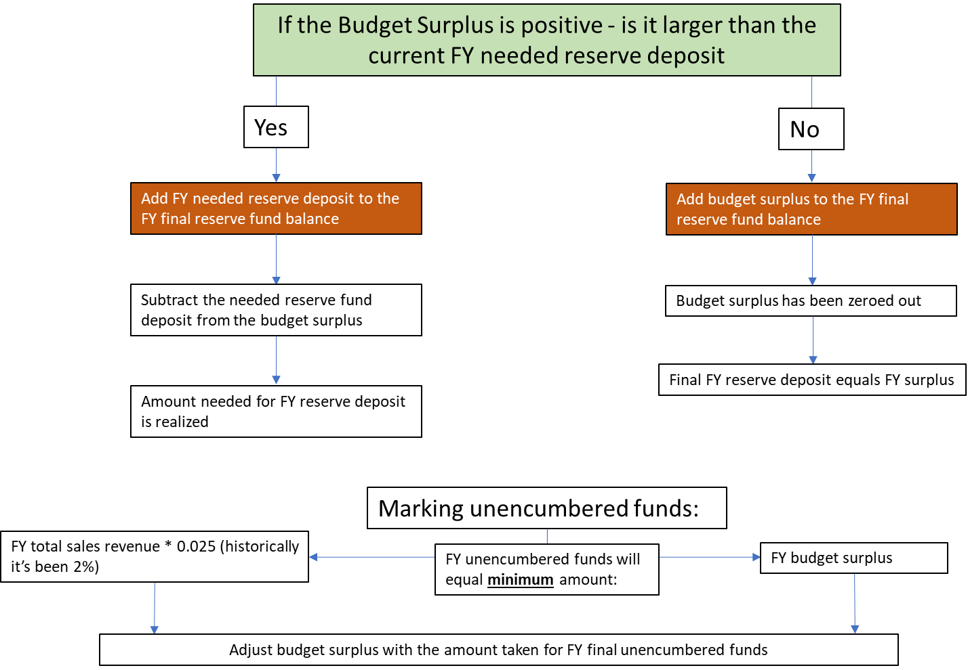
Financial Model – Surplus/Deficit Allocation

Slide 8
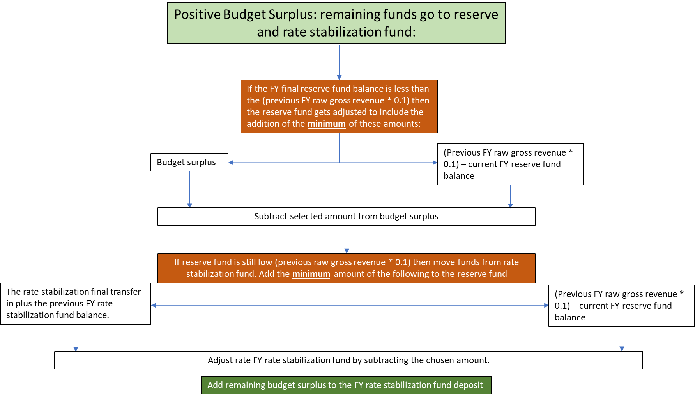
Financial Model – Surplus/Deficit Allocation

Slide 9
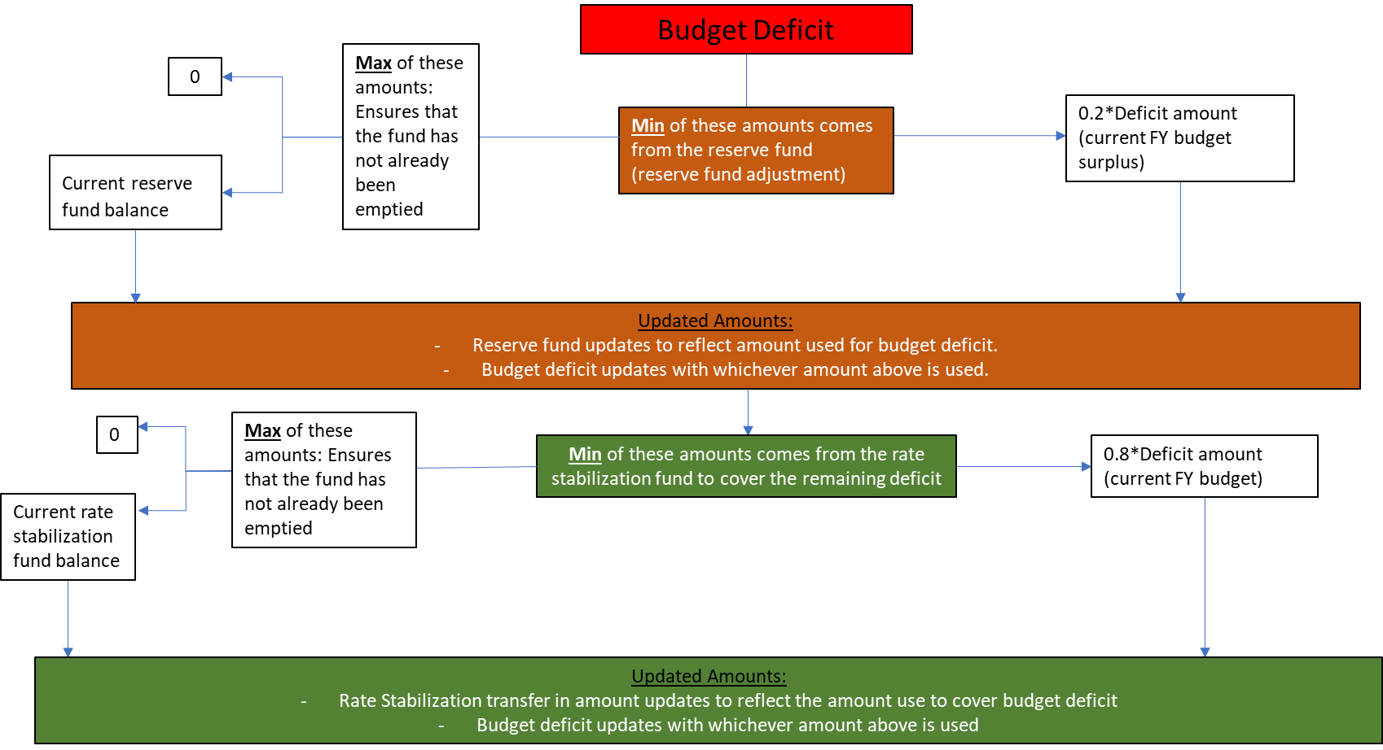
Financial Model – Surplus/Deficit Allocation

Slide 10
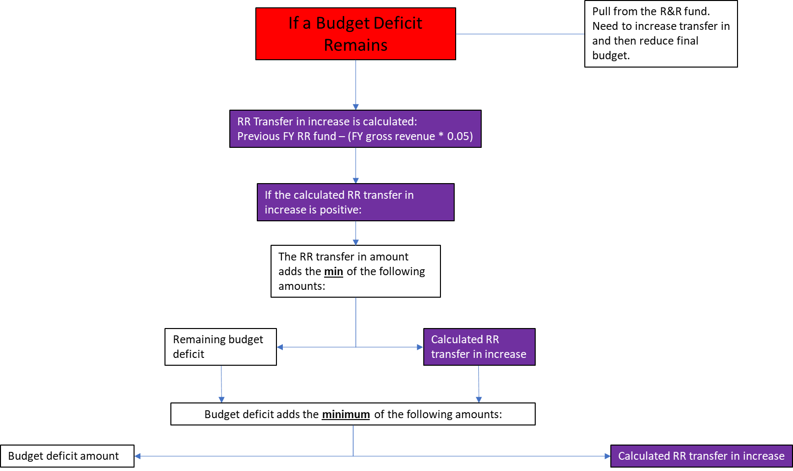
Financial Model – Surplus/Deficit Allocation

Slide 11
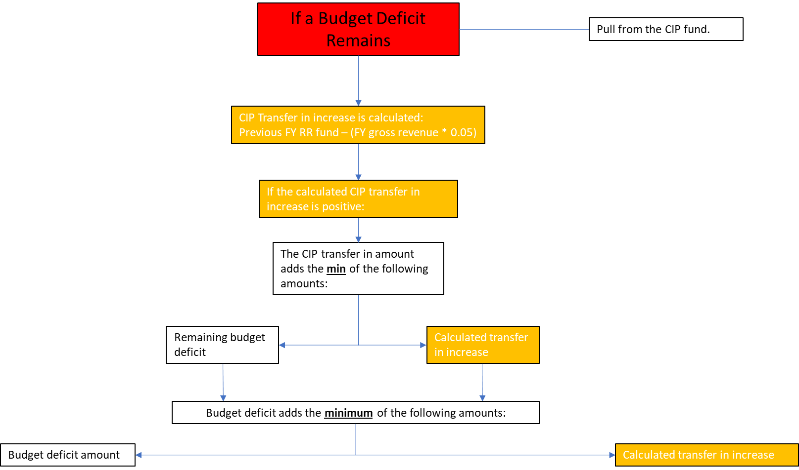
Financial Model – Surplus/Deficit Allocation

Slide 12
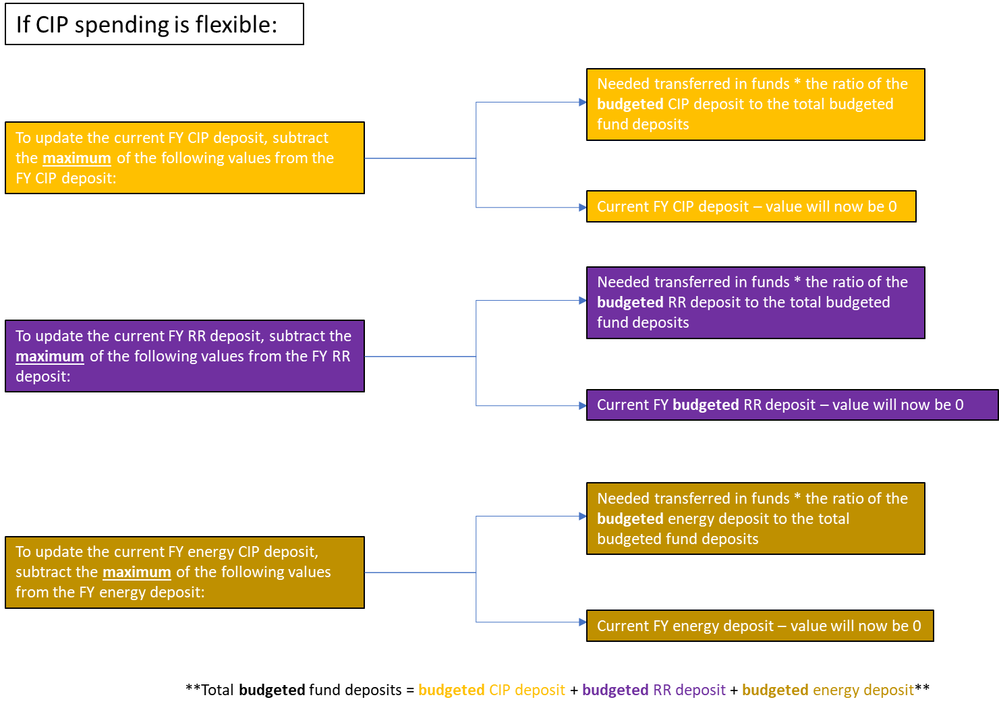
Financial Model – CIP Spending Flexibility

Slide 13
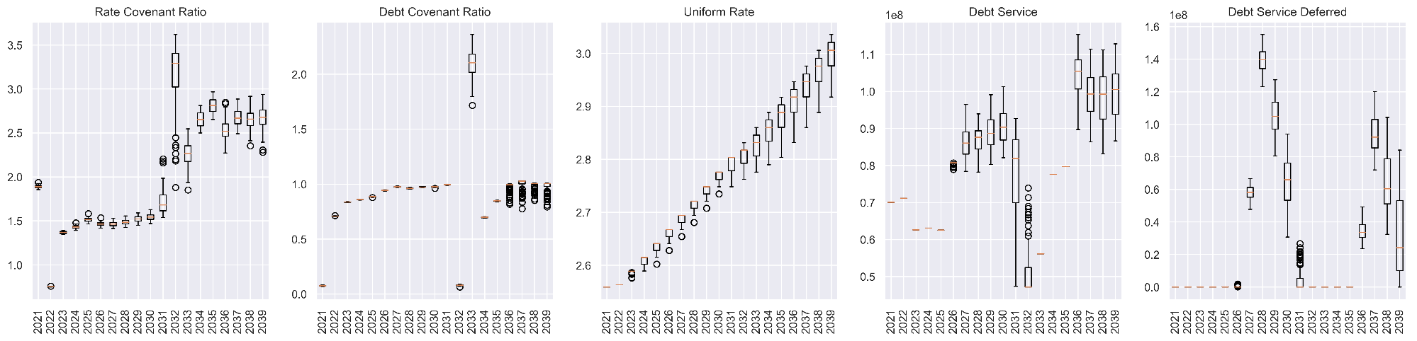
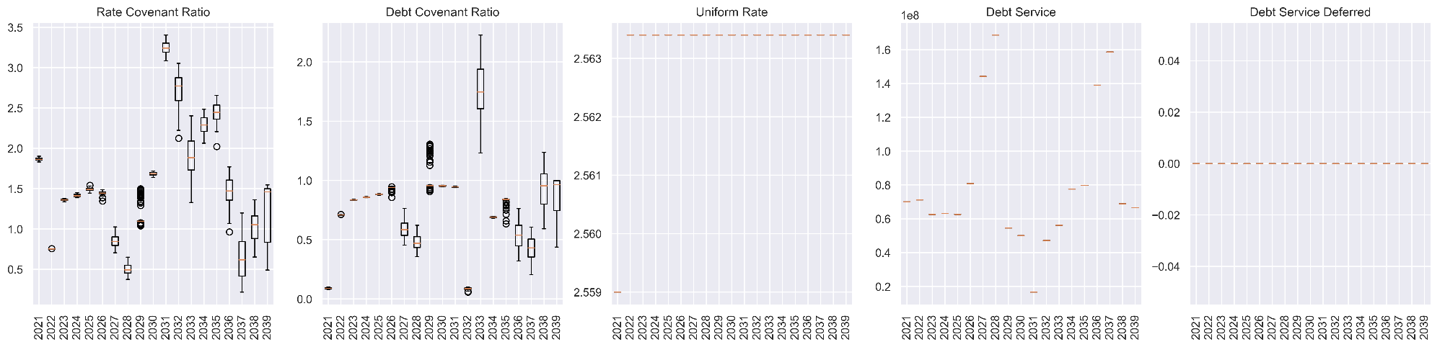
Financial Model – Output Examples
Managed Rate, Debt Service capped at 40% of previous FY gross revenues
Fixed Rate, Debt Service follows CIP plan

Slide 14
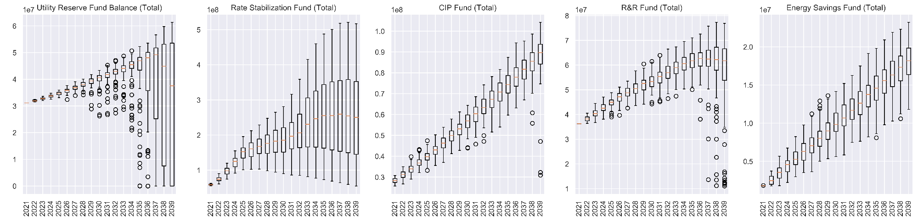
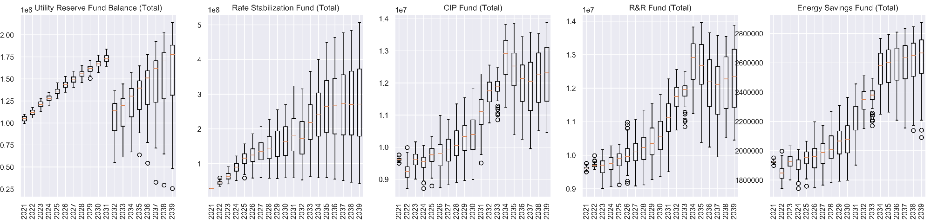
Financial Model – Output Examples
Managed Rate, Debt Service capped
Managed Rate, Debt Service capped, CIP schedule followed for reserve funds

