Slide 1

Clustering spatiotemporal point data to
visualize spatial patterns
Dr. David Frantz
Geoinformatics – Spatial Data Science
Demonstration lecture
Trier / Zoom, 02.07.2020
MSc Applied Geoinformatics, 2nd term

Slide 2
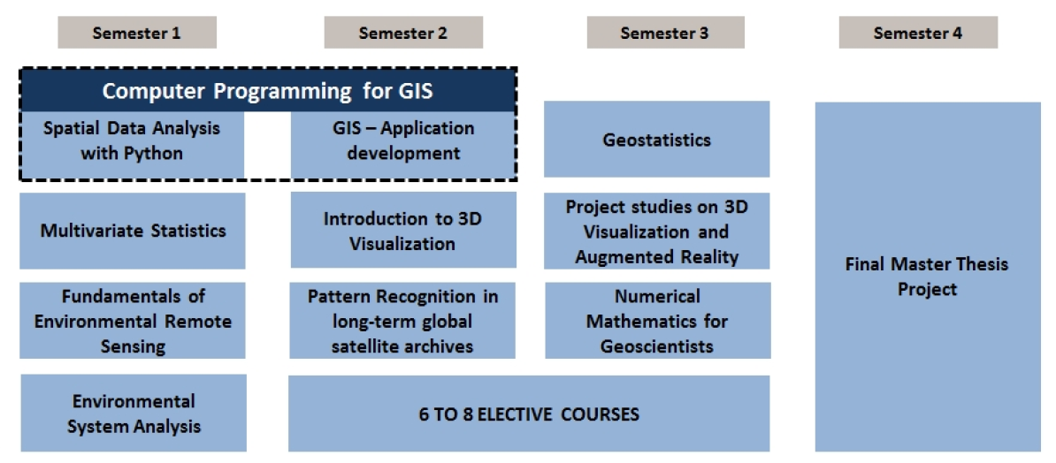

Slide 3
Requirements
Knowledge of geospatial data analysis
Knowledge of multivariate data and statistics
some R skills
Cluster analysis, concept and algorithms

Slide 4
Learning Objective
Introduction to spatiotemporal data types
Clustering algorithm
Practical experience/demonstration to cluster real-life ST data with current relevancy

Slide 5
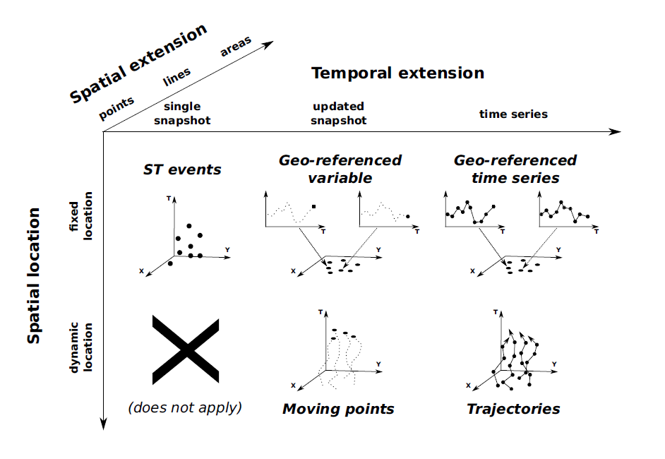
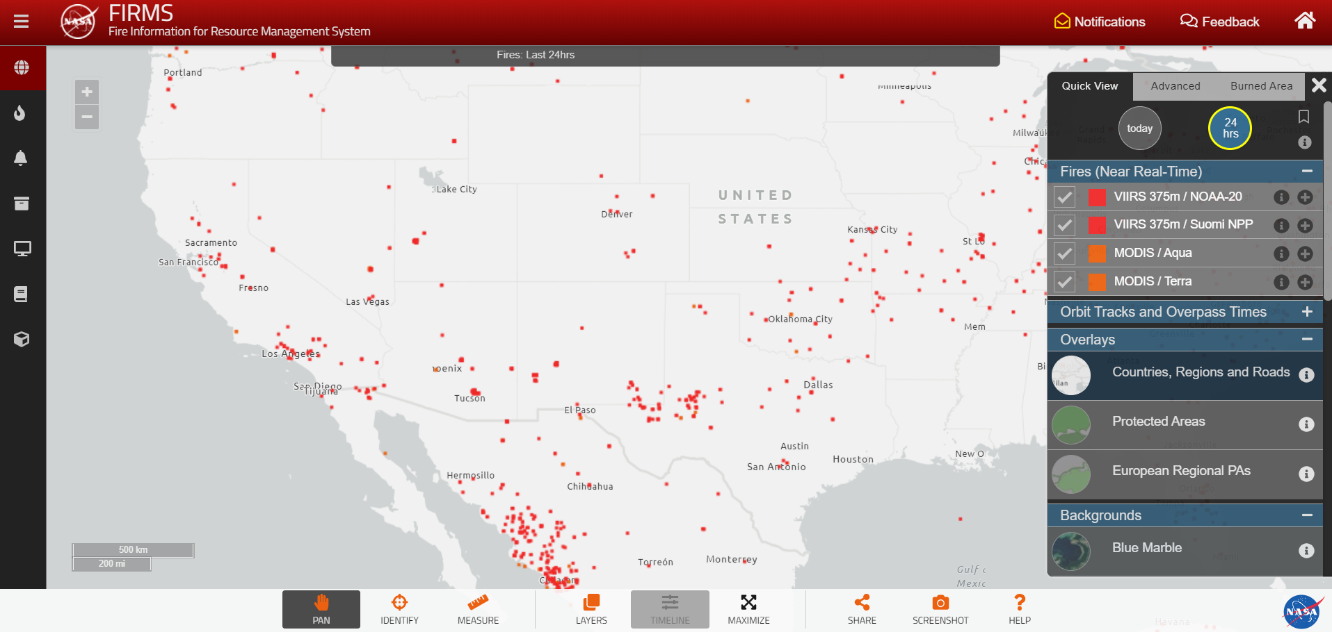
Spatiotemporal data
1) ST event
Single measurement
<longitude, latitude, timestamp>
Fire events
Kisilevich et al.: Spatio-temporal clustering. In: Data mining and knowledge discovery handbook. Springer, Boston, MA, 2009. S. 855-874.

Slide 6
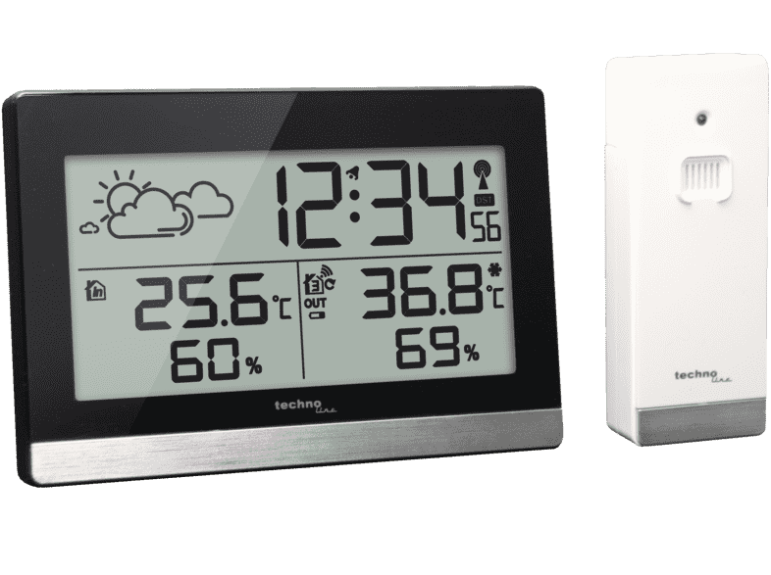
Spatiotemporal data
2) Geo-referenced variable
Evolution in time, but only the most recent value
<longitude, latitude, timestamp, non-spatial value>
Weather station with most recent temperature value
Kisilevich et al.: Spatio-temporal clustering. In: Data mining and knowledge discovery handbook. Springer, Boston, MA, 2009. S. 855-874.

Slide 7
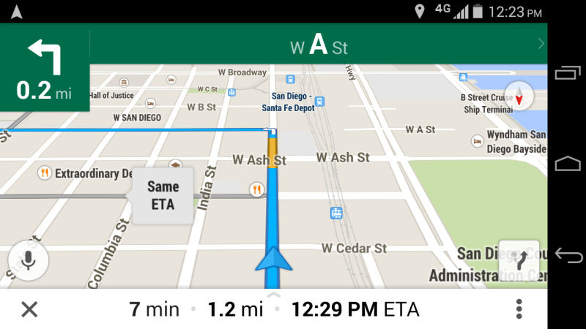
Spatiotemporal data
3) Moving points
object moves, most recent position
navigation /
real-time tracking of vehicles
Kisilevich et al.: Spatio-temporal clustering. In: Data mining and knowledge discovery handbook. Springer, Boston, MA, 2009. S. 855-874.

Slide 8
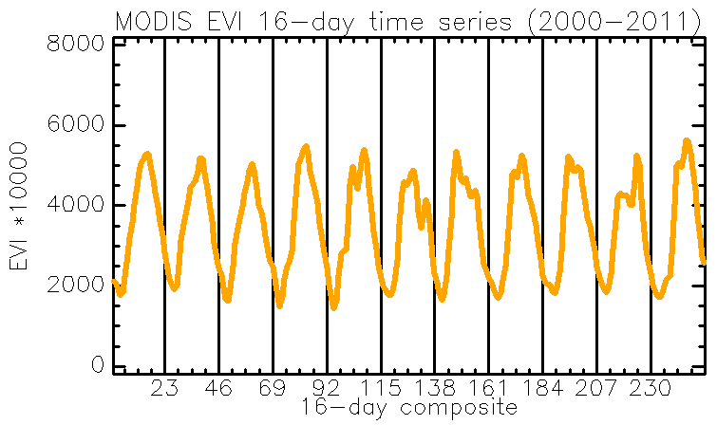
Spatiotemporal data
4) Geo-referenced time series
Whole history is stored
NDVI time series
Kisilevich et al.: Spatio-temporal clustering. In: Data mining and knowledge discovery handbook. Springer, Boston, MA, 2009. S. 855-874.

Slide 9
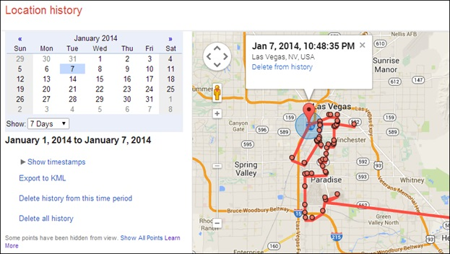
Spatiotemporal data
5) Trajectories
Object moves, whole history is stored
Google Location History
Kisilevich et al.: Spatio-temporal clustering. In: Data mining and knowledge discovery handbook. Springer, Boston, MA, 2009. S. 855-874.

Slide 10
Clustering ST event data
Three dimensions:
<longitude, latitude, timestamp>
Static in space and time = snapshot
Problem: complex datasets
Solution: Spatiotemporal analyses methods to mine meaningful patterns for better understanding
Clustering = unsupervised method for discovering potential patterns
Finding clusters among events means to discover groups that lie close both in time and in space

Slide 11
DBSCAN
Density-Based Spatial Clustering of Applications with Noise
ESTER, Martin, et al. A density-based algorithm for discovering clusters in large spatial databases with noise. In: Kdd. 1996. S. 226-231.
Popular algorithm in data mining, simple application, very efficient
Main assumption
Within each cluster, there is a typical density of points, which is considerably higher than outside
Find clusters of arbitrary shape
Detect noise
Number of clusters not known à priori
https://www.kdnuggets.com/2020/04/dbscan-clustering-algorithm-machine-learning.html

Slide 12
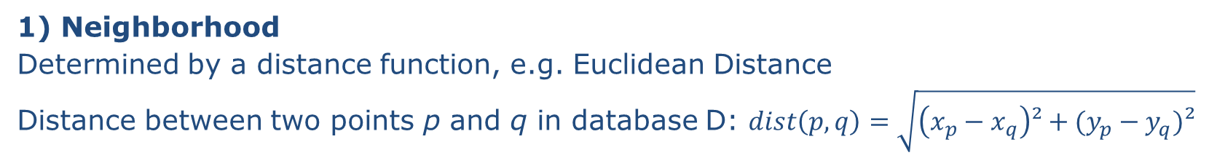
DBSCAN concepts
1) Neighborhood
Determined by a distance function, e.g. Euclidean Distance
Distance between two points p and q in database D: $dist\left(p,q\right)=\sqrt{\left(x_{p}−x_{q}\right)²+(y_{p}−y_{q})²}$
q
p

Slide 13
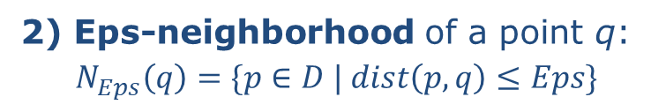
DBSCAN concepts
2) Eps-neighborhood of a point q:
$$N_{Eps}\left(q\right)=\{p∈D | dist\left(p,q\right)≤Eps\}$$
p
Input parameter 1:
Distance threshold Eps
q

Slide 14
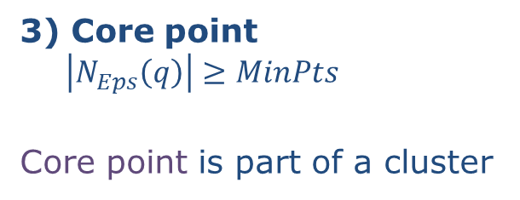
DBSCAN concepts
3) Core point $\left|N_{Eps}\left(q\right)\right|≥MinPts$
Core point is part of a cluster
Input parameter 2:
MinPts = 3
q

Slide 15
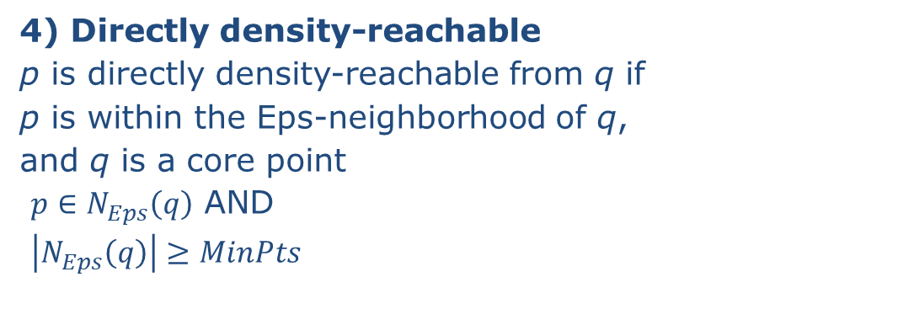
DBSCAN concepts
4) Directly density-reachable
p is directly density-reachable from q if
p is within the Eps-neighborhood of q,
and q is a core point
$p∈N_{Eps}\left(q\right)$ AND
$\left|N_{Eps}\left(q\right)\right|≥MinPts$
p
p directly density-reachable from q
q

Slide 16
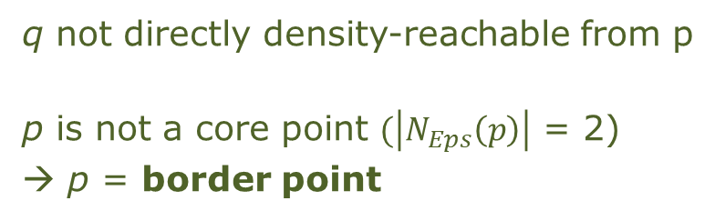
DBSCAN concepts
4) Directly density-reachable
p is directly density-reachable from q if
p is within the Eps-neighborhood of q,
and q is a core point
$p∈N_{Eps}\left(q\right)$ AND
$\left|N_{Eps}\left(q\right)\right|≥MinPts$
p
p directly density-reachable from q
q not directly density-reachable from p
p is not a core point $(\left|N_{Eps}\left(p\right)\right|$ = 2)
→ p = border point
q

Slide 17
DBSCAN concepts
5) Density-reachable
p is density-reachable from q if there is a chain of points that are directly density-reachable
q
p

Slide 18
DBSCAN concepts
6) Density-connected
p is density connected to o, if both p and o are density-reachable from a point q
q
o
p

Slide 19
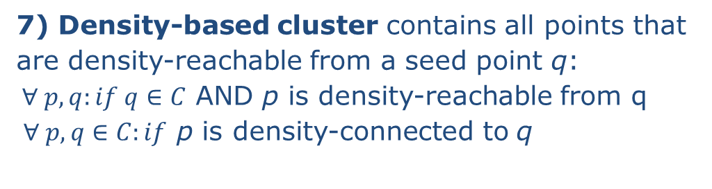
DBSCAN concepts
7) Density-based cluster contains all points that
are density-reachable from a seed point q:
$∀ p, q:if q∈C$ AND p is density-reachable from q
$∀ p, q∈C:if$ p is density-connected to q
q

Slide 20

DBSCAN concepts
7) Density-based cluster contains all points that
are density-reachable from a seed point q:
$∀ p, q:if q∈C$ AND p is density-reachable from q
$∀ p, q∈C:if$ p is density-connected to q
Noise
Any point k not belonging to any cluster
q
k

Slide 21
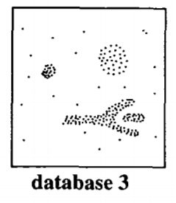
Eps and MinPts
MinPts does not critically affect clustering results
Suggestion use 4 for spatial data
The distance Eps should be set according to the “thinnest” cluster

Slide 22
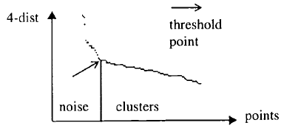
Eps and MinPts
MinPts does not critically affect clustering results
Suggestion use 4 for spatial data
The distance Eps should be set according to the “thinnest” cluster
Simple solution:
1) Compute the distance of a point p to its k-th nearest neighbor
k = MinPts
2) Repeat for each point
3) Sort the distances and plot (k-dist graph)

Slide 23

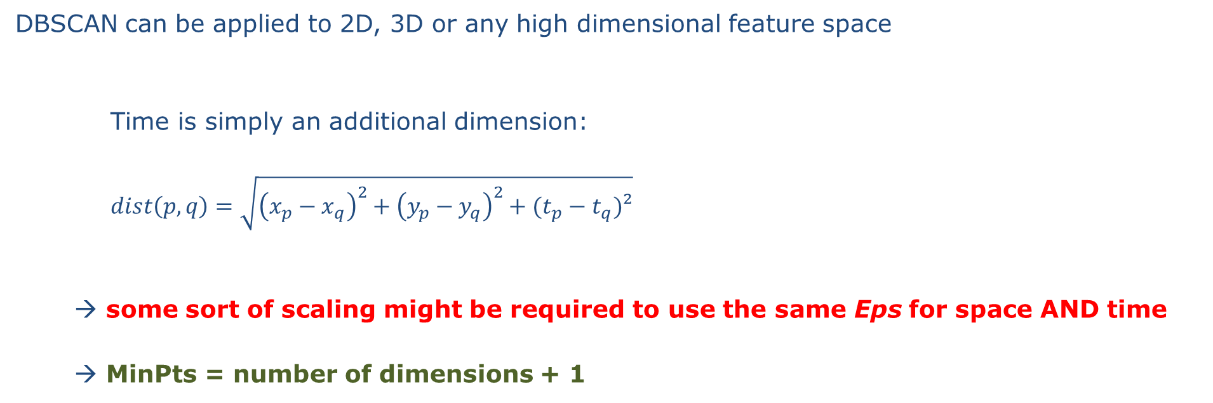
Time in DBSCAN
DBSCAN can be applied to 2D, 3D or any high dimensional feature space
Time is simply an additional dimension:
$dist\left(p,q\right)=\sqrt{{\left(x_{p}−x_{q}\right)}^{2}+{\left(y_{p}−y_{q}\right)}^{2}+(t_{p}−t_{q})²}$
→ some sort of scaling might be required to use the same Eps for space AND time
→ MinPts = number of dimensions + 1
ST-DBSCAN
BIRANT, Derya; KUT, Alp. ST-DBSCAN: An algorithm for clustering spatial–temporal data. Data & knowledge engineering, 2007, 60. Jg., Nr. 1, S. 208-221.

Slide 24
Hands-on / Live Demo
→ covid19.ipynb

Slide 25

Play with the data
Download the JupyterLab environment from
includes
Jupyter notebooks with all plots and code,
COVID-19 data,
this presentation,
literature with suggested reading
requires
JupyterLab
R & R-Kernel
Parameters that will affect the clusters
Number of infections N
→ find larger or smaller hotspots,
Scaling of the temporal dimension
→ 7 days, 31 days?
→ statistical rescaling method for all dimensions? (e.g. z-transform)
Eps
→ Shift the allocations to noise/clusters
github.com/davidfrantz/covid19

Slide 26
Stay healthy. Don’t become a cluster!

Slide 27
DBSCAN for spatiotemporal data
ST-DBSCAN
Extension of DBSCAN, which can handle ST data (or other non-ST variables)
requires another distance parameter for the temporal domain (Eps2),
both Eps1 and Eps2 can be derived from k-dist graphs
BIRANT, Derya; KUT, Alp. ST-DBSCAN: An algorithm for clustering spatial–temporal data. Data & knowledge engineering, 2007, 60. Jg., Nr. 1, S. 208-221.

Slide 28
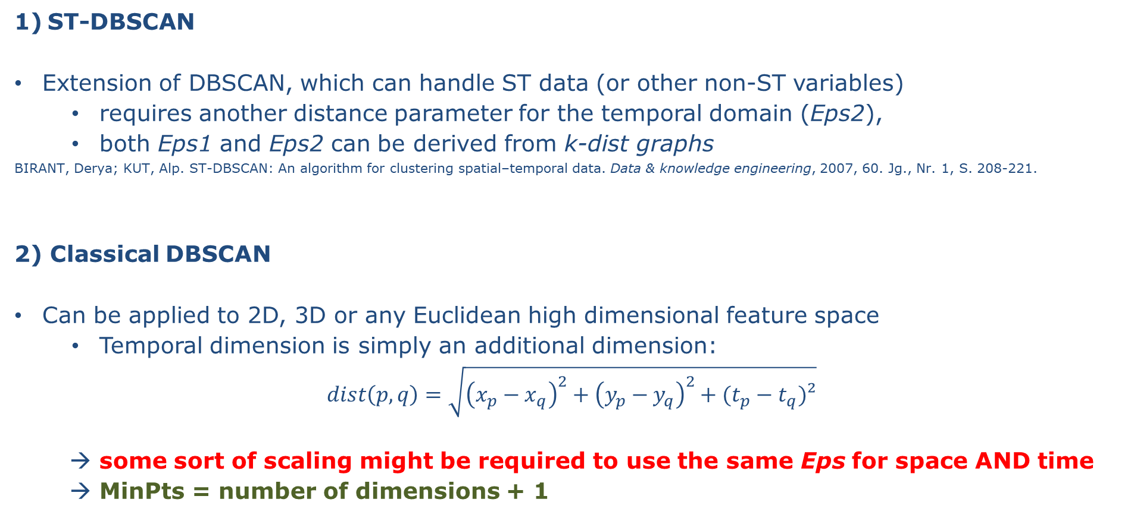
DBSCAN for spatiotemporal data
ST-DBSCAN
Extension of DBSCAN, which can handle ST data (or other non-ST variables)
requires another distance parameter for the temporal domain (Eps2),
both Eps1 and Eps2 can be derived from k-dist graphs
BIRANT, Derya; KUT, Alp. ST-DBSCAN: An algorithm for clustering spatial–temporal data. Data & knowledge engineering, 2007, 60. Jg., Nr. 1, S. 208-221.
2) Classical DBSCAN
Can be applied to 2D, 3D or any Euclidean high dimensional feature space
Temporal dimension is simply an additional dimension:
$$dist\left(p,q\right)=\sqrt{{\left(x_{p}−x_{q}\right)}^{2}+{\left(y_{p}−y_{q}\right)}^{2}+(t_{p}−t_{q})²}$$
→ some sort of scaling might be required to use the same Eps for space AND time
→ MinPts = number of dimensions + 1

Slide 29
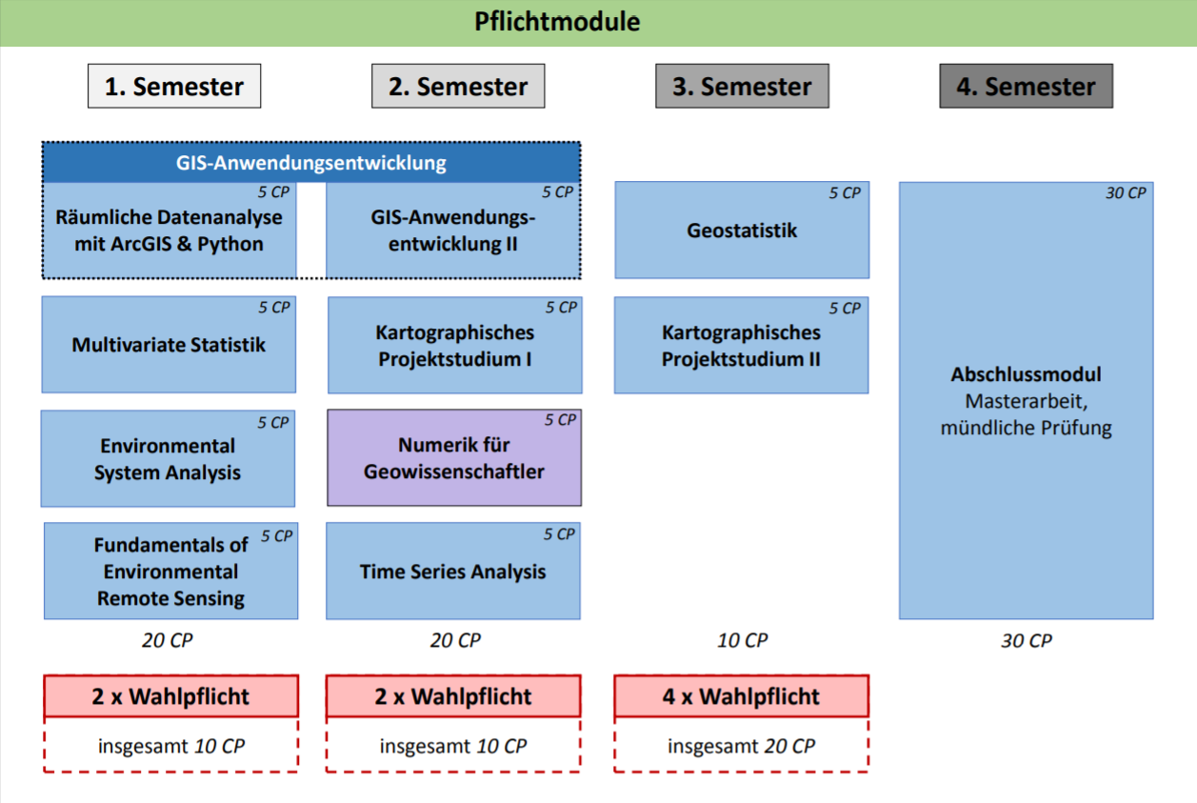
https://www.uni-trier.de/fileadmin/fb6/fb6/stu/bac/AGI/Modulplan_MSc_AGI_Stand2016.pdf

Slide 30
Requirements
Knowledge of geospatial data analysis
Knowledge of multivariate data and statistics
some R skills
Cluster analysis, concept and algorithms

