Slide 1

Clustering spatiotemporal point data to
visualize spatial patterns
Dr. David Frantz
Geoinformatics – Spatial Data Science
Demonstration lecture
Trier / Zoom, 02.07.2020
Applied Geoinformatics, 2nd term

Slide 2
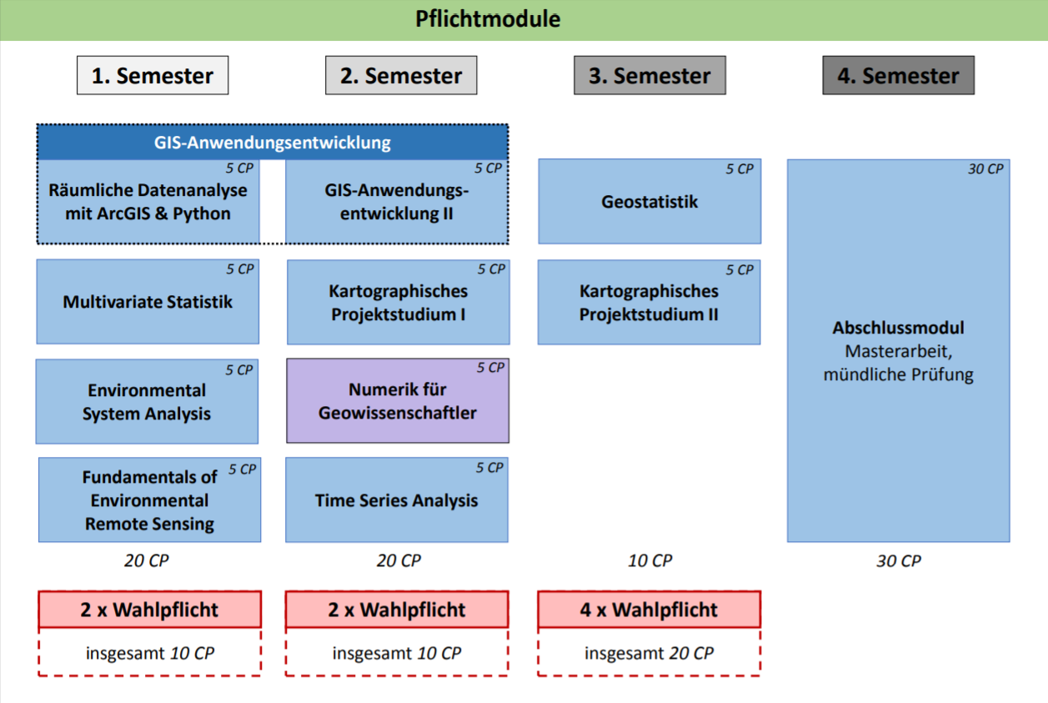
https://www.uni-trier.de/fileadmin/fb6/fb6/stu/bac/AGI/Modulplan_MSc_AGI_Stand2016.pdf

Slide 3
Geostatistics (Semester 2)
Analysis of point data using geostatistical methods, concepts and techniques
Practical exercises in the analysis of spatial patterns using expert software, e.g. R
Translated from the module handbook “M.Sc. Applied Geoinformatics”
https://www.uni-trier.de/fileadmin/fb6/fb6/stu/bac/AGI/Modulhandbuch_MSC_AGI_2013.pdf

Slide 4
Requirements
Processing of vector data, visualization of geodata
→ Knowledge of geospatial data analysis
Fundamental knowledge of relevant multivariate methods for predicting and testing, investigating dependencies and classification
Knowledge of statistics and concepts
Consolidation of skills in SPSS/Matlab
-> some R skills
Cluster analysis
→ Knowledge of the concept
Translated from the module handbook “M.Sc. Applied Geoinformatics”
https://www.uni-trier.de/fileadmin/fb6/fb6/stu/bac/AGI/Modulhandbuch_MSC_AGI_2013.pdf

Slide 5
Learning Objective
Introduction to spatiotemporal data
Clustering algorithm
Practical experience/demonstration to cluster real-life ST data with current relevancy

Slide 6
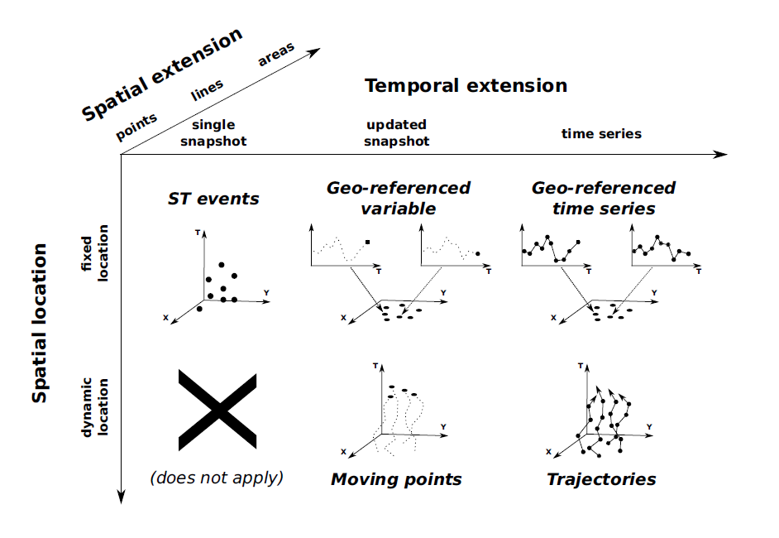
Spatiotemporal data
1) ST event
Single measurement
<longitude, latitude, timestamp>
seismic event
record of an epidemic
Kisilevich et al.: Spatio-temporal clustering. In: Data mining and knowledge discovery handbook. Springer, Boston, MA, 2009. S. 855-874.

Slide 7
Spatiotemporal data
1) ST event
Single measurement
<longitude, latitude, timestamp>
seismic event
record of an epidemic
2) Geo-referenced variable
Evolution in time, but only the most recent value
<longitude, latitude, timestamp, non-spatial value>
Weather station with most recent temperature value
Kisilevich et al.: Spatio-temporal clustering. In: Data mining and knowledge discovery handbook. Springer, Boston, MA, 2009. S. 855-874.

Slide 8
Spatiotemporal data
3) Geo-referenced time series
Whole history is stored
Climate station
NDVI time series
Kisilevich et al.: Spatio-temporal clustering. In: Data mining and knowledge discovery handbook. Springer, Boston, MA, 2009. S. 855-874.

Slide 9
Spatiotemporal data
3) Geo-referenced time series
Whole history is stored
Climate station
NDVI time series
4) Moving points
object moves, most recent position
real-time tracking of vehicles
Kisilevich et al.: Spatio-temporal clustering. In: Data mining and knowledge discovery handbook. Springer, Boston, MA, 2009. S. 855-874.

Slide 10
Spatiotemporal data
3) Geo-referenced time series
Whole history is stored
Climate station
NDVI time series
4) Moving points
object moves, most recent position
real-time tracking of vehicles
5) Trajectories
Object moves, whole history is stored
Google Location History
Kisilevich et al.: Spatio-temporal clustering. In: Data mining and knowledge discovery handbook. Springer, Boston, MA, 2009. S. 855-874.

Slide 11
Clustering ST event data
Three dimensions:
<longitude, latitude, timestamp>
Static in space and time = snapshot
Problem: complex datasets
Solution: Spatiotemporal analyses methods to mine meaningful patterns for better understanding
Clustering = unsupervised method for discovering potential patterns
Finding clusters among events means to discover groups that lie close both in time and in space

Slide 12
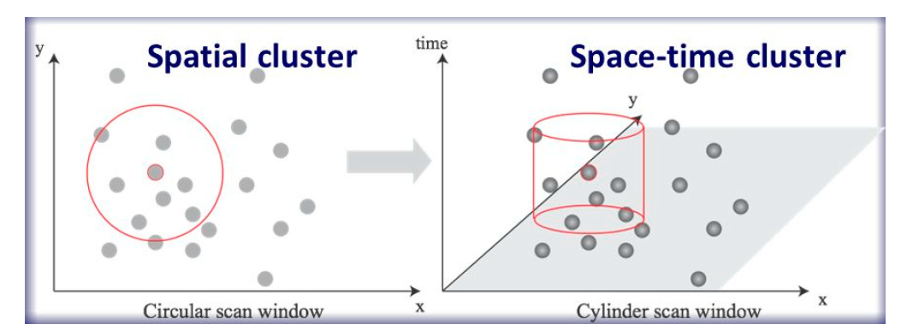
Clustering ST event data
Classical example: spatio-temporal cylinders where the density of events is higher than outside
KULLDORFF, Martin. A spatial scan statistic. Communications in Statistics-Theory and methods, 1997, 26. Jg., Nr. 6, S. 1481-1496.
SHI, Zhicheng; PUN-CHENG, Lilian SC. Spatiotemporal data clustering: a survey of methods. ISPRS international journal of geo-information, 2019, 8. Jg., Nr. 3, S. 112.

Slide 13
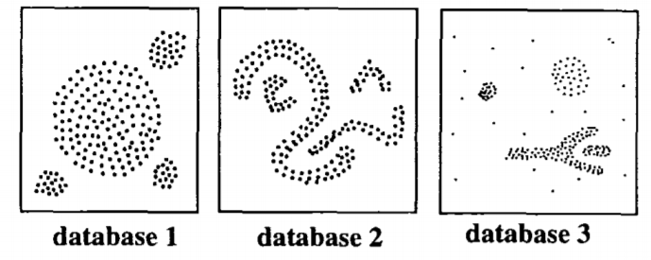
DBSCAN
Density-Based Spatial Clustering of Applications with Noise
ESTER, Martin, et al. A density-based algorithm for discovering clusters in large spatial databases with noise. In: Kdd. 1996. S. 226-231.
Density-based notion of cluster:
Within each cluster, we have a typical density of points, which is considerably higher than outside
Popular algorithm in data mining
Find clusters of arbitrary shape
Detect noise
Only two input parameters, which can be set using simple heuristics
Efficient, even for very large databases

Slide 14
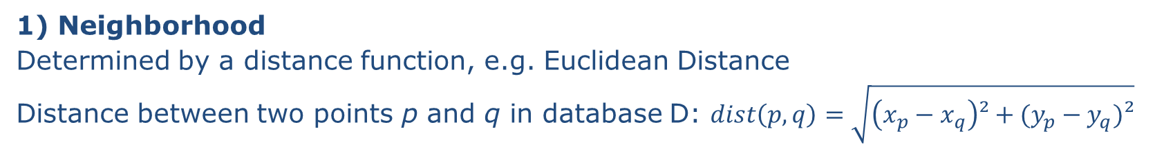
DBSCAN concepts (1)
p
1) Neighborhood
Determined by a distance function, e.g. Euclidean Distance
Distance between two points p and q in database D: $dist\left(p,q\right)=\sqrt{\left(x_{p}−x_{q}\right)²+(y_{p}−y_{q})²}$
q

Slide 15
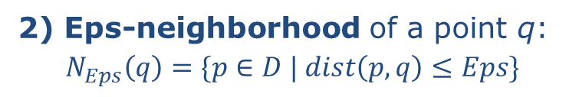
DBSCAN concepts (1)
p
1) Neighborhood
Determined by a distance function, e.g. Euclidean Distance
Distance between two points p and q in database D: $dist\left(p,q\right)=\sqrt{\left(x_{p}−x_{q}\right)²+(y_{p}−y_{q})²}$
q
p
2) Eps-neighborhood of a point q:
$$N_{Eps}\left(q\right)=\{p∈D | dist\left(p,q\right)≤Eps\}$$
q

Slide 16

DBSCAN concepts (1)
p
1) Neighborhood
Determined by a distance function, e.g. Euclidean Distance
Distance between two points p and q in database D: $dist\left(p,q\right)=\sqrt{\left(x_{p}−x_{q}\right)²+(y_{p}−y_{q})²}$
q
p
2) Eps-neighborhood of a point q:
$$N_{Eps}\left(q\right)=\{p∈D | dist\left(p,q\right)≤Eps\}$$
q
3) Core point is part of a cluster C $\left|N_{Eps}\left(q\right)\right|≥MinPts$
q
MinPts = 3

Slide 17
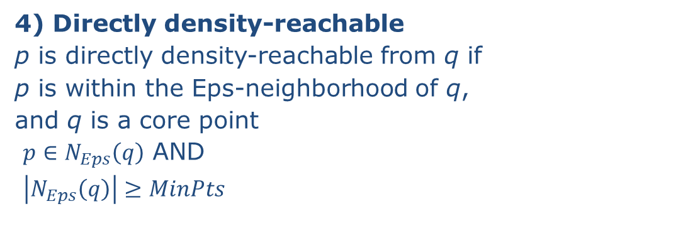
DBSCAN concepts (2)
p directly density-reachable from q
p
q
q not directly density-reachable from p
4) Directly density-reachable
p is directly density-reachable from q if
p is within the Eps-neighborhood of q,
and q is a core point
$p∈N_{Eps}\left(q\right)$ AND
$\left|N_{Eps}\left(q\right)\right|≥MinPts$

Slide 18
DBSCAN concepts (2)
p directly density-reachable from q
p
q
q not directly density-reachable from p
4) Directly density-reachable
p is directly density-reachable from q if
p is within the Eps-neighborhood of q,
and q is a core point
$p∈N_{Eps}\left(q\right)$ AND
$\left|N_{Eps}\left(q\right)\right|≥MinPts$
q
p
5) Density-reachable
p is density-reachable from q if there is a chain of points that are directly density-reachable

Slide 19
DBSCAN concepts (2)
p directly density-reachable from q
p
q
q not directly density-reachable from p
4) Directly density-reachable
p is directly density-reachable from q if
p is within the Eps-neighborhood of q,
and q is a core point
$p∈N_{Eps}\left(q\right)$ AND
$\left|N_{Eps}\left(q\right)\right|≥MinPts$
q
p
5) Density-reachable
p is density-reachable from q if there is a chain of points that are directly density-reachable
6) Density-connected
p is density connected to q, if both p and q are density-reachable from a point o
o
p
q

Slide 20
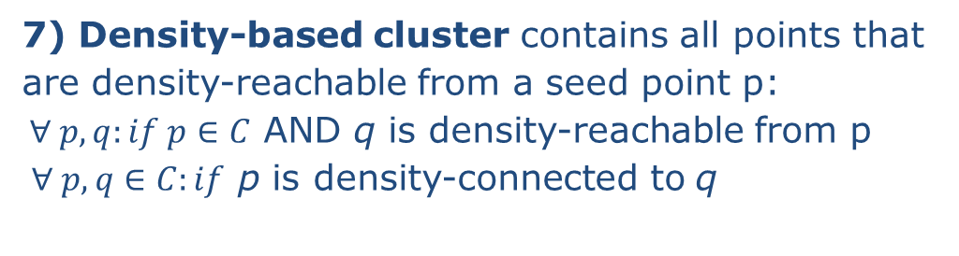
DBSCAN concepts (3)
7) Density-based cluster contains all points that
are density-reachable from a seed point p:
$∀ p, q:if p∈C$ AND q is density-reachable from p
$∀ p, q∈C:if$ p is density-connected to q
p
k

Slide 21
DBSCAN concepts (3)
7) Density-based cluster contains all points that
are density-reachable from a seed point p:
$∀ p, q:if p∈C$ AND q is density-reachable from p
$∀ p, q∈C:if$ p is density-connected to q
p
k
8) Border point
p is a border point if not a core point, but density reachable from another core point
9) Noise
Any point k not belonging to any cluster

Slide 22
Eps and MinPts
MinPts does not critically affect clustering results
It is suggested to use 4, or the number of dimensions + 1, denoted as k
The distance Eps should be set according to the “thinnest” cluster

Slide 23
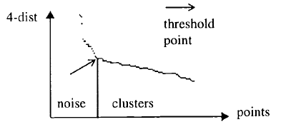
Eps and MinPts
MinPts does not critically affect clustering results
It is suggested to use 4, or the number of dimensions + 1, denoted as k
The distance Eps should be set according to the “thinnest” cluster
Simple solution:
Compute the distance d of a point p to its k-th nearest neighbor
Repeat for each point
Sort the distances and plot (k-dist graph)

Slide 24
Spatiotemporal clustering
Main challenge: different units of time and space..
What distance equals a unit of time?
Depends on the application:
Two pedestrians that have met with a distance of 1.5m within a minute interval could belong to the same cluster (e.g. CORONA App)
Two spatially close sample points in a physics experiment that are nanoseconds apart could belong to different clusters

Slide 25
DBSCAN for spatiotemporal data
ST-DBSCAN
Extension of DBSCAN, which can handle ST data (or other non-ST variables)
requires another distance parameter for the temporal domain (Eps2),
both Eps1 and Eps2 can be derived from k-dist graphs
BIRANT, Derya; KUT, Alp. ST-DBSCAN: An algorithm for clustering spatial–temporal data. Data & knowledge engineering, 2007, 60. Jg., Nr. 1, S. 208-221.

Slide 26
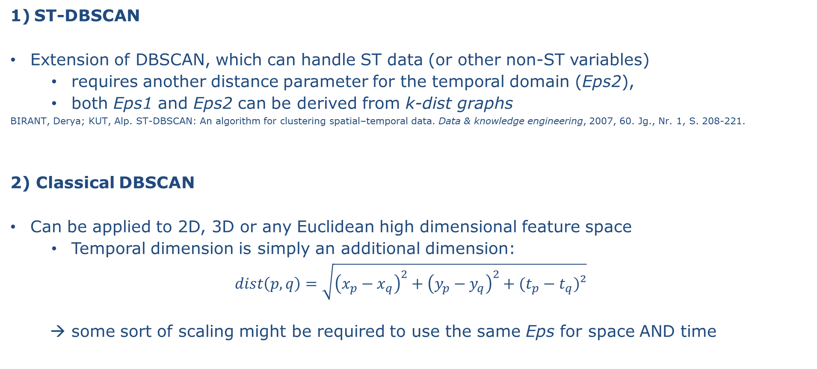
DBSCAN for spatiotemporal data
ST-DBSCAN
Extension of DBSCAN, which can handle ST data (or other non-ST variables)
requires another distance parameter for the temporal domain (Eps2),
both Eps1 and Eps2 can be derived from k-dist graphs
BIRANT, Derya; KUT, Alp. ST-DBSCAN: An algorithm for clustering spatial–temporal data. Data & knowledge engineering, 2007, 60. Jg., Nr. 1, S. 208-221.
2) Classical DBSCAN
Can be applied to 2D, 3D or any Euclidean high dimensional feature space
Temporal dimension is simply an additional dimension:
$$dist\left(p,q\right)=\sqrt{{\left(x_{p}−x_{q}\right)}^{2}+{\left(y_{p}−y_{q}\right)}^{2}+(t_{p}−t_{q})²}$$
→ some sort of scaling might be required to use the same Eps for space AND time

Slide 27
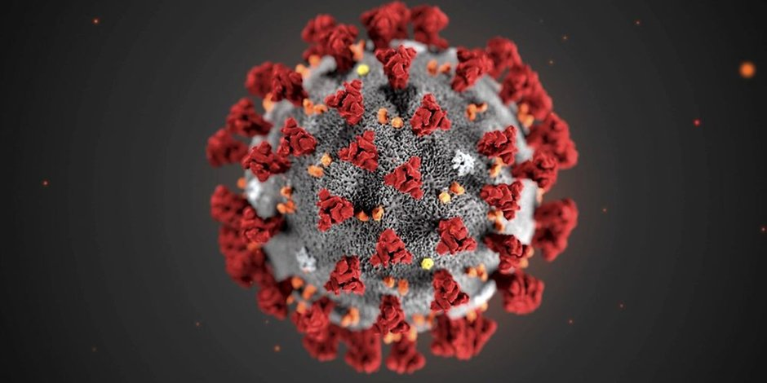
Hands-on session
COVID-19 (Coronavirus SARS-CoV-2)
Foto: imago images/ZUMA Press

Slide 28

Play with the data
Download the JupyterLab environment from
includes
Jupyter notebooks with all plots and code,
COVID-19 data,
this presentation,
literature with suggested reading
requires
JupyterLab
R & R-Kernel
Parameters that will affect the clusters
Number of cases N
→ find larger or smaller hotspots,
→ incidence instead of abs. numbers?
Scaling of the temporal dimension
→ 7 days, 31 days?
→ statistical rescaling method for all dimensions? (e.g. z-transform)
Eps
→ Shift the allocations to noise/clusters
github.com/davidfrantz/covid19

Slide 29
Stay healthy. Don’t become a cluster!

