Slide 1















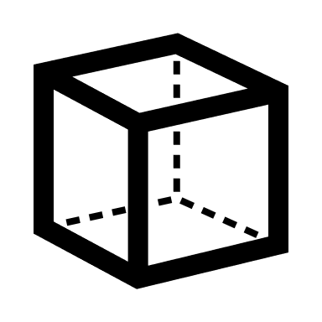
residential
low-rise
mid-rise
mobile homes + lightweight
area (m²)
metals
iron + steel
copper
aluminium
other
residential / commercial mixed use
low/mid-rise
high-rise
skyscraper
height (m)
buildings
non-metallic minerals
concrete
bricks
glass
aggregate (exc. concrete)
other
commercial
+ industrial
volume (m³)
roads
motorway
primary
secondary
tertiary
local
rural
bridge
tunnel
biomass
timber
other
mobility infrastructure
rails
railway
tram
other
subway
bridge
tunnel
petroleum products
bitumen
other
parking
+ yards
airport runways
area (m²)
all other
materials
categories
dimensions
materials
materials
iron + steel
copper
aluminium
other
concrete
bricks
glass
aggregate (exc. concrete)
other
timber
other
bitumen
other
metals
non-metallic minerals
biomass
petroleum products
all other
materials
low-rise
mid-rise
mobile homes + lightweight
motorway
primary
secondary
tertiary
local
rural
bridge
tunnel
residential
commercial
+ industrial
roads
railway
tram
other
subway
bridge
tunnel
parking
+ yards
categories
low/mid-rise
high-rise
skyscraper
residential / commercial mixed use
rails
airport runways
dimensions
area (m²)
buildings
mobility infrastructure
volume (m³)
residential
low-rise
mid-rise
mobile homes + lightweight
buildings
height (m)
residential / commercial mixed use
low/mid-rise
high-rise
skyscraper
commercial
+ industrial
metals
iron + steel
copper
aluminium
other
area (m²)
non-metallic minerals
concrete
bricks
glass
aggregate (exc. concrete)
other
petroleum products
bitumen
other
roads
motorway
primary
secondary
tertiary
local
rural
bridge
tunnel
parking
+ yards
all other
materials
mobility infrastr.
timber
other
area (m²)
rails
railway
tram
other
subway
bridge
tunnel
airport runways
biomass
dimensions
categories
materials

