Slide 1

E-commerce Sales Analysis & Predictive Modeling (2024 Dataset)
Swathi Mulkundkar

Slide 2




Project Overview
• Objective: Analyze E-commerce data to identify customer behavior and product trends.
• Tools: Python (Pandas, Matplotlib, Seaborn, Plotly). Jupyter Notebook, VS code and Github
• Dataset: 3 linked CSVs – Sales, Customer, and Product data.
• Outcome: Visual insights and predictive model to forecast purchases.

Slide 3
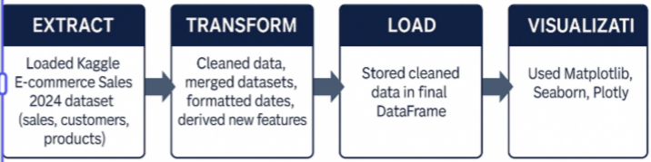
ETL Pipeline
Steps:
• Extract – Loaded CSV files from Kaggle.
• Transform – Cleaned, handled missing values, merged data.
• Load – Saved a unified DataFrame for analysis.

Slide 4
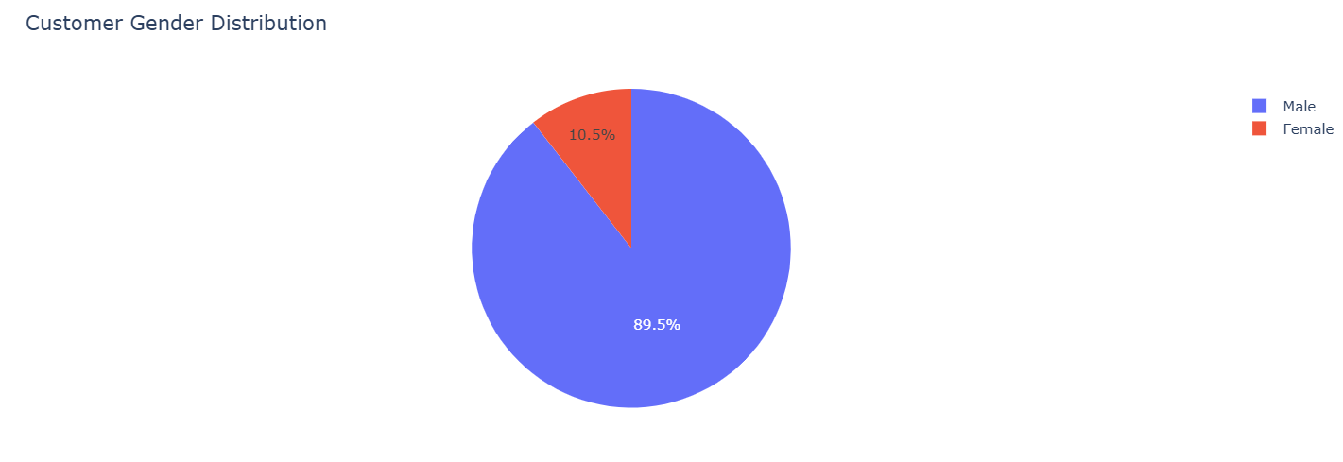
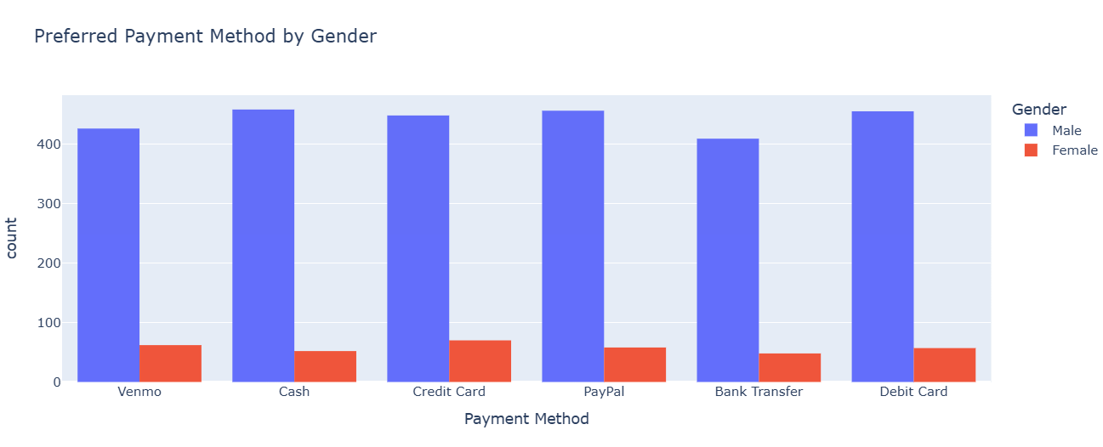
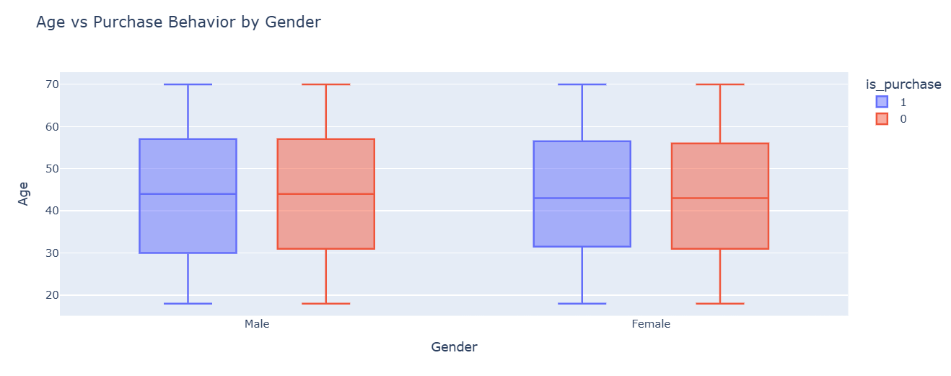
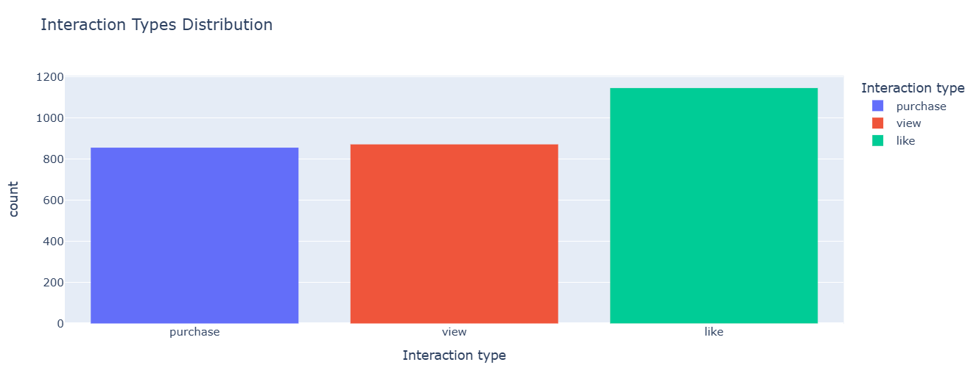
Customer Insights
Key Findings:
• Gender Distribution: Majority of users are male.
• Age Group 25–40 makes the most purchases.
• Preferred Payments: PayPal & Credit Card.
Notes:
Customer Gender Distribution: This pie chart highlights the gender segmentation of the customer base. Understanding
demographic composition enables targeted marketing and product personalization
strategies.
Interaction Types: This visualization examines how customers interact with the platform through actions such
as views, likes, and purchases. It helps identify where users drop off in the engagement
funnel and which interactions dominate user behavior.
Gender & Age:This analysis compares age groups and their purchasing activity. The results show that
customers aged 25–40 form the most active purchasing segment, which informs targeted
advertisement planning.
Payment Behaviour: This visualization reveals how different genders prefer different payment modes. Digital
wallets and credit cards are more popular among certain demographic groups, guiding
checkout optimization strategies.

Slide 5
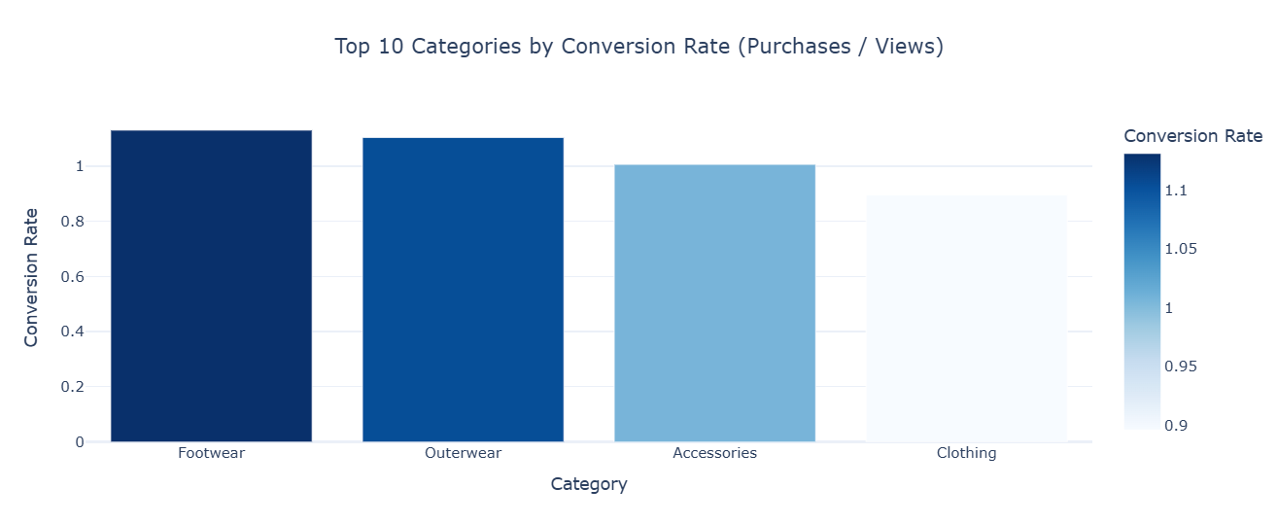
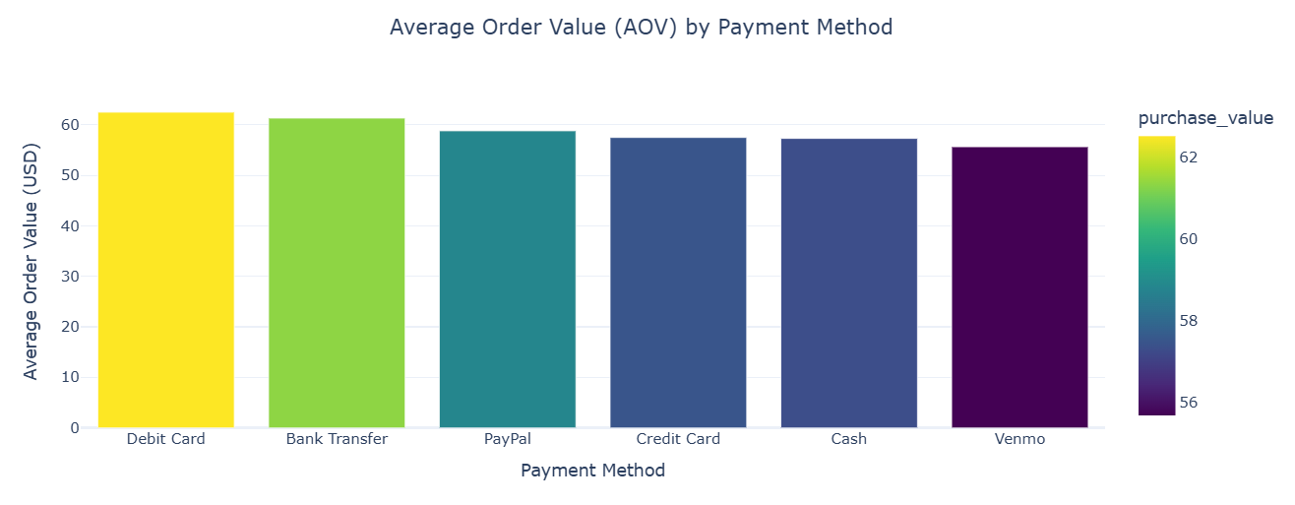
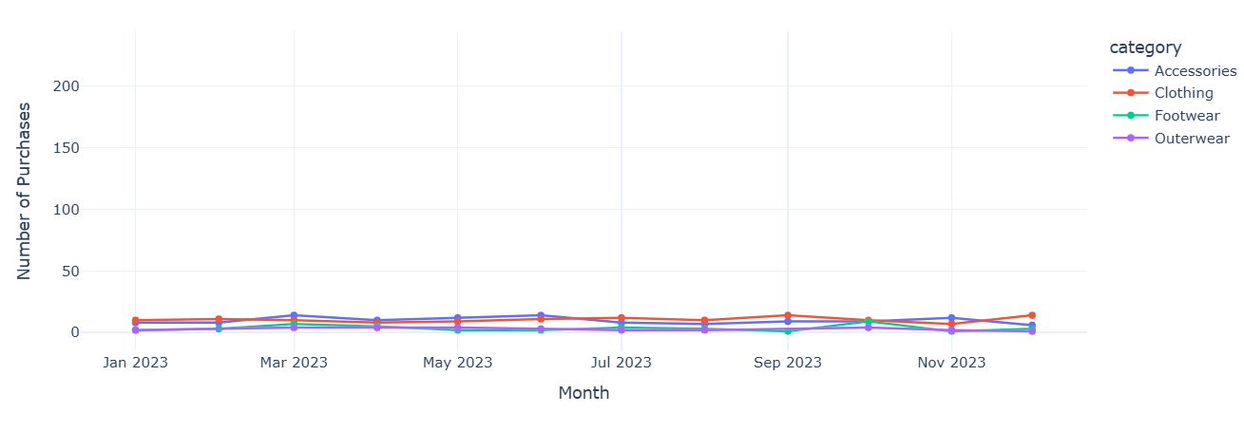
Product Insights
• Top 10 Categories Rate(purchases/views)
Average Order Value by payment method
• Consistent monthly trends observed in 2023–2024.
• Seasonal peaks during October–December.
Notes:
Category Conversion Rate (Purchases / Views):This metric measures how effectively product categories convert user interest (views) into
purchases. High conversion categories signal strong product-market fit or effective
merchandising.Footwear and Outerwear categories show the best conversion from views to purchases.
Average Order Value (AOV) by Payment Method:AOV helps reveal customer spending patterns. Digital payment users tend to make
higher-value purchases, suggesting the importance of seamless online payment
infrastructure.Digital and bank-based payments correlate with higher spend per order.
Monthly Purchases for Top Categories: This trendline captures seasonal and monthly purchase fluctuations. It helps forecast
demand, optimize stock levels, and plan marketing around high-performing months.Clothing shows stable demand, while Accessories and Outerwear have clear seasonal peaks, especially around promotional periods.

Slide 6
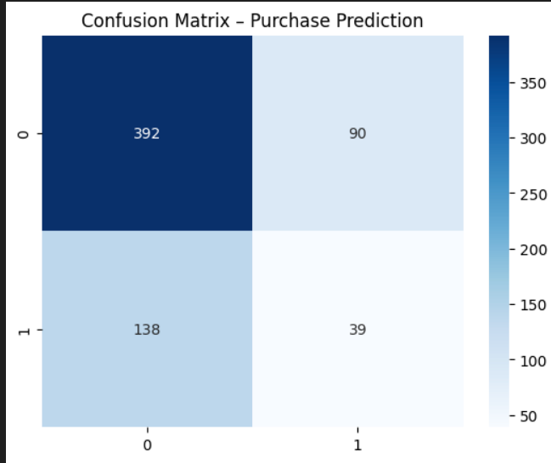
Predictive Modeling
Model: Random Forest Classifier
• Features: Age, Gender, Payment Method, Frequency of Purchases.
• Target: Purchase likelihood.
• Accuracy: ~65%
Notes:
Confusion Matrix – Model Accuracy Assessment:
This visualization evaluates model performance in predicting purchase likelihood. High
diagonal values indicate good classification accuracy, validating the reliability of the
predictive model.The model distinguishes well between purchase and non-purchase classes, with relatively few misclassifications.

Slide 7
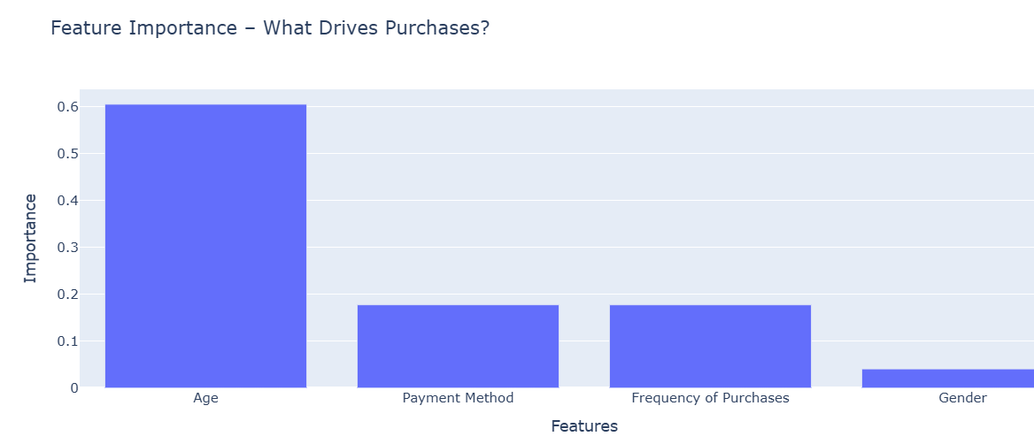
Feature Importance
Top Predictors:
1. Age
2. Frequency of purchases
3. Payment Method
4. Gender
Notes:
Predictive Model – Feature Importance:
The Random Forest model identifies the factors that contribute most to purchase
decisions.
Age is the most influential factor driving purchases, followed by payment method and purchase frequency.
Gender has minimal impact on purchasing behavior.
This indicates that demographics and payment convenience play a bigger role than buying patterns alone.

Slide 8
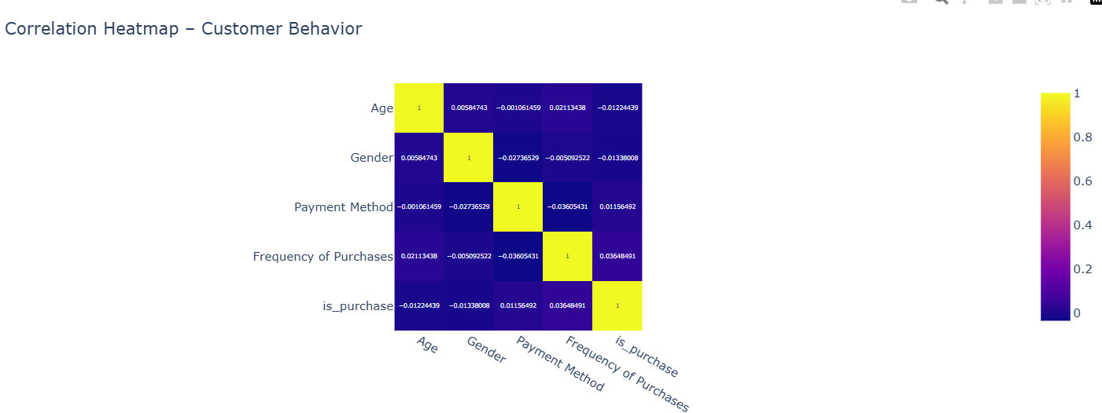
Correlation heatmap – Customer Behavior
Notes:
Correlation Heatmap: This heatmap explores the relationships between numerical features. It helps identify
multicollinearity and key behavioral correlations that influence purchases.
Purchase behaviour is moderately correlated with frequency of purchases and age.

Slide 9
Insights & Recommendations
Insights
Footwear & Outerwear show the highest conversion rates.
Accessories have high views but low conversions.
Debit Card & Bank Transfer users have the highest AOV; Cash & Venmo the lowest.
Clothing demand remains steady year-round.
Accessories & Outerwear show seasonal purchase peaks
Customers aged 25–40 form the highest purchasing segment.
PayPal & Credit Card users have higher purchase rates.
Certain categories contribute disproportionately to total revenue.
Predictive modeling shows engagement frequency is the strongest purchase predictor.
Recommendations
Prioritise Footwear & Outerwear in targeted marketing campaigns.
Enhance Accessories listings (visuals, price competitiveness, bundles).
Promote digital payment methods with loyalty points or small cashback.
Use upsell/cross-sell strategies for low-AOV customers (Cash & Venmo).
Align marketing with seasonal demand peaks (Accessories, Outerwear).
Target customers aged 25–40 with personalised offers.
Push popular high-revenue categories through retargeting ads.
Strengthen loyalty programs to reward digital payment and frequent buyers.
Re-engage high-frequency users early — they are most likely to convert again.

Slide 10
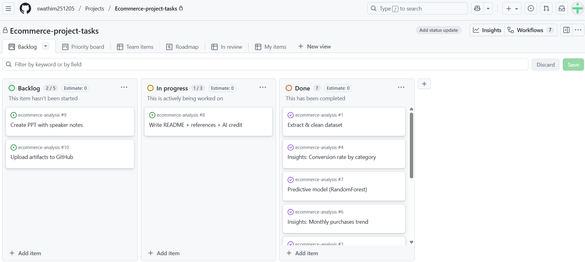
Agile Project Summary & Reflection
• Used GitHub Projects for Kanban-based tracking.
• Regular reflection & problem-solving logged.

Slide 11
Reflection & Learning
• Strengthened Python, Jupyter Notebook (Numpy, Pandas, Matplotlib, Seaborn)and visualization skills.
• Gained experience with predictive analytics.
• Overcame challenges merging large datasets.
• Developed professional documentation and presentation workflow.

Slide 12
Conclusion & Q&A
This project demonstrates an end-to-end E-commerce analytics workflow.
It provided actionable insights to optimize marketing, improve retention, and predict purchase behavior.
Thank you!
Notes:
This comprehensive analysis revealed strong behavioral patterns in consumer
demographics, payment preferences, and purchase activity. The predictive modeling
further identified engagement frequency as the strongest determinant of purchase
likelihood. These insights collectively guide data-driven decision-making for marketing
optimization, inventory planning, and customer retention strategies.

