Slide 1
Beyond Exception Handling

Slide 2
Project’s Goal
Implementation of the operations for the signalling and handling of exceptional situations in Julia

Slide 3
Project’s Goal
The main aim is to implement exception handling that doesn’t jump out and lose scope like in try-catch.
In a classic try-catch, once an exception is caught, the current execution jumps to the catch and local computation is lost and variables from outer scope that aren’t lost can be left in an incorrect / unfinished state.
We implement some exception handling available in Common Lisp Condition System, handlers and restarts.

Slide 4
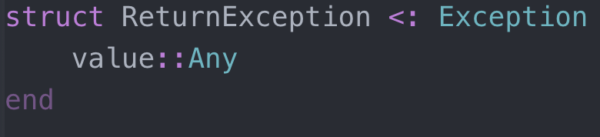
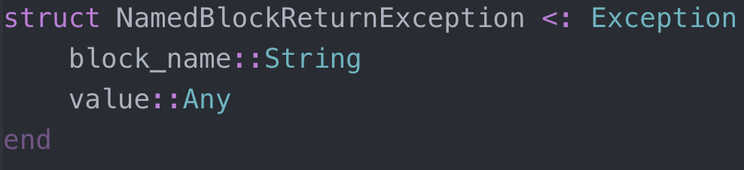
HOW?
With the use of two new exception types
These allow us to pass data specific to each type
ReturnException
Thrown when a restart invocation ends
Contains the return value of the restart function
NamedBlockReturnException
Thrown by return_from function
Used to exit from a named block
May contain an optional value supplied on return_from

Slide 5
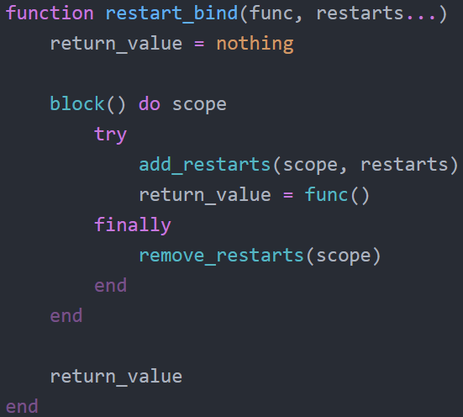
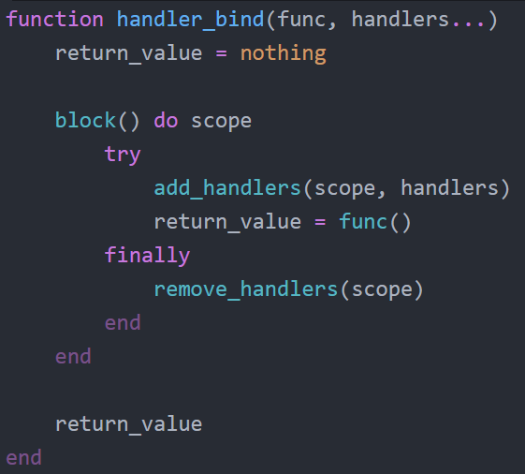
Handlers & Restarts - Bind
Bind functions are higher order functions that execute a function (usually an anonymous function provided by Julia’s do-end)
Essentially, used to make available the desired handlers during the execution of the function

Slide 6
Handlers & Restarts - Error
The key to not losing computational context, is to have a function that attempts to solve the problem without escaping
This is the error function

Slide 7
Scope Problems
Both handler_bind and restart_bind forms are meant to only bind the supplied values on the scope that is provided by Julia’s do-end forms.
We store those values in an appropriate array (one for handlers, one for restarts) and dynamically add and remove on entry and exit of scope.
This is done by wrapping the handler_bind and restart_bind on a block function.
Then, by mapping each handler/restart to the current block name and adding to the array, on exit of the bind functions we just need to remove the handlers/restarts that are bound to the block name.
A try-finally is useful to always remove the handlers no matter what happens.

