Slide 1
Beyond Exception Handling

Slide 2
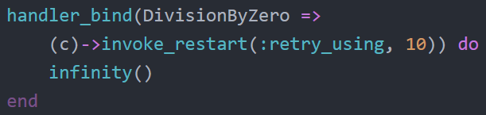
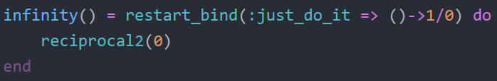
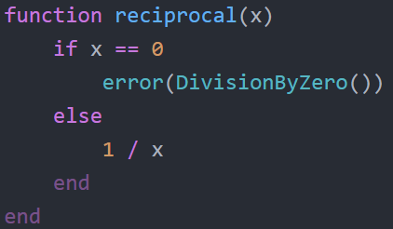
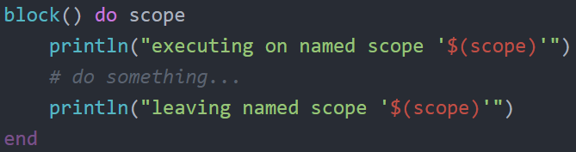
Project’s Goal
Implementation of the operations for the signalling and handling of exceptional situations in Julia

Slide 3
Project’s Goal
The main aim is to implement exception handling that doesn’t jump out and lose scope like in try-catch.
In a classic try-catch, once an exception is caught, the current execution jumps to the catch and local computation is lost and variables from outer scope that aren’t lost can be left in an incorrect / unfinished state.
We implement some exception handling available in Common Lisp Condition System, handlers and restarts.

Slide 4
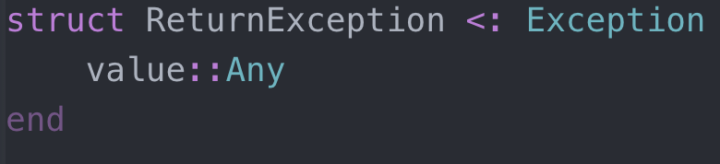
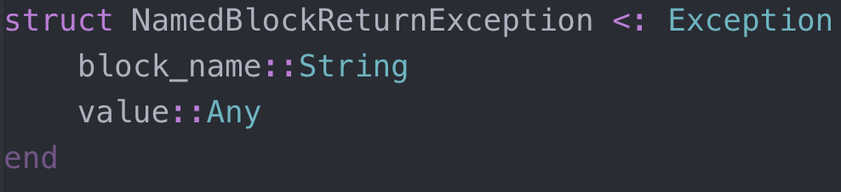
HOW?
With the use of two new exception types
These allow us to pass data specific to each type
ReturnException
Thrown when a restart invocation ends
Contains the return value of the restart function
NamedBlockReturnException
Thrown by return_from function
Used to exit from a named block
May contain an optional value supplied on return_from

Slide 5
Named Blocks + return_from
Useful to be able to manage scope of handlers and restarts
Higher-order function that gets assigned an auto-generated ID for its name
The ID is computed by having a global UInt128 that is incremented on every named block, then appended to “scope-” (example: “scope-1”, “scope-2”, etc...)
Executes the function supplied under a try-catch that looks for NamedBlockReturnException, if it hits the catch, the value received is returned
return-from can be called to exit a named block, with an optional value
This will throw a NamedBlockReturnException

Slide 6
Scope Problems
Both handler_bind and restart_bind forms are meant to only bind the supplied values on the scope that is provided by Julia’s do-end forms.
We store those values in an appropriate array (one for handlers, one for restarts) and dynamically add and remove on entry and exit of scope.
This is done by wrapping the handler_bind and restart_bind on a block function.
Then, by mapping each handler/restart to the current block name and adding to the array, on exit of the bind functions we just need to remove the handlers/restarts that are bound to the block name.
A try-finally is useful to always remove the handlers no matter what happens.

Slide 7
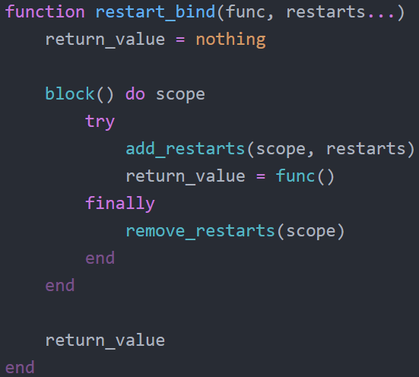
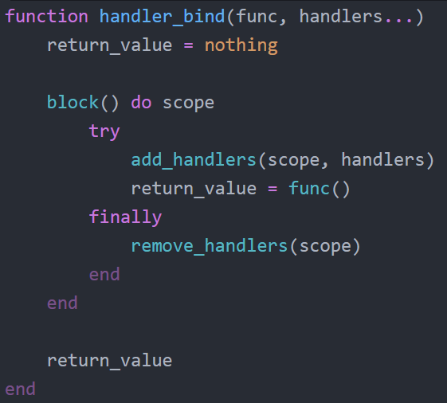
Handlers & Restarts - Bind
Bind functions are higher order functions that execute a function (usually an anonymous function provided by Julia’s do-end)
Essentially, used to make available the desired handlers during the execution of the function

Slide 8
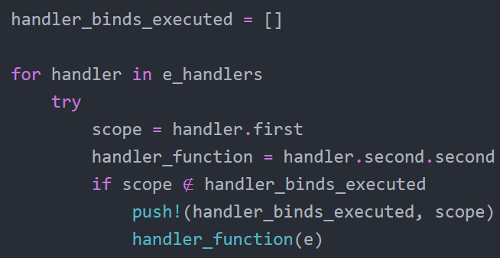
Handlers & Restarts - Error
The key to not losing computational context, is to have a function that attempts to solve the problem without escaping
Error function will try to execute handlers if they match with the exception type
It will, at most, execute 1 handler per handler_bind form
If there are multiple handler_bind forms in a scope and the first one doesn’t solve the problem, the next one will attempt to, until it is solved, or not and the program crashes because the exception wasn’t handled
Achieved by only allowing execution of 1 handler per handler_bind
“scope-5” handler is executed but the Exception is not handled
“scope-5” has another handler for the Exception, will not be executed!
“scope-4” has an handler for the Exception, will be executed

Slide 9
Extensions Implemented
Signal function
This function is essentially error function but without throwing the Exception if the error is not handled
Then, error becomes a call to signal + throwing if the Exception was not handled
User-handling of restarts
Implemented on top of error
If problem was not handled by signal, print available restarts to user and ask for input
Check if number of restart supplied is valid, and if it is, execute the restart

