Slide 1
Movie Review Sentiment Analysis
CS513 Section B
David Fu, Cynthia Loh, Aakash Irengbam, Aniket Patel
All Material Are Used for Project for CS513 Purposes
December 7, 2021

Slide 2
About CS513
A course at Stevens reviewing the knowledge of knowledge exploration and understanding data.

Slide 3
Abstract
There has been a rapid, notable increase of movie reviews written by the viewers. This is thanks to sites like IMDB that encourage users to write feedback.
While reading reviews is a great way for potential viewers to gauge which movie they would enjoy watching or not, the vast amount of reviews make it extremely difficult and time consuming for a person to read through completely.
In order to overcome this challenge, we developed a way to automate movie review classification and summarize the average sentiment
This will allow people to quickly be able to gauge the scores of the reviews

Slide 4
Introduction
There are different technique in NLP on how to convert letters and words into numerical matrices
By applying four different classifications technique in ML modeling we try to compare the effectiveness of each
We then compare the accuracy of each of the different methods to find the most optimal solution for the problem
Naive Bayes
Naïve Bayes Classifier is one of the simple and most effective Classification algorithms which helps in building the fast machine learning models that can make quick predictions. It is a probabilistic classifier, which means it predicts on the basis of the probability of an object.
K Nearest Neighbor
KNN: A k-nearest-neighbor algorithm is an approach to data classification that estimates how likely a data point is to be a member of one group or the other depending on what group the data points nearest to it are in.
Convolution Neural Net
CNN is a multi-layered version of Artificial Neural Net that uses Convolution Layers and is used to detect complex features in data.
Recurrent Neural Net
LSTM a specialized form of ANN that has a feedback loop that does not process each individual feature without the context of other feature. So context is important when words are processed

Slide 5
Data Preprocessing Techniques
In Natural Language Processing, there are various way to extract features from sentences to convert them into numerical matrices while making sure the data is clean
Cleaning Techniques
Removing punctuation, special characters
Removing Stopwords (The, a, and etc)
Reduce complexity by getting rid of hyphenated words
Feature Extraction
Bert Transformer
TF-IDF

Slide 6
Data Analysis
The dataset we are using contains movie reviews gathered from IMDB as well as their binary sentiment classification of either positive or negative. In total there are fifty-thousand movie reviews and the dataset is split evenly for training and testing data. In the entire dataset, there are no more than 30 reviews from the same movie because reviews for the same movie typically have correlated ratings.

Slide 7
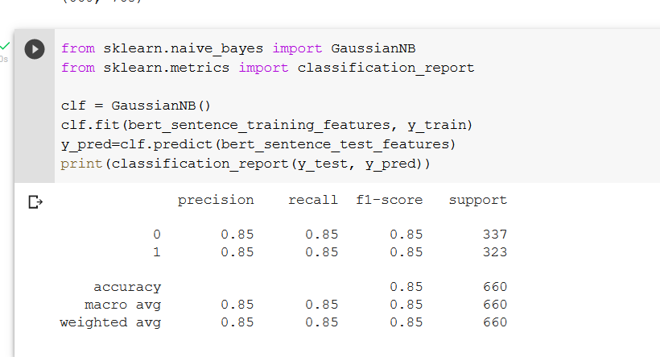
Naive Bayes
Accuracy and Precision using Naive Bayes.

Slide 8
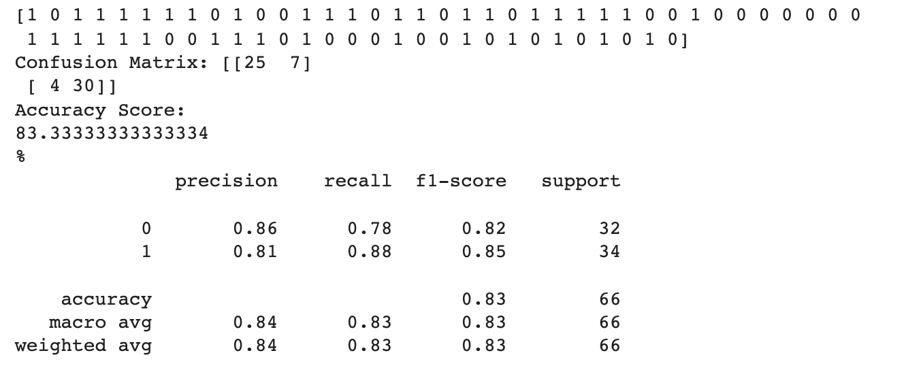
KNN
The table below shows the precision, recall, f1-score and support values from using the KNN methodology .

Slide 9
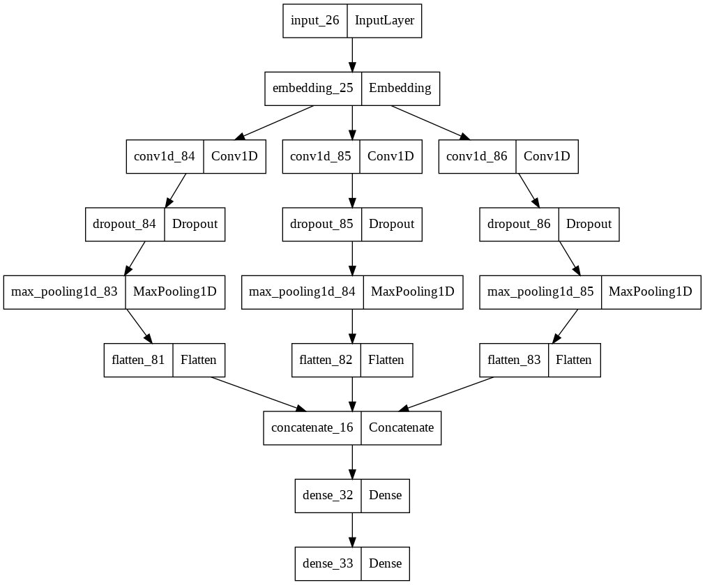
CNN
Accuracy Score: 86.669%

Slide 10
RNN - LSTM
Long Short Term Memory Model
Model: "sequential_8"
_________________________________________________________________
Layer (type) Output Shape Param #
=================================================================
embedding_6 (Embedding) (None, None, 100) 8952800
spatial_dropout1d_5 (Spatia (None, None, 100) 0
lDropout1D)
lstm_5 (LSTM) (None, 100) 80400
dense_5 (Dense) (None, 2) 202
=================================================================
Total params: 9,033,402
Trainable params: 9,033,402
Non-trainable params: 0
_________________________________________________________________
None
Model: "sequential"
_________________________________________________________________
Layer (type) Output Shape Param #
=================================================================
embedding (Embedding) (None, None, 50) 4476400
lstm (LSTM) (None, 10) 2440
dense (Dense) (None, 2) 22
=================================================================
Total params: 4,478,862
Trainable params: 4,478,862
Non-trainable params: 0
_________________________________________________________________
Embedding Layer
LSTM Layer
Dense Layer
Activation Function
Dropout Layer

Slide 11
Model Comparison
 | Naive Bayes | KNN | CNN | LSTM
Runtime | Linear | Linear | Linear-Exponential | Exponential
Precision | 85% | 84% | 85.56% | 81.81%
Accuracy | 85% | 83% | 86.7% | 93.4%
Recall | 85% | 83% | 94.4% | 97.6%
Feature | Bert Transformer | Bert Transformer | TFIDF | TFIDF
Complexity | Simple | Medium | Medium-High | Medium-High

Slide 12
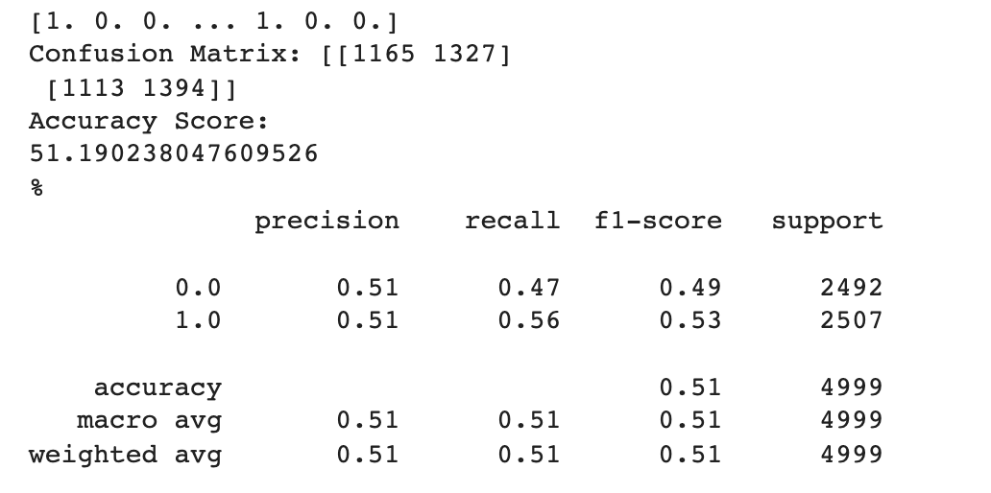
Difference in Preprocessing
This is when the preprocessing for KNN is done through This is when the KNN analysis preprocessing is done through the Bert transform. the simple preprocessing.

Slide 13
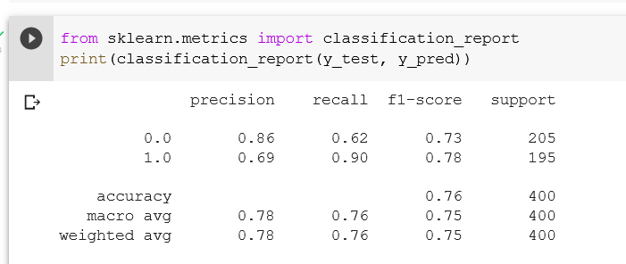
Difference in Preprocessing
Preprocessing using TFIDF for naive bayes
Preprocessing using Bert Transformer for naive bayes

Slide 14
Q&A

