Slide 1
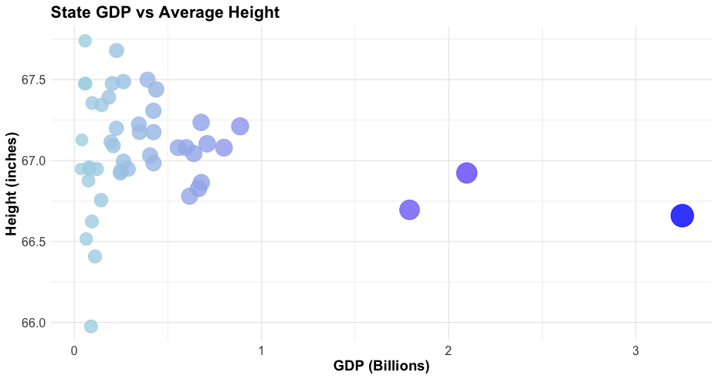
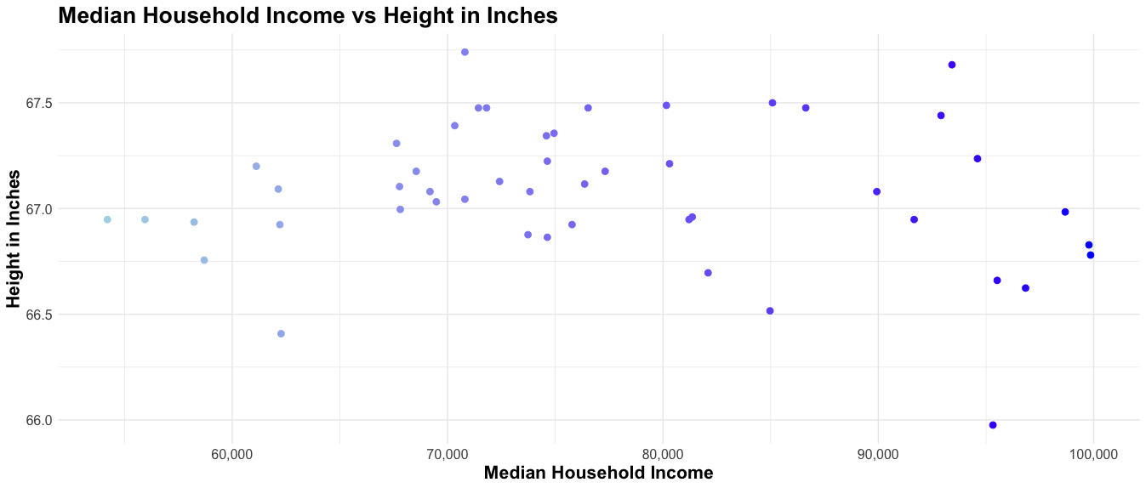
Does Height Affect a States GDP?
Over 58% Fortune 500 CEOs are over 6ft across the world.
While only 14% of the population US population is over 6 ft
Over 30% of these companies are located in just 4 states in the USA.
When you look at GDP Per Capita, states like Minnesota, North Dakota, and Colorado excel, while being in the top 10 tallest states in the United States.
Taller states also tend to have higher income. States like Colorado, Utah, and Alaska all follow this general trend.

