Slide 1
HAL
Natural Language Search Tool
December, 2019

Slide 2
Natural Language Search Tool
What Purpose?
  Translate natural language questions to valid database query language
  Users are not required to understand database schemas and query language syntax

Slide 3
Natural Language Search Tool
Review of Existing Frameworks

Slide 4
API Cache Architecture
Execute ActionList
L1 hit?
Diff Idx ver?
Is Dyn Entry?
API Cache Policy
  The blocks in green contain the currently in place L1 (in-memory) cache policy
  In light blue, the new L2 cache policy
  The L2 entries’ keys are prefixed with the IDX version and the app name (transparently for the user)
  L2 entries are handled by the external cache server with LRU policy (Least Recently Used), once memory exceeds a limit
Yes
No
No
Return Result
No
Yes
Yes
L1 Too Large?
>30s Old?
Cleanup L1
Yes
No
No
Yes
Delete Dyn Entries
Delete Entry L1
L2 hit?
Execute ActionList
SLOW
No
Yes
Add Result to L2
Add Result to L1

Slide 5
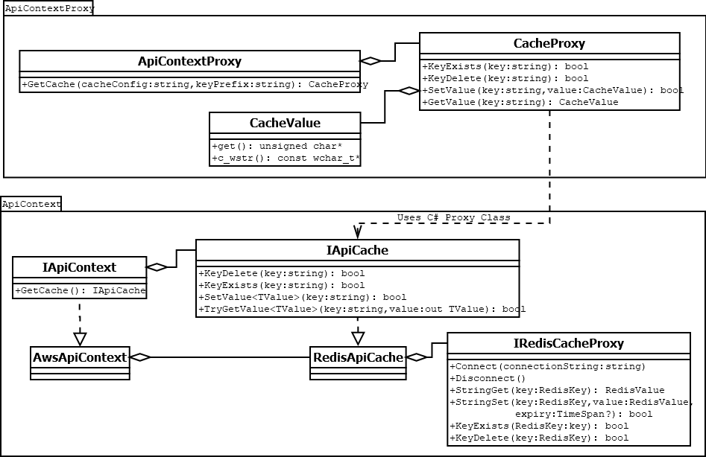
API Cache Architecture
ApiContext Classes
  The C++ ApiContextProxy classes are used by the current API to obtain L2 cache services
  The CacheValue contains the L2 serialized cache entry
  It is the responsibility of the ApiContextProxy’s clients in the API to serialize the cache entry

Slide 6
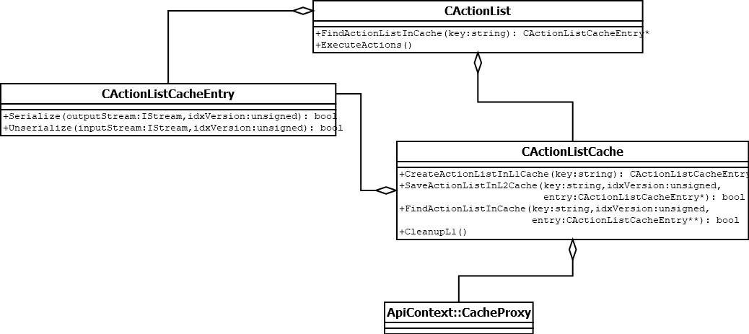
API Cache Architecture
API Refactoring
  After refactoring all L1/L2 cache functionality is now centralized in CActionListCache (new)
  The CActionListCache als offers a filedisk fallback in case L2 cache is not available
  CActionListCacheEntry contains the serialization code. ApiContext only knows about a byte stream
Cache-related classes in BaseApi

Slide 7
API Cache Architecture
Execute ActionList
Missing configuration
Cache Error Handling
  Another view on ActionList result retrieval, focused on error handling
  If a runtime error occurs when accessing the L2 cache, then a local filedisk fallback is used as a replacement
  L2 functionality is transparent to the user, if not working, then L1 still works
L1 hit?
Init L2?
Use filedisk cache
Yes
No
Error
OK
L2 hit?
Yes
Error
No
Execute ActionList
Add Result to L1
Add Result to L1
Return Result
Add Result to L2
Error

Slide 8
API Cache Architecture
API Cache Deploy Requirements
  New API dlls are required:
    ApiContextProxy.dll: Managed C++ dll, new static dependency of BaseAPI.lib. If not present API fails to load.
    ApiContext.dll: C# dll, loaded dynamically by ApiContextProxy.dll. If not present L2 cache is disabled.
    3rd party Redis dependencies. If not present L2 cache is disabled.
      Pipelines.Sockets.Unofficial.dll, StackExchange.Redis.dll, System.Buffers.dll, System.Diagnostics.PerformanceCounter.dll, System.IO.Pipelines.dll, System.Memory.dll, System.Numerics.Vectors.dll, System.Runtime.CompilerServices.Unsafe.dll, System.Threading.Channels.dll, System.Threading.Tasks.Extensions.dll
  Exe config file with binding redirect for Redis SDK
    E.g: $Main\Indexations\Client\Api\Inspect\Inspect.exe.config. If not present L2 cache is disabled.

Slide 9

API Cache Architecture
API Cache Configuration
  Registry parameterization
    The API context type and the Redis connection configuration are required (see picture). If not present L2 cache is disabled.
  Redis Server Configuration
    It is assumed that the Redis server is configured to evict the oldest keys first, once a memory limit is reached. For this, the following needs to be set in redis.conf (adapt the memory limit as required):
    Or, for AWS ElastiCache service, create a parameter group with the maxmemory-policy set to allkeys-lru:
maxmemory 300mb
maxmemory-policy allkeys-lru

Slide 10
Test Coverage
  Redis dependency removed during UT, purpose is to test BVD classes not 3rd party
Unit Test Architecture
ApiContext C# dll
PRODUCTION
ApiContextProxy
C++/CLI DLL
RedisApiCache
IRedisCacheProxy
Test
Test
Inherit
ApiContextProxyTests
C++/CLI DLL
ApiContextTests
C# dll
MockRedisCacheProxy
C#
TEST
Use
  C++ Tests: Not using proper mock. Focus on basic functionality, i.e: no exotic cases
  C# Tests: Uses Moq library, many different scenarios are validated

Slide 11
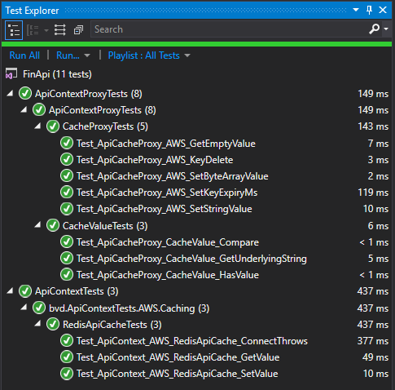
Test Coverage
Test Explorer
  At the moment unit tests are not executed in TFS, proposal is to wait until transition to new CI
  Unit tests can be executed in Test Explorer of FinApi sln (see picture)
  No dependencies required to run unit tests
  C# and C++ test execution is consolidated by Test Explorer

Slide 12
Test Coverage
System Tests
  ActionListTest: Span multiple threads and execute an ActionList with SA_ExecuteXMLSearchRequest. Validate result as expected
  MultiThread: Spawn multiple threads and test ApiContextProxy API
  All system tests in PersonalProjects not in CI
Thread-1
MintNLData
ActionListTest
Thread-2
MintNLData
…
Thread-N
MintNLData
Thread-1
APIContextProxy
MultiThread
Thread-2
APIContextProxy
…
Thread-N
APIContextProxy

Slide 13
Future Tasks
Add Performance Monitoring
  Integrate API with AWS CloudWatch SDK
  Could be another service in ApiContext
  Will allow to monitor the performance of the cache in AWS and optimize configuration
  Some ideas for metrics:
    #Entries in L1 and L2 cache and Memory size of L1 cache
    L2 latency (set/get) and combined L1/L2 latency (set/get)
    ActionList Execution Time

Slide 14
Future Tasks
BaseApi Unit Tests
  The class CActionListCache is good candidate for Unit Testing
    Complex business rules and parameterization
    Standalone
  Mock out dependencies with googletest
  Could be used as a template for other BaseApi tests (BitVectors?)
BaseApiTests
Test
CActionListCache
Use
googletest

Slide 15
Future Tasks
System Tests with Fame
  Prepare a setup in AWS with Fame nodes and a Redis cluster
  Proposal to use Redis ElasticCache, so that we don’t need to worry about managing the cache before we start testing
  Find a way to generate ActionList requests automatically
  Use integration with CloudWatch to monitor Cache performance
TrafficGenerator
CloudWatch
Fame
Fame
Fame
ElasticCache

Slide 16
© 2019 Moody’s Corporation, Moody’s Investors Service, Inc., Moody’s Analytics, Inc. and/or their licensors and affiliates (collectively, “MOODY’S”). All rights reserved.
CREDIT RATINGS ISSUED BY MOODY'S INVESTORS SERVICE, INC. AND ITS RATINGS AFFILIATES (“MIS”) ARE MOODY’S CURRENT OPINIONS OF THE RELATIVE FUTURE CREDIT RISK OF ENTITIES, CREDIT COMMITMENTS, OR DEBT OR DEBT-LIKE SECURITIES, AND MOODY’S PUBLICATIONS MAY INCLUDE MOODY’S CURRENT OPINIONS OF THE RELATIVE FUTURE CREDIT RISK OF ENTITIES, CREDIT COMMITMENTS, OR DEBT OR DEBT-LIKE SECURITIES. MOODY’S DEFINES CREDIT RISK AS THE RISK THAT AN ENTITY MAY NOT MEET ITS CONTRACTUAL FINANCIAL OBLIGATIONS AS THEY COME DUE AND ANY ESTIMATED FINANCIAL LOSS IN THE EVENT OF DEFAULT OR IMPAIRMENT. SEE MOODY’S RATING SYMBOLS AND DEFINITIONS PUBLICATION FOR INFORMATION ON THE TYPES OF CONTRACTUAL FINANCIAL OBLIGATIONS ADDRESSED BY MOODY’S RATINGS. CREDIT RATINGS DO NOT ADDRESS ANY OTHER RISK, INCLUDING BUT NOT LIMITED TO: LIQUIDITY RISK, MARKET VALUE RISK, OR PRICE VOLATILITY. CREDIT RATINGS AND MOODY’S OPINIONS INCLUDED IN MOODY’S PUBLICATIONS ARE NOT STATEMENTS OF CURRENT OR HISTORICAL FACT. MOODY’S PUBLICATIONS MAY ALSO INCLUDE QUANTITATIVE MODEL-BASED ESTIMATES OF CREDIT RISK AND RELATED OPINIONS OR COMMENTARY PUBLISHED BY MOODY’S ANALYTICS, INC. CREDIT RATINGS AND MOODY’S PUBLICATIONS DO NOT CONSTITUTE OR PROVIDE INVESTMENT OR FINANCIAL ADVICE, AND CREDIT RATINGS AND MOODY’S PUBLICATIONS ARE NOT AND DO NOT PROVIDE RECOMMENDATIONS TO PURCHASE, SELL, OR HOLD PARTICULAR SECURITIES. NEITHER CREDIT RATINGS NOR MOODY’S PUBLICATIONS COMMENT ON THE SUITABILITY OF AN INVESTMENT FOR ANY PARTICULAR INVESTOR. MOODY’S ISSUES ITS CREDIT RATINGS AND PUBLISHES MOODY’S PUBLICATIONS WITH THE EXPECTATION AND UNDERSTANDING THAT EACH INVESTOR WILL, WITH DUE CARE, MAKE ITS OWN STUDY AND EVALUATION OF EACH SECURITY THAT IS UNDER CONSIDERATION FOR PURCHASE, HOLDING, OR SALE.
MOODY’S CREDIT RATINGS AND MOODY’S PUBLICATIONS ARE NOT INTENDED FOR USE BY RETAIL INVESTORS AND IT WOULD BE RECKLESS AND INAPPROPRIATE FOR RETAIL INVESTORS TO USE MOODY’S CREDIT RATINGS OR MOODY’S PUBLICATIONS WHEN MAKING AN INVESTMENT DECISION. IF IN DOUBT YOU SHOULD CONTACT YOUR FINANCIAL OR OTHER PROFESSIONAL ADVISER.
ALL INFORMATION CONTAINED HEREIN IS PROTECTED BY LAW, INCLUDING BUT NOT LIMITED TO, COPYRIGHT LAW, AND NONE OF SUCH INFORMATION MAY BE COPIED OR OTHERWISE REPRODUCED, REPACKAGED, FURTHER TRANSMITTED, TRANSFERRED, DISSEMINATED, REDISTRIBUTED OR RESOLD, OR STORED FOR SUBSEQUENT USE FOR ANY SUCH PURPOSE, IN WHOLE OR IN PART, IN ANY FORM OR MANNER OR BY ANY MEANS WHATSOEVER, BY ANY PERSON WITHOUT MOODY’S PRIOR WRITTEN CONSENT.
CREDIT RATINGS AND MOODY’S PUBLICATIONS ARE NOT INTENDED FOR USE BY ANY PERSON AS A BENCHMARK AS THAT TERM IS DEFINED FOR REGULATORY PURPOSES AND MUST NOT BE USED IN ANY WAY THAT COULD RESULT IN THEM BEING CONSIDERED
A BENCHMARK.
All information contained herein is obtained by MOODY’S from sources believed by it to be accurate and reliable. Because of the possibility of human or mechanical error as well as other factors, however, all information contained herein is provided “AS IS” without warranty of any kind. MOODY'S adopts all necessary measures so that the information it uses in assigning a credit rating is of sufficient quality and from sources MOODY'S considers to be reliable including, when appropriate, independent third-party sources. However, MOODY’S is not an auditor and cannot in every instance independently verify or validate information received in the rating process or in preparing the Moody’s publications.
To the extent permitted by law, MOODY’S and its directors, officers, employees, agents, representatives, licensors and suppliers disclaim liability to any person or entity for any indirect, special, consequential, or incidental losses or damages whatsoever arising from or in connection with the information contained herein or the use of or inability to use any such information, even if MOODY’S or any of its directors, officers, employees, agents, representatives, licensors or suppliers is advised in advance of the possibility of such losses or damages, including but not limited to: (a) any loss of
present or prospective profits or (b) any loss or damage arising where the relevant financial instrument is not the subject of a particular credit rating assigned by MOODY’S.
To the extent permitted by law, MOODY’S and its directors, officers, employees, agents, representatives, licensors and suppliers disclaim liability for any direct or compensatory losses or damages caused to any person or entity, including but not limited to by any negligence (but excluding fraud, willful misconduct or any other type of liability that, for the avoidance of doubt, by law cannot be excluded) on the part of, or any contingency within or beyond the control of, MOODY’S or any of its directors, officers, employees, agents, representatives, licensors or suppliers, arising from or in connection with the information contained herein or the use of or inability to use any such information.
NO WARRANTY, EXPRESS OR IMPLIED, AS TO THE ACCURACY, TIMELINESS, COMPLETENESS, MERCHANTABILITY OR FITNESS FOR ANY PARTICULAR PURPOSE OF ANY CREDIT RATING OR OTHER OPINION OR INFORMATION IS GIVEN OR MADE BY MOODY’S IN ANY FORM OR MANNER WHATSOEVER.
Moody’s Investors Service, Inc., a wholly-owned credit rating agency subsidiary of Moody’s Corporation (“MCO”), hereby discloses that most issuers of debt securities (including corporate and municipal bonds, debentures, notes and commercial paper) and preferred stock rated by Moody’s Investors Service, Inc. have, prior to assignment of any rating, agreed to pay to Moody’s Investors Service, Inc. for ratings opinions and services rendered by it fees ranging from $1,000 to approximately $2,700,000. MCO and MIS also maintain policies and procedures to address the independence of MIS’s ratings and rating processes. Information regarding certain affiliations that may exist between directors of MCO and rated entities, and between entities who hold ratings from MIS and have also publicly reported to the SEC an ownership interest in MCO of more than 5%, is posted annually at www.moodys.com under the heading “Investor Relations — Corporate Governance — Director and Shareholder Affiliation Policy.”
Additional terms for Australia only: Any publication into Australia of this document is pursuant to the Australian Financial Services License of MOODY’S affiliate, Moody’s Investors Service Pty Limited ABN 61 003 399 657AFSL 336969 and/or Moody’s Analytics Australia Pty Ltd ABN 94 105 136 972 AFSL 383569 (as applicable). This document is intended to be provided only to “wholesale clients” within the meaning of section 761G of the Corporations Act 2001. By continuing to access this document from within Australia, you represent to MOODY’S that you are, or are accessing the document as a representative of, a “wholesale client” and that neither you nor the entity you represent will directly or indirectly disseminate this document or its contents to “retail clients” within the meaning of section 761G of the Corporations Act 2001. MOODY’S credit rating is an opinion as to the creditworthiness of a debt obligation of the issuer, not on the equity securities of the issuer or any form of security that is available to retail investors.
Additional terms for Japan only: Moody's Japan K.K. (“MJKK”) is a wholly-owned credit rating agency subsidiary of Moody's Group Japan G.K., which is wholly-owned by Moody’s Overseas Holdings Inc., a wholly-owned subsidiary of MCO. Moody’s SF Japan K.K. (“MSFJ”) is a wholly-owned credit rating agency subsidiary of MJKK. MSFJ is not a Nationally Recognized Statistical Rating Organization (“NRSRO”). Therefore, credit ratings assigned by MSFJ are Non-NRSRO Credit Ratings. Non-NRSRO Credit Ratings are assigned by an entity that is not a NRSRO and, consequently, the rated obligation will not qualify for certain types of treatment under U.S. laws. MJKK and MSFJ are credit rating agencies registered with the Japan Financial Services Agency and their registration numbers are FSA Commissioner (Ratings) No. 2 and 3 respectively.
MJKK or MSFJ (as applicable) hereby disclose that most issuers of debt securities (including corporate and municipal bonds, debentures, notes and commercial paper) and preferred stock rated by MJKK or MSFJ (as applicable) have, prior to assignment of any rating, agreed to pay to MJKK or MSFJ
(as applicable) for ratings opinions and services rendered by it fees ranging from JPY125,000 to approximately JPY250,000,000.
MJKK and MSFJ also maintain policies and procedures to address Japanese regulatory requirements.

