Slide 1
Slushie
by Hydro Homies

Slide 2
Problem Statement
America has a major financial literacy problem.
44% of Americans aren’t able to cover a $400 emergency.
43% of student loan borrowers are not making payments.
33% of American adults have $0 saved for retirement.
38% of U.S. households have credit card debt.
Statistics taken from Forbes.com

Slide 3
Solution
Slushie: a budgeting and investment app that helps you make
intelligent financial decisions by minimizing stagnant liquid
assets.
Main Features
Transaction visualization Investment recommendations
Budget breakdown
Notes:
Need more

Slide 4

Jason
22-year old college graduate
Recently started making his own financial decisions
Wants to learn to budget

Slide 5

Onboarding
Informative slides promoting financial literacy

Slide 6
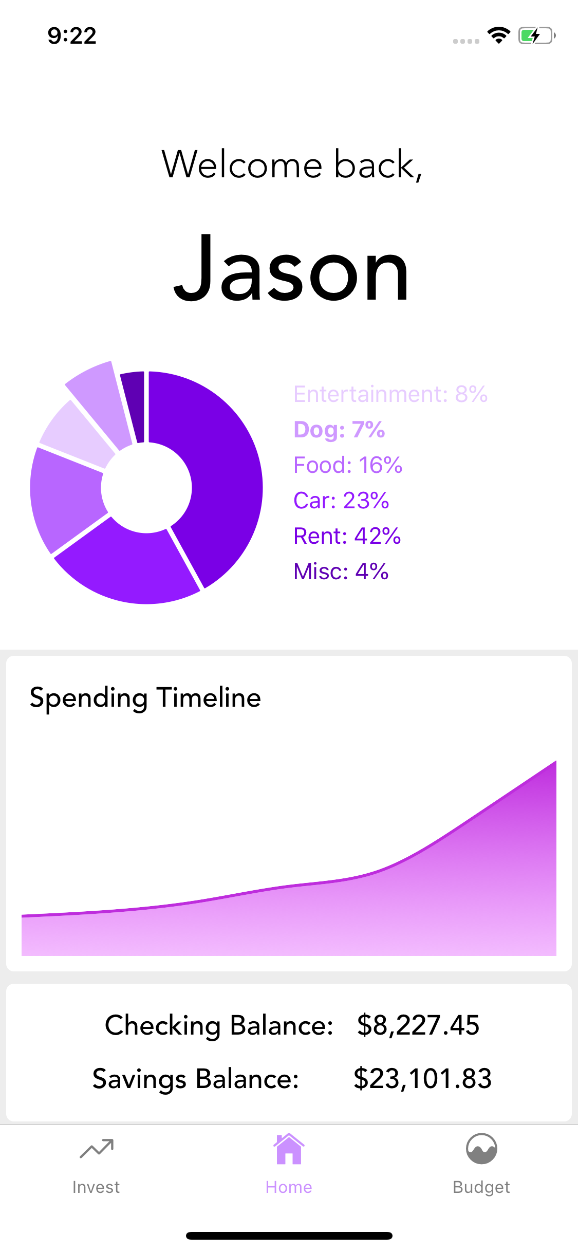
Home
Overview of budgeting and investment portfolios

Slide 7
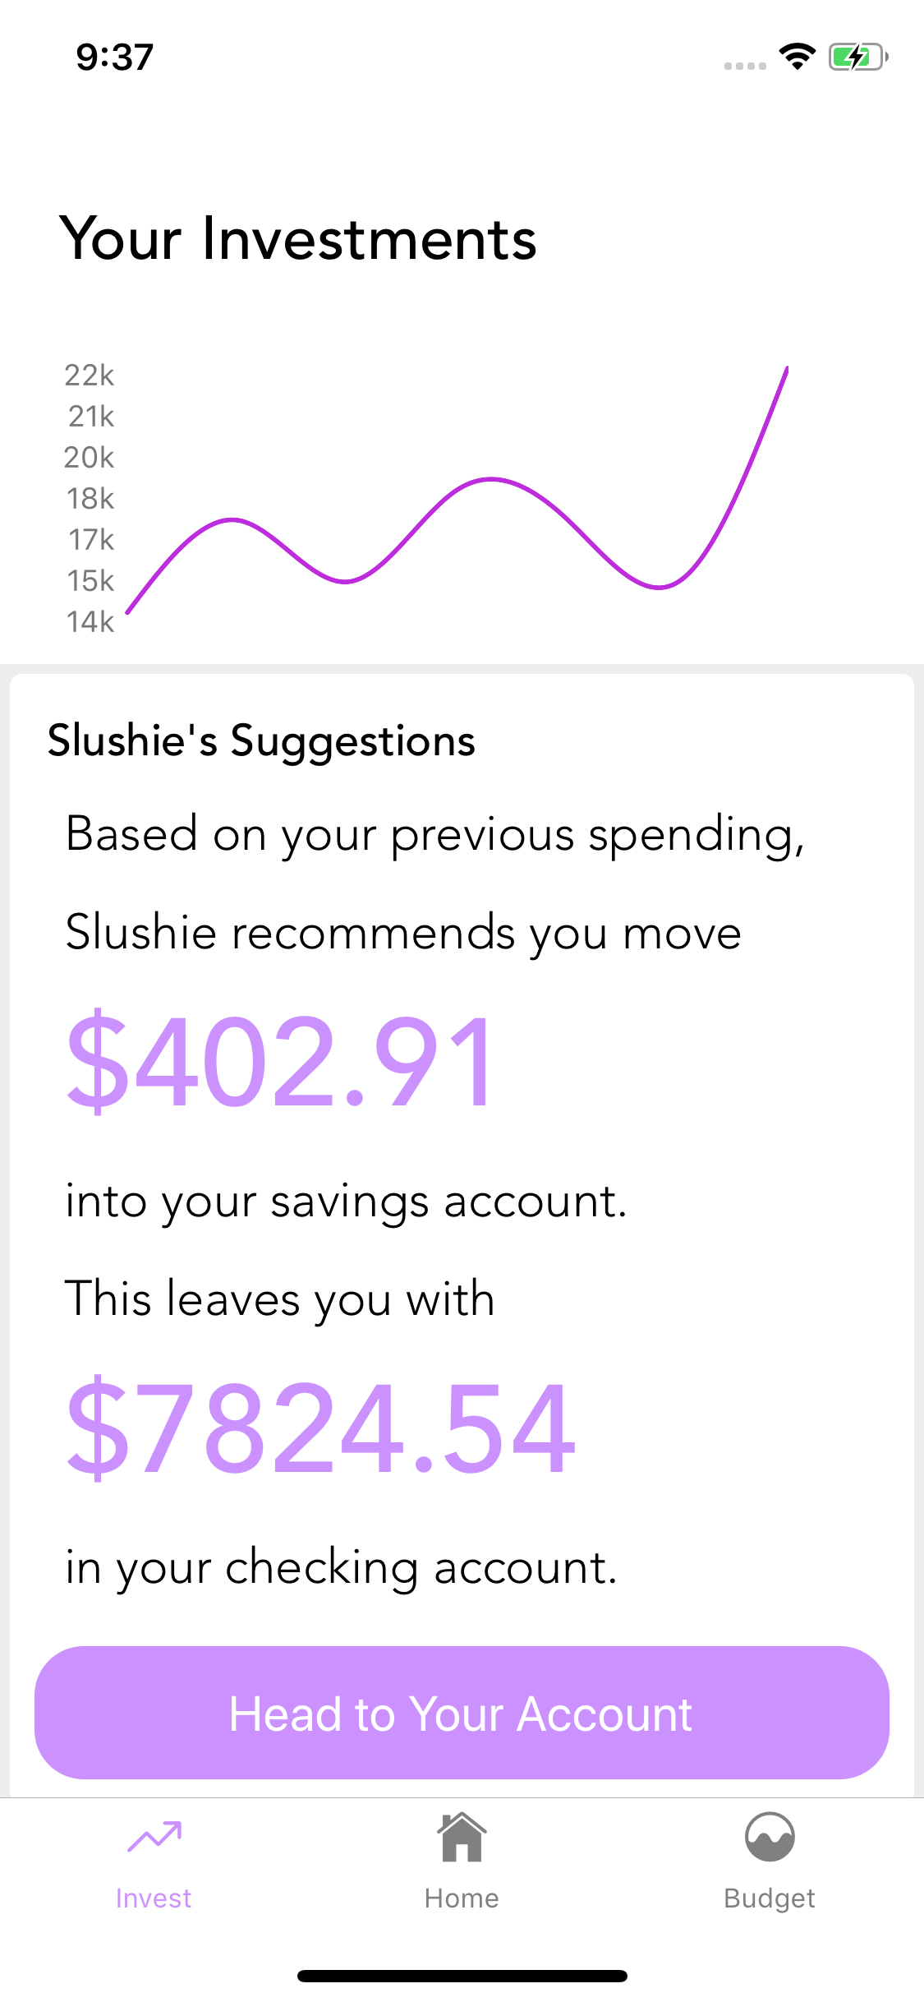
Investing
Projected Earnings
Recommendations

Slide 8
Budgeting
Spending over time
Budget breakdown for this month
Past Bank Transactions

Slide 9
Slushie can help by:
Teaching Jason about different bank deposit accounts
Maximizing the interest he earns by recommending optimal
transfers between accounts
Recommending safe transfer options, to protect Jason
from overdrafting or debt
Helping him budget effectively to pay off
future loans as soon as possible

Slide 10
Future Considerations
More sophisticated back end
Broaden our horizons; e.g. help people with loans pay them
off faster
Allow transferring of money within the app, instead of
purely providing recommendations

Slide 11
Questions?

