Slide 1

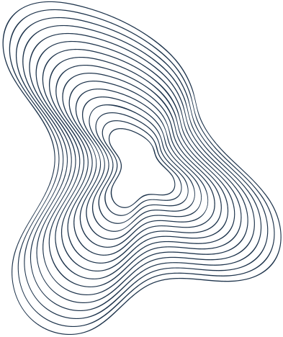
Team UO-Qubit:
Exponential zero-noise extrapolation for quantum materials simulation on IBM hardware
🇨🇷 David Granados: Team Leader & Physics lead
🇲🇦 Boutaina El Hourri: Hardware lead
🇱🇧 Toufic Haddad: Noise models and Plots
🇨🇦 Eli Levasseur: Iceberg Circuit Simulation
🇲🇺 Harshini Gungah: Classical baseline & Numerics
uOttawa Qiskit Fall Fest 2026

Slide 2
Why This Matters for Materials Science
Better energy materials (superconductors for efficient power grids, battery materials, CO₂-capture catalysts) all need the same thing: predicting how many interacting spins and electrons behave. That is the goal behind "Simulation of Materials for Next-Generation Energy Devices", the challenge we build on [1].
• The transverse-field Ising model is the canonical testbed for magnetic materials. Neighbouring spins want to align (ferromagnetic order); the transverse field adds quantum fluctuations that destroy that order. The competition produces a quantum phase transition at h/J = 1 [1, 10].
• We run both regimes: h/J = 1 (the critical point) and h/J = 2 (the disordered phase), and follow how the magnet responds after a sudden change of field (a quench).
• The classical wall: exact diagonalization took 0.004 s at 4 spins and 17.5 s at 12, and was no longer feasible beyond that [1]. Quantum circuits are the way past it, but only if their noise is controlled.
• The previous project applied the same workflow to the 2D Fermi–Hubbard model, a minimal model of high-temperature superconductors (SDG 7: clean energy) [1]. Reliable error mitigation on real hardware is the step those simulations need next.
Notes:
Why a spin chain matters for materials. The previous challenge was titled 'Simulation of Materials for Next-Generation Energy Devices'. Its report frames the TFIM as the canonical testbed for magnetic materials and phase transitions, and the 2D Fermi-Hubbard model as a minimal model of high-temperature superconductors (cuprates), tied to SDG 7 (power grids), SDG 12 and SDG 13 (battery materials, CO2-capture catalysts). Exact diagonalization timings from the report, section 4.4: 0.004 s at N = 4, 17.5 s at N = 12, not executable beyond. The report is explicit that this is an argument for quantum simulation, not a demonstration of quantum advantage; we say the same.

Slide 3
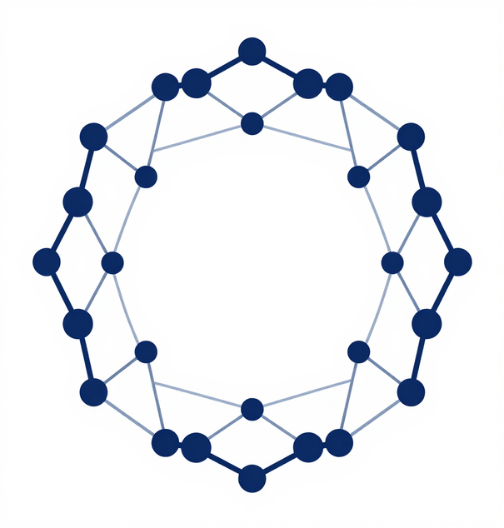
Where We Started
We built on Quantathon CR 2026 (Challenge 3), which simulated magnetic materials on Quantinuum's H2 emulators (H2-1LE and H2-Emulator). Its documented weak spots:
• Linear zero-noise extrapolation began to overcorrect after t ≈ 1.5
• Trotter error reached 8.46 at h/J = 2 (time step 0.05)
• Iceberg error detection discarded up to 95% of shots (17–42% with minimal checks)
• No error bars on mitigated results; typos in its exact reference table (we corrected them)
Goal: fix these on IBM hardware.

Slide 4
Our Plan Costs More Shots, Wastes None
Resource
Previous project [1]
This work
Where it ran
Quantinuum H2 emulators (H2-1LE noiseless, H2-Emulator noisy)
Real IBM quantum computer (ibm_quebec)
Qubits (TFIM)
6–8, plus 4 for Iceberg (2 code + 2 ancilla)
12, no extra qubits (1.5–2× more)
ZNE noise levels
3 (λ = 1, 3, 5)
5 (λ = 1–5): 1.7× the total gates
Shots per circuit
200–500
4000 (8–20× more)
Shots discarded
17–95% with Iceberg
None
Quantum time
Emulator runs (time not reported)
39–58 s of QPU per full time sweep
Classical cost
Noisy emulation (cost grows exponentially with qubits) + exact reference
Exact reference at 12 spins + curve fits (seconds)
Net: more quantum resources per experiment (1.5–2× the qubits, 1.7× the gates, 8–20× the shots), but no shot is thrown away, each sweep takes about a minute of real QPU time, and no noisy emulation is needed. At Iceberg's 95% discard rate, matching our statistics would take ~18× more shots.
Notes:
Sources: previous report sections 3.6, 4.2, 4.5, 4.9 and Limitations (4): 'Results use 200-500 shots' (one adiabatic sweep used 2000). Their TFIM runs were on H2-1LE ('exact emulation, sampling noise only') and H2-Emulator (published noise model), not on the physical H2.
Iceberg [[k+2,k,2]]: 2 extra code qubits + 2 syndrome ancillas. Discards 17.2-41.5% (minimal checks) and 46.8-94.5% (every half-step). At 94.5% discard only 5.5% of shots survive, so 1/0.055 = 18x shots for the same statistics.
ZNE cost: the summed fold factor is 1+2+3+4+5 = 15 vs 1+3+5 = 9, so 15/9 = 1.67x the gates per data point. Our run 1 used 1,3,5 like theirs.
Our QPU time: 39 s (job db2qm2m8v0ts73c3c1eg, 12 circuits) and 58 s (db2r7us2ljfc73d51kig, 20 circuits), 4000 shots each.
Caveat: their quench went to T = 20 at dt = 0.025; ours stops at t = 2 at dt = 0.1, so circuit depths are not directly comparable.

Slide 5
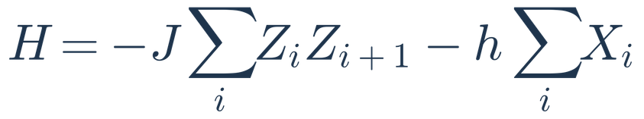
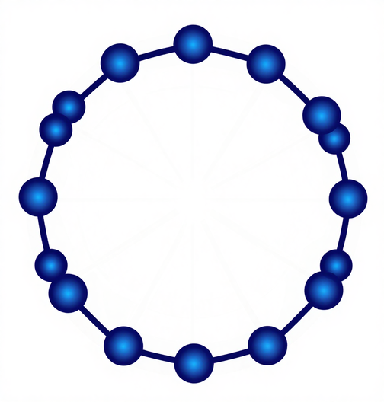
The Physics: A 12-Spin Magnetic Ring
The transverse-field Ising model above is a canonical model of a quantum phase transition.
• 12 spins on a periodic ring, h/J = 1 and 2
• Start all spins up, evolve to t = 0.5–2.0 with a 2nd-order Trotter circuit (time step 0.1)
• Measure Mz, Mx and Mzz
• Exact diagonalization on a laptop is the answer key

Slide 6
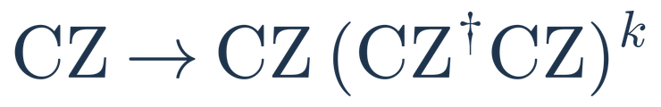
The Circuit: Second-Order Trotter Steps
Each time step (Δt = 0.1) is one second-order Trotter step:
• Rx(hΔt/2) on every qubit
• ZZ rotations on the 12 ring bonds, in 2 parallel layers (even bonds, then odd bonds)
• Rx(hΔt/2) again, fused with the next step's: r + 1 Rx layers instead of 2r
On IBM Heron each ZZ rotation is 2 CZ gates: 24 CZ per step, so t = 2 (20 steps) is 480 CZ at depth ~400.
Start in |0…0⟩; IBM's Estimator measures Mz, Mzz (Z basis) and Mx (X basis).
For ZNE every CZ is folded (same operation, more noise):
Rx(hΔt/2)
ZZ even
ZZ odd
Rx(hΔt/2)
q1
q2
q3
q4
One Trotter step, 4 of 12 qubits shown (the ring also couples q12–q1). Repeated t/Δt times.
Notes:
This is the circuit we actually ran. Each Trotter step is half an X rotation, the ZZ couplings in two parallel layers (a 12-ring is even, so 2 colours suffice), then the other half of the X rotation. Neighbouring half-steps merge, which saves a layer per step. The ZZ rotations are the expensive part: 2 CZ each on Heron, so 24 CZ per step and 480 at t = 2. For ZNE we fold exactly those CZ gates.

Slide 7
The Ring Fits the Chip With Zero SWAPs
IBM heavy-hex chips contain no closed loop shorter than 12 qubits. This means a 12-spin ring is the smallest model that maps natively onto the device topology — requiring zero SWAP gates to implement nearest-neighbour interactions.
Our layout search enumerates every 12-qubit cycle on the device (21 on ibm_quebec) and picks the one with the lowest gate and readout error. Tested on the same heavy-hex architecture (Marrakesh model), 3 Trotter steps need 72 two-qubit gates on our ring, the theoretical minimum, versus 105 (+46%) with the original greedy layout.

Slide 8


Context: The Iceberg Code [[k+2, k, 2]]
An error-detection code (Self, Benedetti & Amaro, Nature Physics 2024 [12]):
• k logical qubits stored in k + 2 physical qubits (two extra: t and b)
• Logical gates (below) make a logical ZZ just ZᵢZⱼ, a natural fit for the TFIM
• Two parity checks (below), read out with 2 ancillas
• Distance 2: any single error is detected and that shot is discarded
• On Quantinuum H1-2: 8 logical qubits, up to 256 layers, logical quantum volume 2⁸ (86.8% of shots discarded)
Why it is not our main path on IBM:
• Each check couples every qubit to one ancilla; heavy-hex qubits have at most 3 neighbours, so SWAPs are needed, and SWAP faults can go undetected at distance 2
• The previous project discarded 17–42% of shots (minimal checks) up to 95% (checks every half-step)
Our plan: a simulated cost study (iceberg.py, Eli).
4
b
3
anc
t
2
1
Reading one check (k = 4): the ancilla couples to all k + 2 data qubits, a star of degree 6. Heavy-hex allows degree 3 at most.
Notes:
Context only, not our main result. The Iceberg code detects errors instead of correcting them: any single fault flips a check, and that shot is thrown away. On trapped ions (all-to-all connectivity) it worked very well. On IBM heavy-hex each check needs an ancilla talking to every data qubit, which the chip cannot do natively. The SWAPs needed add faults the distance-2 code can miss, and the previous project already saw discard rates up to 95%. That's why we put the hardware budget into ZNE, and Eli's iceberg.py studies the Iceberg cost in simulation.

Slide 9
Our Error-Mitigation Stack
Hardware error suppression (IBM Runtime): TREX readout-error mitigation, Pauli twirling of every two-qubit gate, and dynamical decoupling on idle qubits. 4000 shots per circuit.
Zero-noise extrapolation: we fold every two-qubit gate to amplify the noise by λ = 1, 2, 3, 4, 5 (up to 2400 two-qubit gates), measure how the result decays, and extrapolate back to λ = 0. We compare a straight-line fit (the previous project's method) with an exponential fit (ours).

Slide 10
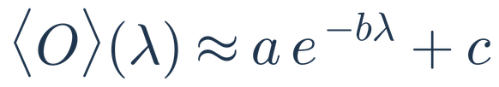

The Noise: Sources and Countermeasures
Each noise source on ibm_quebec has its own countermeasure:
• Readout errors → TREX (twirled readout mitigation)
• Idling and decoherence (T1, T2) → XpXm dynamical decoupling
• Coherent gate errors → Pauli twirling, which turns them into random Pauli noise
• Remaining CZ noise → ZNE: fold every CZ (λ = 1–5), extrapolate to λ = 0
Simulations use the same idea: Aer density matrix with NoiseModel.from_backend(FakeMarrakesh).
Why exponential? Twirled noise shrinks the signal by a fixed factor per CZ, so each observable decays toward its fully mixed value:
0.019%
single-qubit gate error (median)
0.18%
CZ two-qubit gate error (median)
0.54%
readout error (median)
At t = 2 the circuit has 480 CZ: about 0.9 CZ errors per shot at λ = 1 and 4.3 at λ = 5 (2400 CZ). ZNE reads the trend across λ and extrapolates back to zero noise. Calibration: ibm_quebec at submission.
Notes:
Each noise source gets a matching tool. TREX handles readout, dynamical decoupling handles idle qubits, and twirling turns coherent errors into random Pauli errors. The last step matters most: it makes the noise act like a fixed shrink factor per gate, which is why the signal decays exponentially with the fold factor lambda. What's left is CZ noise, the dominant term at 0.18% per gate, and that's what ZNE removes. At t = 2 that's roughly one error per shot at lambda = 1 and four at lambda = 5. Calibration numbers are medians from ibm_quebec when we submitted.

Slide 11
Exponential ZNE Cuts Error 3.8–5× vs. Raw
Mean error vs exact (lower is better)
Mean absolute error vs exact diagonalization (Mz, Mx, Mzz at t = 0.5–2.0), averaged over three independent runs on ibm_quebec:
Raw 0.134 → linear ZNE 0.106 (−21%) → exponential ZNE 0.030 (−78%)
Every run agrees: exponential 0.033 / 0.029 / 0.030, linear 0.105 / 0.118 / 0.095.
0.134
0.106
0.030
Raw
Linear ZNE
Exponential ZNE
Notes:
Headline. Mean |estimate - exact| over Mz, Mx, Mzz and t = 0.5, 1.0, 1.5, 2.0 (12 points per run), N = 12 ring on ibm_quebec.
Runs: h/J=1 run 1 (lambda 1,3,5; job db2qm2m8v0ts73c3c1eg), h/J=1 run 2 (lambda 1-5; job db2r7us2ljfc73d51kig), h/J=2 (lambda 1-5; job db2rctc7f06c73aqdi10).
Raw 0.142 / 0.145 / 0.114. Linear 0.105 / 0.118 / 0.095. Exponential (free asymptote) 0.033 / 0.029 / 0.030. Reduction raw -> exponential: 4.4x / 5.0x / 3.8x.
Full figure: results/figs/zne_summary.png in the repo. Source data: results/zne_time_sweep_ibm_*.json. Methods: Temme et al. PRL 2017 (ZNE), Endo et al. PRX 2018 (exponential extrapolation).

Slide 12
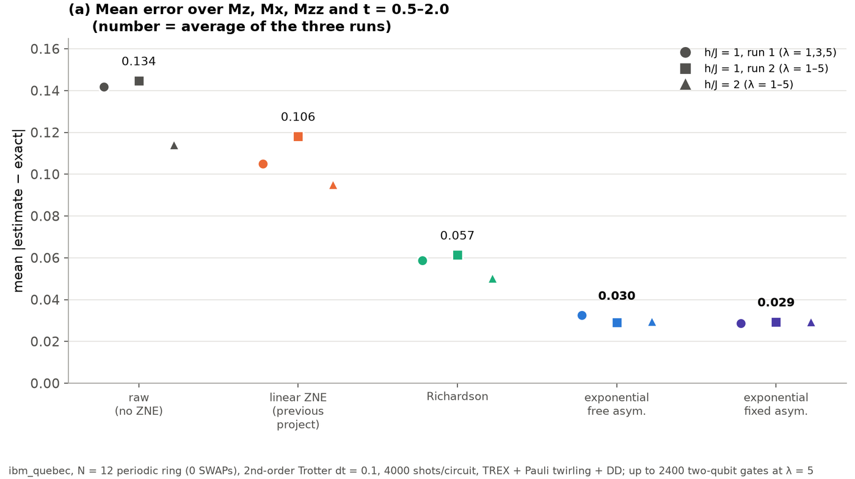
Mean error vs exact (lower is better)
Notes:
Headline. Mean |estimate - exact| over Mz, Mx, Mzz and t = 0.5, 1.0, 1.5, 2.0 (12 points per run), N = 12 ring on ibm_quebec.
Runs: h/J=1 run 1 (lambda 1,3,5; job db2qm2m8v0ts73c3c1eg), h/J=1 run 2 (lambda 1-5; job db2r7us2ljfc73d51kig), h/J=2 (lambda 1-5; job db2rctc7f06c73aqdi10).
Raw 0.142 / 0.145 / 0.114. Linear 0.105 / 0.118 / 0.095. Exponential (free asymptote) 0.033 / 0.029 / 0.030. Reduction raw -> exponential: 4.4x / 5.0x / 3.8x.
Full figure: results/figs/zne_summary.png in the repo. Source data: results/zne_time_sweep_ibm_*.json. Methods: Temme et al. PRL 2017 (ZNE), Endo et al. PRX 2018 (exponential extrapolation).

Slide 13
Exponential ZNE Stays Accurate Where Linear ZNE Breaks Down
Mean error vs time, h/J = 1 (lower is better)
Mean error over Mz, Mx, Mzz at h/J = 1. Linear ZNE's error grows with time like the raw data, from 0.034 to 0.195. Exponential ZNE stays between 0.021 and 0.042 through t = 2, where the most amplified circuit has 2400 two-qubit gates. Same picture at h/J = 2 (0.005–0.060).
Linear ZNE (previous method)
Exponential ZNE (ours)
t = 0.5
t = 1.0
t = 1.5
t = 2.0
Notes:
Bars: mean error over Mz, Mx, Mzz at h/J = 1, run 2 (lambda 1-5).
Linear ZNE: 0.034, 0.097, 0.146, 0.195 at t = 0.5, 1.0, 1.5, 2.0. Exponential ZNE: 0.021, 0.027, 0.042, 0.025.
At h/J = 2: linear 0.022, 0.073, 0.129, 0.156; exponential 0.017, 0.005, 0.060, 0.037.
Example at t = 2, h/J = 1: Mz 0.517 +/- 0.027 vs exact 0.500. The lambda = 5 circuit at t = 2 has 2400 two-qubit gates.
The previous report said its linear ZNE 'begins to overcorrect after t = 1.5'.
With error bars: results/figs/zne_summary_vs_time.png in the repo.

Slide 14
Is It Real? Three Checks
1. Reproducible: two runs a day apart give the same 0.03 error. The device drifts by about 0.01 between runs, so we report that as an extra uncertainty.
2. The model fits: with five noise levels, the exponential curve passes a goodness-of-fit test at 19 of 24 points.
3. Remaining error is hardware noise, not our algorithm: at h/J = 2 the noiseless Trotter circuit is within 0.011 of exact. Linear ZNE, by contrast, has small error bars but sits 7–45 standard deviations from exact at t ≥ 1.5: precise but wrong.
Notes:
1. Run 1 vs run 2 (same circuits at lambda 1, 3, 5): raw values differ by 0.002-0.016, at most 4.1 sigma; mean errors 0.033 vs 0.029.
2. chi2 per degree of freedom <= 2.7 at 19 of 24 points (Mz, Mx, Mzz x 4 times x 2 fields). Failures: h/J=1 t=0.5 (Mz, Mzz), h/J=2 t=1.0 (Mz, Mzz), h/J=2 t=1.5 (Mz). Mx passes everywhere.
3. Noiseless 2nd-order Trotter vs exact at h/J = 2: at most 0.011. Exponential ZNE vs noiseless Trotter: 0.030-0.032, so the residual is hardware noise.
Linear ZNE never lands above exact (0 of 36 points), the signature of systematic under-correction.
Details: docs/RESULTS.md sections 3-4.

Slide 15
~1 Minute of Quantum Computer Time Per Experiment
QPU time billed by IBM Quantum on ibm_quebec:
• 3 noise levels, 12 circuits × 4000 shots: 39 seconds
• 5 noise levels, 20 circuits × 4000 shots: 58 seconds
That is about 10–15 seconds per time point, for a 3.8–5× error reduction on circuits with up to 2400 two-qubit gates.

Slide 16
Limitations & Next Steps
Limitations: a floor of about 0.02–0.03 remains from noise that gate folding does not amplify (single-qubit gates, idling, readout residue); the exponential model fails its fit test at 5 of 24 points; one device, 12 spins, 4 time points; no quantum advantage is claimed.
Next: fold single-qubit gates too; multi-product formulas for lower Trotter error at equal depth; measure Iceberg error detection's SWAP cost on heavy-hex; larger rings (20 and 28 qubits are also native cycles).

Slide 17
Conclusion
On a real IBM quantum computer, a 12-spin Ising ring mapped with zero SWAPs plus exponential zero-noise extrapolation cut the error 3.8–5× (0.134 → 0.030), in three independent runs at two field strengths, for about one minute of QPU time per experiment. The previous project's linear method removed only 17–26% of the error on the same circuits. Careful mitigation, validated against exact results, makes near-term hardware useful for quantum materials simulation.

Slide 18
References
[1] Quantum in Silico, Quantathon CR 2026 Challenge 3, technical report (previous project)
[2] K. Temme, S. Bravyi, J. M. Gambetta, Phys. Rev. Lett. 119, 180509 (2017): zero-noise extrapolation
[3] S. Endo, S. C. Benjamin, Y. Li, Phys. Rev. X 8, 031027 (2018): exponential extrapolation
[4] T. Giurgica-Tiron et al., IEEE QCE 2020, arXiv:2005.10921: digital gate folding
[5] E. van den Berg, Z. K. Minev, K. Temme, Phys. Rev. A 105, 032620 (2022): TREX readout mitigation
[6] J. J. Wallman, J. Emerson, Phys. Rev. A 94, 052325 (2016): Pauli twirling
[7] L. Viola, S. Lloyd, Phys. Rev. A 58, 2733 (1998): dynamical decoupling
[8] C. Chamberland et al., Phys. Rev. X 10, 011022 (2020): heavy-hex lattice
[9] Y. Kim et al., Nature 618, 500 (2023): utility before fault tolerance
[10] P. Pfeuty, Ann. Phys. 57, 79 (1970): transverse-field Ising model
[11] M. Suzuki, Commun. Math. Phys. 51, 183 (1976): Trotter–Suzuki formulas
[12] C. N. Self, M. Benedetti, D. Amaro, Nature Physics (2024), arXiv:2211.06703: Iceberg code
[13] A. Javadi-Abhari et al., arXiv:2405.08810 (2024): Qiskit
Thank you — Team UO-Qubit (David, Boutaina, Ririsha, Eli, Toto) · uOttawa Qiskit Fall Fest 2026

