Slide 1


How does it works ?
DEAL IT
CONNECTING OFFERS

Slide 2


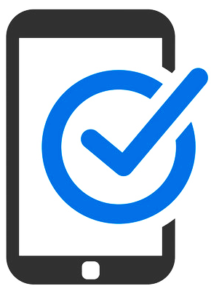
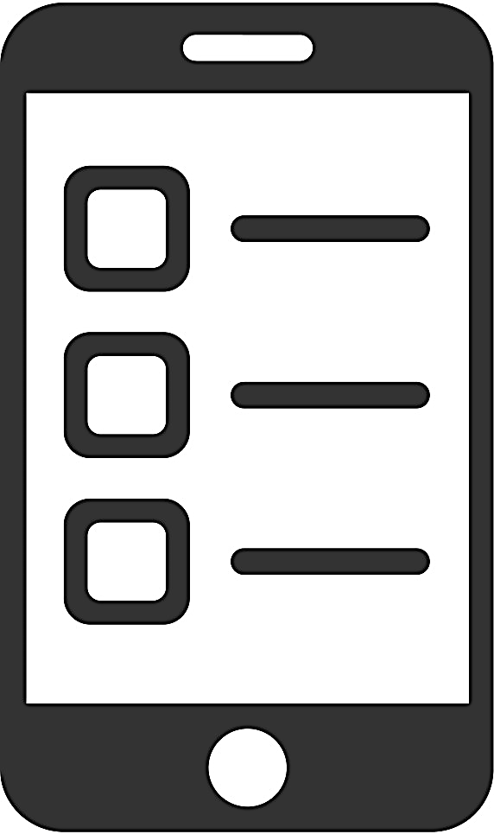
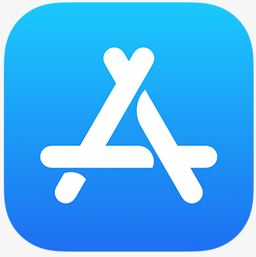





Create an user
User
Download Deal It App
Download Deal It App
Choose Interests
Deal It Cloud System
Restaurants
Bars
Cinemas
Sports Events
Theater
Wasted Food

Slide 3


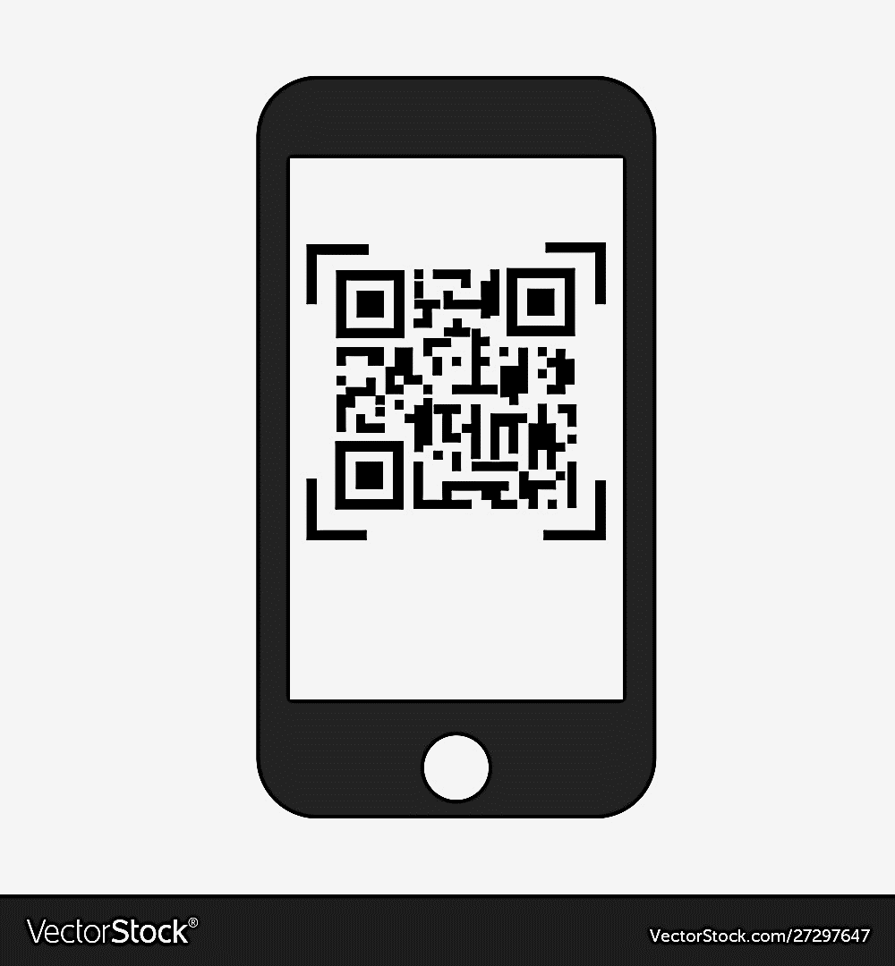
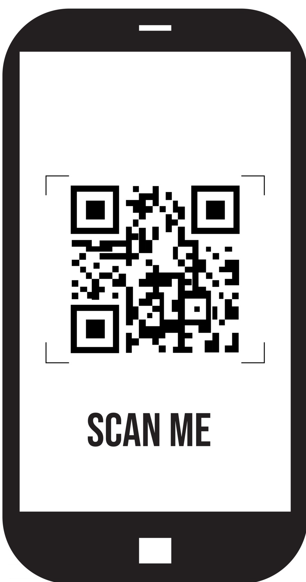

Make a deal
Deal It Cloud System
A Royality is calculated to pay to Deal It
User
Seach/List
Offer/Partner/
Event
Receive QR Code
Go To Partner/Event/
Location
Partner
Restaurants
Bars
Cinemas
Sports Events
Social Evens
Wasted Food
You Made a Deal!
Scan & Enjoy !
Share with Family and Fiends

Slide 4


Create an offer
Deal It Cloud System
A Royality is calculated to pay to Deal It
Partner
Go to Web Site Application
Create Offer
Cross Selling
Send Notification
User
Offer Description
Create Notification
Register User

Slide 5

Create an event
Institution
(p.e CM Leiria)
Create Event
Deal It Cloud System
Send Notification
Partners
Event Description
E-mail and Web App Ctrl.
Registered Partners
No Royality is calculated to pay to Deal It
You Accepted the Event!
User
Send Notification
Create Offer
Accept the
Event ?

Slide 6
So…
Let’s make a deal ?

