Slide 1


DEAL IT
CONNECTING OFFERS

Slide 2


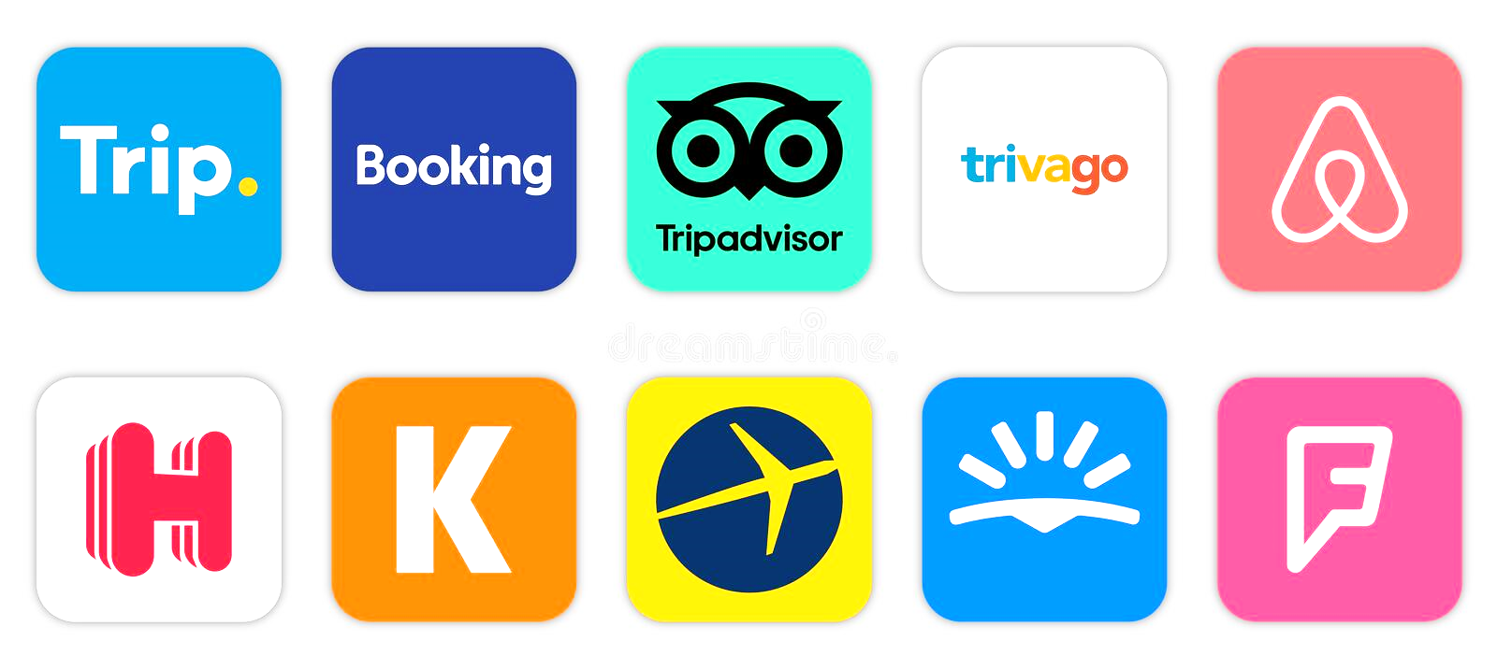


Google someting
Find possible hotels reservations
What will happen this week/weekend ?
See reviews on restaurants apps
Visit too many websites and apps
Can’t find the best match offer for some event
People give up on the idea

Slide 3
Many people don’t know about the events that are going to or are happening
In consequence, on weekends, around 60% of people in Portugal stay at home watching TV
Only 13% go to social activities (museums, cinemas, theater, concerts, and others)
What's the problem ?

Slide 4
Tourism and economy lose thousands of money due to people's lack of interest
Entertainment locals (cinemas, theater, social zones) are getting more empty
Less of reservations on hotels and restaurants
Less of tourism, economy, art and entertainment development
Waste of food and drinks in bars, restaurants and social events (almost 1/3 of the food in the world is wasted)
And because of that ...

Slide 5
DEAL IT
A single Web and Mobile Application to Connect Offers with Institutions, Partners and People
Create Offers and Events, by Partners and Institutions
Notify Users with favorite offers and categories
And.. Make a Deal!
How to solve ?

Slide 6




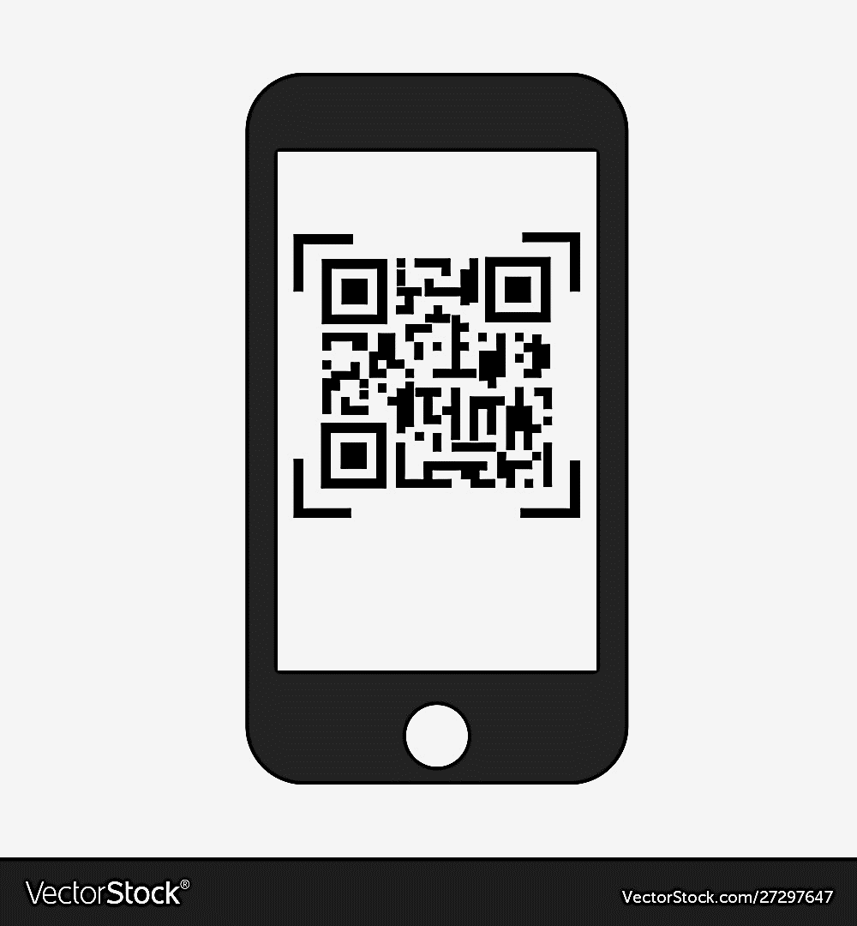


Create an offer
Partner
Create Offer
Deal It Cloud System
Send Notification
User
Registered Users
Bar, Restaurant
Theater, Cinema, Hotel,…
Offer Description
Mobile Push Notification
Scan & Enjoy !
You Made a Deal!
Go To Partner/Event/
Location
Accept the Deal ?
Seach/List
Offer/Partner/
Event
Accept the
Deal ?
You Made a Deal!

Slide 7

Create an event
Institution
(p.e CM Leiria)
Create Event
Deal It Cloud System
Send Notification
Partners
Event Description
E-mail and Web App Ctrl.
Registered Partners
You Accepted the Event!
User
Send Notification
Create Offer
Accept the
Event ?

Slide 8
Partners and Institutions can create specific events and offers, on an single application (Web or Mobile)
People can be notified about upcoming favorite events
People and Partners Make a Deal! With a price, date and time set
More efficiently manage the amount of people and resources needed
Decreasing wasted food and drink
And with this ...

Slide 9
Promote events across the region by local institutions
Increase the economy in the areas of tourism, public transports, hospitality services, health and beauty care,…
And with this ...

Slide 10
With a royality business, it’s a small marketing investiment for the Partners
Partners can buy prepaid notifications, or single notifications at the moment for all users
Partners can create special offers for an event, or to avoid food and drinks
People felt obliged to go to the event (they Made a Deal!)
And who win ?

Slide 11
In 2021, Portugal received 9.6 million tourists in Portugal
Per day, each tourist spends around 51.7 €
For example, with a 1% Royality (use case):
Tourists: 9.6 M
Potential Registered Users: 10%
Total/Day = 960 000 x 1% ⬄ 9 600€
Total/Year = ~ 3.5 M€
Some numbers…

Slide 12
So…
Let’s make a deal ?

