Slide 1
Economic Key Performance Indicators
Understanding Mexico's economy at a glance
Team:
Ricardo Luna
Gerardo Ochoa
Ricardo Gomez
David Girma
Elena Zamudio

Slide 2
AGENDA
Mexico’s GDP
Foreign Direct Investment
International Purchases
Foreign Trade
Trade Value Growth

Slide 3
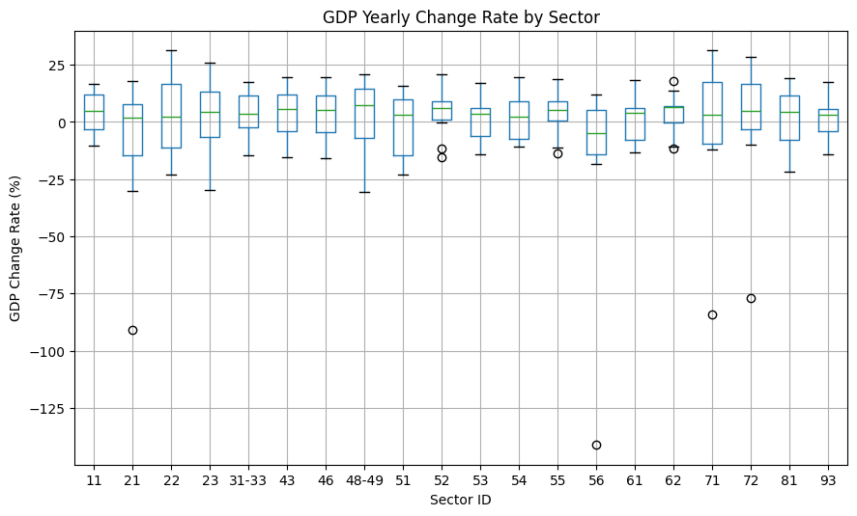
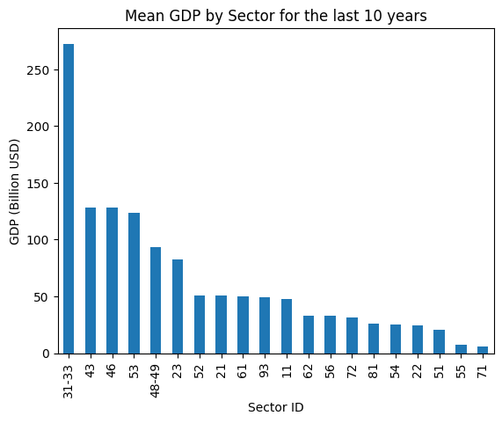
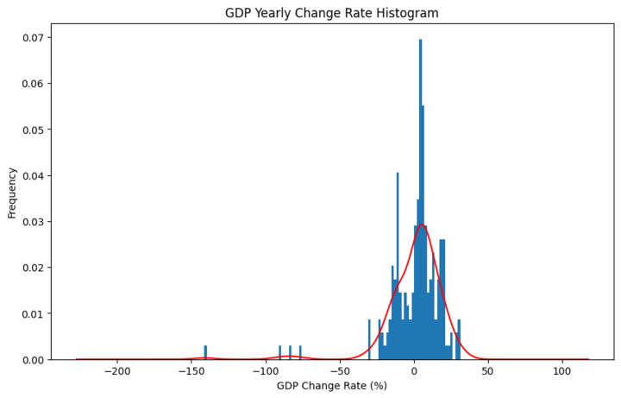
Which economic sector has the most growth?

Slide 4
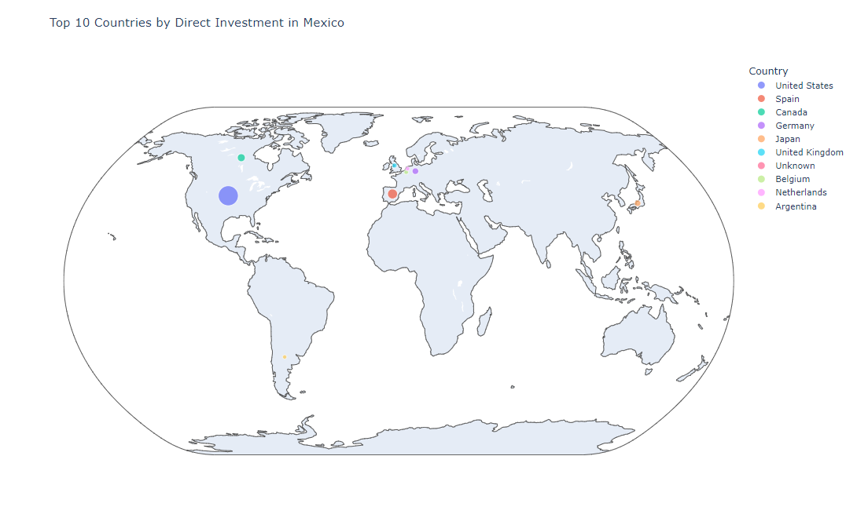
Foreign Investment in Mexico ( FDI )
Which countries invests in Mexico ?

Slide 5
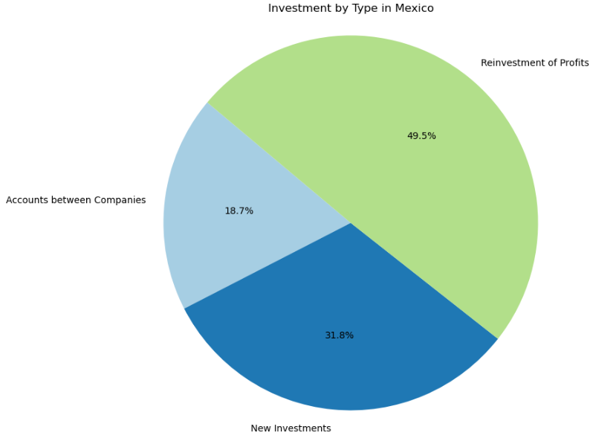
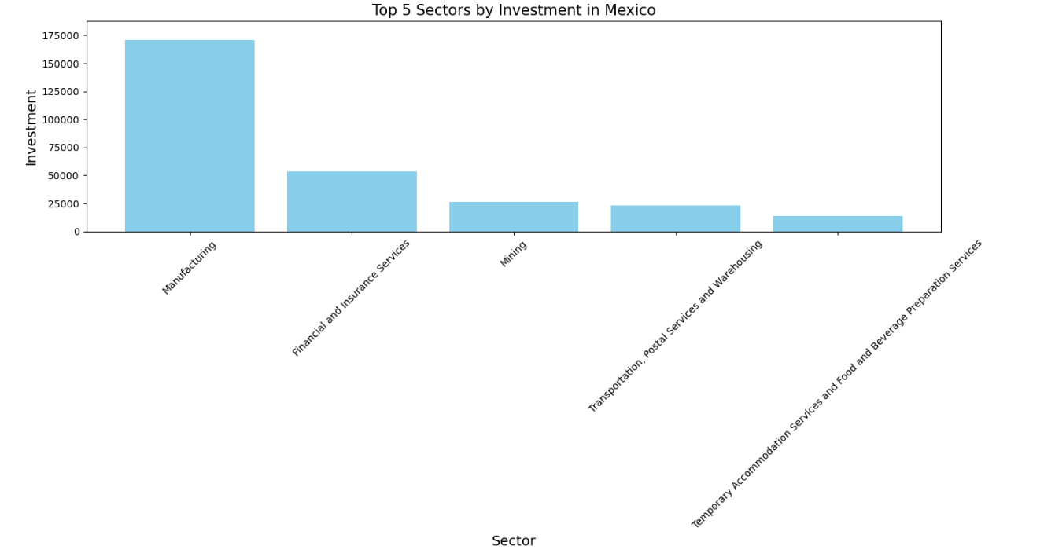
Industries and activities in which the foreign investments are being made.
These sectors represent significant areas of economic activity where foreign investors are contributing capital, which in turn supports industrial growth, infrastructure development, and service enhancements in Mexico.

Slide 6
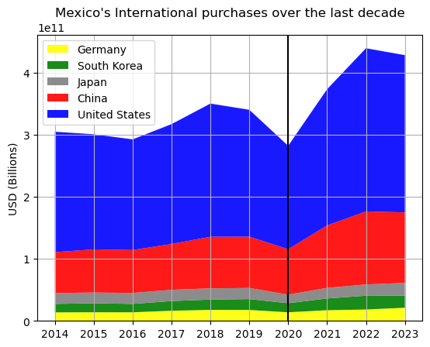
What are the top 5 countries that Mexico buys from in the last decade?
The 5 countries we purchase the most from did not change over time, with the United States and China on top with a significant difference.
In 2018, Mexico held elections for president and this could explained a rise on purchases, beginning from 2017.
Then in 2020, due to COVID-19 it was expected that China ranked lower, but that did not happened. Although there was less spending in general.
Lastly in 2021-2022 the metrics spiked as globally we recovered from the pandemic and we experienced political stability (presidency on midterm).

Slide 7
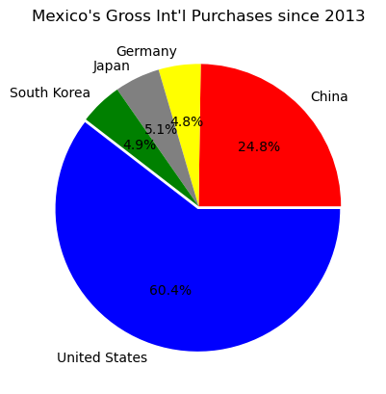
What are the top 5 countries that Mexico buys from in the last decade?
In this graph we observe the sum of all the purchases in the last decade. Mexico depends heavily on the United States economy, as they are our biggest provider of oils and petroleum. This could be considered negative as we should diversify our spending.
China has been playing a greater role in the country's economy as they introduced massively new OEMs (original equipment manufacturers, car brands) so vehicle parts and accessories, as well as electronic integrated circuits, have been our top product bought.
We may see a bigger participation from China and then we could shorten the gap between our first two places, purchasing-wise.

Slide 8
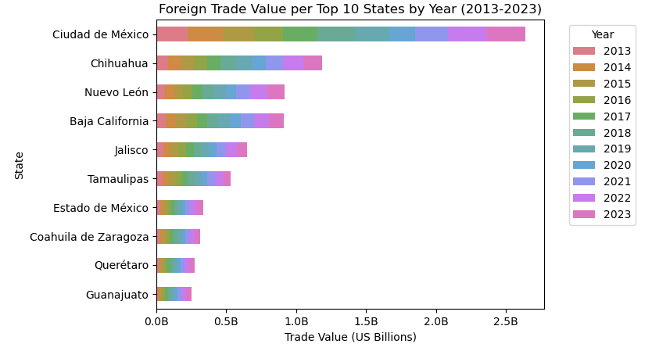
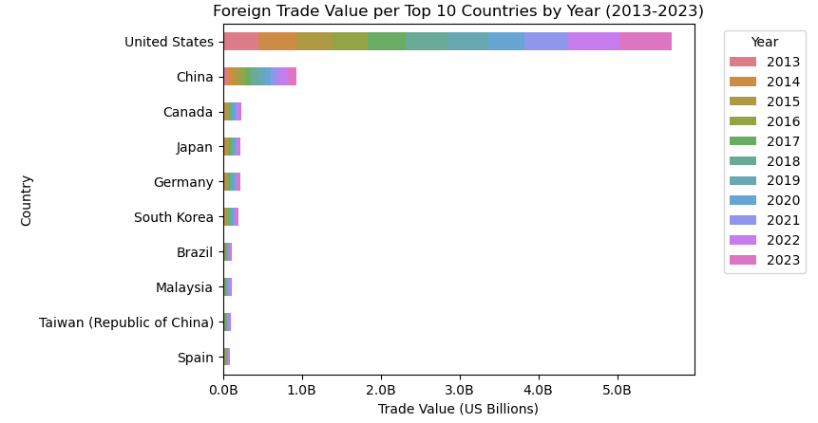
Which are the top 10 states of Mexico with the highest export value and to which countries?
The first place in exports is Mexico City and its export value is greater than the states of Chihuahua and Nuevo Leon combined.
Mexico not only depends on the United States for imports but also for exports of products. The country with the second place in exports is China, even though it represents a fraction of the total value of exports to the United States.

Slide 9
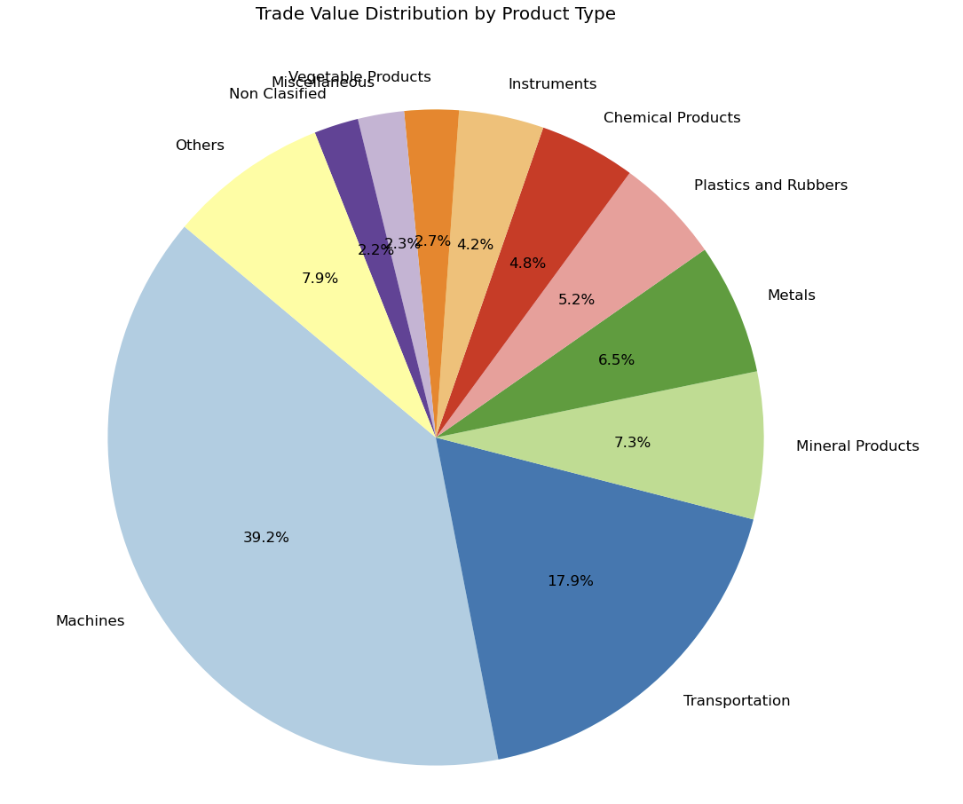
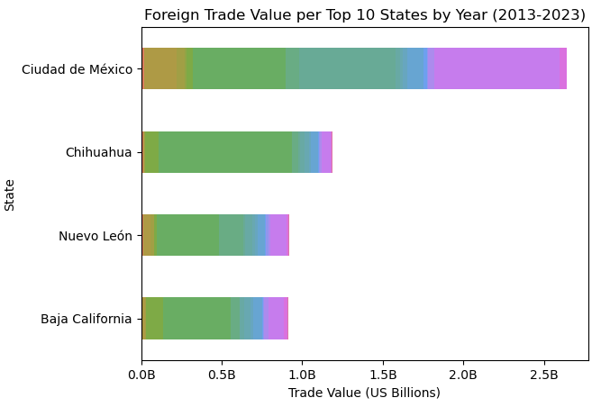
Which products contribute the most to the total value of exports?
At the same time, the type of product with the highest export value is machinery. And the states that contribute the most are Chihuahua, Nuevo Leon and Baja California, along with Mexico City.

Slide 10
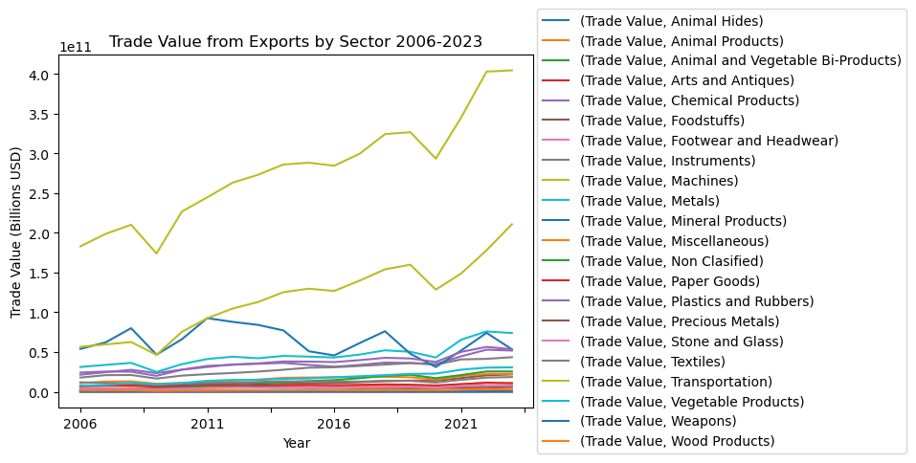
Trade Growth - How does trade value changes across time?
Mexico’s trade value is one of the main drivers of its GDP and most sectors have increase their trade value over the years. One important exception is the Mineral Product sector which seems very volatile.
But this economic indicator can be affected by other countries or major global events.

Slide 11
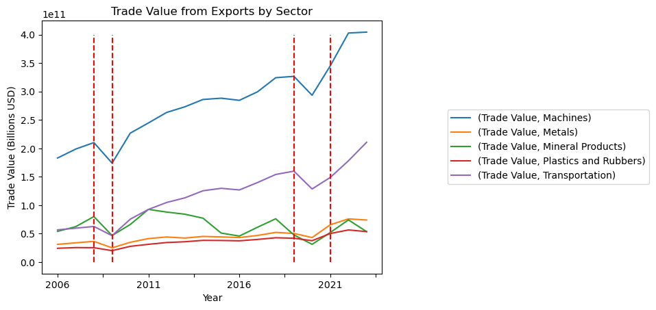
Trade Growth - How does trade value changes across time?
Considering the top 5 sectors, there are two clear examples of the trade growth being affected, one in 2008 in which the crash of the housing market in US occurred and in 2020 the COVID global pandemic.

Slide 12
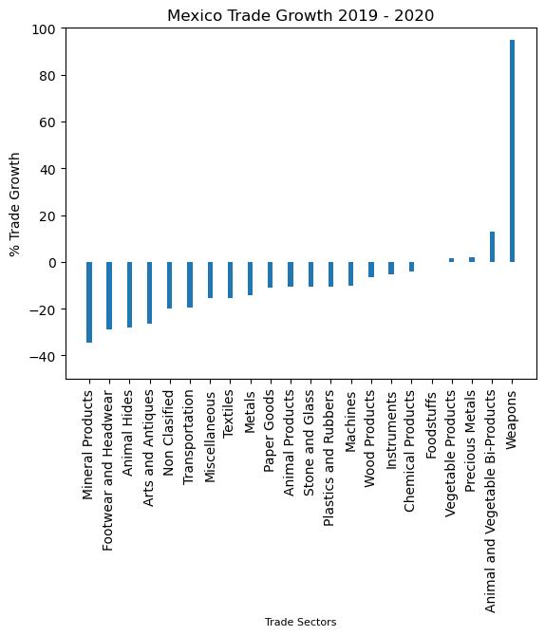
Trade Growth - How does trade value changes across time?
The most affected sectors were:
Mineral Products
Footware and Headware
Animal Hides
Arts and Antiques
Non Classified
And some sectors had some growth, being Weapons a growth of 100%, then Animal and Vegetable Bi-Products, Precious Metals and finally Vegetable Products.

Slide 13
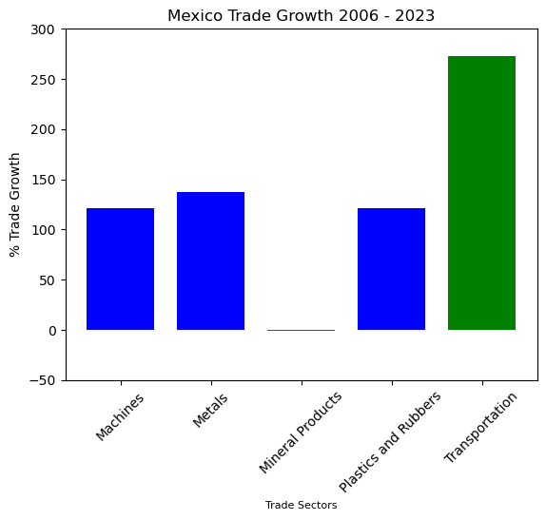
Trade Growth - How does trade value changes across time?
In the period of time analyzed, the sector with the most growth in trade value was Transportation, with more than 250% increase.
Overall, Mexico’s trade value growth shows that the country is consolidating as a world manufacturer of vehicles and industrial machines.

