Slide 1
Kafka
A distributed streaming platform

Slide 2

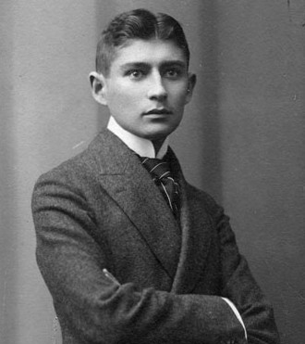
Franz Kafka
1883 – 1924

Slide 3
Overview
Introduction
Quick Start
Kafka Design
Kafka Management
Kafka Programming

Slide 4
Introduction
Capabilities
Publish and subscribe to stream of records
Store streams of records in a fault-tolerant way
Process streams of records as they occur
Features
High throughput
Distributed
Multiple client support
Real time

Slide 5
Introduction
Concepts
Running as a cluster on one or more brokers
Storing streams of records/messages in categories called topics
Topics are partitioned as partition logs, distributed and replicated within a Kafka cluster
Producers publish data to the topics
Consumers consume data from the topics
Each record consisting of a key, a value and a timestamp

Slide 6
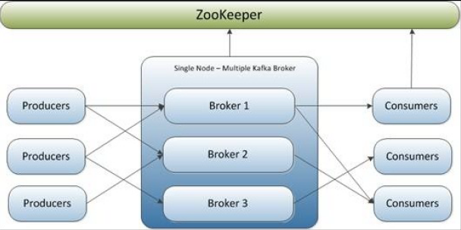
Clusters and Brokers
Kafka uses ZooKeeper as the cluster container
ZooKeeper serves as the coordination interface between Kafka brokers and clients
State information
Message offsets
Replication information

Slide 7
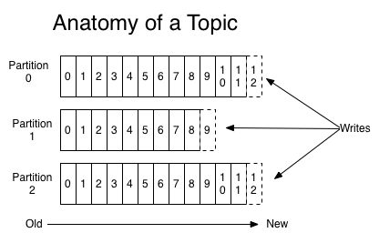
Kafka Topic
A category or feed name to which messages are published by message producers
Topics are always multi-subscriber
Topic are partitioned as partition logs maintained by Kafka cluster

Slide 8
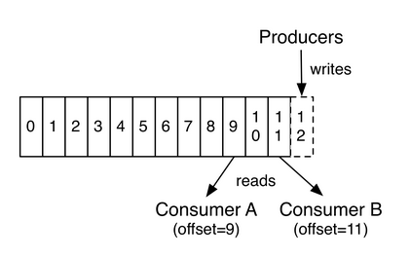
Topic Partition
Topics are partitioned
Each partition is represented by an ordered immutable sequence of messages
Each message in a partition is assigned a unique sequential ID called offset
Partitions act as the unit of replication

Slide 9
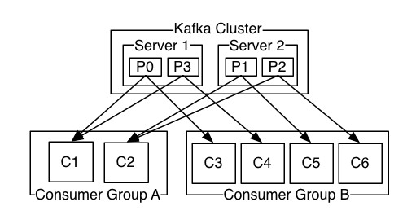
Partition Distribution
Partitions are distributed over the servers in the Kafka cluster
Each server handles data and request for a share of the partitions

Slide 10
Producer
Publishing records to Kafka topics
Taking the responsibility to choose between partitions when sending records
Inquiring the broker leader from any of the broker nodes and then send records only to the leader

Slide 11
Consumer
Subscribing to topics in Kafka
Grouped into consumer groups, sharing partitions exclusively within the group
There can’t be a greater number of consumers in a consumer group than that of the partitions of the subscribed topic
Controlling offset of partition consumption

Slide 12
Quick Start
Installation
Configuration
Server Start Up
Creating Topic
Producing messages
Consuming messages

Slide 13
Installation
Download Kafka
Visit the URL http://kafka.apache.org/downloads to get the latest stable release of Kafka.
Install Kafka
For Windows, unzip the downloaded file and copy the unzipped folder to your desired location, such as C:\kafka_xxx where xxx stands for the Kafka version your using.
For Linux/Mac OS, use the tar -xzf kafka_xxx.tgz command where xxx stands for the Kafka version your are using, then copy the unzipped directory to a directory as you desire.

Slide 14
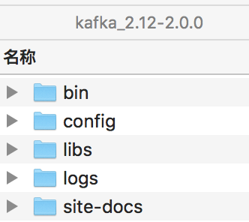
Installation
Kafka Directory Structure
console commands
configuration
depended libraries
logs
documentation

Slide 15
Configuration
Broker
Property | Description | Default Value
broker.id | The broker’s identity | 0
log.dirs | Directories in which the log data is stored | /tmp/kafka-logs
zookeeper.connect | ZooKeeper connection string in the hostname:port form | localhost:2181
num.partitions | The default number of partitions per topic | 1
auto.create.topics.enable | Enabling auto-creation of the topic on the server | true
default.replication.factor | Default replication factor for automatically created topics | 1
Refer to http://kafka.apache.org/documentation.html/#brokerconfigs for a complete list of broker configuration properties.

Slide 16
Configuration
Topic
Property | Description | Broker Default
flush.messages | interval of messages to force an data flush to the log | log.flush.interval.messages
flush.ms | interval of milliseconds to force an data flush to the log | log.flush.interval.ms
max.message.bytes | The largest record batch size allowed by Kafka | message.max.bytes
retention.bytes | maximum size of log growth before discarding old segments | log.retention.bytes
retention.ms | maximum log retention time before discarding old segments | log.retention.ms
Refer to http://kafka.apache.org/documentation.html/#topicconfigs for a complete list of topic configuration properties.

Slide 17
Configuration
Producer
Property | Description | Default Value
bootstrap.servers | List of Kafka brokers in the host1:port1, host2:port2… form
batch.size | The batch size for asynchronous message sending | 16384
acks | Flag of acknowledgment the producer regards as message completion | 1
retries | Times of message resend upon sending failures | 0
linger.ms | Time to wait before sending messages when the batch size is not full | 0
request.timeout.ms | The maximum amount of time to wait for the response of a request | 30000
Refer to http://kafka.apache.org/documentation.html/#producerconfigs for a complete list of producer configuration properties.

Slide 18
Configuration
Consumer
Property | Description | Default Value
bootstrap.servers | List of Kafka brokers in the host1:port1, host2:port2… form
client.id | A unique string identifying the consumer
group.id | A unique string identifying the consumer group of the consumer
enable.auto.commit | Enabling auto-commit of consumer offset | true
auto.commit.interval.ms | The frequency in milliseconds of consumer offsets auto-commit | 5000
fetch.min.bytes | The minimum amount of data be to returned for a fetch request | 1
request.timeout.ms | The maximum amount of time to wait for the response of a request | 305000
Refer to http://kafka.apache.org/documentation.html/#consumerconfigs for a complete list of consumer configuration properties.

Slide 19
Server Start Up
Configuration Preparation
Copy the server.properties file in Kafka configuration folder to three duplicates as server-1.properties, server-2.properties and server-3.properties
Modify the threes server property file as follows
 | broker.id | listeners | log.dir
Server 1 | 1 | PLAINTEXT://:9093 | /Users/xxx/tmp/kafka-logs-1
Server 2 | 2 | PLAINTEXT://:9094 | /Users/xxx/tmp/kafka-logs-2
Server 3 | 3 | PLAINTEXT://:9095 | /Users/xxx/tmp/kafka-logs-3
The values in the table are examples, you can make your own values as applicable.

Slide 20
Server Start Up
Start the Zookeeper server
./zookeeper-server-start.sh ../config/zookeeper.properties
Start the Kafka servers
./kafka-server-start.sh ../config/server-1.properties
./kafka-server-start.sh ../config/server-2.properties
./kafka-server-start.sh ../config/server-3.properties
Move to the bin directory and use separate consoles for each of the commands above.

Slide 21
Creating Topic
Create a topic
./kafka-topics.sh --create --zookeeper [zookeeper address] --replication-factor m --partitions n --topic [topic]
List topics
./kafka-topics.sh --list --zookeeper [zookeeper address]
View specifc topic
./kafka-topics.sh --describe --zookeeper [zookeeper address] --topic [topic]
Arguments
zookeeper: the Zookeeper address
topic: the topic name
partitions: count of partition for the topic
replication-factor: count of replicas for each partition

Slide 22
Producing messages
Start a producer console
./kafka-console-producer.sh --broker-list [broker list] --topic [topic name]
Arguments
broker-list: the Kafka broker list for producing
topic: the topic name

Slide 23
Consuming messages
Start a consumer console
./kafka-console-consumer.sh --bootstrap-server [bootstrap server] --topic [topic] --from-beginning
Arguments
bootstrap-server: the Kafka bootstrap server for consuming
topic: the topic name
from-beginning: indicating the consumer will be consuming from the beginning (offset = 0)

Slide 24
Kafka Design
Persistence
Efficiency
Log Implementation
Message Delivery Semantics
Replication
Producing
Consuming

Slide 25
Persistence
Kafka relies heavily on filesystem for storing and caching messages
The keys to the performance
Linear reads/writes, specifically read-ahead and write-behind (linear over random)
Pagecache instead of in-memory cache (space over time)

Slide 26
Efficiency
Batching
Server: batch append of logs
Producer: batch send of messages
Consumer: batch fetch of messages
Byte copy
Uniform message format among server, producer and consumer
Work with Linux sendfile system call to avoid unnecessary byte copying
Batch Message Compression
Compressed by producer
Stored in Kafka log
Decompressed by consumer

Slide 27
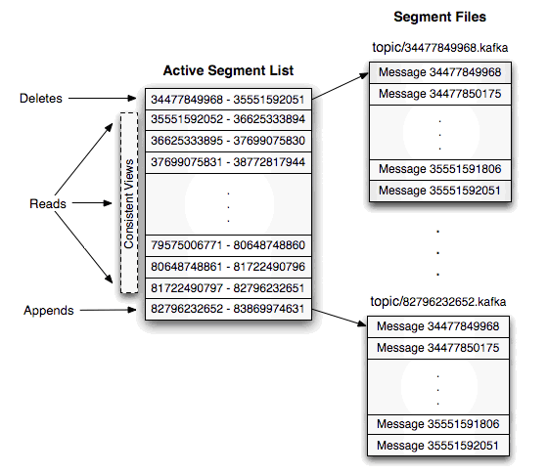
Log Implementation
Kafka stores logs in equal-sized files with each file named with the least offset within that file

Slide 28
Log Implementation
The Log files located in the Kafka broker are populated with “log entries”
Each log entries is a batch record
Each batch record contains
Batch offset (8 bytes)
Batch length (4 bytes)
Batch attributes
Messages
Batch
Batch
Batch
Log File
Log entry
Messages
Messages
Messages
Log entry
Log entry

Slide 29
Message Delivery Semantics
At most once: messages may be lost but are never redelivered
At least once: messages are never lost but may be redelivered
Exactly once: each message is delivered once and only once
 | At Most Once | At Least Once | Exactly Once
Producer | Non-retriable | Resend non-idempotently | Kafka Streaming
 | Resend idempotently
Consumer | Read-Save-Process | Read-Process-Save

Slide 30
Replication
Partitions are replicated across a configurable number of servers
Each partition has one server acting as the "leader" and zero or more servers acting as "followers"
The leader handles all read and write requests
The followers passively replicate the leader and one of them will become the leader when the original one fails
In-Sync Replicas (alive replicas)
Keep the heartbeat with Zookeeper
Keep pace with the leader and not fall “too” far behind (configuration properties: replica.lag.time.max.ms)

Slide 31
Producing
Producers send records asynchronously via batch sending
Producers can choose between three strategies of sending acknowledgement (configuration property: acks)
0: not wait for any acknowledgement for the server
1: have the leader acknowledge the producer once the leader itself has successfully written the record
all: have the leader acknowledge the producer after all the in-sync replicas have successfully written the record

Slide 32
Consuming
A committed message means a message sent and applied by all in-sync replicas of the partition the message is targeted
Only committed logs are visible to consumers
Consumers consume messages by issuing “fetch” requests to the leader broker (the Pull pattern)
Consumers specify offsets in the log within the fetch request
The offsets are maintained and freely controlled by consumers

Slide 33
Kafka Management
Console Management
Web management (Kafka Manager)

Slide 34
Console Management
List topic
./kafka-topics.sh --list --zookeeper localhost:2181
View topic
./kafka-topics.sh --describe --zookeeper localhost:2181 –-topic [topic name]
topic details
partition details

Slide 35
Console Management
Topic modification
./kafka-topics.sh --alter --zookeeper localhost:2181 –-topic [topic name] --replication-factor m --partitions n
Topic configuration modification
./kafka-topics.sh --alter --zookeeper localhost:2181 --entity-type topics --entity-name [topic name] -- add-config name=value --delete-config name

Slide 36
Web Management
There is a tool called Kafka Manager which can operate on Kafka cluster and topics via web interface, check the URL: https://github.com/yahoo/kafka-manager for reference.

Slide 37
Kafka Programming
Ways of programming with Kafka
Kafka Producer/Consumer API
Spring Kafka Template
Spring Kafka Annotation

Slide 38
Kafka Programming
Examples
 | Example 1 | Example 2
Producer | Kafka API | Spring Kafka Template
Consumer | Kafka API | Spring Kafka Annotation

Slide 39
Q & A

Slide 40
References
Kafka Documentation: http://kafka.apache.org/documentation/
Learning Apache Kafka, Second Edition, Nishant Garg
kafka入门：简介、使用场景、设计原理、主要配置及集群搭建: http://www.cnblogs.com/likehua/p/3999538.html

Slide 41
Thanks

