Slide 2
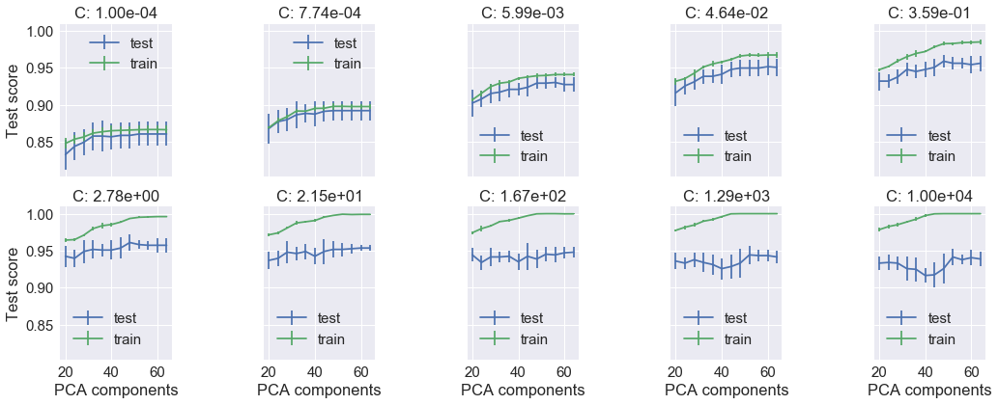
Grid Search of Hyper-parameters using CV

Slide 3
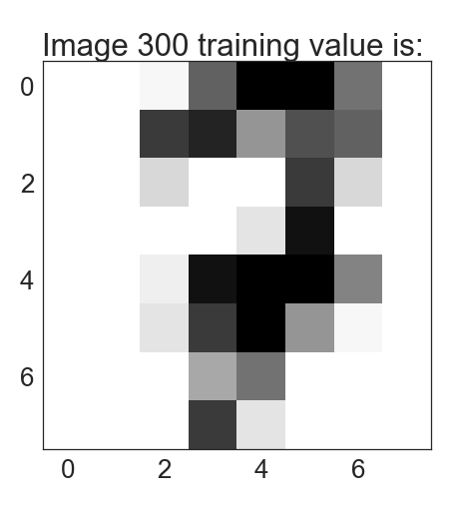
7

